Slide 1
MOLAR MASS of POLYMERS

Slide 2
Polymer Size and Shape

Slide 3
Mass Distribution in Low-MW Polystyrene

Slide 4
Mn: Number-Average Mol. Wgt.

Slide 5
Mn: Number-Average Mol. Wgt.
The number average molecular weight is just the total weight of all the polymer molecules in a sample, divided by the total number of polymer molecules in a sample.
The number average molecular weight is the statistical average molecular weight of all the polymer chains in the sample and is defined by:
where Mi is the molecular weight of a chain and Ni is the number of chains of that molecular weight.
Mn can be predicted by polymerization mechanisms and is measured by methods that determine the number of molecules in a sample of a given weight; for example, colligative methods such as end-group assay.
If Mn is quoted for a molecular weight distribution, there are equal numbers of molecules on either side of Mn in the distribution.

Slide 6
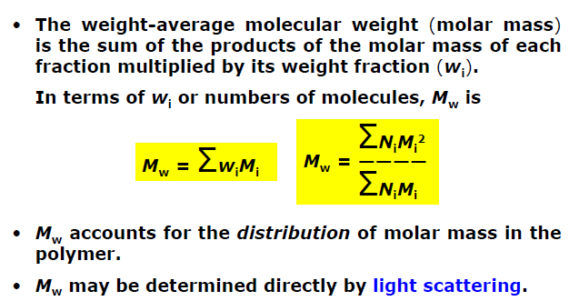
Mn: Number-Average Mol. Wgt.
Mw: Weight-Average Mol. Wgt.

Slide 7
Mn: Number-Average Mol. Wgt.
Weight average molecular weight: Mw
The weight average molecular weight is defined by:
Compared to Mn, Mw takes into account the molecular weight of a chain in determining contributions to the molecular weight average.
The more massive the chain, the more the chain contributes to Mw.
Mw is determined by methods that are sensitive to the molecular size rather than just their number, such as light scattering techniques.
If Mw is quoted for a molecular weight distribution, there is an equal weight of molecules on either side of Mw in the distribution.

Slide 8
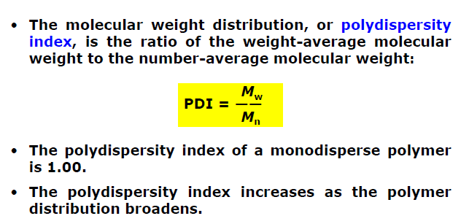
Mn: Number-Average Mol. Wgt.
Molecular Weight Distribution

Slide 10
Example

Slide 11
Answer

Slide 12
Answer

Slide 13
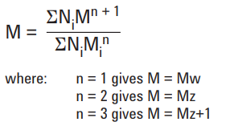
Mz: Z-Average Mol. Wgt.
In general, a series of average molecular weights can be defined by the equation:
The higher averages are increasingly more sensitive to high molecular weight polymers and accordingly are increasingly more difficult to measure with precision.
They tend to be associated with methods that measure the motion of polymer molecules, such as diffusion or sedimentation techniques.
Although the z-averages are not commonly quoted for polymers, several important methods for measuring the dimensions of chains that yield z-average molecular weights.

Slide 14
Mz: Z-Average Mol. Wgt.
For all synthetic polydisperse polymers:
Mn < Mw < Mz < Mz+1
The polydispersity index is used as a measure of the broadness of a molecular weight distribution of a polymer, and is defined by:
Polydispersity index = Mw Mn
The larger the polydispersity index, the broader the molecular weight.
A monodisperse polymer where all the chain lengths are equal (such as a protein) has an Mw/Mn = 1.
The best controlled synthetic polymers (narrow polymers used for calibrations) have Mw/Mn of 1.02 to 1.10. Step polymerization reactions typically yield values of Mw/Mn of around 2.0, whereas chain reactions yield Mw/Mn values between 1.5 and 20.

Slide 15
Mv: Viscosity-Average Mol. Wgt.

Slide 16
Mv: Viscosity-Average Mol. Wgt.

Slide 17
Experimental Methods

Slide 18
Experimental Methods-End-Group Analysis
The end-group analysis needs the information about the number of determinable groups per molecule.
This method is not suitable for high molecular weight because the fraction of end groups becomes too small to measured with precision (>25,000).
Condensation polymers
End-group analysis in condensation polymers usually involves chemical methods of analysis for functional groups.
Examples: • Carboxyl groups in PE and in polyamides are titrated with base in an alcoholic or phenolic solvent. • Amino groups in PA are titrated with acid • Hydroxyl groups is reacted with a titratable reagent
Addition polymers
End-group analysis in addition polymers does not have general procedure because of the variety of type and origin of the end groups. Analysis may be made for initiator, elements, radioactive atoms.

Slide 19
Experimental Methods-Colligative Property Measurement
The relations between the colligative properties and molecular weight for infinitely dilute solutions in a fact that the activity of the solute in a solution becomes equal to its mole fraction as the solute concentration becomes sufficiently small.
This method is based on
•Vapour-pressure lowering,
•Boiling-point elevation (ebulliometry),
•Freezing-point depression (cryoscopy), and
•Osmotic pressure (osmometry).

Slide 20
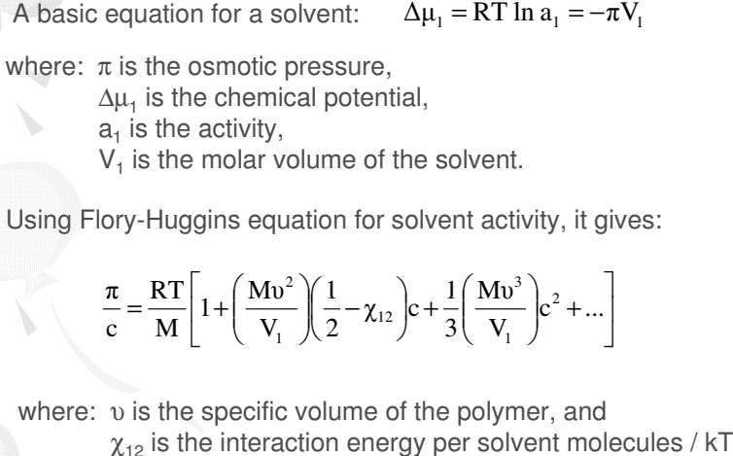
Experimental Methods-Experimental Methods-Osmometry

Slide 21
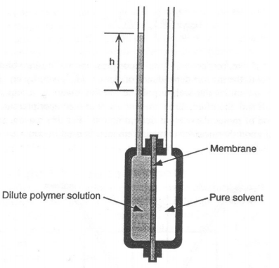
Experimental Methods-Experimental Methods-Osmometry
Experimental Methods-Experimental Methods-Osmometry
The experimental procedures to determine osmotic pressure are relatively simple but very time consuming.
A pure solvent and a dilute solution of the polymer in the same solvent are placed on opposite sides of a semipermeable membrane (cellulose or a cellulose derivative).
The differences chemical potentials between solvent and the polymer solution causes solvent to pass through the membrane and raise the liquid head of the solution reservoir.
In the equilibrium pressure: π= ρgh
where ρ is the solvent density

Slide 22
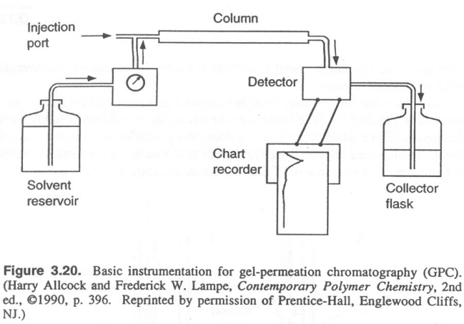
Experimental Methods-Experimental Methods-Osmometry
Experimental Methods-Gel-permeation chromatography (GPC)
One of the most widely used methods for routine determination of molecular weight and molecular-weight distribution is GPC.
This method based on the principle of size-exclusion chromatography to separate samples of polydisperse polymers into fractions of narrower molecular-weight distribution.
The equipment:
Several small-diameter columns (L = 30 – 50 cm) are packed with small highly porous beads (∅ = 10 – 107 Â). Pure pre-filtered solvent is continuously pumped through the columns at a constant flow rate (1 – 2 mL/min).
Then, a small amount (1 – 5 mL) of a dilute polymer solution is injected by syringe into the solvent stream and carried through the columns.
The smallest polymer molecules are able to penetrate deeply into the bead pores but the largest may be completely excluded.

Slide 23
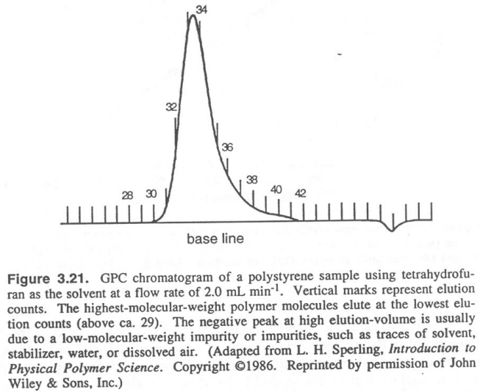
Experimental Methods-Experimental Methods-Osmometry
Experimental Methods-Gel-permeation chromatography (GPC)
The process is repeated until all polymer molecules have been eluted out of the column in descending order of molecular weight.
The concentration of polymer molecules in each eluting fraction can be monitored by means of a polymer-sensitive detector, such as IR or UV device.
The detector is usually a differential refractometer (differ the refractive index between the pure solvent and polymer solution).
Flow-rate vs elution volume (Vr) For a given polymer, solvent, temperature, pumping rate, and column packing size, Vr is related to molecular weight.
In calculation of molecular-weight averages, the peak height ~ Wi.
A proper calibration curve should be measured to relate Vi to Wi, direct calculation of all molecular weights (Mn, Mw, Mz) are possible.

Slide 24
Experimental Methods-Experimental Methods-Osmometry
Experimental Methods-Light-scattering methods
Light-scattering techniques are important in polymer research but it is not routinely used for molecular-weight determination because of the difficulty and expense of sample preparation and the specialized facilities required.
Light-scattering method → dilute polymer solution,
Small-angle neutron scattering → solid samples.

Slide 25
Mass Distribution in a Chain-Growth Polymer

Slide 26
Mass Distribution in a step-Growth Polymer

Slide 27
Impact of MW on Physical Properties
• Mn: Brittleness (resin versus elastomer), stressstrain properties
• Mw: Tensile strength, hardness
• Mz: Flex life, stiffness, melt viscosity
• Mv: Solution viscosity, extrudablility, molding properties

Slide 28
Impact of MW on Physical Properties

