Slide 1
MEM 4210 POLYMERS
Prof.Dr. Hale BERBER

Slide 2
Contents:
Introduction to Polymers: Basic concepts and definitions
Classifications of polymers
Mechanisms of Polymerizations
Polymer Production Methods
Physical, chemical, mechanical, thermal, rheological and morphological properties of polymers
Structure-property relationships of polymers
Characterization methods for polymers
Thermoplastics
Thermosets
Elastomers
Engineering Plastics
Polymeric Fibres
Thermoplastic Elastomers
Special Polymers
Polymer Processing
Polymer Composites
Recycling of Polymeric Materials and Their Environmental Effects

Slide 3
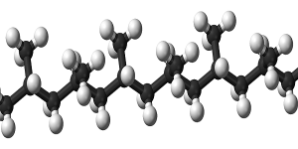
Chapter I
Introduction to Polymers

Slide 4
A polymer is a long-chain large molecule built up by the repetition of small, simple chemical units.
poly - mer
many
parts, unit
The repeating unit of the polymer is usually equivalent to the “monomer” or starting material from which the polymer is formed.
The process of combining monomers together to yield a macromolecule is known as “polymerisation”.

Slide 5
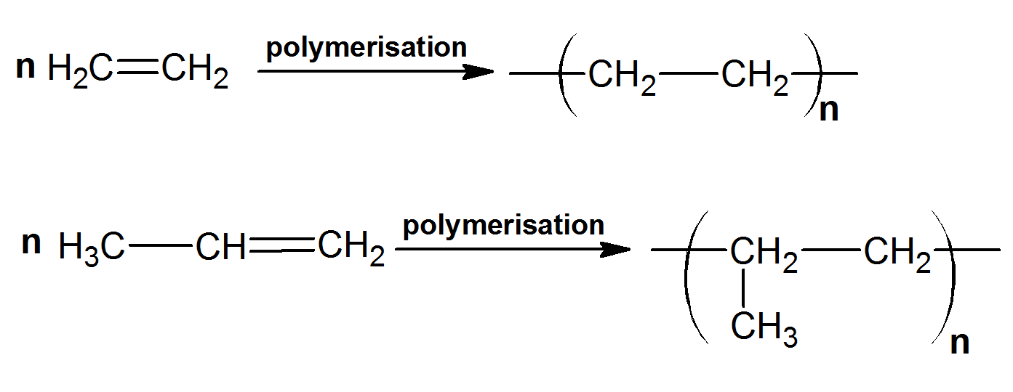
Monomers are simple molecules which are linked to each other other or to other molecules by chemical bonds to form a polymer.
Vinyl monomers are unsaturated molecules which contain carbon-carbon double bonds
ethylene
polyethylene
propylene
polypropylene

Slide 6
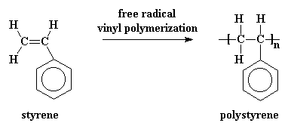
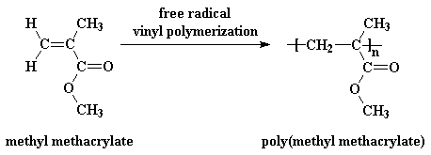

Slide 7
Other monomers which contain more than one double bond:
isoprene
polyisoprene
butadiene
polybutadiene

Slide 8
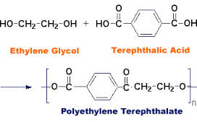
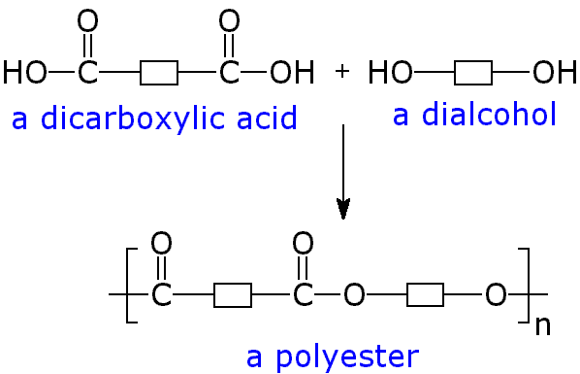
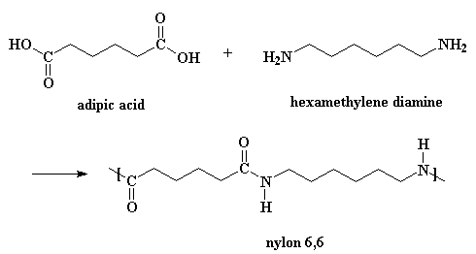
Monomers which contain two or more functional end groups such as –OH, -COOH, -NH₂, etc.

Slide 9
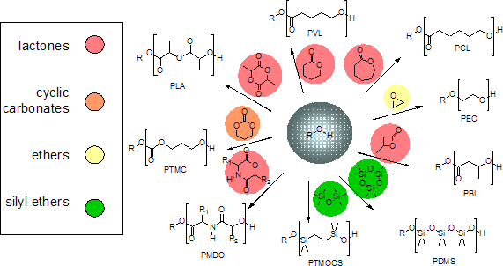
Cyclic monomers which are able to be polymerized by ring-opening polymerizations. Cyclic ethers, cyclic esters, cyclic amides, cyclosiloxanes, etc.

Slide 10
History of the development of polymers
1839 Eduard Simon discovered polystyrene.
1843 Hancock in England and Goodyear in USA developed the vulcanization of rubber by mixing it with sulphur.
1854 Samuel Peck produced “union cases” for photographs by mixing shellac (produced from the secretions of the lac beetle which live on trees native to India and South-East Asia) sawdust, other chemicals and dye, and heated and pressed the mixture into a mould to form the parts of a Union Case.
1862 Alexander Parkes exhibited Parkesine, made from cellulose nitrate (first man-made plastic), at an International Exhibition in London.
1872 Eugen Baumann, one of the first to invent polyvinyl chloride (PVC).
1907 Leo Baekeland produced phenol-formaldehyde, the first truly synthetic plastic, Bakelite.
1933 ICI discovered polyethylene.

Slide 11
1935 Wallace Carothers, working for DuPont, invented poly(hexamethylene-adipamide), Du Pont named this product “nylon”. the widespread application of his work in consumer goods such as toothbrushes, fishing lines, and lingerie, or in special uses such as surgical thread, parachutes, or pipes. it had in launching a whole era of synthetics.
1936 The Wulff brothers in Germany produced commercially viable polystyrene.
1937 Otto Bayer patented polyurethane.
1938 Roy Plunkett working for DuPont accidentally discovered poly(tetra fluroethylene), PTFE, trademarked Teflon.
1941 Polyethylene terephthalate (PET), a saturated polyester patented by John Rex Whinfield and James Tennant Dickson.
1948 Acrylonitrile butadiene styrene (ABS).
1964 Stephanie Louise Kwolek of DuPont developed Kevlar fibre from polyaramide (an aromatic polyamide).
1987 BASF in Germany produced a polyacetylene that has twice the electrical conductivity of copper.

Slide 12
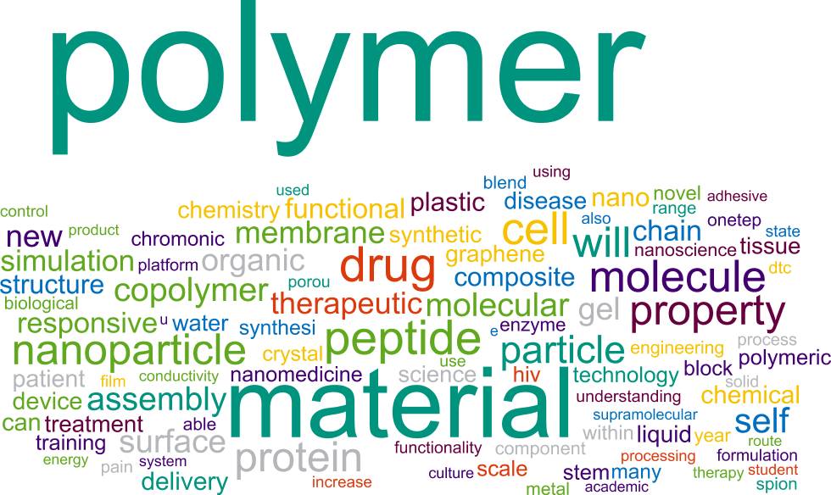
Polymers offer a diversity of molecular structures and properties and thus lend themselves to be employed in a variety of applications. They increasingly replace or supplement more traditional materials such as wood, metals, ceramics and natural fibres.

Slide 13
Chapter II
Classification of Polymers

Slide 14
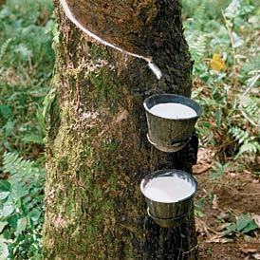
Classification Based on Sources
Natural polymers: The polymers which are widely found nature. All living things - plants, animals, and people - are made of polymers.
Amino acids; DNA, RNA
proteins; collagen, keratin
cellulose; wool,
starch; (polysaccharides) corn, rice, grains and potatoes
Chitin
Gum
Natural rubber
Natural polymers are widely used in foods, medicines, agriculture, environmental protection, cosmetics, bio-medical applications, textile and tire industry.

Slide 15
(ii) Synthetic polymers: They are human-made polymers and are produced in
laboratories or industries. The main source of synthetic
polymers is crude oil, although coal and natural gas
are also used.
Polyethylene, Fibers, PVC, epoxy resins, silicon rubber, polyurethane, etc.
(iii) Semi Synthetic polymers: These types of polymers formed by chemical
modification with neutral polymers.
Cellulose acetate, vulcanized rubber

Slide 16
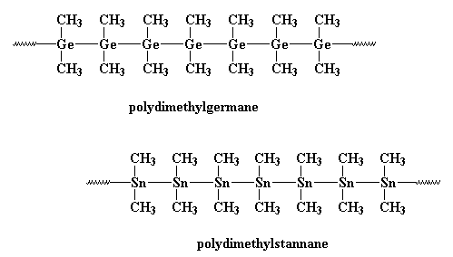
Classification Based on Chemical Nature
Organic polymers: polymers whose backbone chains are made mostly of carbon atoms.
Inorganic polymers: polymers that don't have any carbon atoms, have Si, Ge, etc. atoms in the backbone chain.
silicones
polysilanes

Slide 17
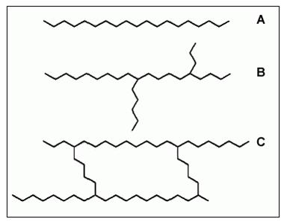
Classification Based on Chain Structure
Lineer polymers: (A)
Branched polymers: (B)
Crosslinked polymers: (C)

Slide 18
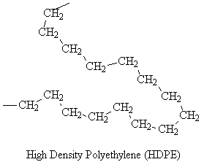
Lineer polymers: The polymers have long and straight chains
Example: High Density Polyethylene

Slide 19
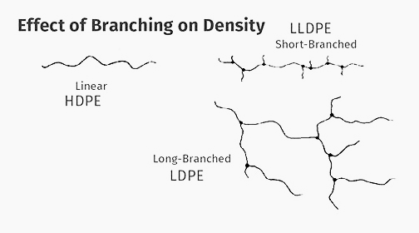
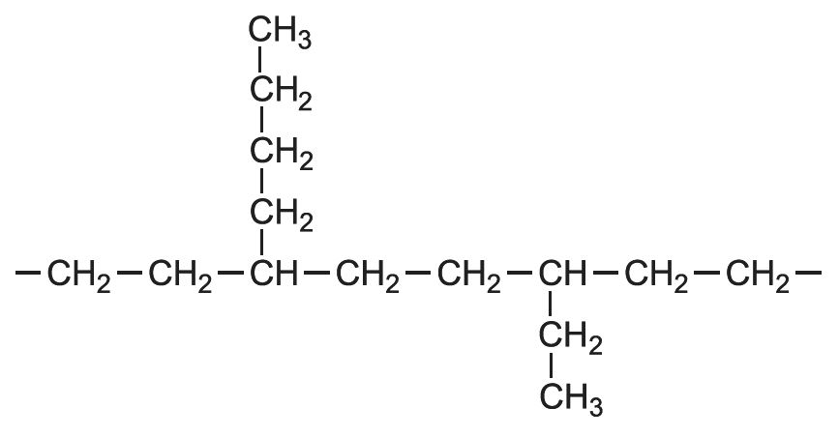
Branched polymers: The polymers have linear chains including small branches
Example: Low Density Polyethylene

Slide 20
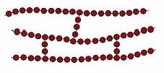
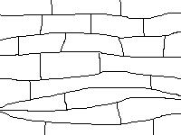
Crosslinked polymers: The polymers have strong covalent bonds between linear polymer chains.
Example:
Hydrogels
Thermosets

Slide 21
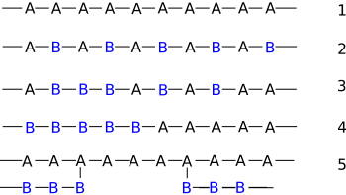
Classification Based on Monomer Type
Homopolymer
Alternating copolymer
Random copolymer
Block copolymer
Graft copolymer

Slide 22
Classification Based on Molecular Weights of Polymers
Monomer
Oligomer MW< 1000
Polymers
1000< MW >10000
High Molecular Weights Polymer
10000< MW >1000000
molecular weights typically 10,000 - 1,000,000

Slide 23
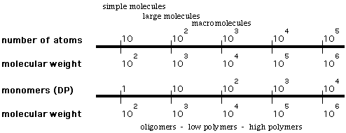
polymer - a large molecule consisting of a number of repeating units, with molecular weight typically several thousand or higher
repeat unit - the fundamental recurring unit of a polymer
monomer - the smaller molecule(s) that are used to prepare a polymer (may or may not be equivalent to the repeat unit)
oligomer - a molecule consisting of several repeat units of a monomer, but not large enough to be considered a polymer

Slide 24
Classification Based on Thermal Behavior
Thermoplastics: Thermoplastics are a family of plastics that can be
moltenwhen heated and hard when cooled. When frozen, however, a thermoplastic becomes glass-like and subject to fracture. These characteristics, which lend the material its name, are reversible. That is, it can be reheated, reshaped, and frozen repeatedly. This quality also makes mechanically recyclable.
Thermoplastic materials are those materials that are made of polymers linked by intermolecular interactions or van der Waals forces, forming linear or branched structures.
There are dozens of kinds of thermoplastics, with each type varying in crystalline organization and density. Some types that are commonly produced today are polypropylene, polyethylene, polyvinylchloride, polystyrene, polyethylenetheraphthalate (PET), Nylon and polycarbonate.

Slide 25
Thermosetting Plastics: are synthetic materials that undergo a chemical
change when they are treated, creating a three-dimensional network. After they are heated and formed, these molecules cannot be re-molten and reformed. Their molecular chains are crosslinked together by primary bonds (covalent).
Thermoset material properties:
You can not melt.
Generally do not swell in the presence of certain solvents
They are insoluble.
High resistance to creep
Unsaturated polyester resin
Epoxy resin
Phenol-formaldehyde resin
Urea-formaldehyde resin
Melamine-formaldehyde resin
Polyurethane foam

Slide 26
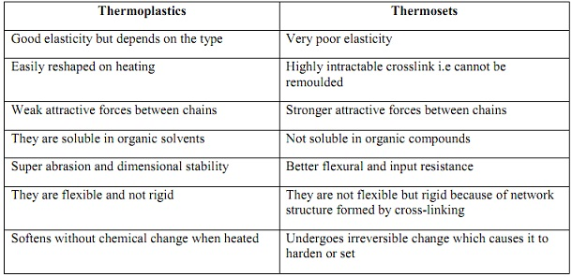

Slide 27
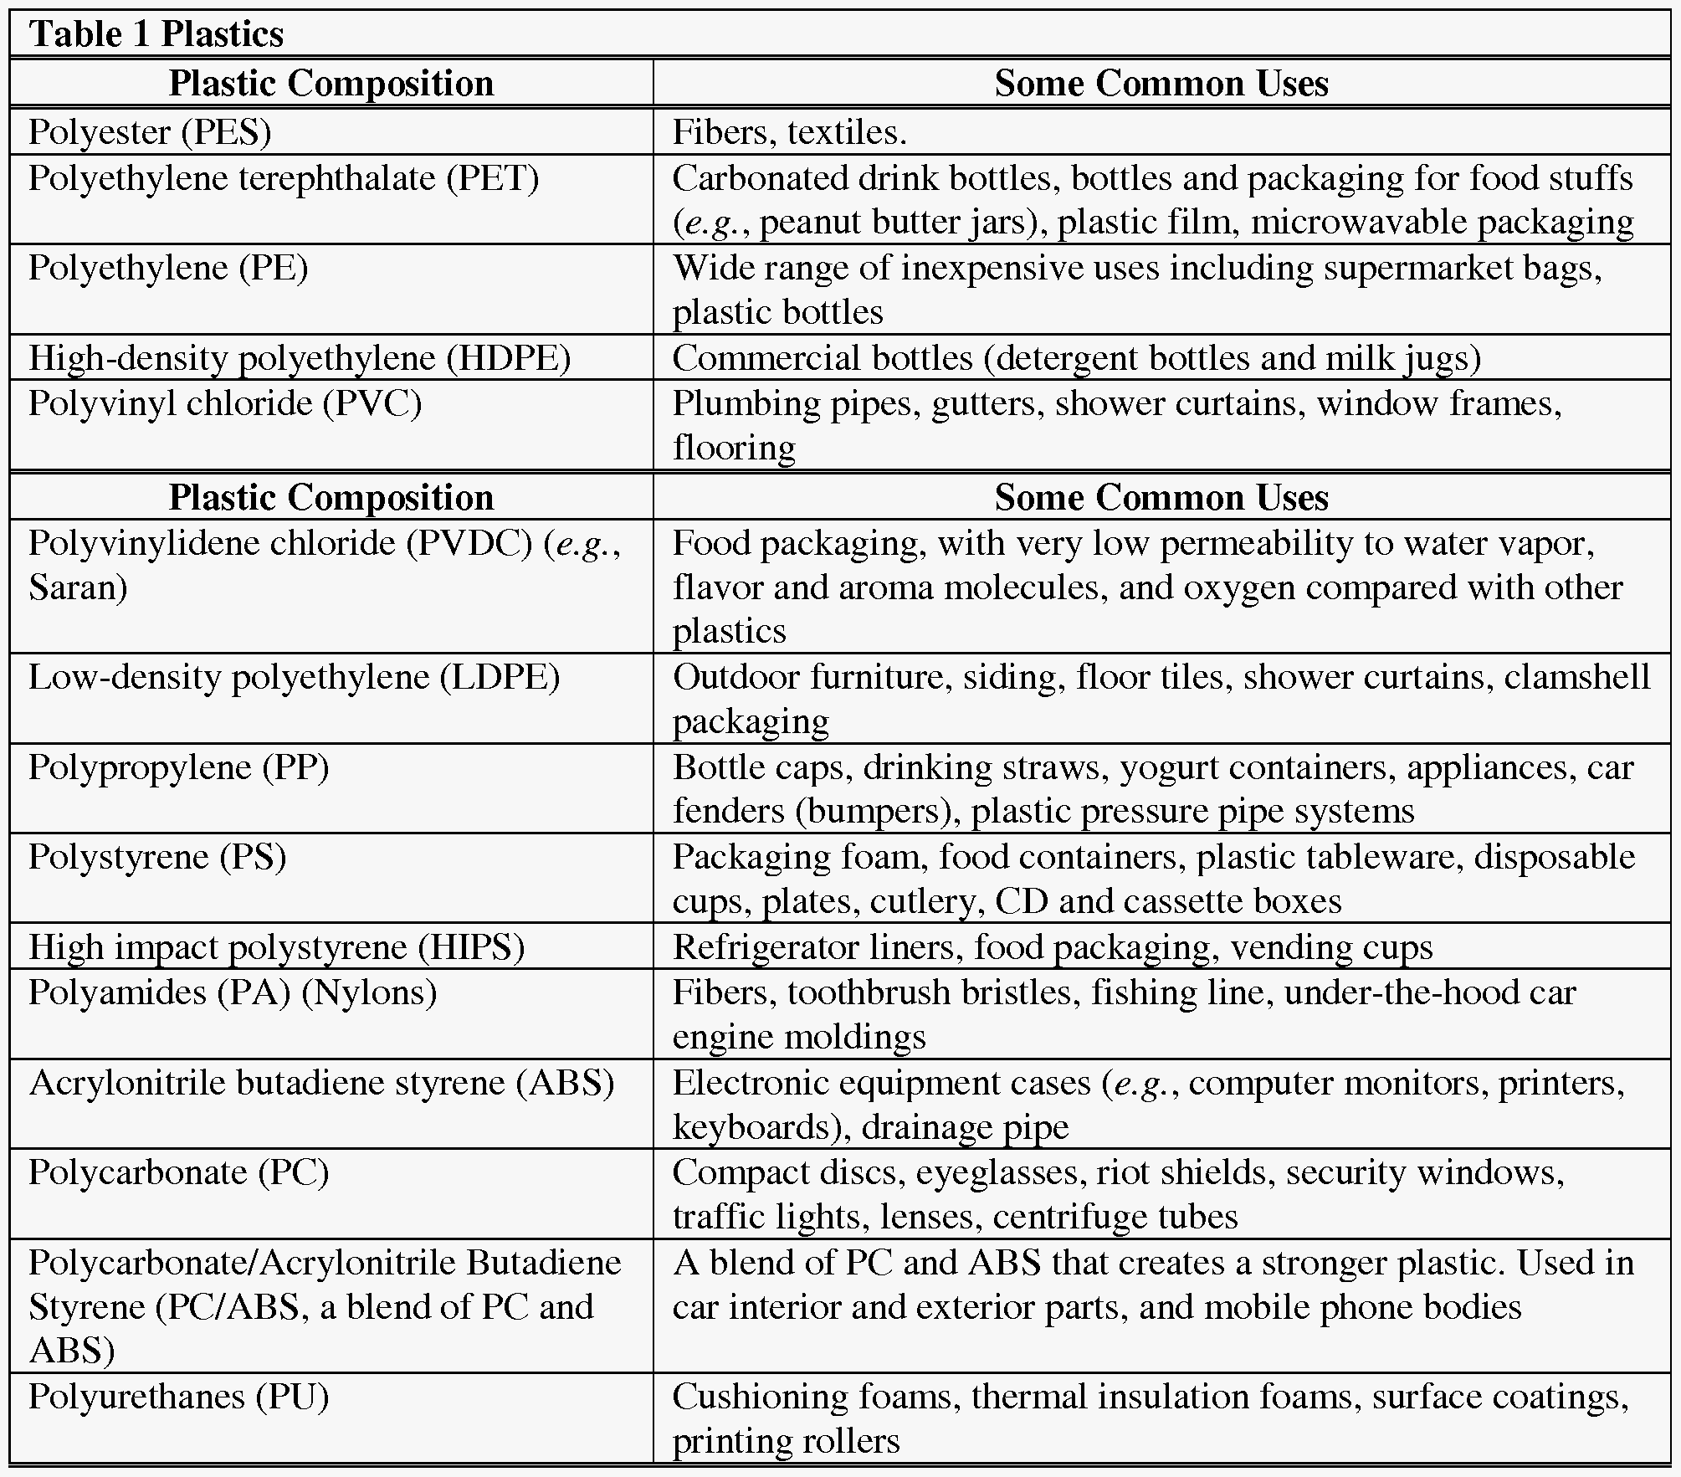

Slide 29
Classification Based on Mechanical Behavior
Plastics: They include thermoplastics and thermosetting materials.
Elastomers: Elastomers exhibit large reversible extensions up to ten
times the original length. They are polymers that have long flexible chains with a low intermolecular attraction to enable a high localised mobility of segments. However, permanent relative chain flow or slippage must be prevented, which is achieved by cross-linking the chains to form a three-dimensional network. Varying the cross-link density allows control of properties. For example, natural rubber, which is crosslinked with sulphur (the process is known as “vulcanisation”) can also result in ebonite (a hard, rigid thermoset) by adding more sulphur to the mix and hence increasing the crosslink density.
Natural polyisoprene, natural rubber (NR), Synthetic polyisoprene (IR)
Polybutadiene (BR), Chloroprene rubber (CR), Nitrile rubber (NBR),
Butyl rubber (copolymer of isobutylene and isoprene, IIR), silikon rubber
Styrene-butadiene Rubber (SBR), EPDM rubber (ethylene propylene diene rubber, a terpolymer of ethylene,

Slide 30
Classification Based on Mechanism
Addition polymers: a polymer that consists of a repeat unit
equivalent to its monomer - generally vinyl polymers, e.g., polyethylene, or ring-opening polymers, e.g., poly(ethylene oxide)
Condensation Polymers:a polymer that differs from its
monomer(s) by the elimination of a small molecule during polymerization (Carothers' original definition) e.g., polyamides and polyesters. the definition has been expanded to include any polymer that incorporates new functional group(s) in the chain that were not present in the monomers (to allow inclusion of polyurethanes).

Slide 31
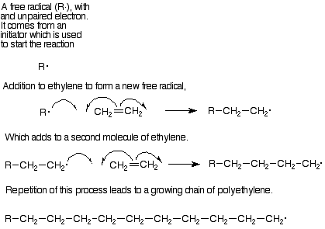
Addition polymers: For these polymers, a polymerization
mechanism in which monomers add rapidly to a relatively few reactive growth sites (e.g., free radical chain polymerization of ethylene)

Slide 32
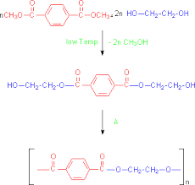
Condensation Polymers: For these polymers,
a polymerization mechanism in which each reaction between monomers is a discrete and independent step (e.g., formation of PET from diols plus diacids)

Slide 33
Classification Based on Polymerization Process
The polymerisation process requires a quantity of monomers and a suitable initiator/catalyst system to start the reaction to form polymer molecules that consist of thousands of monomers linked together.
Polymerisation processes can be classified in terms of the reaction medium:
bulk,
solution,
suspension,
emulsion,
gas.

Slide 34
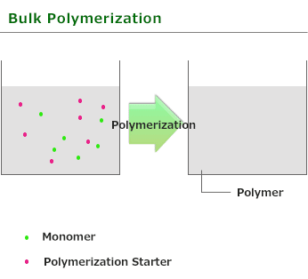
Bulk polymerization:
Polymerisation of the pure liquid or gaseous monomer is called bulk polymerisation. It can be used for the production of free-radical polymers and some condensation polymers.
- In the reaction only monomer, polymer, and initiator are present and, therefore, a very pure product is obtained.
- The polymerisation is very rapid and strongly exothermic. It can lead to hazardous temperature build up and run away reactions. Overheating can cause branching and crosslinking and lead to the formation of gels.
- The process produces highly transparent polymers: e.g., PS and PMMA.

Slide 35
Solvent polymerization:
The monomer is added to an inert solvent with a boiling point that corresponds to the polymerisation temperature.
During the polymerisation process some solvent evaporates and thus helps to remove the heat of polymerisation.
Since the boiling point of the solvent is constant, this ensures a constant polymerisation temperature.
Some difficulty lies in the separation of the residual solvent from the polymer after completion of polymerisation.
In comparison with bulk polymerisation, solution polymerisation offers easier temperature control because of the added heat capacity of solvent and lower viscosity.

Slide 36
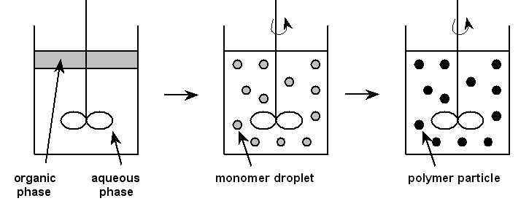
Suspension polymerization:
Suspension polymerisation is essentially a bulk polymerisation carried out in droplets in an aqueous solution in which the monomer is dispersed. The polymer precipitates as fine spherical particles with diameters of 0.01 to 1.0 mm.
- The polymerisation begins by radical initiators in the monomer droplets.
- Protective colloids are added in order to prevent coagulation of the particles and to produce uniform polymer particles.
- The water absorbs the heat of reaction.
- It is used in the manufacture of PVC and PS.
- Residual additives need to be removed.

Slide 37
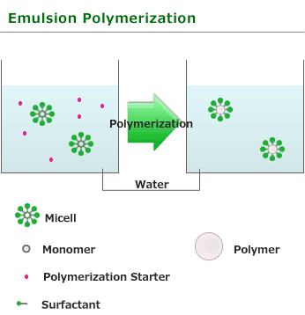
Emulsion polymerization:
As in suspension polymerisation the monomer is also dispersed in water but in much smaller droplets created with the use of emulsifiers, e.g., soaps.
In the presence of soapy water, the chemicals, such as the monomer droplets and subsequently formed polymer molecules are kept apart and dispersed rather than coalesce into a useless lump! The temperature control is easier, since the viscosity changes very little with conversion.
Surfactant and coagulant residues are hard to remove and also contribute to high impurity levels. Used mainly for the production of polyvinyl acetate, PMMA and PVC.

Slide 38
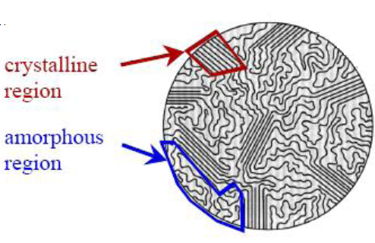
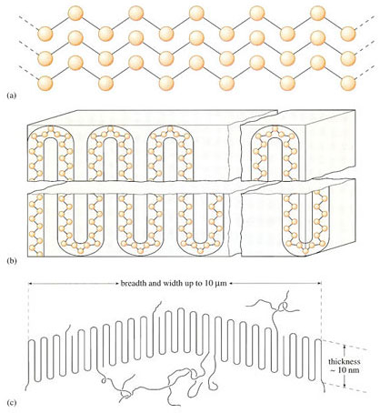
Classification Based on Crystallinity
Polymers processes can be classified in terms of their crytallinity degree:
Crystalline,
Semi-crystalline,
Amorphous

Slide 39
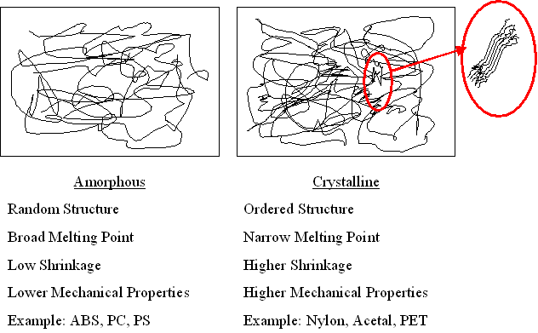

Slide 40
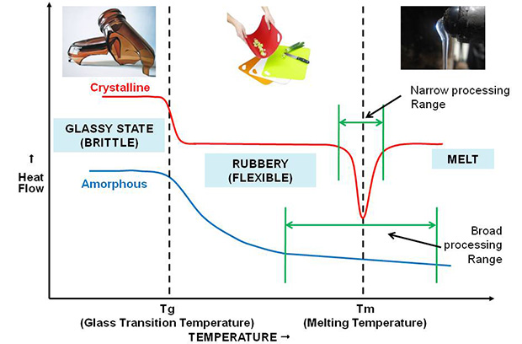
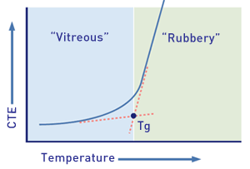

Slide 41
Classification Based on Tacticity
configuration at chiral centers
CH2=CHX ---> -CH2-CHX-CH2-CHX-CH2-CHX- ...
Note that achiral monomers can generate new chiral centers in the polymer.
However, chiral centers in most vinyl polymers are asymmetric only by virtue of the differing chain lengths and end groups in either direction.
isotactic - all chiral centers same
syndiotactic - chiral centers alternate
atactic - chiral centers random
different polymerization methods lead to different types and amounts of tacticity - requires that the previous position on a growing chain influences the stereochemistry of the next addition physical properties of the polymer depend on tacticity because it influences the ease of crystallization

Slide 42
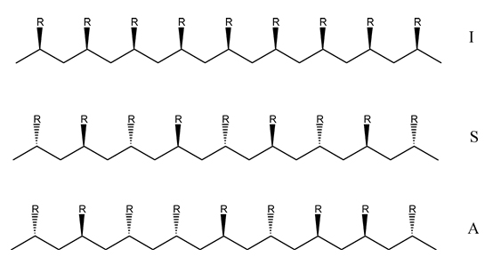
Isotactic
Syndiotactic
Atactic

Slide 43
