Slide 1
NANOTECHNOLOGICAL APPROACHES USED IN MEDICINE
Prof.Dr. İbrahim IŞILDAK LESSON 7

Slide 2
NANOMEDICINE
Nanomedicine according to the definition of the European Technology Platform;
is the process of monitoring, treating and restructuring human biological systems at the molecular level using nano-devices and nano-structures.
With the use of nanotechnology in the field of medicine, the science of nanomedicine has emerged.
THE PURPOSE OF NANOMEDICINE: is to try to solve the problems that cannot be solved with today's techniques depending on the developing technology.

Slide 3
NANOMEDICINE
Diseases, injuries, and even all the physical disorders and reactions that take place in the body take place at the molecular level.
Therefore, it is of great importance to get to the root of the problem and solve the problem at the molecular level.
Nanotechnology enters our lives in this part and allows us to create treatment opportunities at the molecular level for the problems encountered.

Slide 4
NANOMEDICINE APPLICATIONS
Nanostructures that target only the areas where the disease is found and spread and release drugs,
Nano-sized diagnostic preparations that provide movement within the human body can be shown as an example of the potential applications of nanotechnology in the medical and health sector.

Slide 5
NANOTECHNOLOGICAL APPROACHES IN THE FIELD OF NANOMEDICINE
Nanosensors; provides early treatment by allowing diseases to be diagnosed at an earlier stage in the living body
Nanophotothermolysis; There are also nanotechnological approaches, such as the destruction of cancerous tissue in the human body with nanobombs that release their active substances at certain temperatures.

Slide 6
ADVANTAGES OF NANOPARTICLES
Increased drug solubility,
Providing protection against premature lysis by the defense cells of the immune system,
Reduction of toxic effects,
Increasing the bioavailability of the drug/active ingredient,
Regulation of the dispersion properties of the drug,
Develop structures specifically targeted to tissue or cell.

Slide 7
NANOTECHNOLOGY IN THE PHARMACEUTICAL INDUSTRY
The number of studies in the field of disease identification, drug targeting to specific tissues and molecular imaging is quite high.
Multifunctional nano delivery systems developed with nanotechnological approaches; can be used for multiple purposes such as targeting, diagnosis and treatment.

Slide 8
NANOTECHNOLOGY IN THE PHARMACEUTICAL INDUSTRY
Today, drugs can be placed in nano-sized spheres and capsules and can directly affect the tissues with the help of capillary vessels from the blood, reach the desired effective concentration in the tissue, thus providing local effect instead of systemic effect.
Since these drug molecules and drug delivery systems can easily pass through structures such as the cell membrane and the blood-brain barrier, they can easily reach the targeted area.

Slide 9
NANOTECHNOLOGY IN THE PHARMACEUTICAL INDUSTRY
Drugs taken into the body may be excreted from the body without showing their effects due to uncontrollable half-life periods or dispersion throughout the body, or they may not show a sufficient effective effect.
In addition, there are risk factors such as poisoning a healthy area of the body to treat a small area of the body in the intake of drugs with traditional methods.
This has led scientists to develop targeted therapy systems.

Slide 10
NANOTECHNOLOGY IN THE PHARMACEUTICAL INDUSTRY
With nanoparticle drug release systems, it is possible to target drugs to specific areas we want and provide a more effective treatment.
In this method, the drug or active substance is loaded into nanoparticle systems and these systems are injected into only the patient areas of the body through syringes.

Slide 11
NANOTECHNOLOGY IN CARDIAC TREATMENT
Cardiac diseases; is one of the main causes of death, illness and disability in society.
Many people die due to causes such as myocardial vascular occlusion and rhythm disturbances..
Nanotechnology;
Cardiac drug applications,
Prevention of cardiovascular diseases,
It is an effective treatment method used in the location and transportation of blockages.

Slide 12
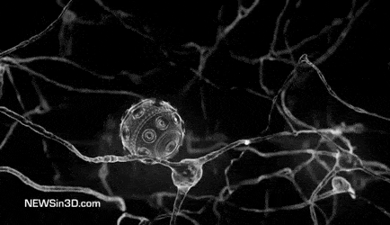
NANOTECHNOLOGY IN CARDIAC TREATMENT
With the introduction of nanorobots into the bloodstream, it can prevent heart attacks by removing lipids that accumulate on the vessel wall and cause vascular occlusion and hardening.
In addition to the destruction of harmful substances in the circulatory system, it is also possible to provide oxygen to damaged tissues or monitor diseases.

Slide 13
NANOTECHNOLOGY IN CANCER TREATMENT
Traditional diagnostic methods are insufficient to diagnose cancer at an early stage.
When matter is studied at nanoscales, it exhibits different properties in terms of physical, chemical and biological aspects due to quantum mechanical causes.
These substances, which can be reduced to nano size; Since they acquire optical, magnetic and thermic properties, they can be used for cancer imaging, targeting-treating cancerous tissue and destroying hyperthermia and cancerous cells and tissues.

Slide 14
NANOTECHNOLOGY IN CANCER TREATMENT
When the surface of quantum dots, which are 5-25 nm in size and have semiconductor properties, are coated with antibodies, very high sensitivity imaging of the targeted cell, tissue or organ can be obtained.
By using nanotechnology, cancer can be diagnosed at an early stage.

Slide 15
NANOTECHNOLOGY IN CANCER TREATMENT
The number of cells formed in the cancerous area is an important determinant in the early diagnosis of cancer.
While 1 million cancer cells are expected to have formed in order to diagnose breast cancer with traditional imaging techniques, even less than 100 cells with nanotechnology is sufficient to diagnose breast cancer.

Slide 16
NANOTECHNOLOGY IN CLINICAL MICROBIOLOGY
Products developed in the field of nanotechnology have been used for the early detection of bacteria and viruses.
The sensors developed have the ability to recognize microorganisms and viruses.
Thanks to these sensors, viruses such as HIV and SARS can be diagnosed at an early stage and the diseases they cause can be treated quickly.

Slide 17
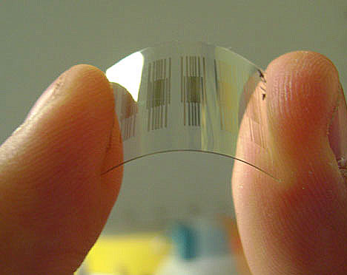
NANOTECHNOLOGY IN CLINICAL MICROBIOLOGY
A nanotechnological device capable of detecting narcotic drugs in saliva has been developed in Europe.
The device can detect 5 different groups of drugs (cocaine, heroin, methamphetamine, amphetamine and kanabis) in a single saliva in less than 90 seconds.

Slide 18
NANOTECHNOLOGY IN DIABETES TREATMENT
Diabetic patients need to calculate their insulin doses continuously and apply them at certain intervals.
Glucose monitoring in diabetic patients is desirable to be painless and non-invasive.
Monitoring patients' glucose levels using smart nano devices was done with a preclinical study.

Slide 19
NANOTECHNOLOGICAL APPLICATIONS IN DIABETES TREATMENT
Below the working mechanism of these miniature nanochips, which measure the glucose level by recognizing the patient's glucose molecule; With the mimetic theory lies in imitating the principle of operation of the pancreas and thereby preventing fluctuations in the blood glucose level.
Thus, by monitoring the glucose level, long-term side effects associated with diabetes can be prevented.

Slide 20
NANOTECHNOLOGICAL APPLICATIONS IN THE PREVENTION AND TREATMENT OF INFECTIONS
Metallic silver is used effectively against bacteria and microorganisms due to its anti-infective properties.
The surface coated with silver powders prevents the development of infection and reduces the risk of toxicity.
These products;
Outer surface coating of catheters
In wound dressings
Burns
Used in other chronic wounds.

Slide 21
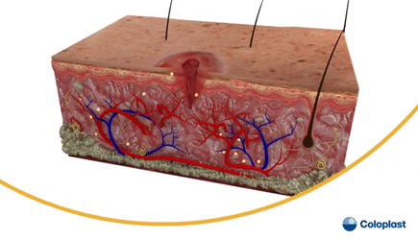
NANOTECHNOLOGICAL APPLICATIONS IN WOUND HEALING
Nanotechnological products used in wound healing; carriers, drug-related ones and tissue scaffolding.
Nanofibers produced by electrospin method are used to heal chronic wounds such as diabetic ulcers or burns..
However, with the daily use of lotions with nanoparticle added, skin complaints of eczema patients can be alleviated.

Slide 22
IN THE NEAR FUTURE
which will be widely used with the help of nano sensors placed on people
heartbeat,
their body temperature and
blood sugars
and some other vital functions, blood parameters are regularly checked, producing clothes that can transmit abnormal conditions to the doctor via wireless lines.

