Slide 1
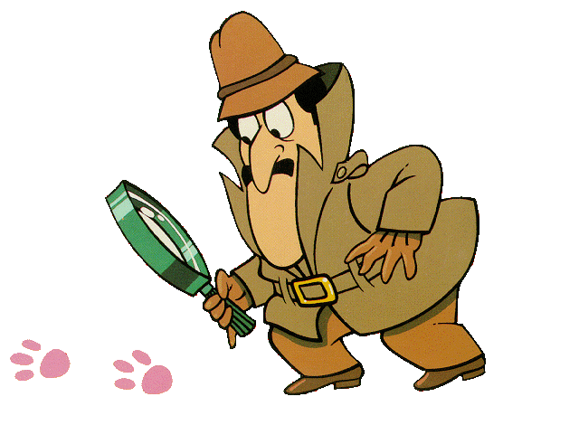
Hand-Helds
Scientists are working
on a simple inexpensive
hand-held instrument that can detect agents in minutes using nanotechnology.

Slide 2
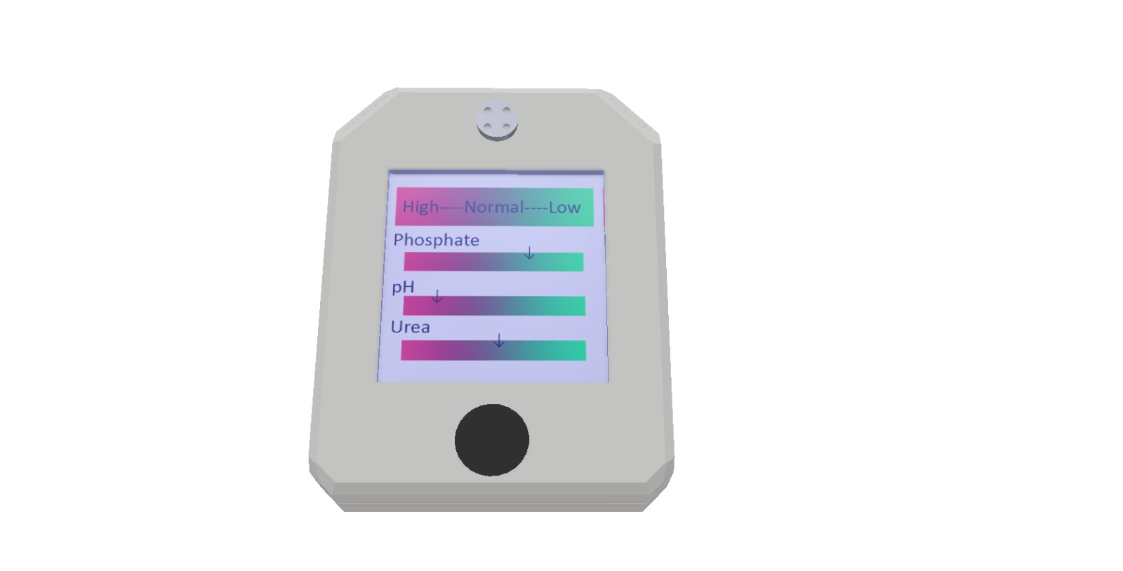

Slide 3
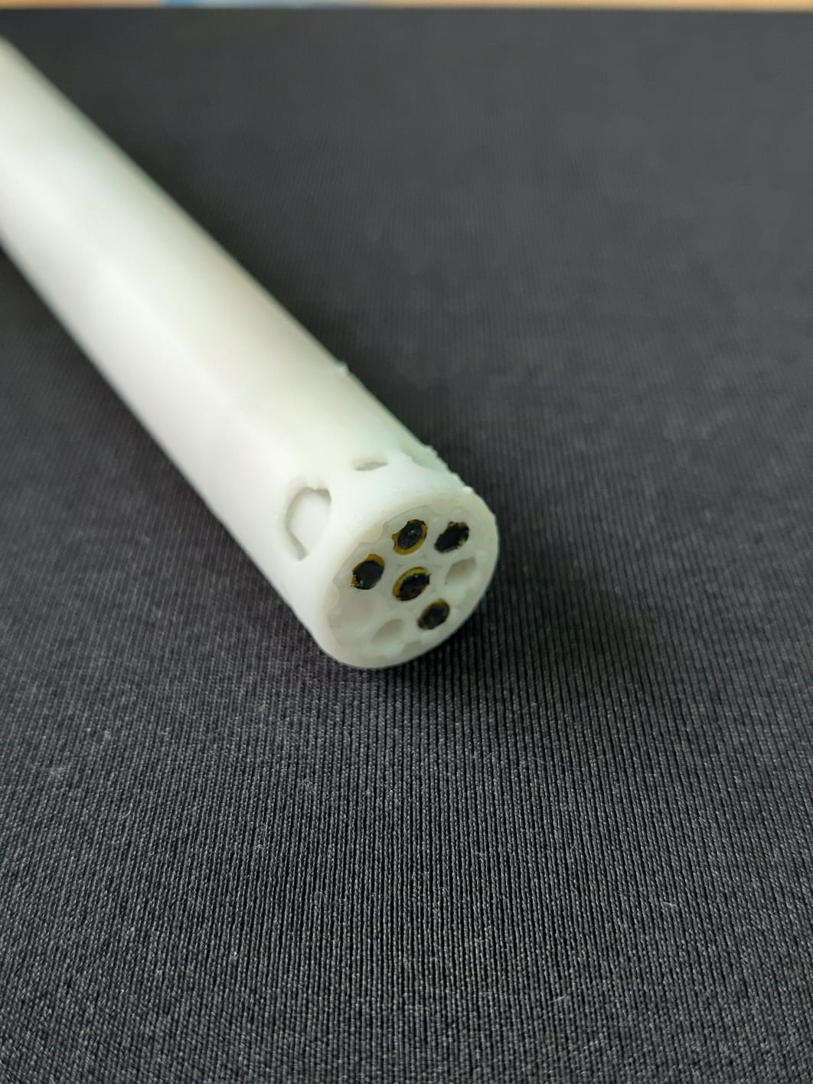

Slide 4
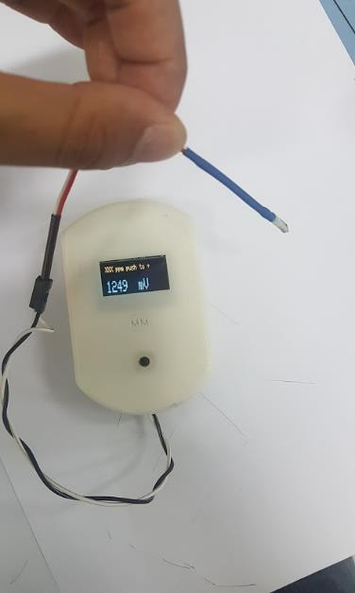
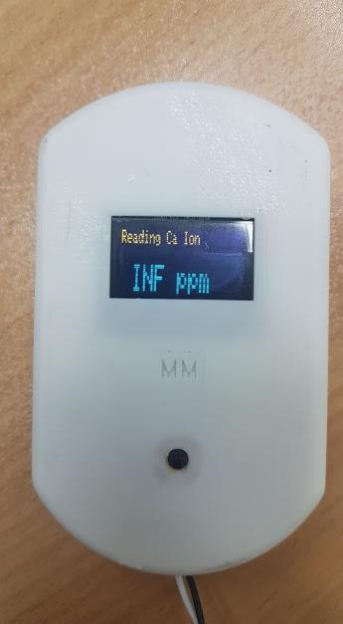

Slide 8
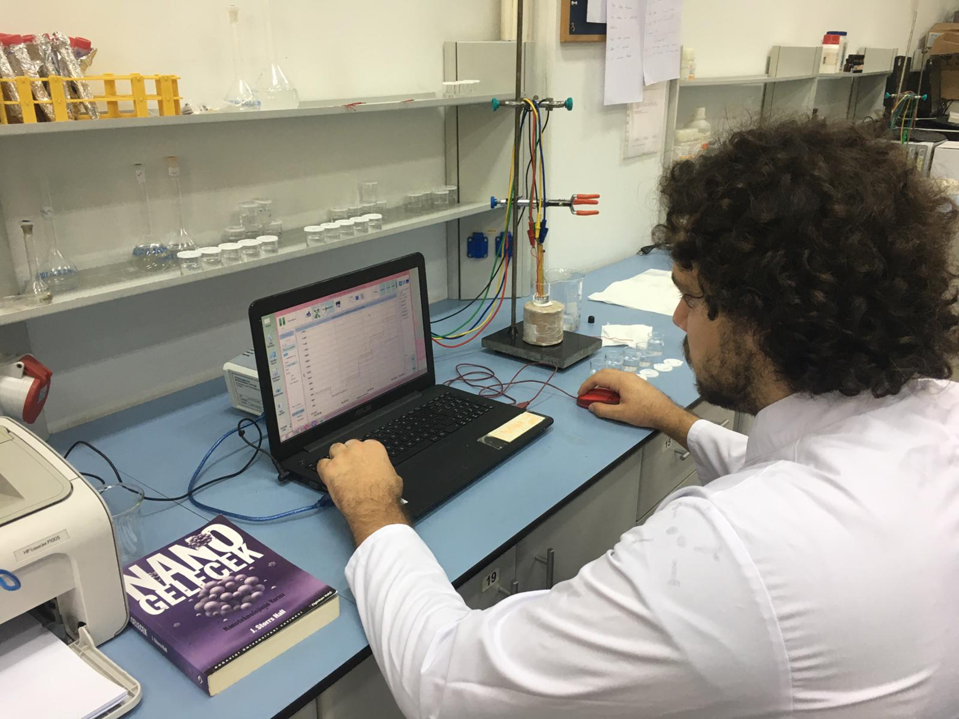

Slide 9
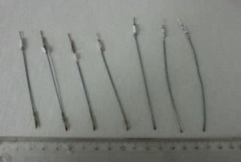
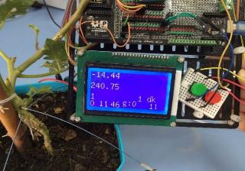
Preparation of sensors: The development of all-solid state composite salicylate and calcium selective sensors consists of solid contact and membrane preparation. When the sensors were being prepared, the solid contact mixture that forms the innermost part of the electrode was first coated on a copper wire, and the prepared PVC membrane cocktails were then coated on this solid contact surface.
2. Development of data acquisition system: A pre-conditioning circuit has been prepared for the use of ion selective electrodes in data collection. The signal from this circuit goes to the developed low-pass filter circuit. The analogue sensor signal processed in this way is converted into digital data by an analog-to-digital converter. The data coming to the microcontroller is transmitted by a wireless communication radio that is made ready for use. The receiving circuit of the wireless communication radio is connected to a computer via virtual com port. If the information necessary to receive, use, process and display the data ...

Slide 10
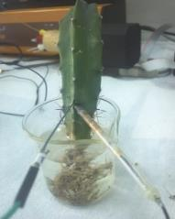
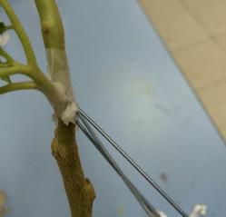
3. Carrying out tests of the system on plants: Studies were carried out on tomato and cactus plants. Plants were kept in the same conditions before the study. Cactus plants were grown hydroponically, and tomato plants were grown in pots. Reference and working electrodes were placed in the plants as close as possible to each other in connection with the xylem. While only calcium selective sensors were used in preliminary studies on cactus, both calcium and salicylate selective sensors were used together in studies on tomatoes. The responses of plants to biotic stress, NaCl salinity stress and cold stress were studied.
Examples of application in cactus and tomato plants

Slide 12
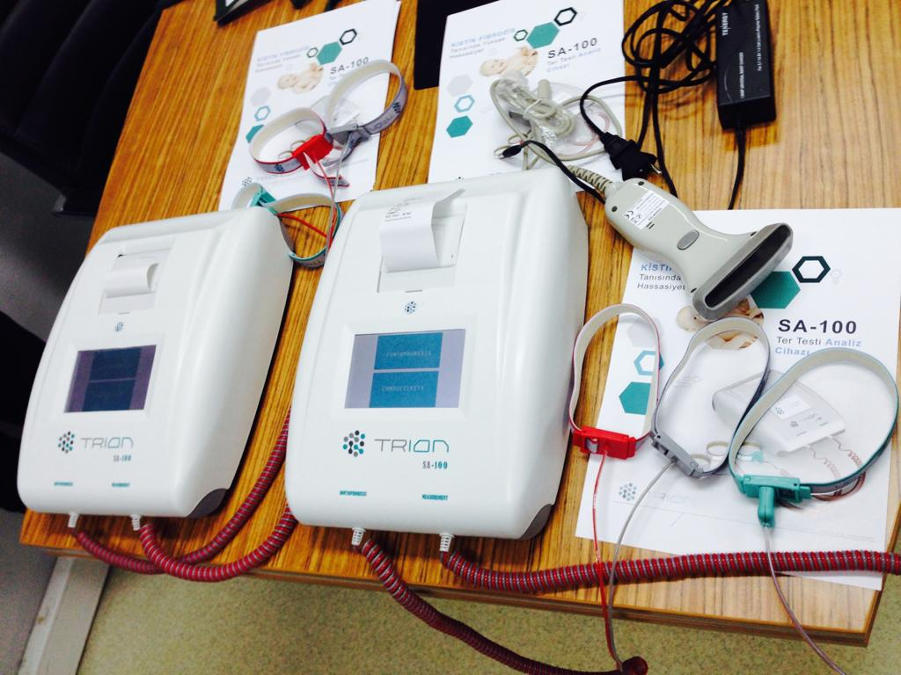

Slide 13
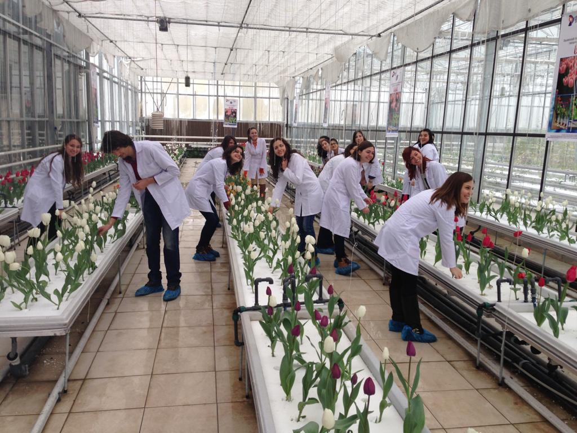

Slide 14
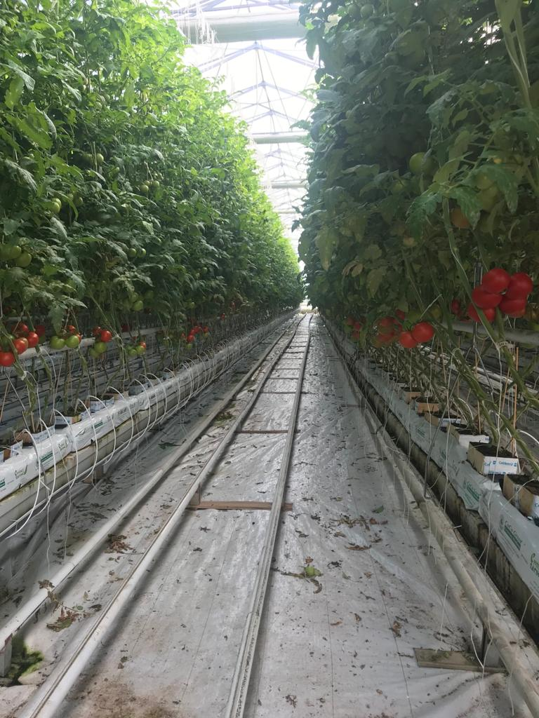

Slide 15
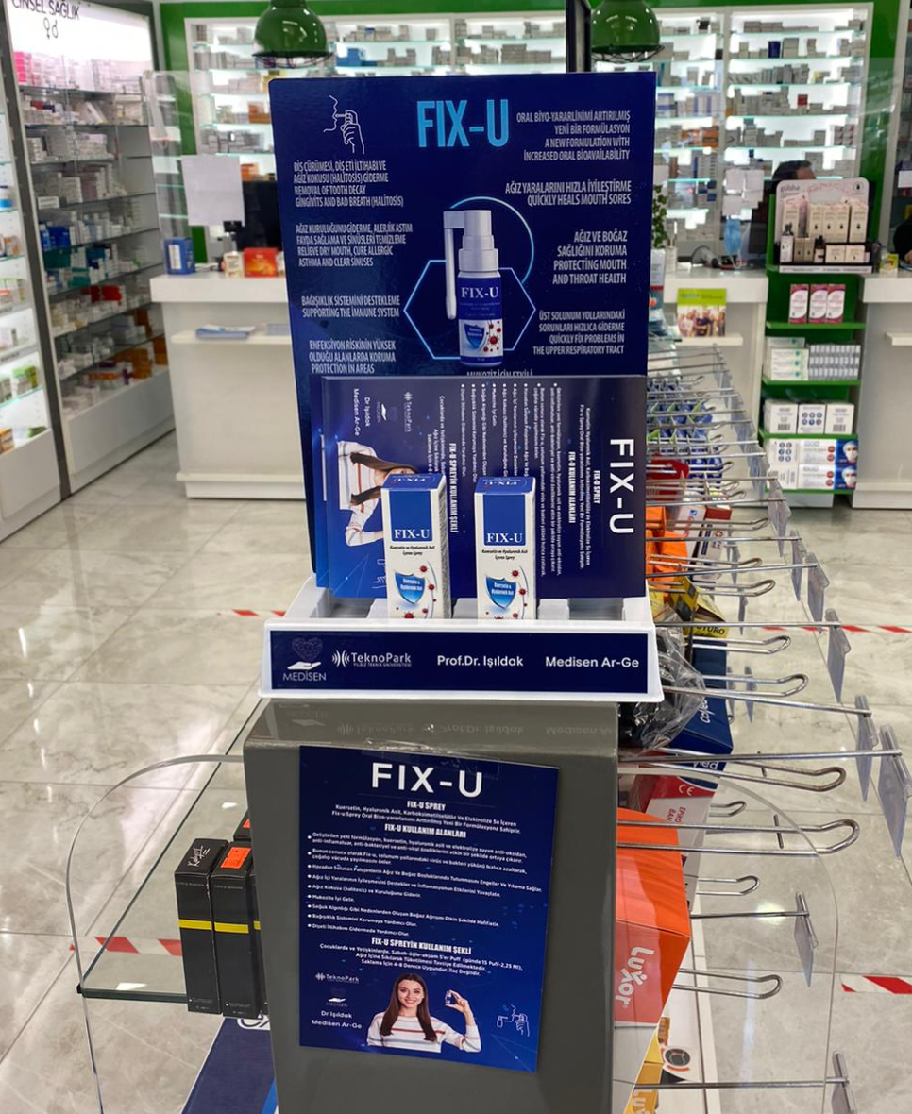
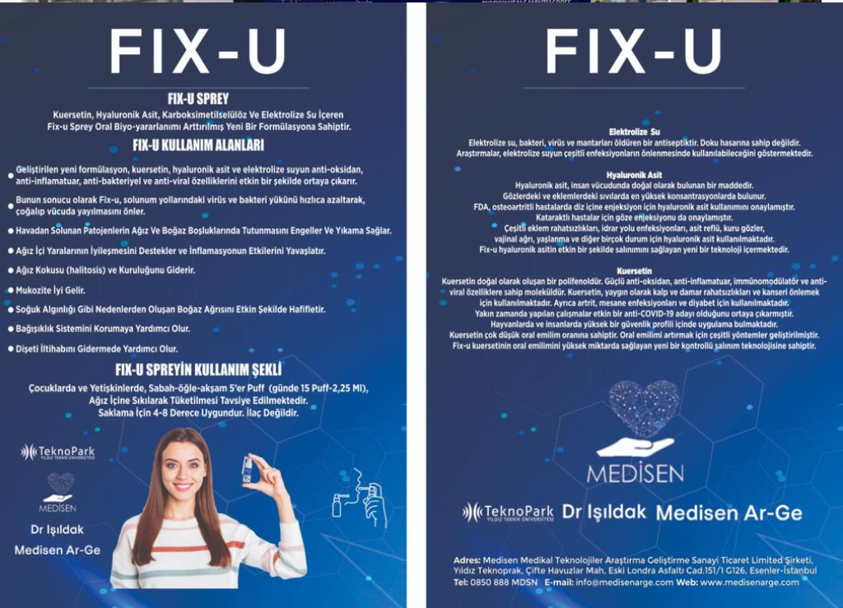
New Drug Formulation Technologies: An OverviewNew Drug Formulation Technologies: An Overview

Slide 17
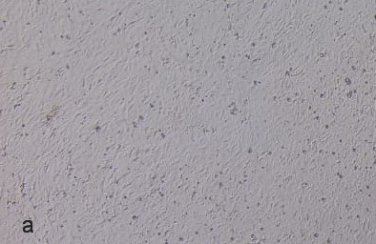
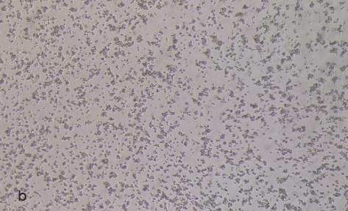
Cytotoxicity findings (a.Cell control, b.1/32 cytotoxicity observed in reconstitution)

Slide 18
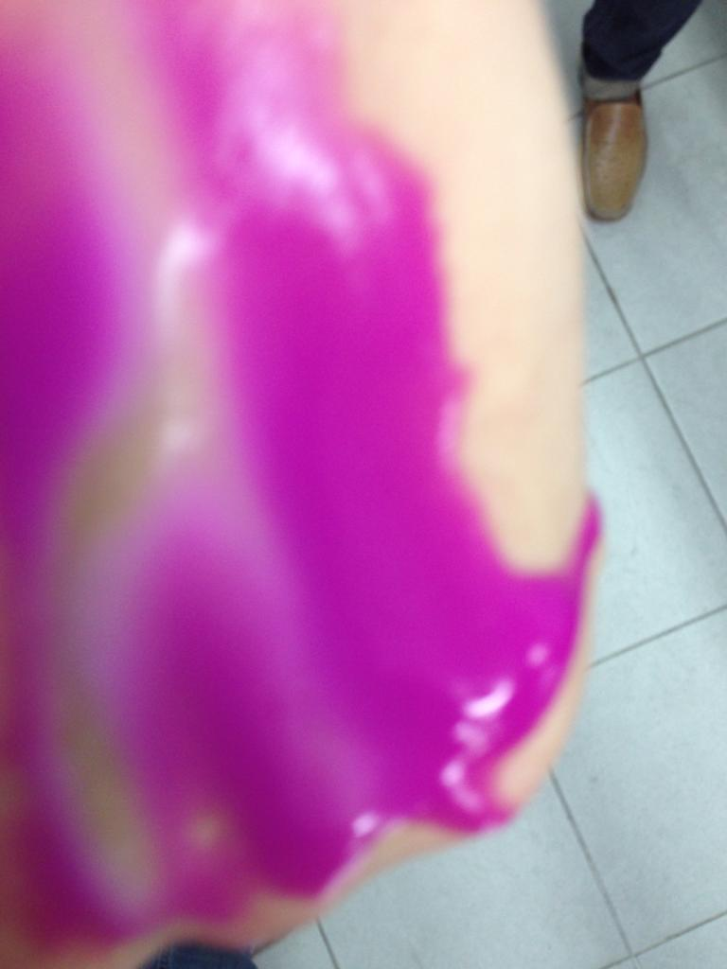

Slide 19
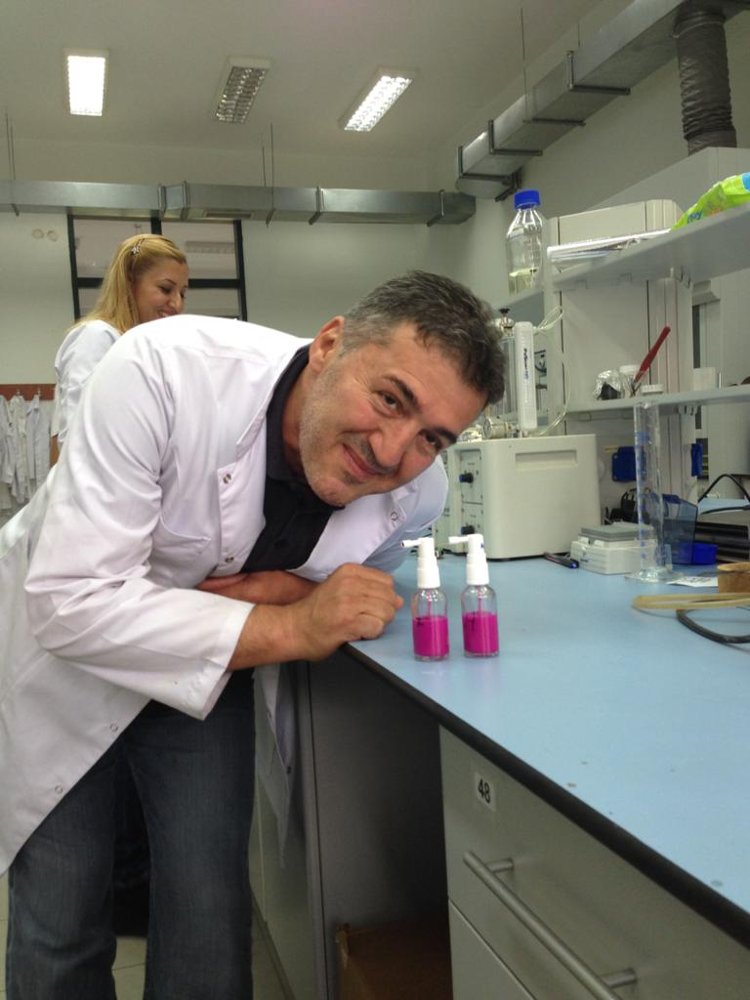

Slide 20
Conclusion
Nanotechnology offers the ability to build large numbers of products that are incredibly powerful.
Nanotechnology is heavily intertwined with biotechnology and information technology, making its scope very wide.
Nanomedicine for cancer has the ability to improve health care dramatically.
Current research is mostly in diagnostic tools, although there are many other application of nanomaterials in medicine.
There are still lots of advances needed to improve Nanomedicine

