Slide 1
NANOTECHNOLOGY IN THE DIAGNOSIS AND TREATMENT OF NANO-DIAGNOSTIC CANCER
Prof.Dr. İbrahim IŞILDAK LESSON 8

Slide 2
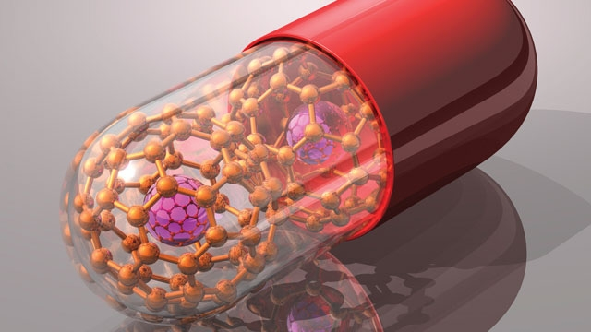
Nanotechnology;
provides functionalized novel materials for a variety of biomedical applications such as diagnostics, drug handling, therapy, tissue engineering and biosensors.
Thanks to the medical applications of nanotechnology, early diagnosis, prevention, treatment and follow-up of many life-threatening diseases such as cancer, cardiovascular diseases, diabetes, Alzheimer's, AIDS and even infectious diseases can be done.

Slide 3
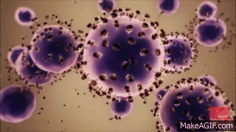
CLASSIC DIAGNOSIS OF CANCER
In the classical methods used in cancer diagnosis, growths and changes in organs can be detected with X-Ray and / or CT scans.
In suspicious cases, the diagnosis of cancer can be clarified by performing a biopsy.
However, early diagnosis with these methods is not very possible because the tumor can only be imaged when it reaches a diameter of 1 cm or a weight of about 1 g.
In this case, the number of cancerous cells is approximately ${10}^{8}$.
Unfortunately, in the past years, 2/3 of cancer cases could be diagnosed when the disease became fatal.

Slide 4
DIFFICULTIES IN THE CLASSIC DIAGNOSIS OF CANCER
Many problems encountered in classical diagnostic methods reduce the efficiency of the methods used.
Some of the problems encountered; limited spectrum range, insufficient depth of penetration, inability of target cells to fully focus, and low signal/noise ratio (SNR)

Slide 5
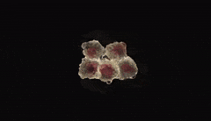
CANCER DIAGNOSIS AND NANOTECHNOLOGY
Thanks to today's technology, tumors can be diagnosed at an early stage by using nanotechnology.
The ability of nanostructures to enter the tumor cell increases the limits of imaging techniques in this regard.
For example, in order to make a clinical diagnosis of breast cancer with mammography, 1,000,000 tumor cells must have been formed.
With the help of nanotechnology, it is possible to diagnose breast cancer even in the presence of less than 100 tumor cells.

Slide 6
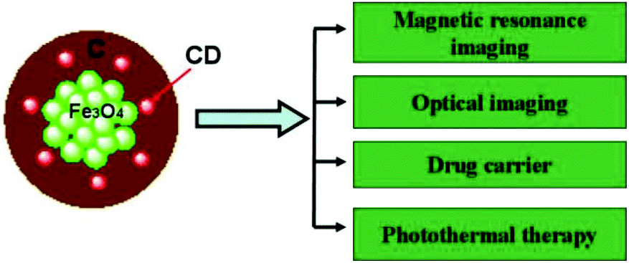
CANCER DIAGNOSIS AND NANOTECHNOLOGY
Quantum dots and iron oxide nanocrystals have been placed in silica spheres for use in imaging.
Thanks to the iron oxide nano crystals contained in nano structures, it is aimed at certain cells and high image quality is obtained thanks to quantum dots.
The composition of iron oxide nanocrystals and quantum dots has been shown to provide the best imaging quality.

Slide 7
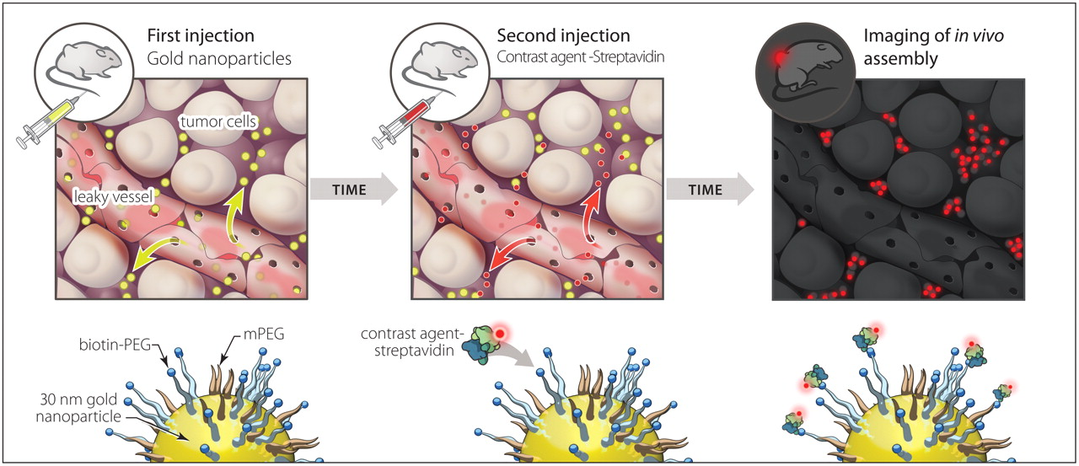
CANCER DIAGNOSIS AND NANOTECHNOLOGY
In order to detect cancer early, nanostructures that can bioconjugate with cancer-specific biomolecules are also used.
The various physical properties of nanostructures change when they combine with biomolecules.
These changes can be detected by optical, mechanical and electrical methods to obtain information about the presence or amount of the tumor or disease in question.

Slide 8
NANOSTRUCTURES USED FOR DIAGNOSTIC PURPOSES
Cantilevers
Nanopores
Nanotubes
Nanowires
Nanoshells
Dendrimers
Magnetic Nanoparticles
Quantum Dots
Graphene Oxide (GO)
Gold and Silver Nanoparticles
Nanobots Nanochips

Slide 9
CANTILEVERS
These materials, which are bound at one end, are produced to bind certain molecules associated with cancer.
They bind to altered DNA sequences or proteins that contain certain types of cancer.
When these molecules bind to the gentlevers, the surface tension changes, resulting in the centylevers bending.
Twisting gentlevers are displayed.
This property of cantilevers makes them potential tools for detecting cancer-related biomolecules even at very low concentrations in the early stages of the disease.

Slide 10
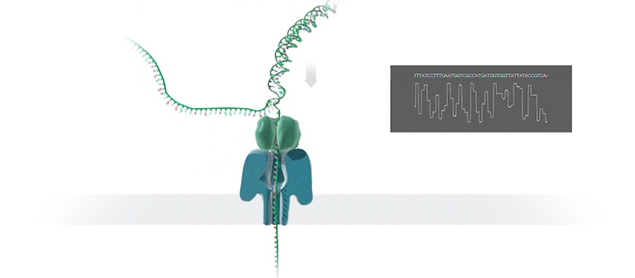
NANOPORES
Nanopores; They are very small holes that allow a single helix of DNA to pass through in one go.
In this way, the DNA sequence becomes more efficient.
As DNA passes through the nanopore, the researcher is able to image the shape and electrical properties of each base, information, and helix.
These features are unique for each of the four bases that make up the genetic code, with researchers using the passage of DNA through nanpor to decipher encoded regions within the code, such as errors associated with cancer.

Slide 11
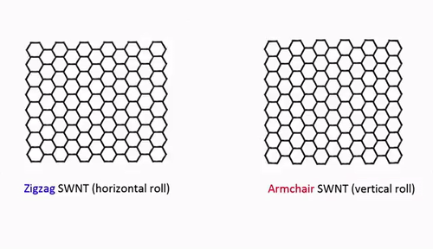
NANOTUBES
Nanotubes are also used to detect certain changes in DNA that occur and are associated with cancer.
Nanotubes are nanorods that are approximately half the diameter of DNA.
Nano tools that not only detect the presence of altered genes, but can also be used to find the exact points at which these changes occur.

Slide 12
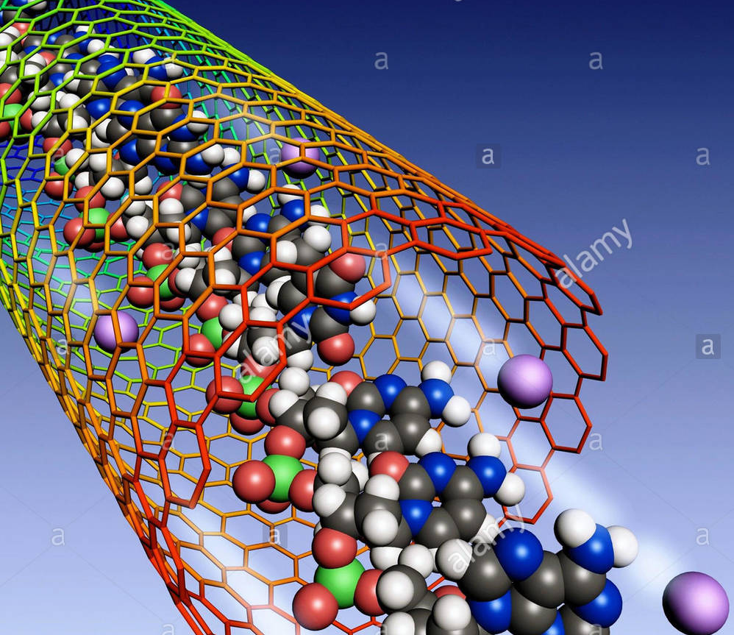
NANOTUBES
To prepare DNA for nanotube analysis, researchers must insert a large volume of molecules into cancer-related regions of DNA.
Scientists can design specific labels that find and link to these regions.
Once the mutation is labeled, the physical shape of the DNA can be traced back and the exact regions where the mutation occurred can be identified.

Slide 13
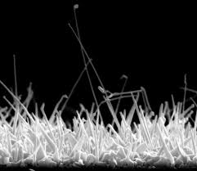
NANOWIRES (NW)
NWs are nanostructures that allow the electrical perception of molecular conjugations.
They can be created using metal, semiconductor or polymer structures.
However, they can be used to detect tumor biomarker proteins by functionalizing them with antibodies or oligonucleotides.
Current flows very closely to the surface in NWs, making NWs very sensitive to minor changes that can occur on the surface.
The combination of tumor biomarker proteins with antibodies on the NW surface produces a change in the flow flowing from the NW. This creates a kind of electrical biosensor system.

Slide 14
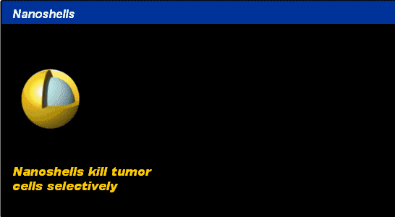
NANOSHELLS
Nanoshells are very small beads coated with gold.
The thickness of the layers can be changed.
These beads can be used to absorb light at specific wavelengths.
The most useful are those that can absorb near-infrared light and easily penetrate into many centimeters of human tissue.
The absorption of light with nanoshells generates an intense temperature that is lethal for the cells.

Slide 15
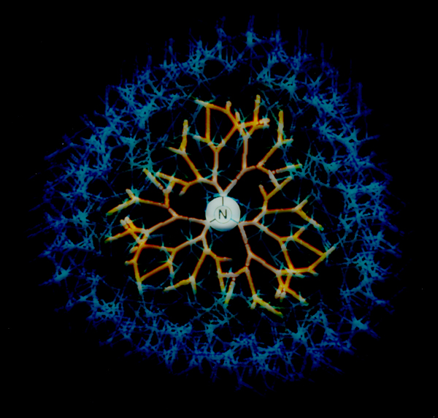
DENDRIMERS
Among the drug delivery systems, dendrimers have high potential for use in early detection, diagnosis and treatment.
Multiple functional groups on their surface make dendrimers ideal for targeted drug handling.
Dendrimers are molecules with a branched shape that are approximately the size of an average protein.

Slide 16
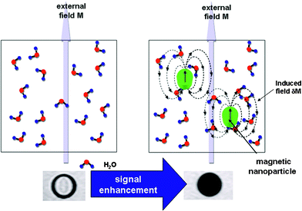
MAGNETIC NANOPARTICLES
Magnetic nanoparticles; It is used in many fields such as biosensor, magnetic resonance imaging and nanoelectronics.
They are commonly developed using elements that have magnetic properties, such as iron, nickel and their derivatives.
Magnetic nanoparticles are versatile nano-tools that can be magnetically guided by the help of an external force.
Thanks to the ability to control from a long distance and rapid penetration into living tissue, the diagnostic and diagnostic capabilities of magnetic nanoparticles are used in vivo in MRI technology.

Slide 17
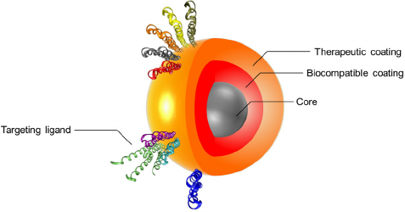
MAGNETIC NANOPARTICLES
Super paramagnetic iron oxide nanoparticles (SPION) are composed of an iron oxide core and the inorganic materials covering them, such as silica, or phospholipids, or natural polymers such as dextran, chitosan.
SPIONs are versatile diagnostic and diagnostic agents used in the early diagnosis of cancer and atherosclerosis.
Moreover, SPIONs are also used as contrast agents in MRI imaging. In addition, when used in biosensors, they increase the sensitivity and selectivity of the diagnosis..

Slide 18
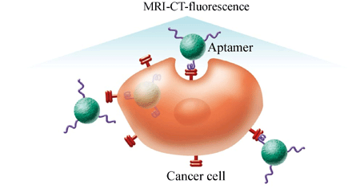
MAGNETIC NANOPARTICLES
Circulating tumor cells (CTCs); characterizes the invasive behavior of cancer cells and is responsible for the development of metastasis.
Their detection and analysis play a prominent role in clinical practice and cancer biology.
Nanotechnology offers promise for the detection of CTCs thanks to the unique structures and functions of nanomaterials.

Slide 19
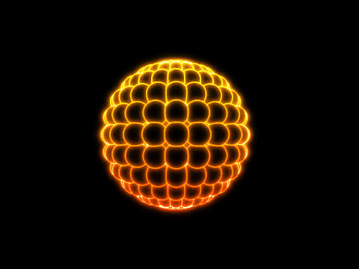
QUANTUM DOTS
Quantum dots are very small crystals that glow in different colors when stimulated by UV rays.
The color or wavelength of the light depends on the size of the crystal.
Latex beads filled with these crystals can be designed to bind to specific DNA sequences.
By collecting quantum dots of different sizes in a single bead, it can produce probes that emit distinct colors and light intensities.
When the crystals are stimulated by UV light, each bead emits light in spectral barcodes defined for specific regions of DNA.

Slide 20
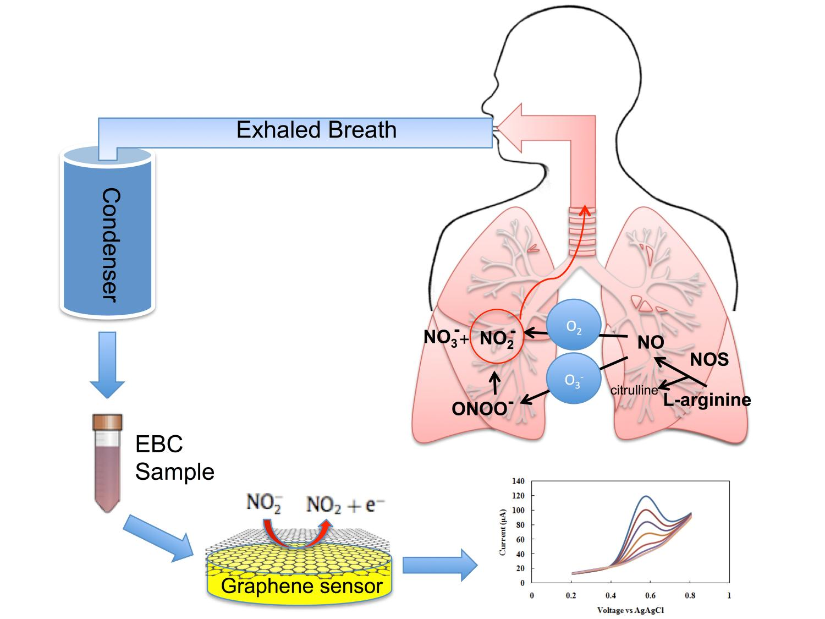
GRAPHENE OXIDE(GO)
Graphene oxide is a thin layer of sp2 hybridized carbon used in medical diagnosis due to its unique properties.
In some studies, antibodies attached to GO bind to cancer cells and cancer cells were labeled with fluorescent molecules.
In this way, cancer cells can be observed under a microscope.
In addition, GO has the sensitivity to detect very low amounts of cancer cells.
So much so that it has the force to detect even 3 to 5 cancer cells in a milliliter blood sample.

Slide 21
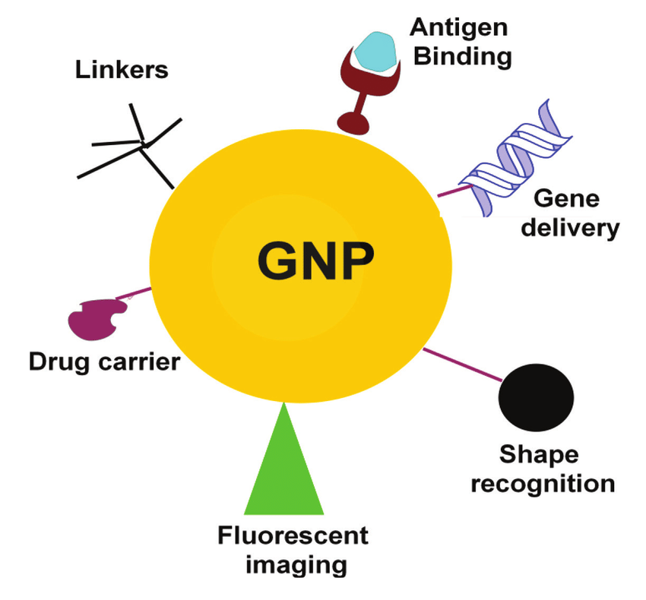
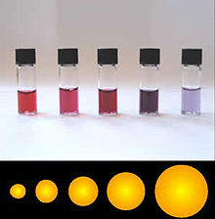
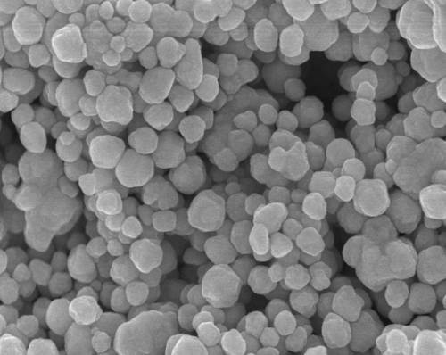
GOLD NANOPARTICLES & SILVER NANOPARTICLES
Gold nanoparticles; nanomaterials that are the most widely researched and most interesting in the field of medical diagnosis due to their ease of synthesis, high biocompatibility and non-cytotoxic.
They are widely used in the fields of marking and biosensors.
Silver nanorodes in diagnostic systems; used to separate microscopic components such as bacteria and viruses from blood samples.

Slide 22
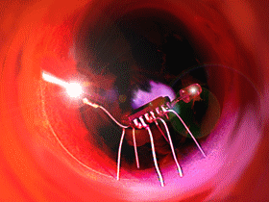
NANOROBOTS
Nanorobots, also known as nanorobots, are robots developed on the nanoscale..
It is used in early detection of cancer and as a drug delivery system.
It is also used in pharmacokinetic imaging of diabetes.
Nanorobots used as toothpaste, toothpaste or mouth wash water cover the entire subgingival surface, turning any metabolic organic matter trapped between the teeth into odorless and harmless vapors.
Pathogenic bacteria in dental plaque can also be identified and destroyed by nanobots.

Slide 23
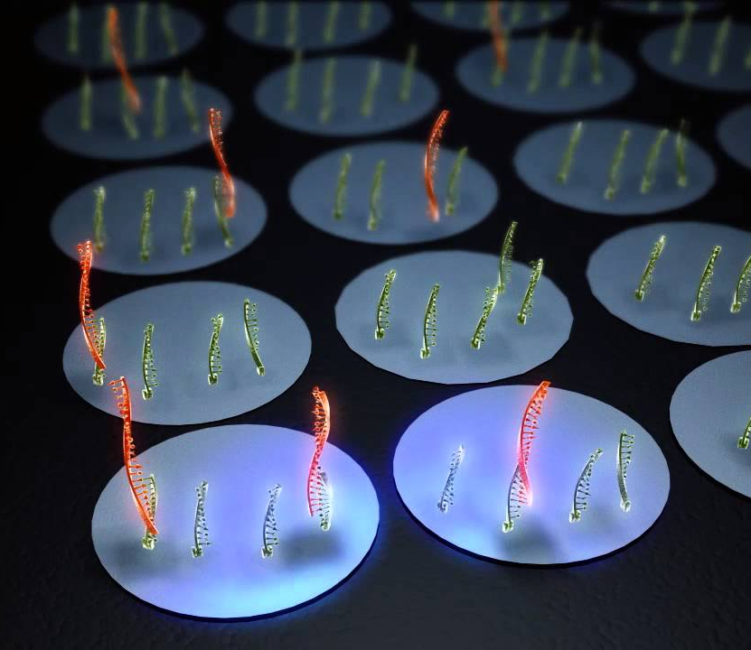
NANOCHIPS
One of the most common methods used today to analyze DNA sequences is hybridization, or the matching of separated helices of DNA with complementary DNA helices of a known sequence that act as probes.
Today, DNA chips, called DNA microarray testing, are used to analyze DNA.

Slide 24
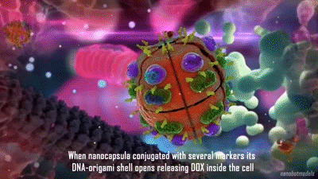
THORANOTIC
Chemotherapy drugs can be added to nanoparticles currently used as imaging agents to create theranostic platforms.
In the study conducted by Bagalkot et al., the Quantum Dot (QD)–Aptamer (Apt)–Dox nanostructure was used in the simultaneous treatment and imaging of cancer.
In this study, the surfaces of CdSe/ZnS QDs were functionalized with A10 PSMA aptamers to provide target orientation.
Dox has been added to the resulting QD-Apt structure (QD-Apt( Dox )

Slide 25
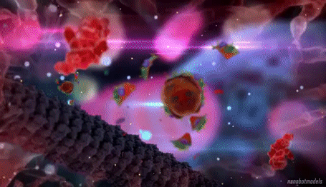
THORANOTIC
Here, QD and Dox are fluorescent molecules and have dampened each other's fluorescence properties by the bi-fluorescence resonance energy transfer (FRET) mechanism.
Therefore, the fluorescence-suppressed QD-Apt(Dox) nanoparticle was obtained.
This nanoparticle released the Dox, which it carries when it enters prostate cancer cells by PSMA-indirect endocytosis.
As a result, Dox and QD regained their fluorescence properties.
In this way, targeted drug therapy and imaging with QD-Apt(Dox) theranostic nanostructures can be performed simultaneously.

Slide 26
FUTURE
In the future, existing treatment methods will be further developed and their use will become widespread,
Thanks to nanotechnology, early diagnosis of many diseases, especially cancer, will be provided and a significant decrease in mortality rates due to diseases will be observed,
Nanotechnology; Thanks to the materials with unique properties it offers, it will be important and hopeful for diseases that cannot be treated today,
Thanks to the studies carried out, it is thought that it will develop day by day and become widespread.

