Slide 1
NANOROBOTS
Prof.Dr. İbrahim IŞILDAK LESSON 9

Slide 2
NANOROBOTICS
Nanorobotics is the technology of building machines or robots at or near the scale of one nanometer.

Slide 3
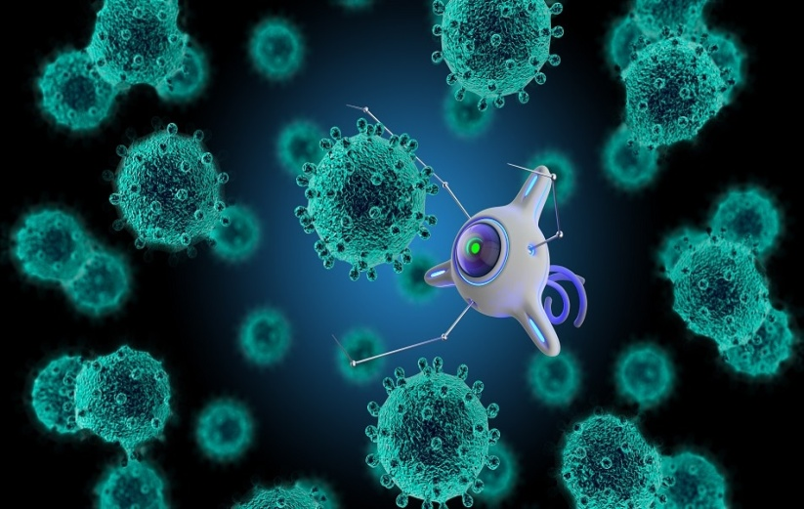
NANOROBOTS
Nanorobotics; is the scientific field of study that allows the design of machines or robots on the nanometer scale.
Nanorobots; Also called nanobots, nanoids, nanites or nanomites.
Nanorobots perform their tasks in both medical and industrial fields; nano devices capable of performing at the atomic, molecular and cellular level.
Nano robots used in the field of nanomedicine are small enough to be easily transferred to the human body.

Slide 4
NANOROBOTS
DNA represents a nano-sized device in which proteins, such as carbon nanotubes, can function as motors, mechanical connections, transmission elements, or sensors.
When these different components are put together, they can create nanorobots, apply power to nano-sized objects, and manipulate them.

Slide 5
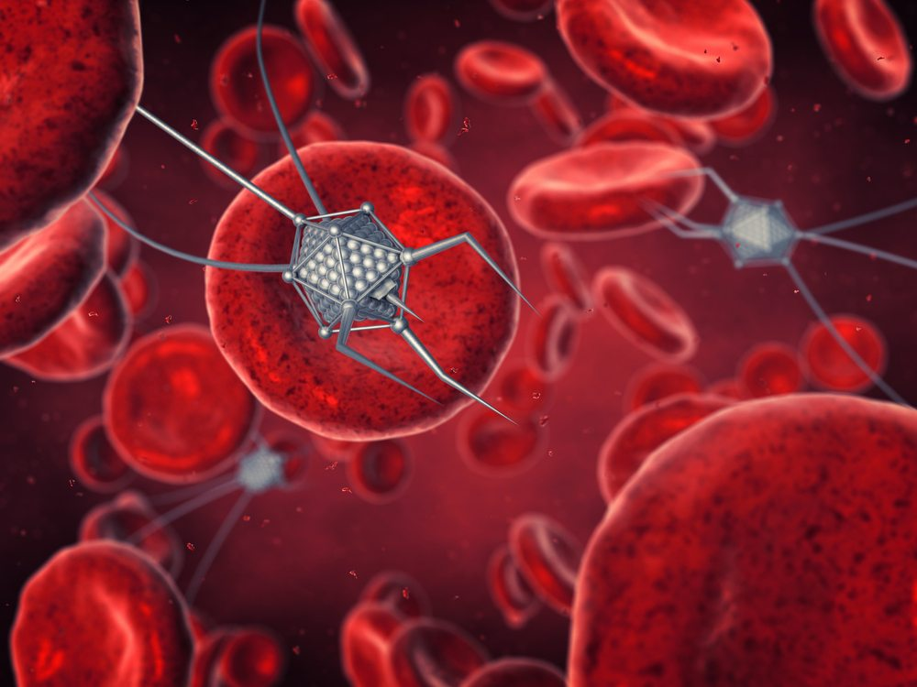
NANOROBOTS
Studies have shown in the literature that it would be more reasonable to make nanorobots from carbon atoms in the form of diamonds due to the durability and inert properties of the outer part.
Super-smooth surfaces have been shown to reduce the body's immune system stimulation without interfering with nanorobots from performing their tasks.

Slide 6
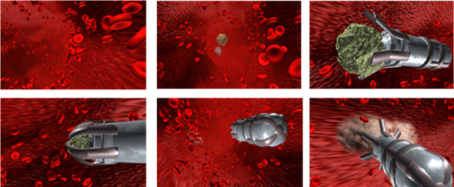
NANOROBOTS
Glucose, or natural body sugars and oxygen, could be used as a power source for nano-robots.
Nano robots; may contain various biochemical or molecular compartments depending on their role.

Slide 7
USES
Destruction of kidney and liver stones,
Treatment of skin diseases,
Regeneration of neurons,
In smart anti-cancer therapeutics,
Destruction of cancer cells and prevention of heart attack,
Targeted drug release systems,
Detection and destruction of bacteria and viruses,
Treatment of arteriosclerosis,
It is also available as a mouth wash water.

Slide 8
CONTROL OF BIONANOROBOTIC SYSTEMS
INTERNAL CONTROL
Passive control- depends on the biochemical detection mechanism and the selective binding of various biological molecules with various elements.
Active control- The 'active' control mechanism must be designed for nanorobots to change their behaviour according to the situations to which they are exposed, as macro robots do. This requires the nanorobot to be programmable and have memory storage capacity.

Slide 9
CONTROL OF BIONANOROBOTIC SYSTEMS
EXTERNAL CONTROL
This type of control mechanism affects the dynamics of the nanorobot in the working environment by applying external potential fields.
The researchers use MRI as an external control mechanism to manipulate the nanoparticles. An MRI system can create variable magnetic field gradients that can exert forces on the nanorobot in three dimensions and therefore control its motion and direction. However, this method has some limitations in terms of control precision..

Slide 10
APPROACHES
BIOCHIP
Photolithography is preferred as a way to enable the necessary manufacturing technologies for nanorobots for common medical applications such as the joint use of nanoelectronics and new biomaterials, surgical instruments, diagnostics and drug handling.
This viable approach to nanotechnology manufacturing is one that is still being used in the electronics industry.
Therefore, practical nano-robots can be integrated as nanoelectronic devices that allow tele-operations and provide advanced capabilities for medical devices..

Slide 11
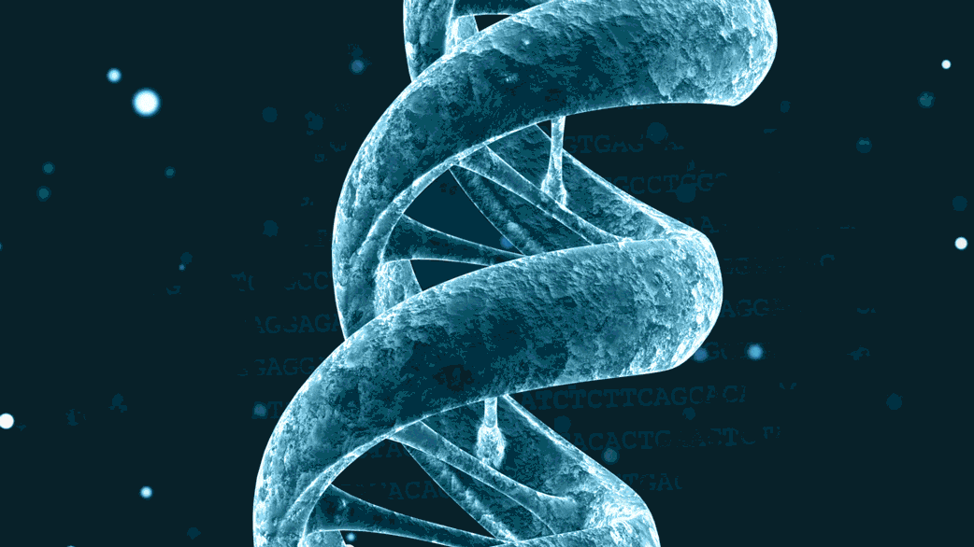
APPROACHES
NUBOTS
Nubot; is a generic name given to nucleic acid robots.
Nubots are synthetic robotic tools developed on the nanoscale.
It has a double helix structure, similar to the helical structure of DNA.

Slide 12
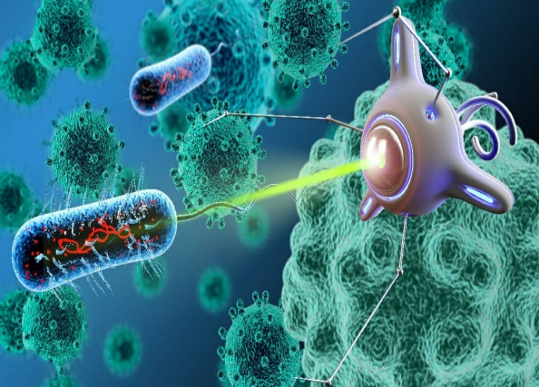
APPROACHES
BACTERIUM-BASED
Within the scope of this approach, microorganisms such as E. coli are used.
In fact, the model uses a flagellium as the driving force.
The use of electromagnetic fields is applied to controlling the movements of a variety of biologically integrated devices, although it has a limited field of application.

Slide 13
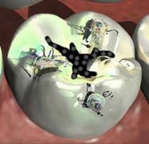
POTENTIAL APPLICATIONS
NANOROBOTICS IN DENTISTRY
Due to the interest in nanotechnology in dentistry, the concept of nano-dentistry has emerged.
Nano robots induce oral analgesia, manipulate tooth tissue to realign with reduced sensitivity, and regulate the irregular set of teeth to increase the durability of the teeth.
Nanorobots can be used to perform processes involving prophylaxis and treatment.

Slide 14
POTENTIAL APPLICATIONS
IN CANCER DIAGNOSIS AND TREATMENT
Nanorobots are ideal devices for cancer diagnosis and treatment.
Nanorobots can directly destroy cancer cells; destroy it as part of chemotherapy treatment using laser, microwaves or ultrasonic signals, or by transporting the drug to cancerous cells.
Using nanorobots, doctors can minimize the side effects of small but adequate doses of the drug without any loss in the effectiveness of the drug.

Slide 15
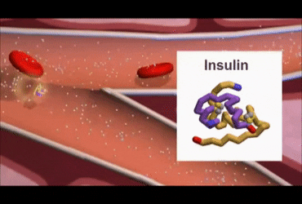
POTENTIAL APPLICATIONS
NANOROBOTS IN THE DIAGNOSIS AND TREATMENT OF DIABETES
Glucose transported through the bloodstream is important for the healthy functioning of human metabolism, and the correct level of glucose is key to the diagnosis and treatment of diabetes.
Even in the immune system reaction inside the body, the nanorobot is not attacked by white blood cells thanks to its biocompatibility.
Using nanorobots to image glucose levels, it determines whether the patient needs insulin injection thanks to its integrated chemical sensor.

Slide 16
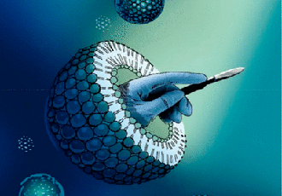
POTENTIAL APPLICATIONS
NANOROBOTS IN SURGERY
Nanorobots, programmed by surgeons, coordinated with computers, are used in different areas such as screening for pathology, diagnosis and healing of lesions with nanomanipulation.

Slide 17
POTENTIAL APPLICATIONS
DIAGNOSTICS AND NANOROBOTS
Medical nanorobots; can perform a wide range of diagnostic, testing and imaging functions both in tissues and in the bloodstream.
These devices can continuously record and report all vital signs such as temperature, pressure, chemical composition, and immune system activity from all different parts of the body.
For example, nanorobots swallowed by the patient for diagnostic purposes perform their tasks by approaching the relevant tissue to look for signs of infection on the lining of the stomach.

Slide 18
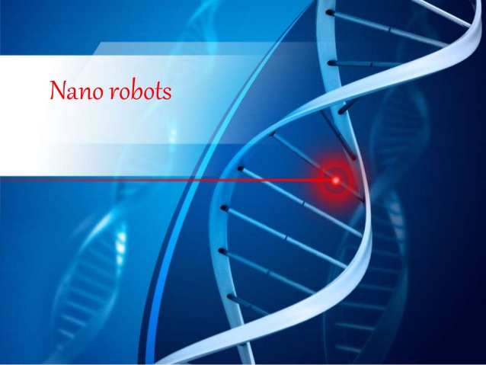
POTENTIAL APPLICATIONS
NANOROBOTS IN GENE THERAPY
Medical nanorobots can easily treat genetic diseases by comparing the structures of DNA and proteins in the cell with known and desired reference structures.
In this way, any irregularity or modification in the desired region on the DNA can be edited.
In some cases, chromosomal displacement therapy may be more efficient for cellular repair.
Nanorobots perform genetic repairs by floating within the nucleus of a human cell.

Slide 19
POTENTIAL APPLICATIONS
NANOROBOTS IN REMOVING BLOOD CLOTS
Blood clots can cause complications ranging from muscle death to paralysis.
Nanorobots can reach blood clots and destroy them.
This application is one of the most dangerous among the uses of nanorobots.
Nanorobots should be able to remove the blockage in the bloodstream without losing their small particles, which can then reach some parts of the body and cause problems there.
However, nanorobots must be designed in such small sizes that they do not adversely affect blood flow.

Slide 20
POTENTIAL APPLICATIONS
NANOROBOTS IN THE TREATMENT OF GOUT
Gout is a condition in which the kidneys lose their ability to remove waste from the blood as a result of the breakdown of fats.
These wastes sometimes crystallize in joint areas such as the kneecaps and elbows.
Gout patients suffer from aches and pains that occur in these areas.
Nanorobots can relieve symptoms by breaking down crystal structures at joint sites, but they can't permanently reverse the situation.

Slide 21
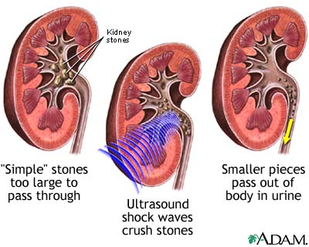
POTENTIAL APPLICATIONS
NANOROBOTS IN THE DESTRUCTION OF KIDNEY STONES
Kidney stones can be quite painful, especially when they are larger in size.
Doctors break down large kidney stones with the help of ultrasonic frequencies, but this method may not always be effective.
Nanorobots more effectively break down kidney stones with the help of a small laser.

Slide 22
POTENTIAL APPLICATIONS
IN CELL AND TISSUE REPAIR NANOROBOTS
Damaged tissue is identified and multiple-programmed medical robots are delivered to the patient's body, and nanorobots automatically detect the damaged tissue.
Then all the nanorobots head to the infected tissue and destroy the dead cells there by means of a laser.
After all the dead cells are removed, this area is cleaned by nano-chemicals and then the nanorobot begins to repair the tissue.
This process progresses quite quickly and the healing process can take a few hours for simpler wounds and a few days for deep wounds.

Slide 23
ADVANTAGES
Nanodevices that can work at the molecular level.
They can refresh themselves to replace them with mediocre units. this feature is called self-replication.
The microscopic size of nanomachines translates into high operational speed.
Each unit requires a low amount of energy to perform its task.
The most important advantage of nanobots is their high level of durability. According to the theory, nanorobots can maintain their function for years or even centuries.

Slide 24
DISADVANTAGES
The design cost is quite high.
Nanorobot design is highly complex.
The electrical system can activate bioelectric-based molecular recognition systems in biology.
Since nanorobots have the ability to destroy the human body at the molecular level, if they are put to use in the wrong hands, they can pose a risk to communities.

Slide 25
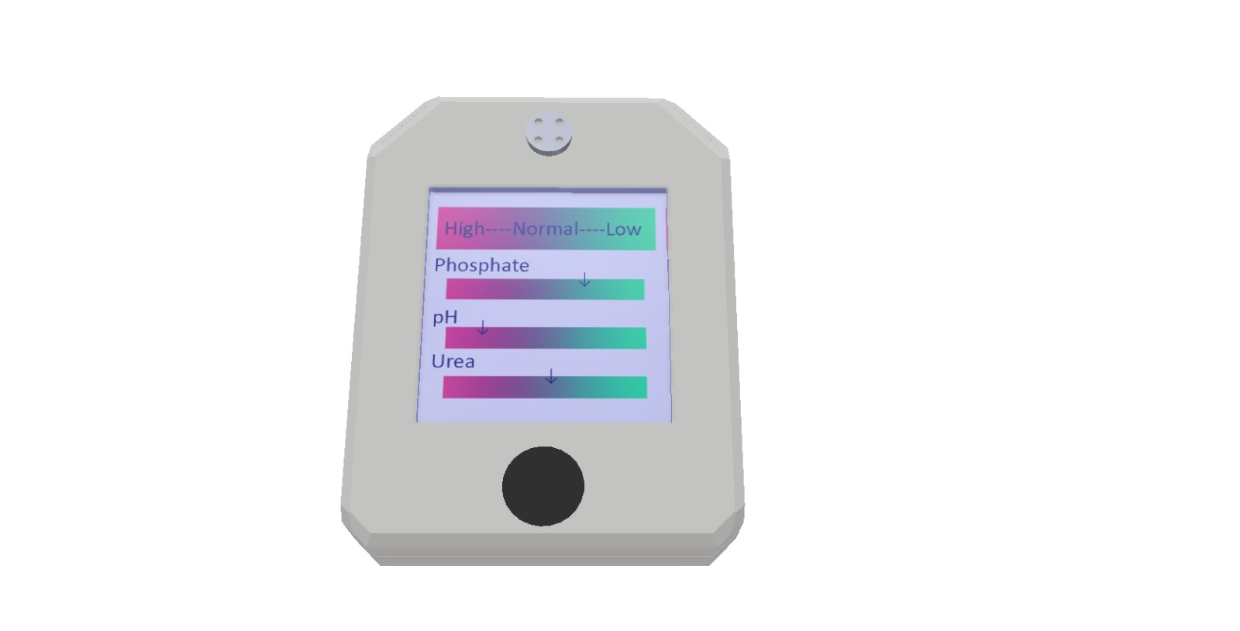

Slide 27
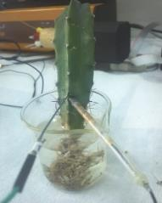
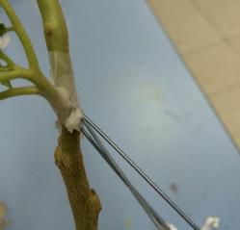
3. Carrying out tests of the system on plants: Studies were carried out on tomato and cactus plants. Plants were kept in the same conditions before the study. Cactus plants were grown hydroponically, and tomato plants were grown in pots. Reference and working electrodes were placed in the plants as close as possible to each other in connection with the xylem. While only calcium selective sensors were used in preliminary studies on cactus, both calcium and salicylate selective sensors were used together in studies on tomatoes. The responses of plants to biotic stress, NaCl salinity stress and cold stress were studied.
Examples of application in cactus and tomato plants

Slide 29
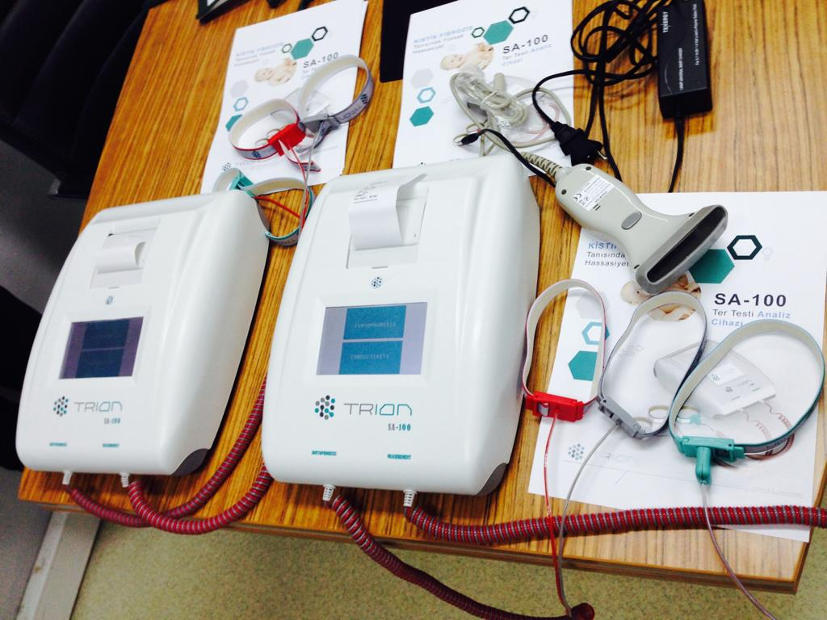

Slide 30
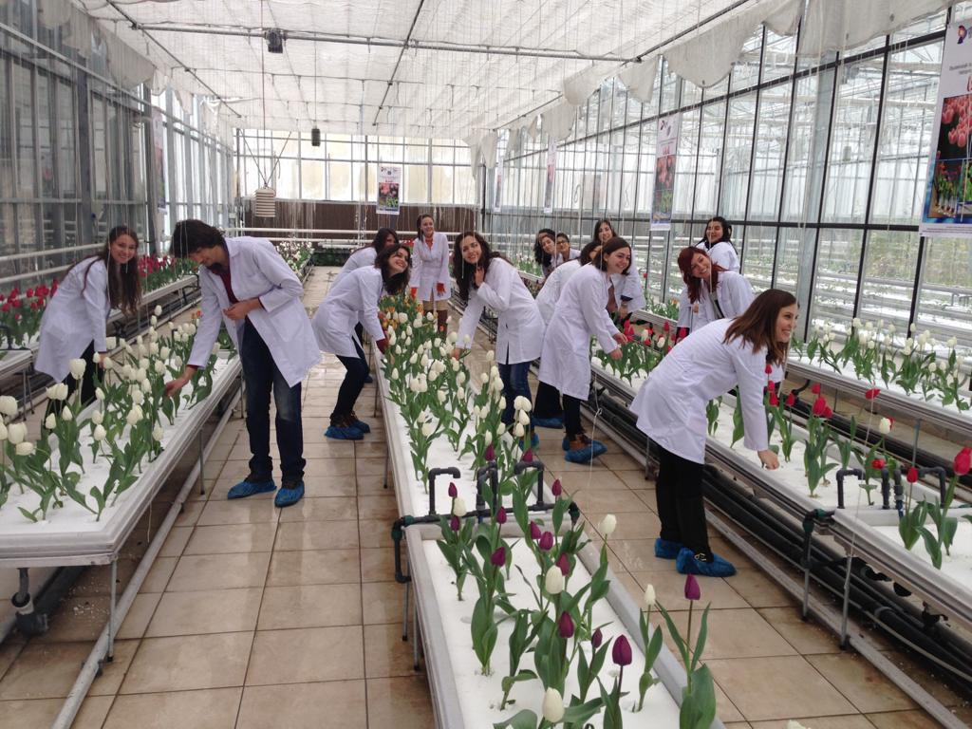

Slide 31
