Slide 1
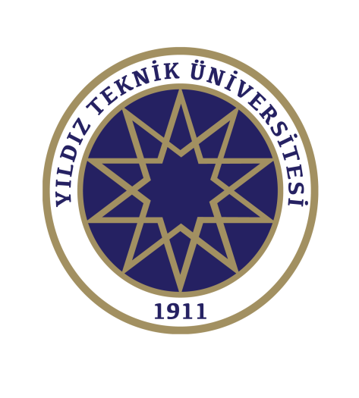
Introduction to Nanotechnology AND general concepts
Prof.Dr. İbrahim IŞILDAK
Department of Bioengineering
23.10.2022
LESSON 1

Slide 2
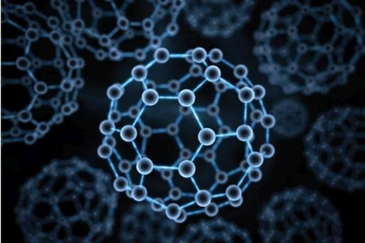
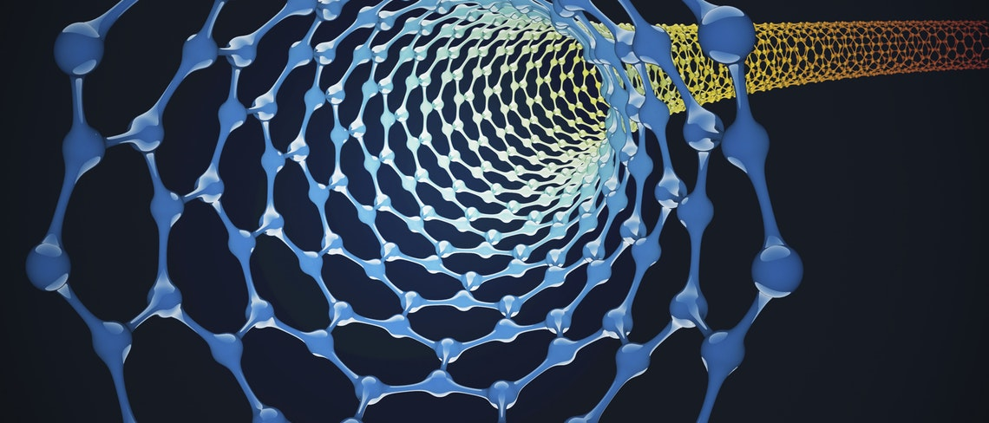
What is Nanotechnology?
It is the field that allows many substances, tools and machines used in physics, chemistry, biology and engineering to work in very small functions.

Slide 3
1 NANOMETER = 1 nm,
One billionth of 1 meter
10 meters
1 inch = 25,400,000 nm
Newspaper thickness ~ 100,000 nm
-9

Slide 4
History of Nanotechnology
Nanotechnology is a technology that has been used for more than 3 billion years. Cells in the early stages of evolution formed proteins and other molecules by placing atoms on top of atoms according to a certain plan. By coming together in these molecules, they provided the formation and formation of living things. But concretely it appeared in the second half of the 20th century.

Slide 5
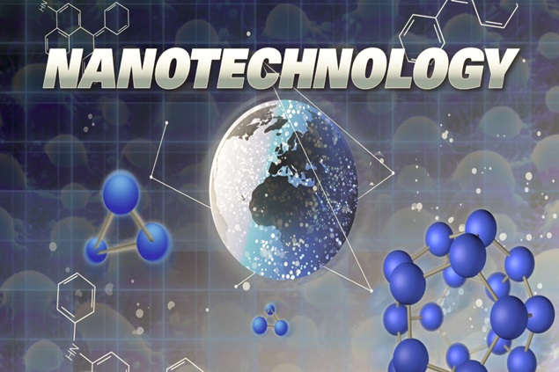
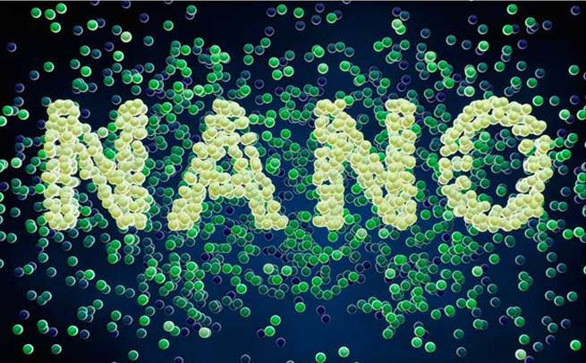
Emergence
During his training at MIT, Dr. Eric Drexler proposed that molecular machines could be made inspired by biological systems, and he first coined the word nanotechnology.

Slide 6
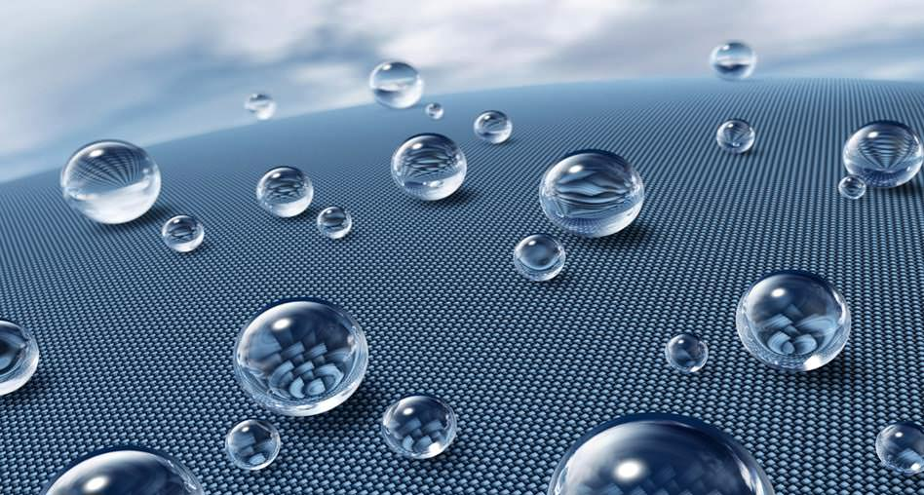
Nanotechnology, which gives new synthesis properties to substances, will shape all branches of industry and every aspect of human life in the near future!

Slide 7
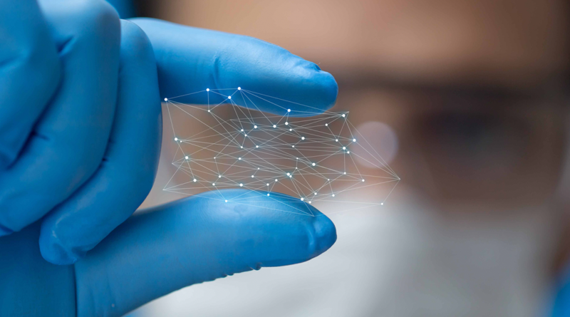
NANOTECHNOLOGY
Understanding and controlling substances with dimensions of 1-100 nm and modifying and making them functional at the atomic level, constructing structures, materials and tools with special methods and techniques at atomic and molecular scale; the ability to measure, predict, monitor and construct activities at this scale and to take advantage of some of the key features of this scale.

Slide 8
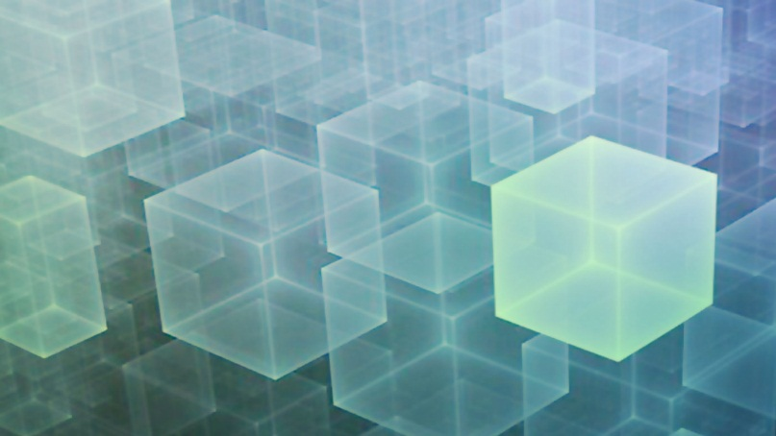
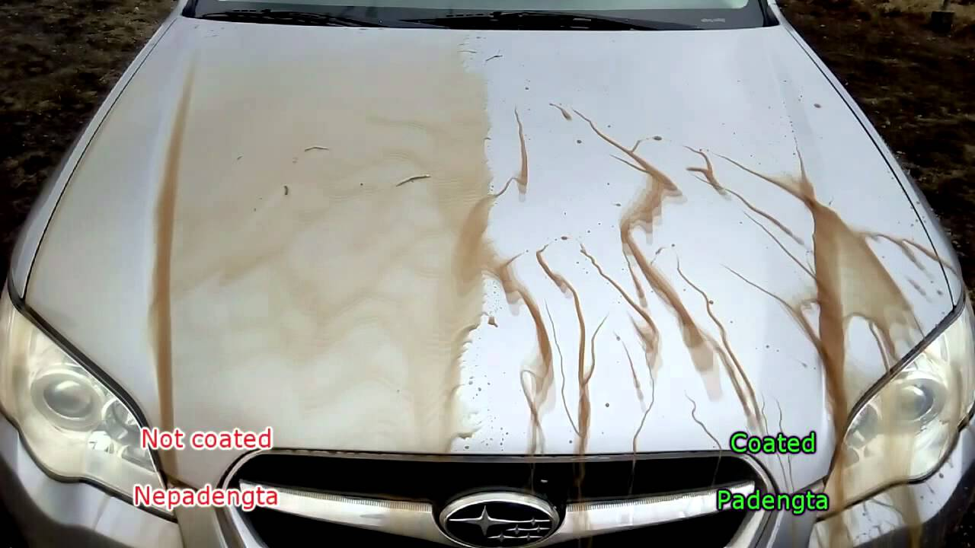
From cars to airplanes, from textiles to space machines, from household appliances to buildings, from mobile phones and calculators to supercomputers, the materials used are improving day by day and as a result, these structures are emerging with superior features. The development of the products here is thanks to nanotechnology.

Slide 9
Objectives of Nanotechnology
Creation of new nanoscale functional materials,
Analysis of nanometer-scale structures,
Understanding of the physical properties of nanometer-sized structures,
Development of nano-sensitive devices,
Development of nano-scale devices,
Control of matter of this size,
Establishing the link between the nanoscopic and microscopic world by finding appropriate methods

Slide 10
Advantages of Nanotechnology
The desire to develop more robust, higher quality, longer lasting and cheaper, lighter, smaller devices are trends observed in many business lines.
The trend of miniaturization forms the basis of many engineering studies. With miniature size production, less material and less energy is consumed.
It provides cheaper and easier shipping.
It offers more functionality and ease of use.

Slide 11
Nano-Made MaterIals
The physical and chemical properties of nanostructured materials (such as optical absorption and fluorescence, melting point, catalytic activity, magnetism, electrical and thermal conductivity, etc.) vary considerably.

Slide 12
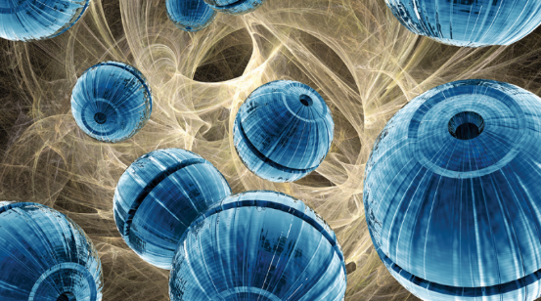
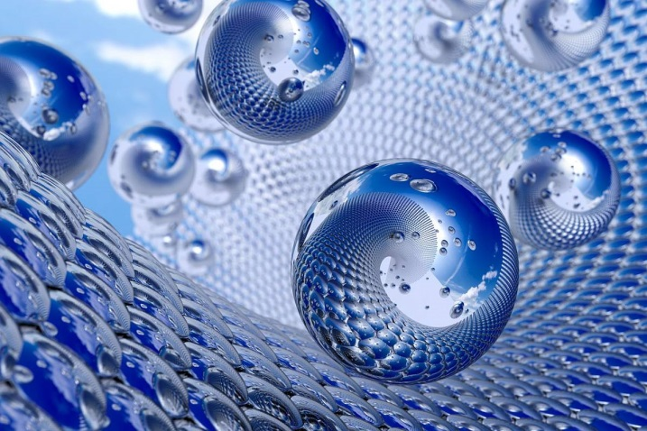
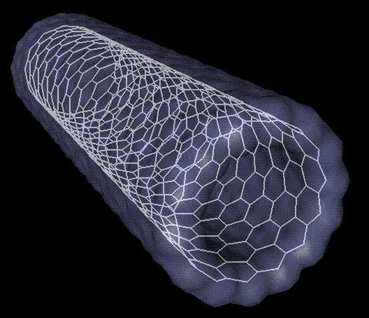
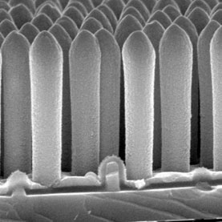
CLASSIFICATION OF NANOSTRUCTURES ACCORDING TO THEIR SIZE
Nanoparticles (nano-scale in 3 dimensions), Nano wires-tubes (nano-scale in 2 dimensions) and Nano layers (nano-scale in one dimension) or nanopores (nanoporous)

Slide 13
NanopartIcles
Nanoparticles are made up of tens or hundreds of atoms or molecules of various sizes and morphologies (amorphous, crystal, etc.).
Some types of nanoparticles are now commercially available as dry powder or liquid dispersions. The latter is achieved by combining nanoparticles with an aqueous or organic liquid to form a suspension or paste.

Slide 14
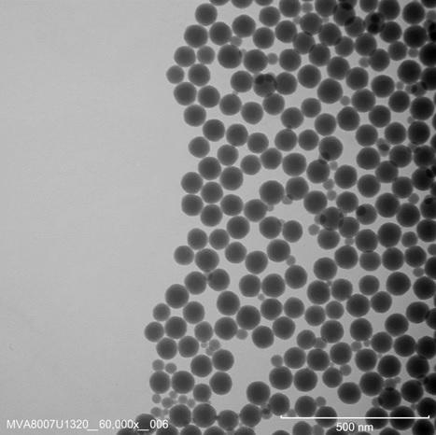
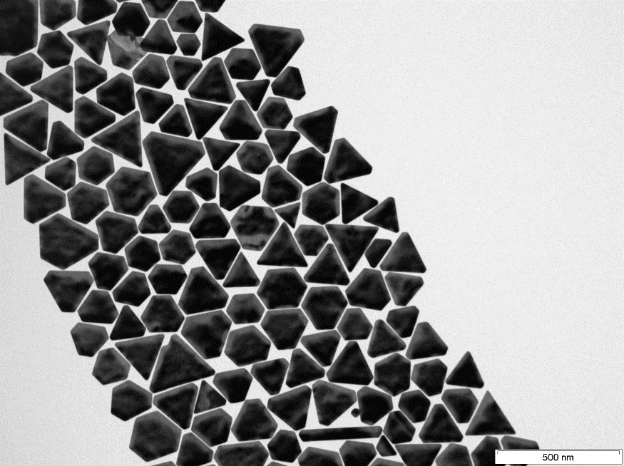
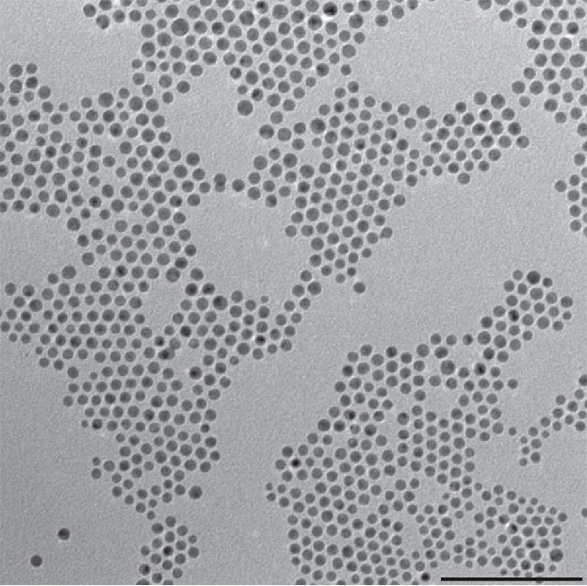
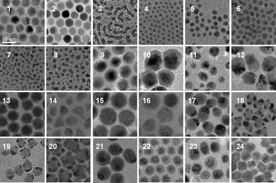
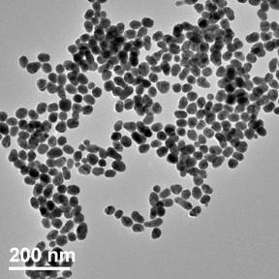

Slide 15
Nanolayers
Nanolayers constitute one of the most important topics in the field of nanotechnology. By engineering surfaces and layers at the nanoscale, a very wide degree of functionality and new physical effects (e.g. magnetoelectronics or optics) can be achieved.

Slide 16
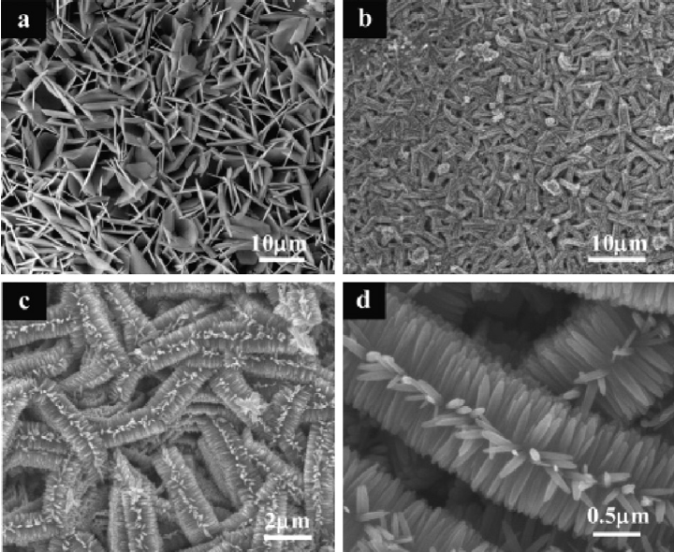
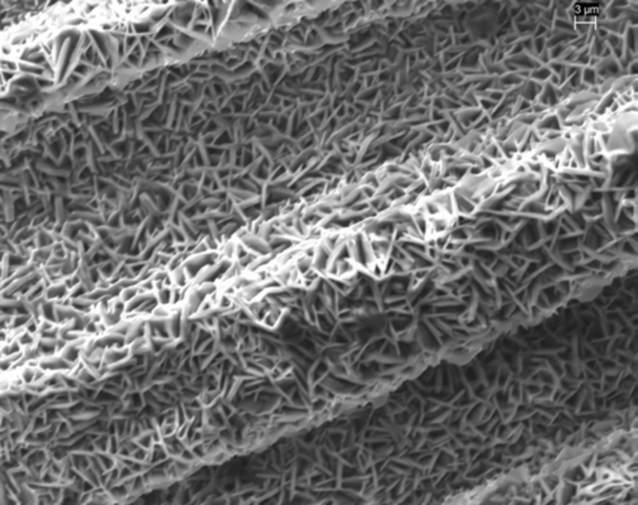
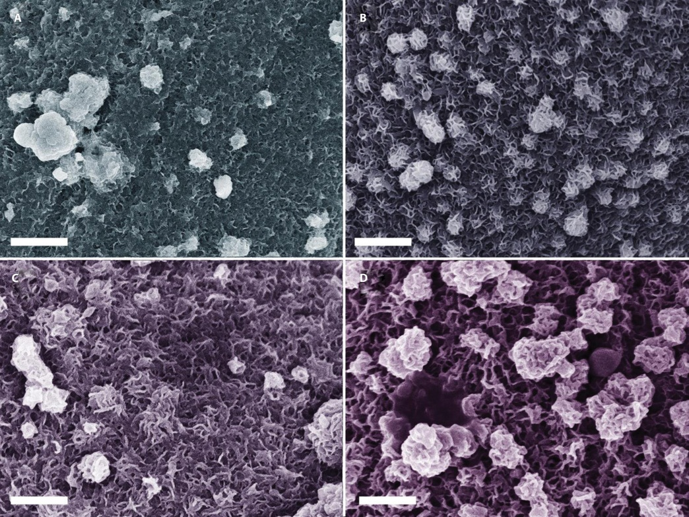
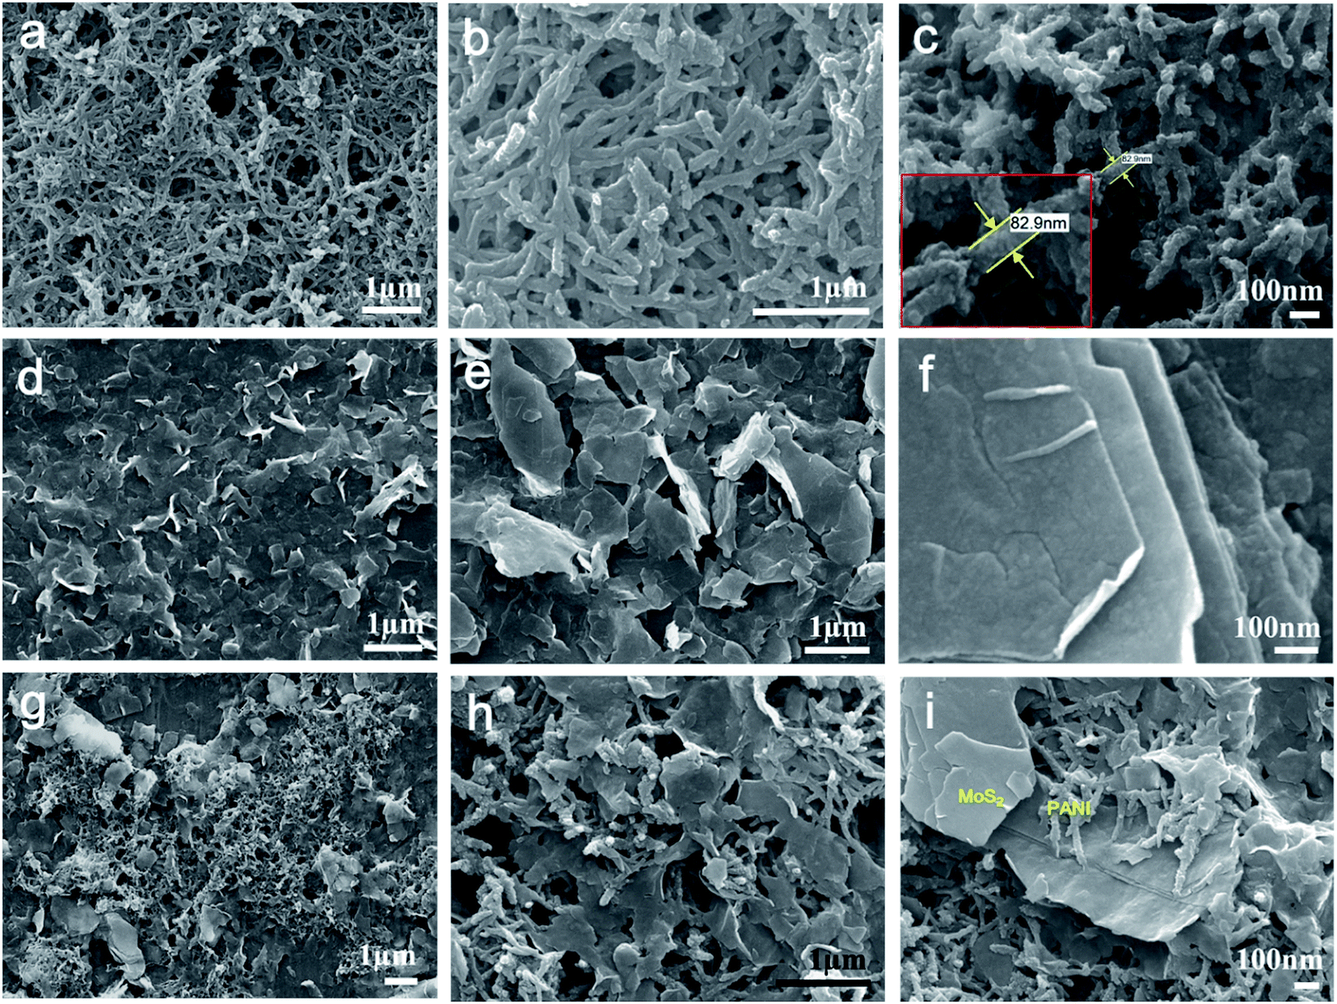

Slide 17
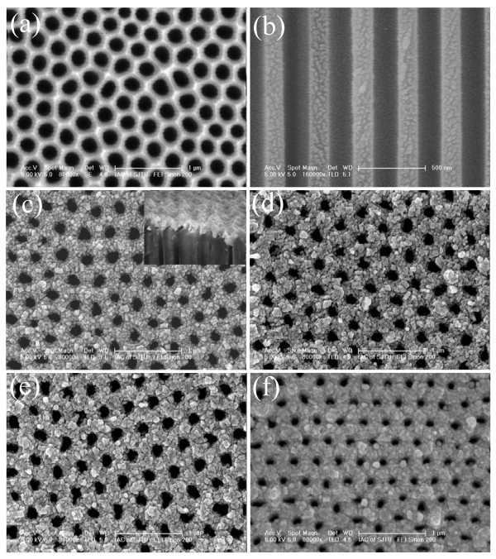
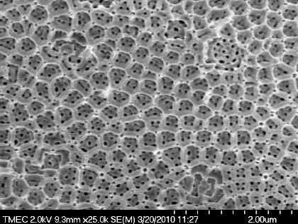
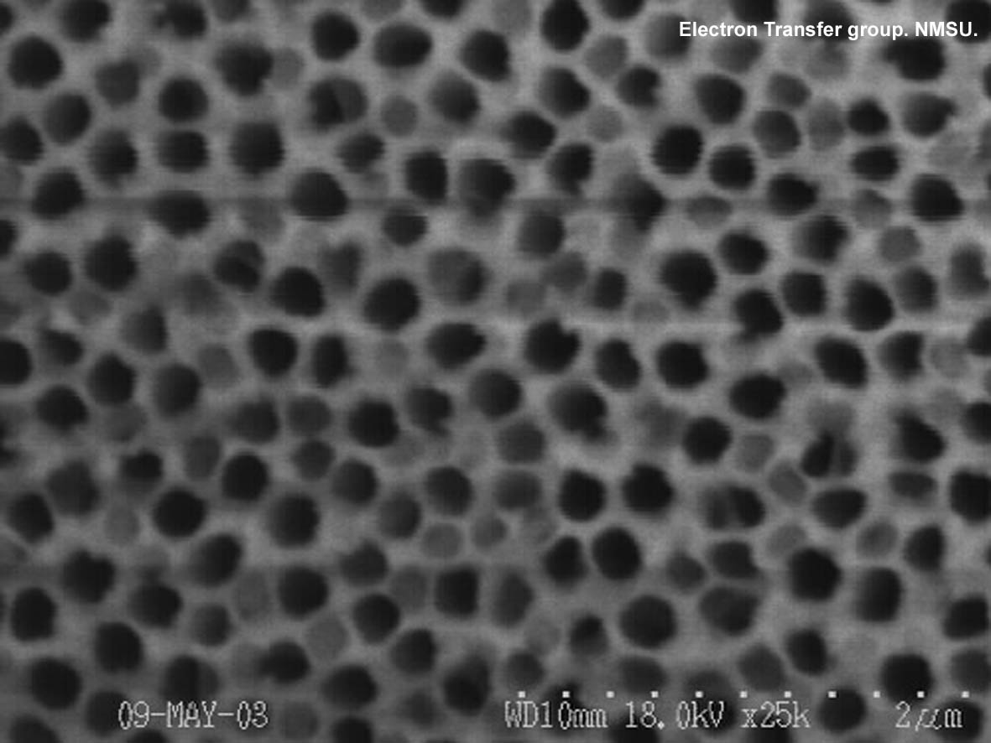

Slide 18
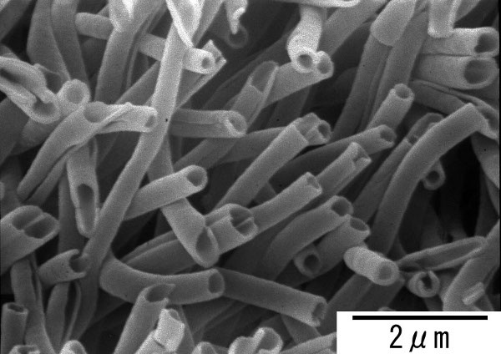
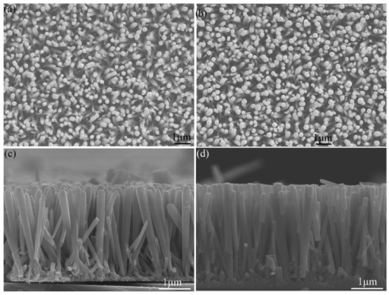
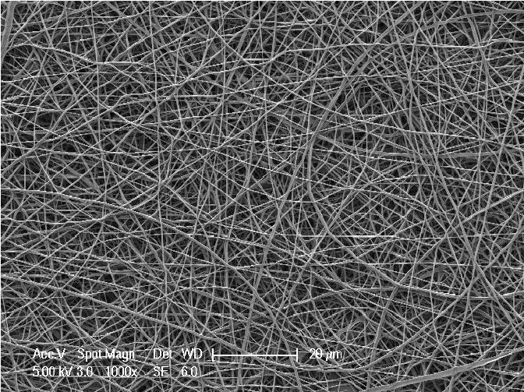

Slide 19
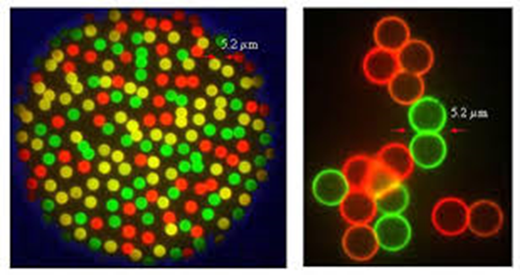
Quantum Dots
With quantum dots, the optical properties of a particle can be very well adjusted and controlled depending on the particle size and composition.

Slide 20
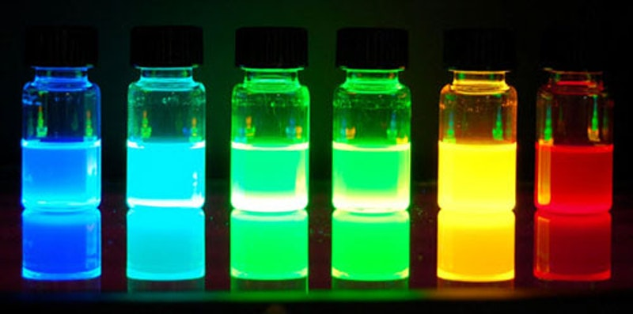
Unlike traditional fluorescence paint, a quantum dot can be made to absorb or transmit all wavelengths of light that scan the spectrum from ultraviolet simply by changing its size.
For example, a particle 3 nm in size from cadmium cellinuride emits green light at 520 nm, while a particle of the same material at 5.5 nm emits red light at 630 nm.

Slide 21
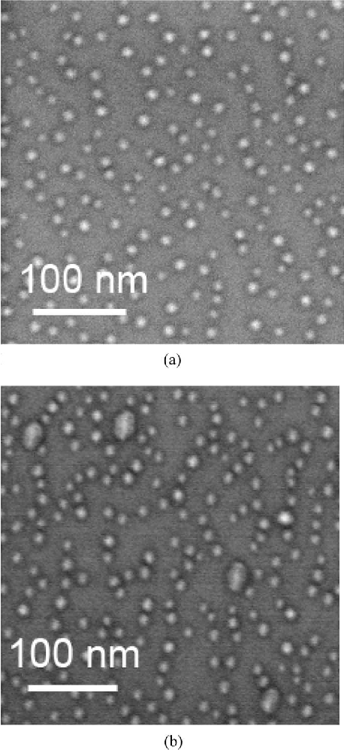
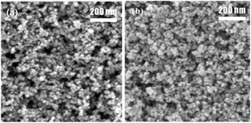
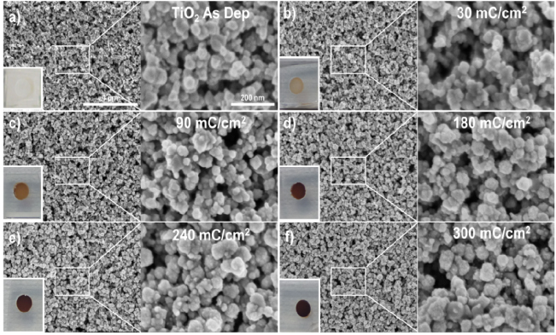

Slide 22
OBJECTIVES OF NANOTECHNOLOGY
Analysis of nanometer-scale structures,
Creation of new nanoscale functional materials, Understanding the physical properties of nanometer-sized structures,
Development of nano-sensitive devices,
Development of nano-scale devices Controlling matter of this size,
Establishing the link between the nanoscopic and microscopic world by finding appropriate methods.

Slide 23
Areas of Use of Nanotechnology
Materials and manufacturing sector (including textiles)
Nano Electrical and Computer Technologies
Medical and Healthcare Sector
Aerospace Research
Environment and Energy
Defense
Sector Biotechnology,
Agriculture and Food

Slide 24
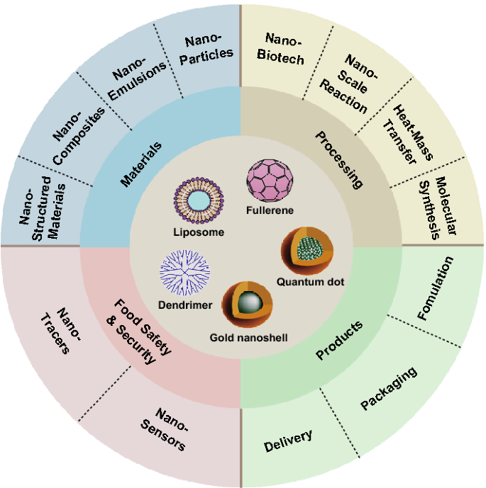

Slide 25
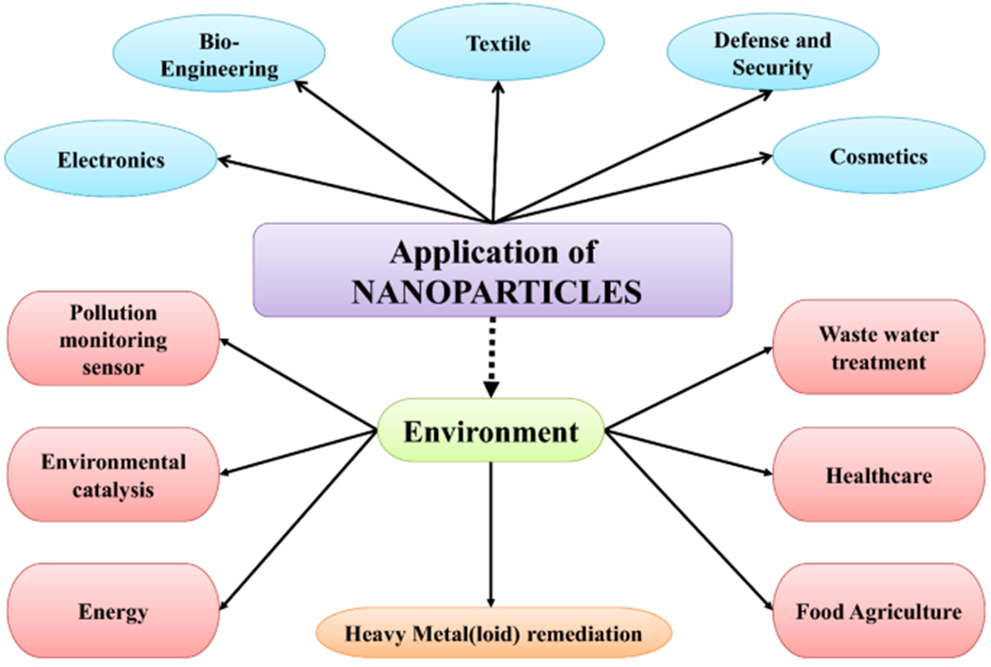

Slide 26
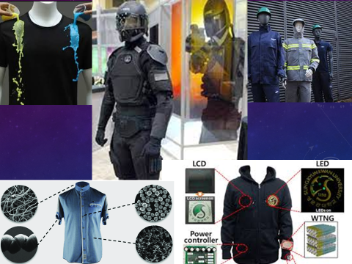

Slide 27
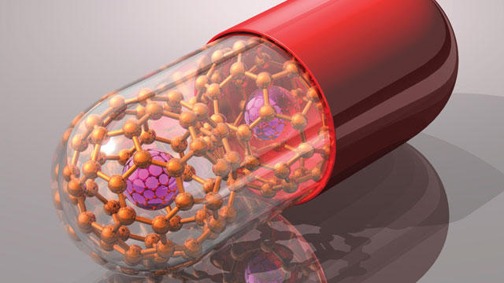
NANOMEDICINE
It includes areas such as nanoelectronic biosensors and molecular nanotechnology that will allow personalized medical applications, especially the use of nanomaterials for diagnostic and therapeutic purposes.

Slide 28
Areas of Nano Medicine
Nanomaterials
Control of surfaces
Intracellular instruments
BioMEMS
Enzyme control
Nanorobots
Nanopores
Cell stimulation and diagnosis
DNA sequencing, manipulation and diagnosis
Diagnostic instruments chips, sensors
Drug release
Nanoterapeutics
Synthetic biology and nanoinstruments
Biotechnology and biorobotics

Slide 29
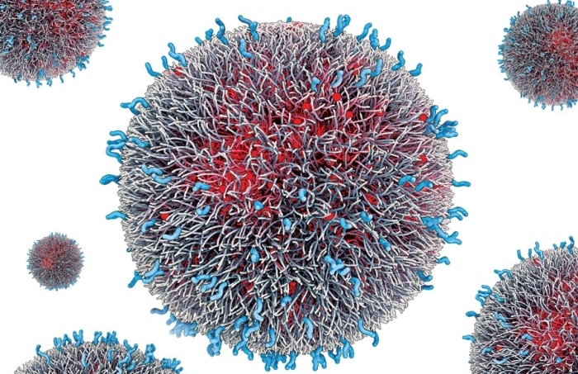
Every event that takes place in our body occurs at the molecular level.
The methods used in medicine today do not manage to get down to the molecular dimension very well.
For example, it is possible that micro-sized robots to be produced with the help of nanotechnology can be delivered to the bloodstream and remove lipids that accumulate on the vessel wall and cause hardening of the arteries, thus preventing heart attack and hardening of the arteries.

Slide 30
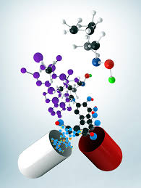
With the application of nanotechnology to the field of medicine, nanorobots will be sent to the immune system, strengthening immunity and providing an organism that is more resistant to bacteria and viruses.
The risk of nanorobots being used as biological weapons!!!
It is also expected in the future that seemingly permanent damage to cells and tissues will be treated with nanotechnological methods.

Slide 31
Thanks to the development of repair mechanisms in the body and the strengthening of the skeletal system, human life can be extended for hundreds of years,
Increasing human memory with nanostructures,
It is possible that the human sense of sight will be extended to the point of having infrared and night vision.

Slide 32
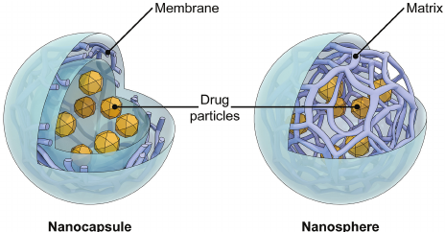
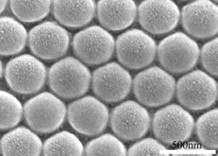
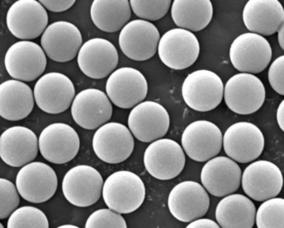
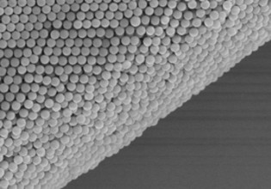

Slide 33
Nano-dIagnosIs
One of the important innovations that nanotechnology has brought to the medical world is the imaging methods recommended instead of the interventional procedures used in the early diagnosis, staging and follow-up of cancer formation, new vascularization and many similar pathologies.
The ability to target nanoparticles, which can be tracked by radiodiagnostic methods, to be specific to tissue type, cell type and even subunits of specific receptors, will enable the introduction of new imaging technologies within the next five years.

Slide 34
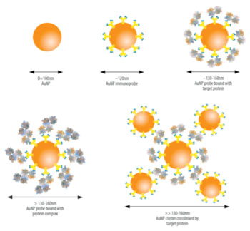
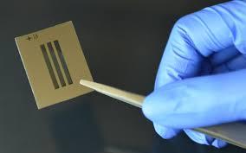
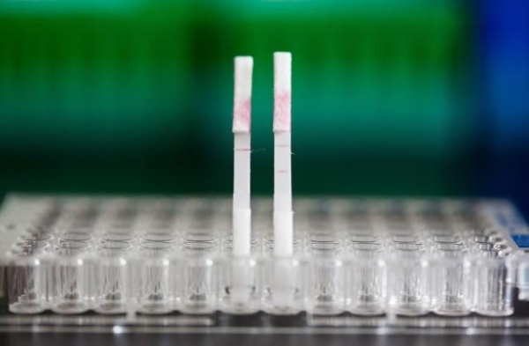

Slide 35
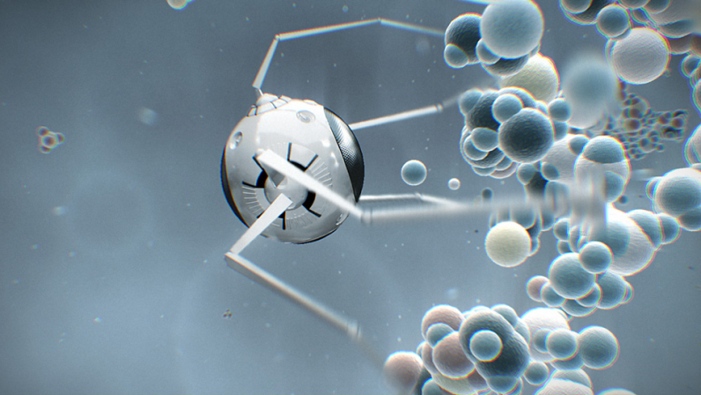
Nanorobot
Transporting the drug to the right destination is especially important for the destruction of cancer cells. Because only sick cells need to be cleaned, healthy cells should not be destroyed.

Slide 36
In 1999, the government of Bill Clinton in the United States launched the first official government program, the National Nanotechnology Initiative, which aimed to increase the speed of research, development and commercialization activities in the field of nanotechnology.
In 2001, the European Union included nanotechnology studies as a priority area in the Framework Programme. Japan, Taiwan, Singapore, China, Israel and Switzerland have launched similar programs, stepping up their efforts to take a leading place in the first global technology race of the 21st century.

Slide 37
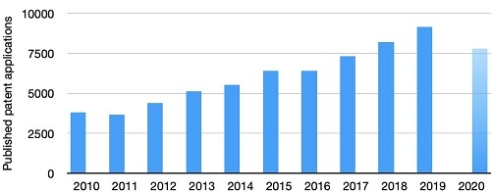
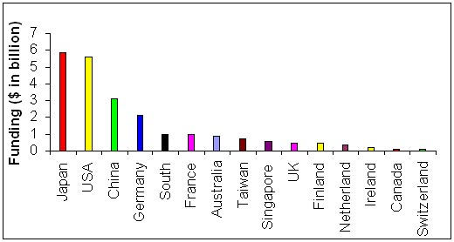

Slide 38
PRIORITY NANOTECHNOLOGY BRANCHES IN OUR COUNTRY'S VISION 2023 STRATEGY
Nanophotonics
Nanoelectronics
Nanomagnetism
Nanomaterial
Nanocharacterization Nanofabrication
Nanoscale quantum computing Nanobiotechnology

Slide 39
WHAT WOULD YOU LIKE TO DO IN THE FIELD OF NANOTECHNOLOGY?
WHAT IS YOUR DREAM???

