Slide 1
Nanoparticle Synthesis Methods
Prof.Dr. İbrahim IŞILDAK
LESSON 2

Slide 2
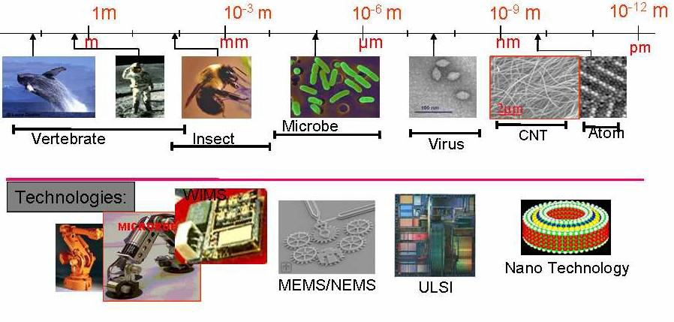
A nanometer is about the size of a medium-sized molecule, for example, a molecule containing 60 carbon atoms.
"Nanoscience" is the science that studies matter and energy at the nanometer scale.

Slide 3
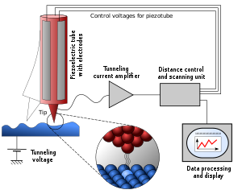
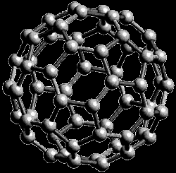
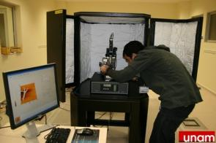
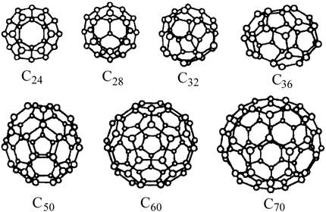
The invention of the "scanning tunneling microscope"
In 1981 to manipulate structures at the nanoscale and take images of them
The discovery of "fullerenes" in 1985 and the invention of the "atomic force microscope"
In 1986 have been crıtıcal turnıng poınts ın nanotechnology!!!

Slide 4
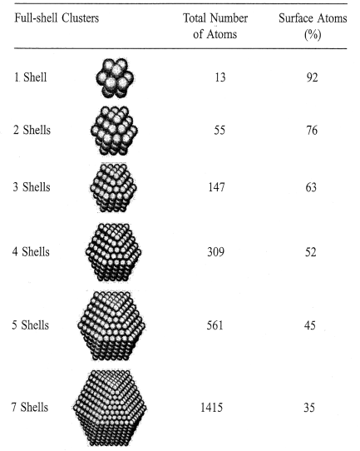
Materials with a size of 100 nm and smaller form the basis of nanotechnology. Nanoparticles exhibit properties that are generally considered different and superior to other commercial materials.
The reasons for the attractiveness of frequently mentioned nanoparticle properties are known today; quantum dimension effects, the dimensional dependence of the electronic structure, the unique characters of the surface atoms and the high surface/volume ratio.
Nanoscale materials have new properties that are very different from the properties of the mass material or the properties of the material in its molecular state.
In nanoscale materials; their interaction with mechanical and electromagnetic waves varies.

Slide 5
UNUSUAL FEATURES IN NANO SIZES
The ratio of surface area to volume increases!!! Therefore, the ratio of surface atoms to volume atoms increases.
Surface/volume ratio for a cube with 1 cm edge for a typical material: 0.6*10-7
Surface/volume ratio for a cube with 1 nm edge: 0.6
Surface behavior suppresses mass material behavior.
Materials smaller than 100 nanometers in size have a very large percentage of surface according to their total volume compared to materials in the mass state.
For example, in materials up to three to five nanometers in size, one-third of the atoms are surface atoms.

Slide 6
UNUSUAL FEATURES IN NANO SIZES
Different physical forces begin to take effect, and some of the forces we are accustomed to exist lose their importance:
gravitation increases and decreases depending on the volume,
while Van der Waals and surface interactions increase and decrease with surface area.
Momentum becomes less important, while thermal effects become more important.
Quantum effects become quite dominant.

Slide 7
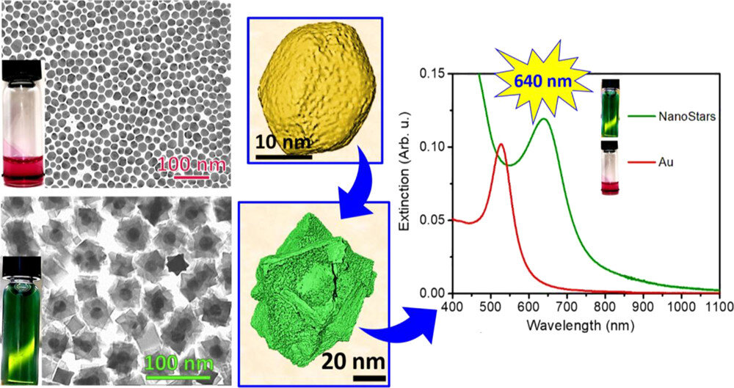
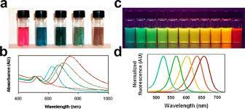
If the propertIes that vary wIth magnItude In nanosIzes are sImply summarIzed; 1- ChemIcal propertIes-reactIvIty-catalytIc propertIes 2- Thermal propertıes- MeltIng temperature 3- Mechanical properties 4-OptIcal propertIes-RadIatIon absorptIon and scatterIng of lIghtheads 5-Electrical propertIes 6-MagnetIc properties-super paramagnetIc propertIes

Slide 8
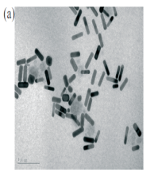
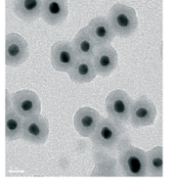
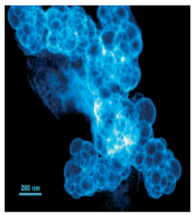
Nanoparticles that form the starting point of nanotechnological materials; they can be produced in a wide chemical range and morphology.
Today, nanoparticles with desired properties can be prepared based on metal, metal alloy, ceramic and polymer with different morphologies such as core-shell, doped, sandwich, cavity, spherical, rod-like and multi-faceted.
Electron microscope images of nanoparticles
(a) gold nanocubics
(b) GoldShell Nanoparticles
(c) In-spaced platinum nanoparticles.

Slide 9
Thanks to the superior properties of nanostructured particles;
They have been used in many industrial areas,
especially in the electrical and electronics,
biomedical, automotive and chemical sectors.
It is seen that different production methods have been developed due to the fact that the physicochemical and morphological properties of nanoparticles are affected by the characteristics of the starting material used.

Slide 10
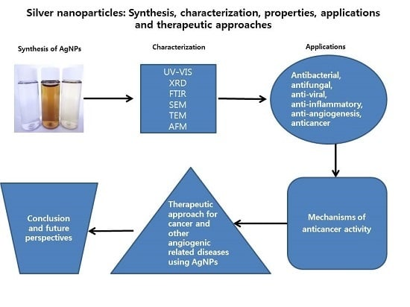
SYNTHESIS AND PROCESS OF NANOMATERIALS
Each different application has one or several specific production, purification and functionalization methods in order to obtain the desired characteristics (efficiently) in the least amount of money and time. In addition, some operations combine steps. For example, the left gel process can combine the formation of particles with their dispersion/integration into the matrix material.

Slide 11
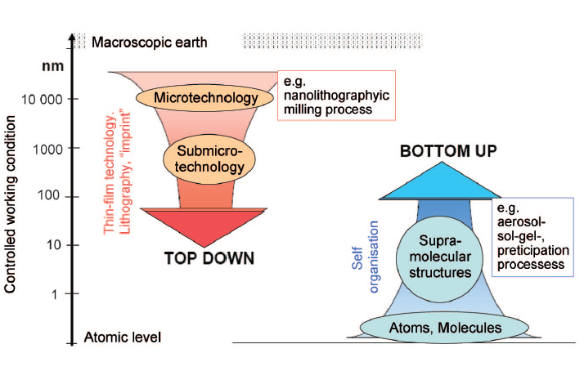
NANOPARTICLE PRODUCTION METHODS
Production can be done in two main ways:
"top-down production approach« (is the reduction of the structural dimensions of microscopic elements to the nanometer scale by special processing and chemical etching techniques—lithography, extremely flawless surface shaping.)
"bottom-up production approach« (the arrangement of atomic and molecular aggregates so that they are brought together in a controlled manner to form larger systems—clusters, organic lattices, supramolecular structures, and synthesized macromolecules.)

Slide 12
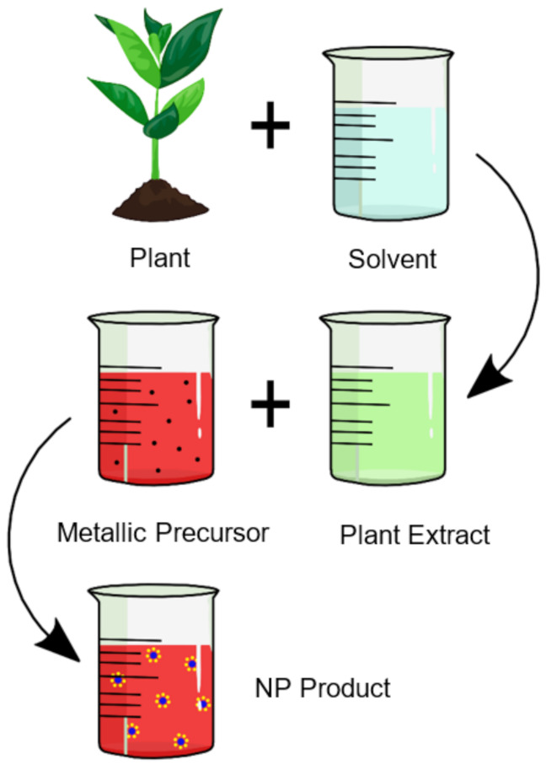
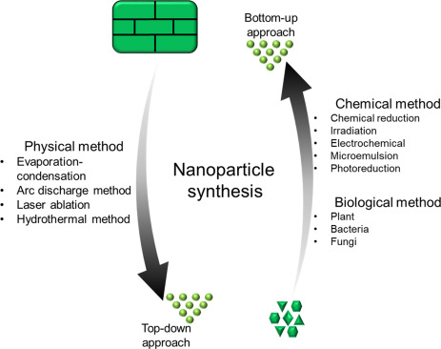

Slide 13
Apart from the top-down and bottom-up production methods used in nano-sized synthesis, it is possible to classify them separately on a physical or chemical basis.
As mechanical energy is used, the methods in which physical properties come to the fore are considered to be physical
and the methods in which chemical reactions are carried out are considered chemically based.

Slide 15
TOP-DOWN Production Technique
In the methods included in the approach from above to the bottom, it is based on the separation of the material into small pieces that can go down to nano size as a result of energizing the volumetric material from the outside by mechanical and / or chemical processes.
The most general examples that can be given are; mechanical grinding and etching They are also called high-energy milling or high-speed mills because much more energy is consumed in these techniques than classical milling processes.
Another important top-down manufacturing approach, especially for the field of optics, is the surface shaping of highly sensitive components, e.g. by mechanical or plasma treatment.

Slide 16
TOP-DOWN Production Technique
Lithography is the key technology used to achieve very small particle sizes in nano components.
There are various lithography methods that are based on different physical principles and have different characteristics in relation to resolution, speed, demolding and transfer steps. Examples include beam lithography techniques (optical, x-ray, ion beam or electron) or soft lithography techniques (printing, stamping, molding and embossing preparation).

Slide 17
TOP-DOWN Production Technique
Lithography, Extreme Ultraviolet Lithography (EUVL)
As a candidate for the next generation microelectronics industry, this activity is heavily supported by associations of industrial companies and public funding programs. EUV lithography at 13 nm will allow to achieve a part size of 45 nm and below.
Soft Lithography (patterning), Nano-stamping
Soft lithography techniques such as nano-stamping are among the cheapest and fastest nanolithography techniques that can be applied in laboratories. A stamp consisting of elastomer, when printed on the substrate, is coated with an ink, which can form a single self-regulating layer.

Slide 18
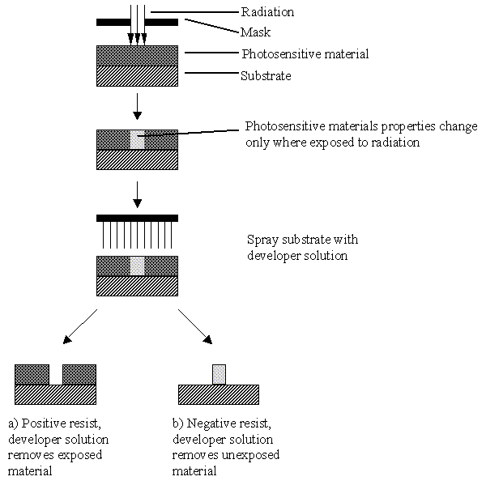
The optical lithography technique, which is the most widely used technology in the field of microelectronics today, is based on the photochemical molding of a resistor by masking and then chemically carving the exposed areas.
The smallest particle size accessible by this method is determined by the wavelength of the lighting. It is estimated that optical lithography can also be applied to sizes smaller than 100 nm using instruments with an ultraviolet wavelength.

Slide 19
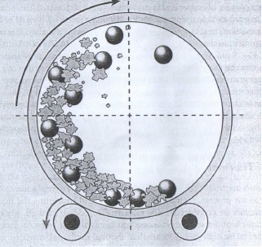
MECHANICAL METHOD
Cutting, rolling, forging, machining, compression, milling and atomizing are the main production methods applied to obtain nano parts. There is a physical application in the mechanical production method, there is no chemical change. For example, tattooing is a production method known for centuries. With forging, gold easily comes to nano thinness.
GRINDING
The material is put into a grinder cauldron with balls inside, as can be seen in the picture. As the boiler is rotated, the balls tighten the material and break it into pieces. The resulting powder is made up of a variety of nano-sized materials. It is necessary to separate the nano-sized ones from these. Grinding is the cheapest top-to-bottom production method. There are other ways to move the balls in the boiler (such as moving back and forth). With this method, particles smaller than 20 nm can be obtained.
Ball Grinder

Slide 20
MILLING
Problems related to the final quality of the produced nanoparticles and the contamination of the nanoparticles by the milling environment can be considered as the main obstacles. The most important disadvantages of the milling technique are identified as high production costs and heterogeneous size distribution.

Slide 21
COMPRESSION METHOD
After grinding, copper and iron materials are compressed under high pressure and temperature. The result is a material consisting of grains with an average length of 40 nm.
THERMAL (THERMAL) METHOD
Eğer yukarıdan aşağı yönteminde sıcaklık uygulanırsa izlenen yöntem ısıl yöntemdir. Yalnız lazerle ısıtma, güneş enerjisi gibi yüksek enerji yöntemini klasik ısıl yöntemden ayırmak gerekir. Isıl yöntemde ısıtılan malzeme ergitilir ve eriyik nano malzemelere dönüştürülür.
SOLIDIFICATION METHOD ON ROTATING COLD SURFACE
In this method, the melted material is sprayed onto a rotating surface by means of a nozzle. The material concentrated on the surface is nano-sized.
GAS ATOMIZER
In this method, high-speed inert gas is sprayed into the metal melt beam. As a result of this collision, nano-sized pieces of metal are formed. As a result of solidification, powder consisting of nano-sized particles is obtained. By compressing this powder, solid material with superior properties is obtained.

Slide 22
ELECTRODYNAMIC ATOMIZER
This system is similar to the electrostatic spraying system. The liquid from the spray gun gushes in the form of a cone. Alternating current is supplied to the liquid. The electric charge on the drops breaks the drops into nano pieces thanks to the Coulomb driving force. Very small nano-particles can be obtained with this system.
HIGH ENERGY METHOD
In evaporation under high-current arc, laser, and solar energy, high electric current, monochromatic radiation, and solar radiation, respectively, are directed to a solid plate to obtain the nanoparticle. With these methods, carbon nanotubes can be obtained.
CHEMICAL METHOD
Combustion is a technique of manufacturing both top-down and bottom-up nanomaterials. Etching is a chemical top-down method, it has various application areas, especially lithography printing).

Slide 23
BOTTOM UP PRODUCTION TECHNIQUE
It is the specific arrangement of atomic or molecular aggregates to transform into larger systems. Methods included in the bottom-up approach; It is defined as the realization of particle formation by absorbing atomic or molecular structures by chemical reactions.
This method mainly draws on the principles of self-regulation, organic/inorganic boundary surfaces, and the selective chemical or physical bonding of molecular systems to prepared surfaces. Various biological supramolecular structures, including double helixes, protein coatings and multi-protein complexes, are formed by such spontaneous self-structuring.

Slide 24
Self-Arranged Single-Layers (KDTK)
Self-arranged monolayers, such as a substrate with a metallic or porous surface, are produced when they are placed in a solution consisting of organic molecules, and then these molecules spontaneously line themselves according to the substrate. After that, this material, which is coated, can be used as a substrate for one layer or for a different compound.
Wet Chemical Synthesis
There are several years of chemical methods that can be used to produce nanomaterials, such as gel-processing or precipitation methods. In these, nanomaterials are obtained by processing the initiating materials in solutions or colloids with special methods. Nanomaterials can be separated and processed to obtain nano-powders or nano-coatings with specific properties.
Accumulation Methods
Classical deposition methods, which have been well established for some time, can be used to produce films, nanoparticles, nanotubes or other structures at the nanoscale; they have wide application possibilities in the field of nanotechnology. is aimed at improving .

Slide 25
Steam Methods
Steam techniques are used for the production of metal or metal oxide ceramics.
Physical Vapor Deposition (FBB)
Physical vapor deposition is the process of atomizing or evaporating a solid source under vacuum and depositing this substance on the substrate to form a coating. Usually this method is expensive, and the resulting materials are in low quantities.
Chemical Vapor Deposition (ENT)
In its most basic terms, it is the solid accumulation of the components in the gas phase on a heated surface under the vacuum/argon atmosphere.
The cost factor also applies to the ENT method
Thermal Decomposition
If we give an example of this method, solid silicon nanoparticles are formed by thermal separation of silane gas (SiH) in oxygen-free environment.

Slide 26
COMBUSTION
For example, if carbon graphite is burned under appropriate conditions, single and multi-walled nanotubes are formed in its flame. The combustion method is highly advanced to create multi-walled nanotubes in nano composite materials.
LIQUID INTEREST METHOD
Most chemical reactions occur in the liquid phase. Because the liquid state provides the most suitable environment for the materials to come together and react. Most often in biological phenomena occurs in the aqueous environment. There is a wide range of liquid phase production methods. The best nanoparticle is obtained by the liquid phase method. The nanoparticles obtained by this method are dispersed and clumping can be reduced or prevented. The nanoparticles produced are of the same size with a very small difference, and the chemical composition and morphology can also be controlled by this method.

Slide 27
The most important liquid phase methods are;
Molecular self-making method:
In this method, when the appropriate conditions are met, the molecules suddenly come together to form mass with certain properties. However, the reaction needs to be controlled because the formation may not remain nano-sized and the mass may continue to grow.
Supramolecular chemistry method:
Supramolecular chemistry is a new branch of chemistry. It is a soft matter chemistry and is a complete bottom-up production method.
CHEMICAL SYNTHESIS / SOLUTION METHODS
Chemical-solution methods are the most popular methods for the production of nanoparticles. Oxide is the result of separating the micro-emulsion of the appropriate solvent and surface regulator mixture of the salts created by reaction initiators such as water etc. and drying the nanoparticle as a result of drying.

Slide 28
SOL-GEL METHOD
Sol-gel synthesis, based on the hydrolysis and condensation of molecular pre-initiators, is used in a wide range to prepare inorganic materials. The sol-gel technique is a very useful method of obtaining both inorganic and organic-inorganic hybrid polymers. The main advantage of this technique is that the entire process is carried out in simple conditions. In contrast to solid-state processes, the sol-gel process offers molecular level control of the reaction pathway during the conversion of pre-initiator types into the final product. Thus, the sol-gel process allows the synthesis of highly purity and homogeneity, uniform crystal morphology and well-defined nanoparticles.
ELECTROLYTIC - ELECTROSTATIC PRECIPITATION METHODS
The electrolytic method is a galvanic (metallic thin surface with electrochemical methods) coating method. The method for nano-sized thickness is applied under strict supervision. The method of precipitation without electricity is not the galvanic method. Here, the surface to be coated is in a metal salt and the metal atoms precipitate above the surface. Electric-free gold plating has wide application in semiconductor devices and metallized ceramic parts.

Slide 29
Other Production Methods
Examples of "microwave techniques" are expensive due to their energy conversion inefficiencies. Other methods include "ultrasound techniques" (which can be used in conjunction with other techniques) and "electron deposition processes." The obstacles associated with these are of a technical nature. The "supercritical fluid (SDG) deposition process" is a highly complex process and requires the use of expensive equipment.
"Biological/biomimetic" techniques also face significant technical hurdles.
A better scientific understanding of these is another challenge that needs to be overcome.
Other production techniques mentioned include "incineration processes via urea or citric acid" that can be adapted to continuous production, delamination of layered materials (e.g. natural clays, synthetic CVD) and "controlled crystallization from amorphous initiators" (e.g. for metal nanoparticles). According to some experts, the latter method is quite suitable for preparing nanoparticles embedded in an amorphous matrix

Slide 30
MAJOR NANOPARTICLE ACQUISITION PRINCIPLES
Chemical Vapor Thickening Method
The chemical vapor densification method (CVC) was first developed in Germany in 1994 and is an ideal method for the production of large amounts of nanoparticles. In this method, compounds such as metalorganics, carbonyls, chlorides and hydrides that can easily pass into the vapor phase are used as the starting material. The biggest advantage of the CVC method is that it is possible to produce almost any variety of materials in a wide range of chemical compounds due to the easy commercial availability of starting materials with different chemical contents. The preparation of non-agglomerated nanoparticles and the ability to produce optionally core-shell or hollow particles are recognized as another advantage of the method. The method is basically based on the conversion of the material in the gas phase into particles by thermal disintegration. Process flux; In short, gas flux is given to the region where the starting material passes into the gas phase and the steam is transported into the furnace, also called the reactor, where it is thermally disintegrated. Although inert gases such as He, Ar or N2 are used as the carrier gas, gases such as H2, CO or CH4 can be used in addition to the carrier gas for the reduction of the compound. Clusters of atoms or nanoparticles formed as a result of thermal disintegration are collected by different dust collection methods at the furnace exit. The most commonly used of these is the precipitation of particles in a closed compartment of a rod through which liquid nitrogen passes. The following figure is a sematic representation of the CVC method.

Slide 31
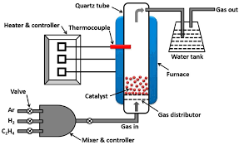
The size, morphology and crystallinity of the particle produced in the CVC method are mainly influenced by the flow rate of the carrier gas, the composition of the starting material, the processing temperature, the type of carrier gas and the reactor geometry.

Slide 32
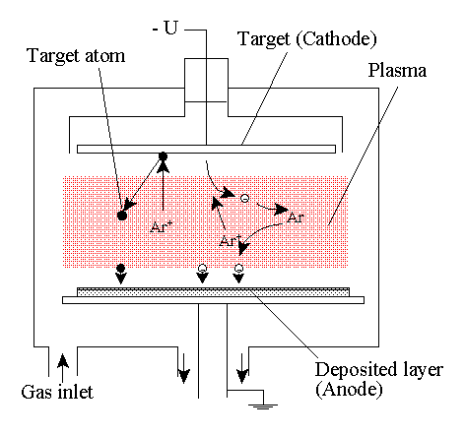
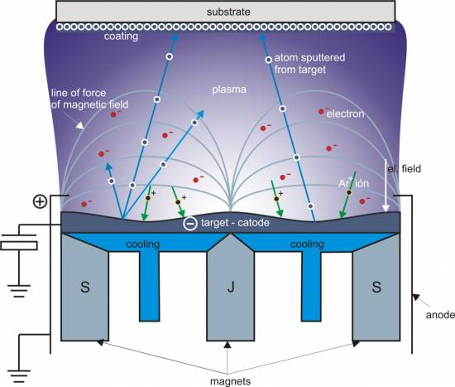
Physical Steam Deposition Method
Physical vapor deposition (FBB) is the process of atomizing or evaporating a solid source under vacuum and depositing this substance onto the substrate to form a coating. With this technique, ceramic coatings with very suitable properties (very good adhesion to the surface, high hardness, density) have started to be produced for wear and friction applications. The FBB method can be applied at lower temperatures than the chemical vapor deposition (ENT) method. Therefore, the effect of high temperature, which adversely affects the underside properties in ENT processes, has been eliminated.

Slide 33
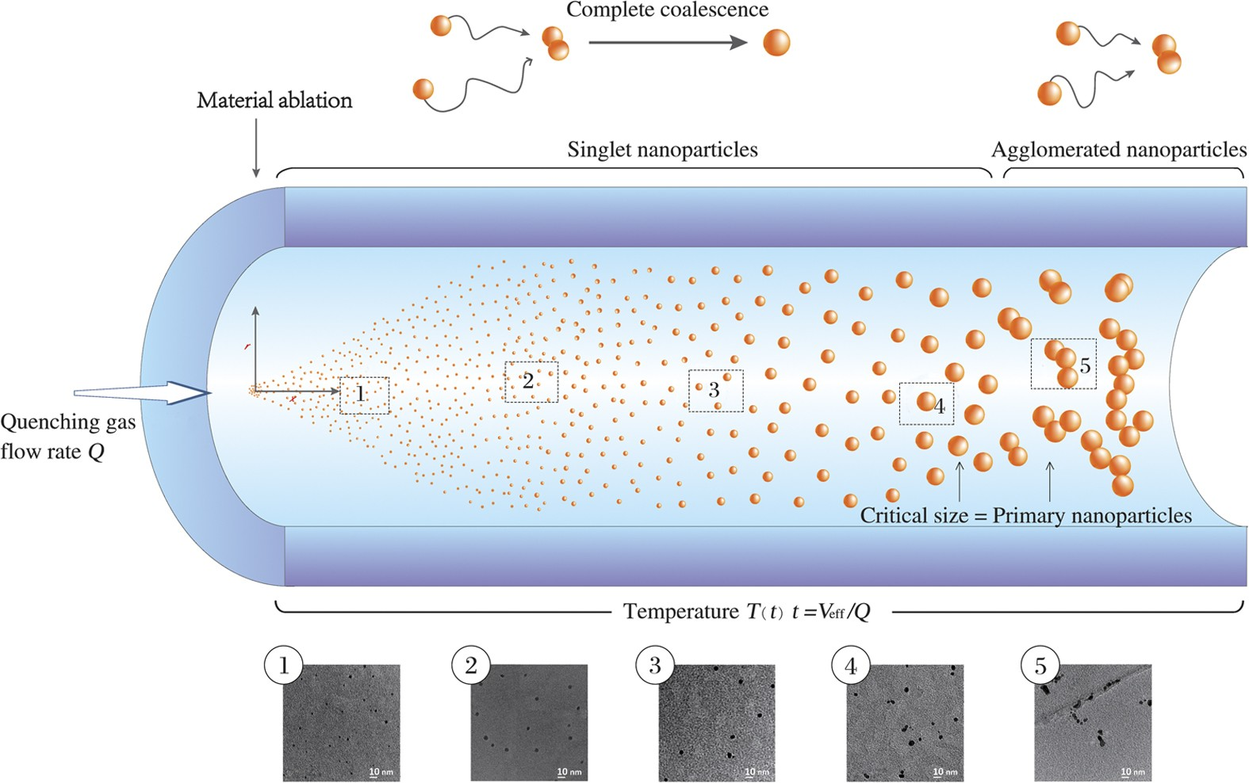
Hydrogen assisted Reduction Method
It is a method that realizes the production of metallic nanoparticles by reduction in the gas phase, and when the studies are examined, it is seen that it is used especially in the laboratory synthesis of iron group metal (Fe, Ni and Co) nanoparticles. As seen in the figure below, the method; It consists of particle formation, particle collection and gas washing steps.

Slide 34
The initial solution used in the first phase of the method is evaporated and transported to the preheated region with a carrier and/or reductive gas and then to the warmer region where the reduction will take place and particle formation is realized. During processing, hydrogen gas can be used as both a conductor and a transporter, as well as as a carrier in inert gases such as nitrogen and argon. The concentration of the reactants, the reaction temperature, the temperature of the preheated region, and the duration of the steam/particle in the furnace are the main factors that control particle size, size distribution, and crystallinity.
Noble Gas Condensation Method
First used by Birringer and his colleagues in 1984 for the production of nanoparticles, the inert gas densification (IGC) method is the oldest technique used to produce nanocrystalline metals and their alloys directly from a century-old saturated vapor phase. Due to its versatility, the this method is currently used in the synthesis of laboratory scale nanostructured powders. In the method, metallic, ceramic and composite nanoparticles can be produced, as well as oxides or other compounds using a reactive gas such as oxygen. The method is technically similar to heating water on a cold day. The heated water begins to lose heat due to its interaction with the environment by evaporating and the density of water droplets occurs on the cold glass surface. The inert gas intensification technique, the sematic appearance of which is given as follows, consists of the following processes:

Slide 35
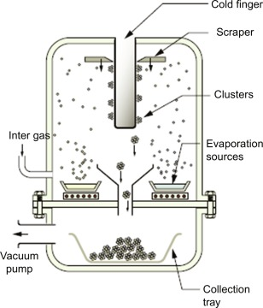
Before the steam is formed, the system is taken into vacuum and filled with 1 – 50 mbar inert gas, and then the starting material is evaporated using any energy source such as heat, laser or electron beam. Evaporation is carried out in W, Ta or Mo crucibles. Evaporating atoms or molecules gather homogeneously to form clusters of atoms in the immediate vicinity of the heat source. On the steam source, a century of saturation is reached and nucleation and particle formation occurs in the region close to the liquid metal when the evaporating atoms of the starting material and the gas molecules existing in the system lose their energy as a result of the collision. For this reason, the presence of high gas pressure increases the number of distortions, which allows very fine particles to form with faster cooling.

Slide 36
The size of the synthesized nanoparticles is affected by the duration of their stay in the system, the evaporation rate of the starting material, the ambient temperature, the gas pressure and the type of inert gas. The increase in the mass of the inert gas used will also cause an increase in the particle size.
Nanoparticle Production from Microheterogeneous Systems
Synthetic methods for the production of nanoparticles from the molecular level with a bottom-up approach are based on the use of different microheterogeneous systems. The aforementioned microheterogeneous systems can be in the form of liquid crystals, gels, mycelial solutions and microemulsions. These are fast and low-cost techniques, making it possible to synthesize water-soluble inorganic and organic materials in combination with metals, oxides, sulfates and water-insoluble materials at the nanoscale. In addition, the method can be easily used in the production of core-shell, doped, sandwich or porous nanoparticles. Microheterogeneous systems have practical applications as the end product. Such systems, which can have magnetic, electrical, wetting and / or lubricating properties and which are increasingly of interest day by day, are called nano fluids. In particular, magnetic nanofluids have found wide use from the medical sector to the automotive sector today.

Slide 37
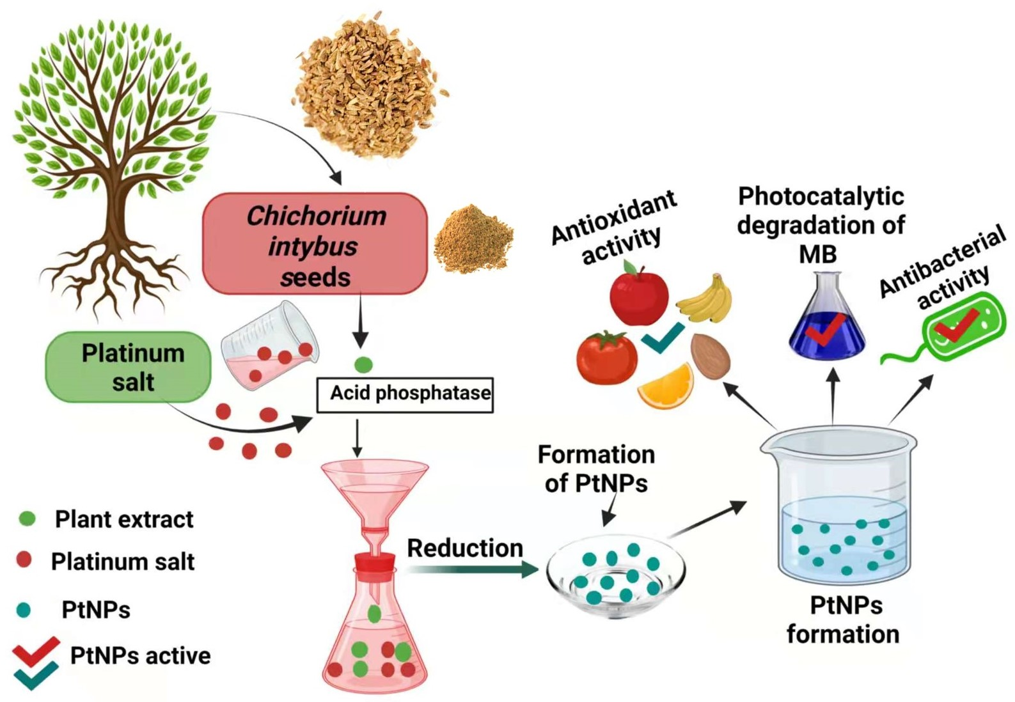
The synthesis of nanoparticles from microheterogeneous systems occurs as a result of successive processes. The most important steps of the method are the selection of the appropriate microheterogeneous system according to the desired nanomaterial, the examination of the structures of the reactants after the analysis and the characterization of the physico-chemical properties of the system resulting from the mixing process and time dependence.
The following is the nanoparticle production flux diagram of the microheterogeneous system.

Slide 38
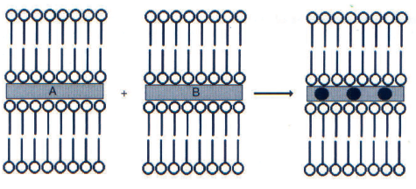
This method is suitable for synthesizing metallic nanoparticles and magnetic nanoparticles containing iron. The most common example is the production of magnetic g-Fe2O3 nanoparticles from liquid crystals in the family of microheterogeneous systems. In this process, iron oxide powders are synthesized as a result of acidification and oxidation with ferric nitrate following the addition of alkali to aqueous solutions of Fe (III) and Fe (II) salts. CoxFe3-xO4 nanoparticles with magnetic properties and dimensions of 10 nm are synthesized as predicted from their aqueous cosals by adding Fe(NO3)3 and Co(NO3)2 to sodium dodecylsulfate co-assemblies and by adding NaOH. As in the examples given in summary, metallic, semiconductor and magnetic nanoparticles can be easily produced in different solutions.
Sematic view of nanoparticle synthesis in liquid crystals

Slide 39
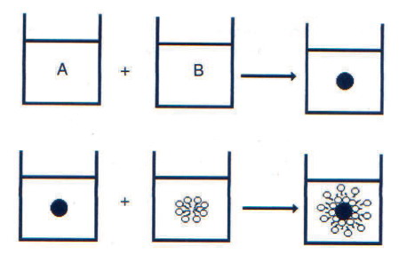
The fine size of the synthesis process, which usually takes place at room temperature, allows for polydispersion and the preparation of 1D, 2D and 3D nanoparticle sequences. In addition, since it is based on the nanoparticle synthesis approach from the atomic/molecular size, the nanoparticle size and shape are controlled by the selection of the appropriate microheterogeneous system. This method is suitable for the synthesis of metallic nanoparticles and iron-containing magnetic nanoparticles. Nanoparticles can be synthesized from liquid crystals.

Slide 40
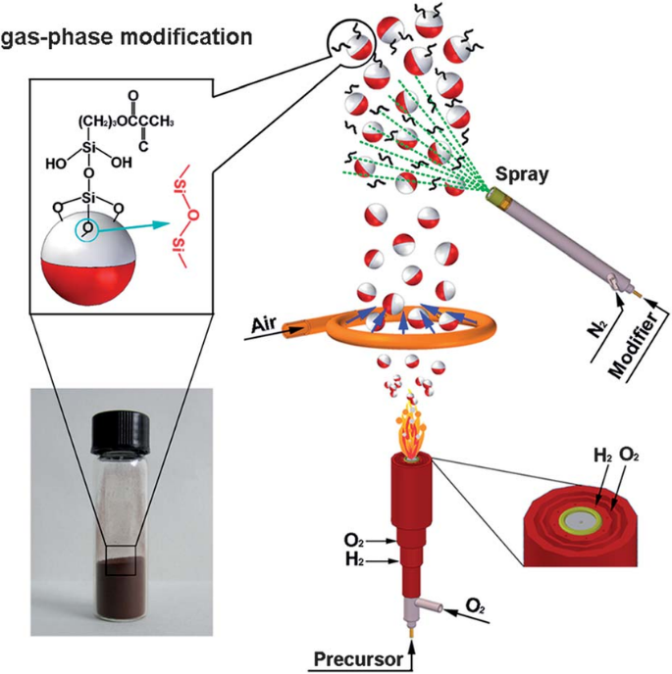
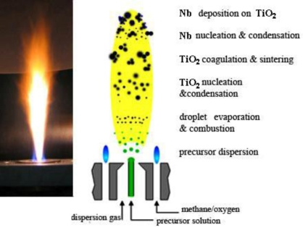
Flame Synthesis Method
The flame synthesis technique, which is widely used for the production of nanoparticles in commercial quantities, has different advantages from other methods. These are chemical composition range, control of particle morphology, control of particle size distribution and low cost. Due to the high oxidizing effect of the flame medium, the method is particularly suitable for the production of oxide nanoparticles. In the flame synthesis technique, which is among the methods of synthesis from the vapor phase, metal halides with easy volatility are used as the starting material, while the formation of atomic clusters and nanoparticle formation are realized by the combination of these as a result of the reactions in the gas phase that occurs by transporting the formed vapor phase to the flame environment with a gas such as air, hydrogen or oxygen. The sematic appearance of the flame synthesis method, which is also used in the production of shell/core nanoparticles, is given as follows.

Slide 41
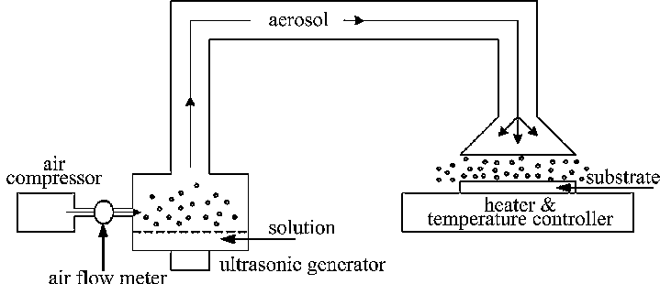
Ultrasonic Spray Pyrolysis Method
The technique of obtaining spray by ultrasonic atomization has long been known for its applications and thin-film production, especially in the medical field. However, the production of submicron-dimensional particles by this method has been carried out for the last twenty years. This method was developed at the Grenoble Nuclear Research Center (CENG) and patented in 1971 under the name of Pyrosol technique and has been used for different applications for years. Especially the ultrasonic atomization technique has come to the fore in the production of superior quality semiconductor oxide thin films.
Since then, due to the ease of control and reliability of its system, it has been used in Grenoble and many laboratories all over the world to obtain different materials in the form of thin films or very fine powder.
In this method, cleaned leaching solutions of high-purity metal salts or secondary raw materials are used. The process consists of the formation of discrete droplets from the initial solution in aerosol form, the realization of thermal breakdown and the control of phase change. The aerosol can be easily created ultrasonically by directing the high-frequency (100 kHz-10 MHz) ultrasonic wave used to the gaseous liquid interface.

Slide 42
Mechanical Etching Method
The production of powder particles by mechanical etching (Ma) method was developed for industrial applications in the 1970s, and the production of new alloys and phase wives is successfully realized thanks to this technique. In this method, which has a production approach from top to bottom, nanostructures are formed not in the form of collective aggregation from atomic or molecular patterns, but by the separation of coarse-grained structures at the end of plastic deformation. In mechanical hanging method, amorphous or nanostructured materials such as alloy, intermetallic, ceramic and composite can be produced in a wide range of components. The industrial use of the technique is limited to hard and crunchy materials that can be easily broken during processing. Many different ball trainers used for this purpose are listed below;
• Abrasive Trainers
• Planetary Trainers
• Pulsating Trainers
• High Energy Ball Mills

Slide 43
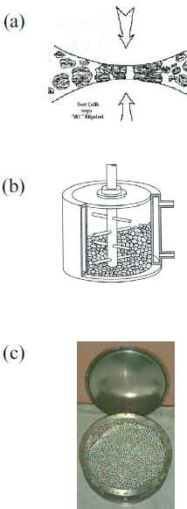
The energy required for the dust to decrease to its fine particle size is obtained from the high frequency and low amplitude vibrations used. In the form of the sematics of the mechanical hanging process and the ball inflator view are given. Mechanical hanging operations include (a) and (b) schematic vision, and (c) ball trainer.
The biggest disadvantage of the process is the mixing of impurities from the ball compound used into the material composition ground during mechanical hanging. In addition, metallic particles are oxidized in processes that take place in the open atmosphere or nitrogenous structures are formed on the surface. However, this problem can be eliminated by filling the grinder chamber with inert gas and using suitable sealed gases.

Slide 44
SOL-GEL Method
This is not a new method, but it opens up a lot of possibilities for nanotechnology. It has wide application to obtain colloidal nanoparticles from the liquid phase. In recent years, it has been developed a lot to produce advanced nanomaterials and coatings. It is particularly suitable for the production of metal oxide nanoparticles and composite nanoparticles. The low temperature requirement is a great advantage.
Sol-gel technology is the general name given to the production technique of ceramic, glass and composite materials for different application areas based on the solution form. Metal alkoxidesolutions or inorganic compounds such as metal powders, nitrates, hydroxides and oxides are combined with water and acid in certain proportions to form a solution and this solution is mixed at certain temperatures, resulting in a series of successive chemical reactions in the solution and electro-chemical interactions of the surface charges of the particles ...

Slide 45
Sol; is a stable suspension of colloidal solid grains in liquid. These solid grains must be small enough as they are responsible for dispersion forces greater than gravity. The smaller these particles are in reality, the more accurate it is to talk about the molecules in solution. Particles defined as colloids are particles with dimensions of 500 nm and below that are too small to be seen by the eye. These particles cannot be seen with a normal optical microscope. Because their maximum size is equal to the wavelength of light.
Jel; Kolloidal parçacıkların çöktürülmesiyle elde edilen ve bol miktarda su içeren çökeleklere denir. Jel, katı ve sıvı faz arasında bir ara fazdır.
Steps of the Sol-gel Method
Alkoxide Hydrolysis
2. Peptidization or polymerization
3. Gel Extraction
4. Calcination/Sintering
The main areas of use of the Sol-Gel Method are: Making wear-resistant coatings, Coatings for optical purposes (e.g., TiO2-SiO2 coating without reflectivity, lenses and similar applications), Fiber optics, Production of high-strength fiber (such as Na2O-ZrO2-SiO2fibers), Production of electronic and magnetic materials (such as V2O5, WO3, Fe2O3).

