Slide 1
Graphıcal velocıty analyses
Meral BAYRAKTAR

Slide 2
Defınıtıon of velocıty

Slide 5
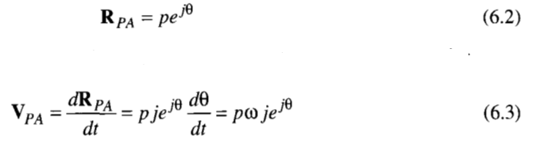

Slide 17

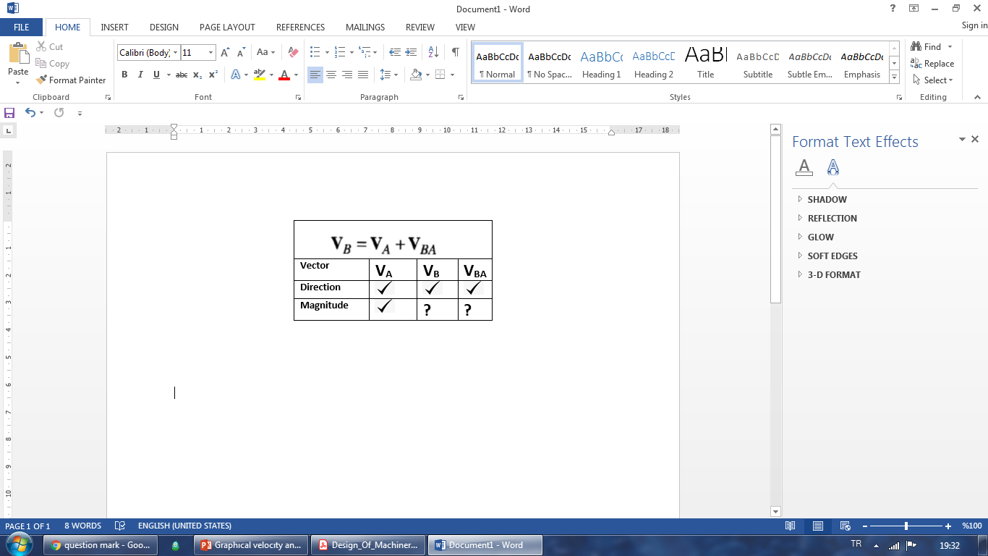
…mm
V_{BA} =…..mm
+Ov
2
measure
……mm
3
V_{B} =…..mm
1
Notes:
fdfdfdfdf

Slide 20
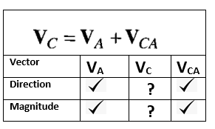
1
+Ov
Direction of V_{C}
is obtained
4
5
measure
……mm
3
2

Slide 22
