Slide 1
Busıness englısh
2018-2019 SPRING SEMESTER
THE PRESENTATION

Slide 2
INTERVIEWER: FERIDE BODUR INTERVIEWEE: TUGBA AYDIN DATE: 06.04.2019 VENUE: YEDITEPE UNIVERSITY \KAGISDAGI\ ISTANBUL

Slide 3
About Tugba Aydın
Tugba Aydin was born in 1984, in İstanbul. She graduated of Anadolu University from the business management department. She started her career in Gemak Shipyard in 2005. After working there as an administrative assistant for 5 years. And than she started to work at Yeditepe University as an assistant in 2010. She promoted over time to become a manager. She has been working in that position in the human research department of Yeditepe university since 2010

Slide 4
About Yeditepe University
Yeditepe university was founded in 1996 by the Istanbul Education and Culture Foundation (ISTEK). Yeditepe University aims to educate students who are inquisitive, innovative, well-equipped with technological skills, well-versed in world culture, have a solid identity, and are equipped with all the qualifications required by the business world. With its up-to-date academic programs and training, Yeditepe University offers an education compatible with the expectations of the information age.

Slide 5
About the Human Research Department
Human resources managers plan, direct, and coordinate the administrative functions of an organization. They oversee the recruiting, interviewing, and hiring of new staff; consult with top executives on strategic planning; and serve as a link between an organization’s management and its employees.

Slide 6
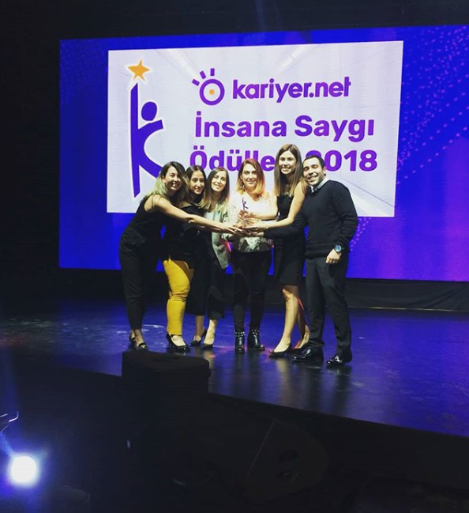
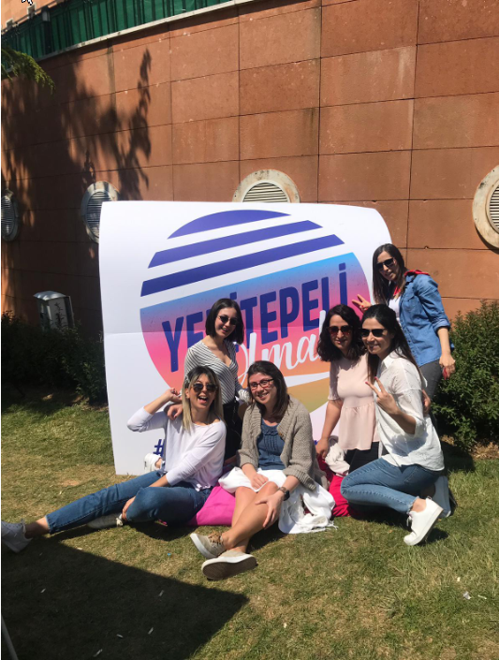

Slide 7
Me: What is your department responsibility for?
Mrs. Aydin: Our department’s responsibility is to manage and
report our employee’s servers. Plan and coordinate an
organization’s workforce to best use employees’ talents.
Coordinate and supervise the work of specialists and support
staff. Oversee an organization’s recruitment,interview,
selection, and hiring processes. Handle staffing issues, such
as mediating disputes and directing disciplinary procedures.

Slide 8
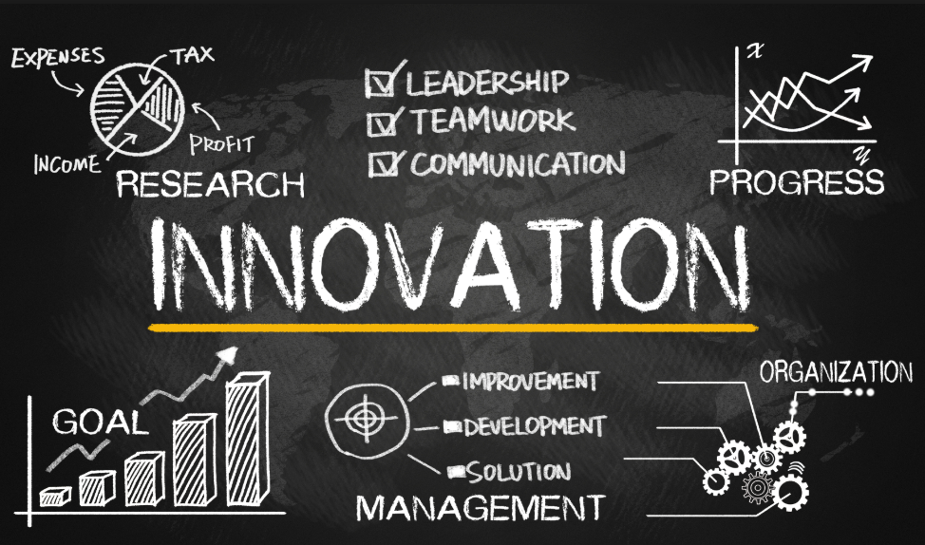

Slide 9
Me: What’s your role in the department?
Mrs. Aydin: I check the recruitment documents of the recruited personnel, arrange the payroll and ensure that the staff follow the whole process until they quit.

Slide 10
Me: Dou you feel satisfied with your position in the company?
Mrs. Aydin: Our work load is demanding. We have to check our
work carefully because we can not make any mistakes so we are
under constant stress.

Slide 11
Me: If you could do so, how would you plan your academic study differently? Why?
Mrs. Aydin: I wanted to be a chemical engineer because I loved my chemistry teacher in high school and I was interested in experimenting and producing something new but I did not go to university due to economic crisis in 2001 So I enrolled correspondence school.

Slide 13
Me: How would you describe yourself?
Mrs. Aydin: I think, I am fair, determined, equitable, hardworking.
At the same time helpful and instructor. And than I am passionate
about my work. Because I love what I do I have a steady source of
motivation that drives me to do my best. In my last job, this passion
led me to challenge myself daily and learn new skills that helped
me to do better work.

Slide 14
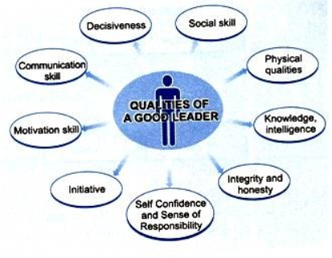

Slide 15
Me: What qualities should a successful manager possess?
Mrs. Aydin: A successful manager should has important qualities like decisionmaking, interpersonal, leadership, organizational and speaking skills. And also honest, responsible, make empathy, creative, optimistic.

Slide 16
Me: What have you learned from your mistakes?
Mrs. Aydin: I have learned never to give up, to think well all the time, to turn the mistakes into opportunities and not to be biased.

Slide 17
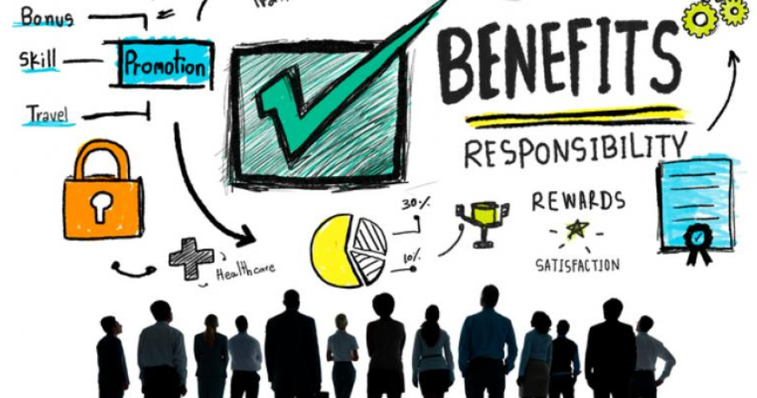

Slide 18
Me: What are your future plans in your business life?
Mrs. Aydin: I would like to be in a position to work more effectively than my company.

Slide 19
Conclusion
To summarize, Mrs. Aydin says’ I have learned never to give up, to think well all the time, to turn the mistakes into opportunities and not to be biased’ and than she says ‘I am passionate about my work.’ I realized that even if this profession was not your dream, you would always be successful with labor and determination. And than they work under stress because they have to check their work carefully and can not make any mistakes so business life is more difficult than college life.

Slide 20
Thank you for listening…

