Slide 1
BUSINESS ENGLISH
INTERVIEW PRESENTATION
16071136 SINEM HOCAOGLU

Slide 2
Interviewer : Sinem Hocaoğlu
Interviewee Polat Özyurt
Date: 10.05.2019
Place: Yıldız TEAM Office

Slide 3
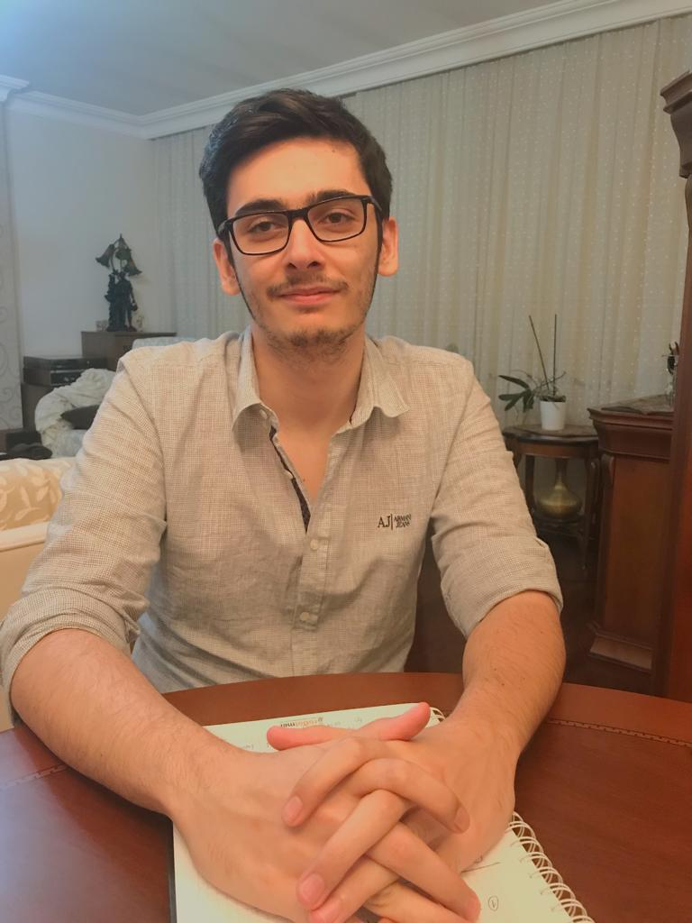
About Polat Ozyurt
Polat Ozyurt is a 32 years old Pricing Analyst who works in Yıldız Team for 8 years . Despite of his young age, the things that he accomplished are remarkable .He is already head of the Pricing part of the Sales department. Its quite seenable that he has no intention to stop here with respect to his answers to our questions.

Slide 4
About Yıldız TEAM TEAM Yıldız is a local company which sells kitchenware products all over Turkey. The Firm has established in 1972 in İstanbul by Erdal Özyurt. Mr. Erdal has started this Project with 3 empleyee and one supporting woman. Now ıt has 26 distributors, nearly 8000 employee and 4 factory.
About Sales Department
A sales department is the direct link between a company’s product or service and its customers. However, a well-trained sales department does more than making sales. Your sales staff builds relationships with your customers.

Slide 5
Some of the answers of the interview
What is your departments role at your firm ?
Mr. Ozyurt: The department that ı am working at is Sales Department and basically my departments role at the firm is stocking, pricing and customer contracts and based on these we are giving feedbacks to marketing department.
What is your role at the department?
Mr. Ozyurt: I am a pricing analyst so the essential responsibilites of mine are determining the optimum prices for our products that we sell and cricisize the demanding market.

Slide 6
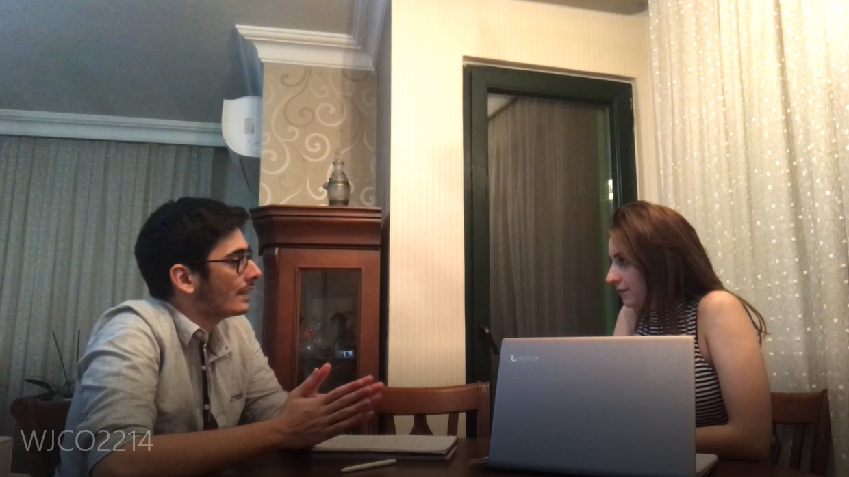
Do you feel satisfied with your position at your company ?
Mr. Ozyurt: Yes, I feel quiet satisfied with my postion, ofcourse form my age. But to be honest, ı want to climb the carreer steps at future.
Are there any side benefits in your job ?
Mr. Ozyurt: Of course there are. As a sales department employee, I quite travel a lot and Ilove travelling.

Slide 7
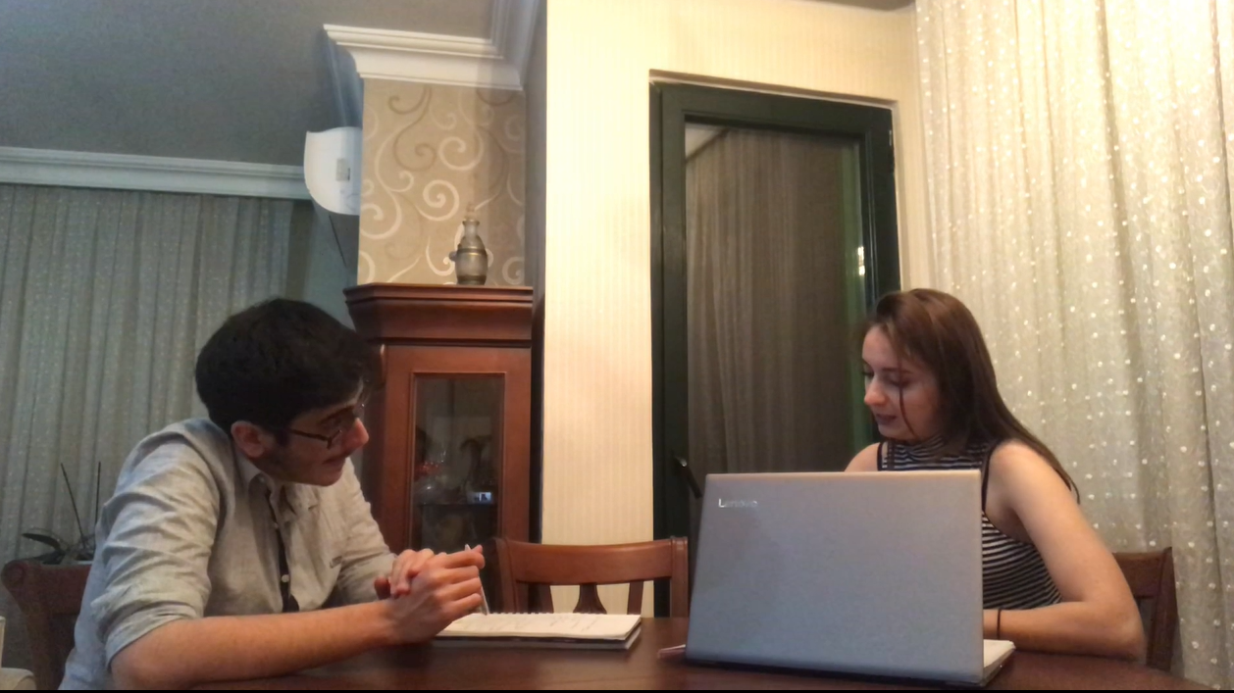
Do you have any suggestions for new candidates of business life?
Mr. Ozyurt: Maybe I can give one; They need to be humble and work hard for what they love.
Do you think the education you had at the university had prepared you for the business life?
Mr. Ozyurt: I believe that at schools, they teach you how to learn some things but ı guess 90 percent of my knowledge has learnt in business life .

Slide 8
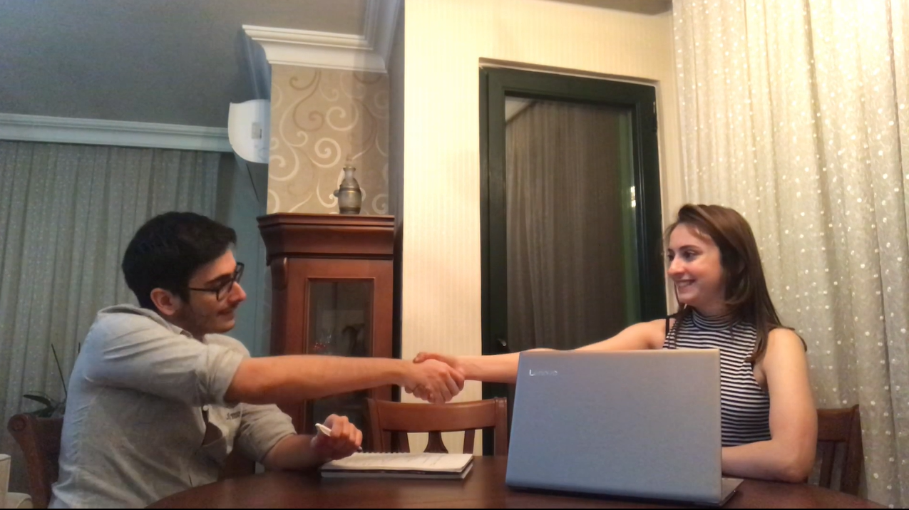
What are your future plans in your future carreer?
Mr. Ozyurt: I want to gain some experience about global business relations and global economy.
What is your dream work place ?
Mr. Ozyurt: I guess my dream work place is my home office, I cant ever imagine a more comfortable place to work.

Slide 9
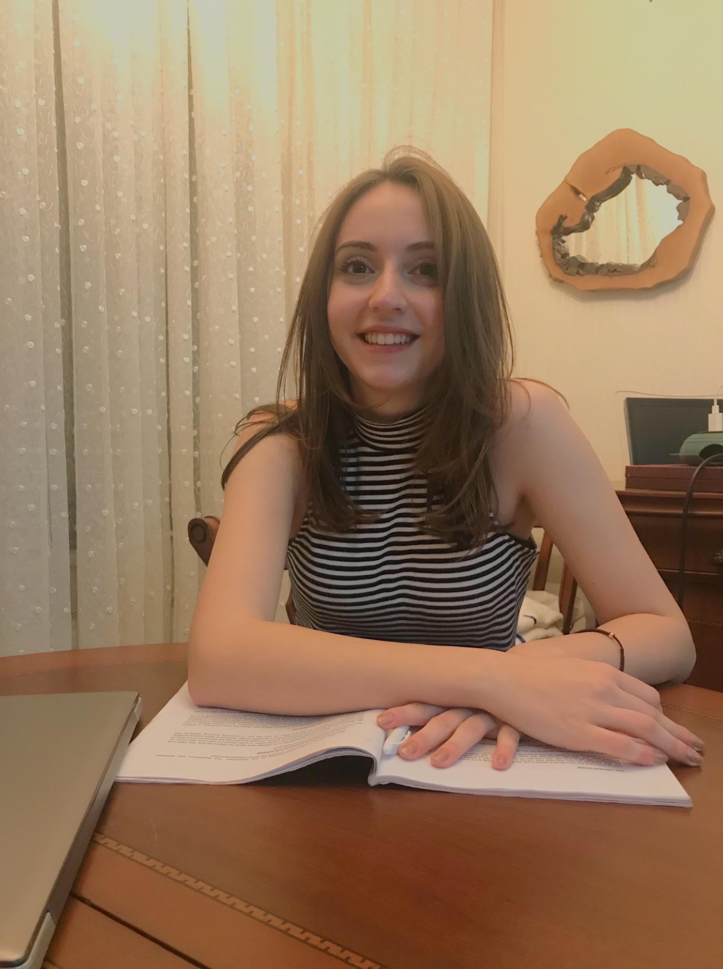
Conclusion:
To summarize, polat says his work is fun and enjoyable. He thinks that the difficulties are not important to him besides the pleasant part of the work. In this interview I had the chance to see what business life looks like. If we want to be successful in business life we must be able to transform what we know into an efficient experience. This is a valuable piece of advice for me.
THANKS FOR LISTENING.

