Slide 1
END3880 Applied Data Analytics
Meryem Ezgi ASLAN, Ph.D.
Lecture 1

Slide 2
Overview
Communication and office hours
Syllabus
Tutor responsibilities
Student responsibilities
Class project
Introduction
What is data?
What is data analytics?
Why we need data analytics?
Road Map to Data Analytics
DIKW Pyramid
Data types

Slide 3
Communication and office hours
Office Hours:
Monday 13:00-14:30
Thursday 12:30-14:00
*Please make an appointment before you come to the office.
*Office hours can be changed or canceled due to exams, meetings or emergencies
E-mail: ezgiuluhan@gmail.com
While writing e-mails:
Fill the subject line with a very short explanation of why you are writing(1-5 words) and include the course code (END3880).
Introduce yourself by giving only the necessary information.
State your problem and/or request clearly.

Slide 4
Announcements
Please check the following contents regularly for any updates and announcements.
https://avesis.yildiz.edu.tr/muluhan/dokumanlar (my institutional website)
For updates and announcements of our course
For documents about our course, if any available
For changes in office hours
Your student e-mails
Essential for interclass communication and also announcements

Slide 5
Announcements
Please check the following contents regularly for any updates and announcements.
https://enm.yildiz.edu.tr/ (Industrial Engineering Department website)
Anything regarding our department
Updates and announcements
Internship
Exams
Commissions
Also updates and announcements of our course may be posted here
Events, news, achievements
Job and internship opportunities, if any available

Slide 6
Announcements
Please check the following contents regularly for any updates and announcements.
https://ogi.yildiz.edu.tr/ (Student affairs department website)
Anything about studentship
Legislations
Enrollment
Fees, if any
Transfer programs
Graduation certificates

Slide 7
Grading
Midterm exam %30
Exam type: Classical written
Class Project %30
Interim report
Final report
Presentation
*Students who did not attend to the presentations will have 0(zero) grade from the project
Final exam %40
Exam type: Classical written
Letter grading
Letter grading will be done automatically by the system using bell curve.

Slide 8
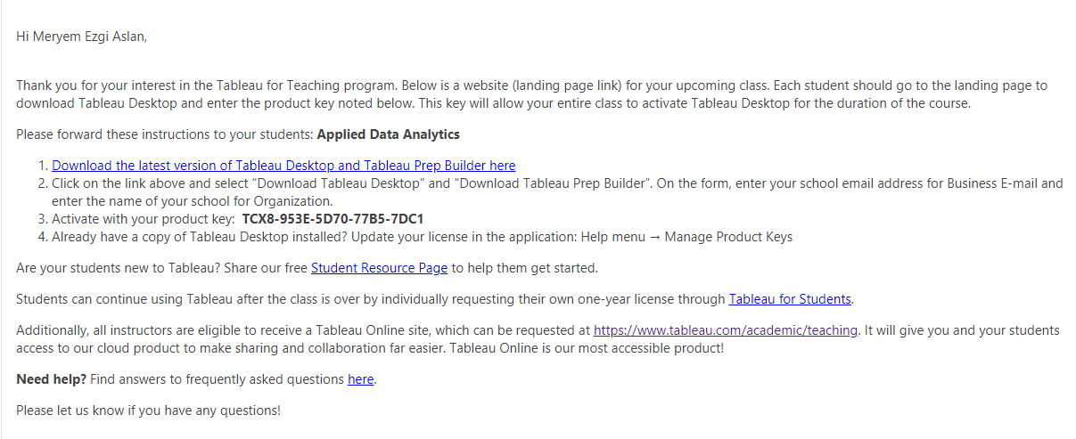
Requirements
Prior knowledge of basic statistics
Prior knowledge of Python, R or any other programming languages. Tableau will be main tool for analysis and taught during the class.
Tableau installed and running on your computer
Development environment suitable for the programming language of your choice installed and running on your computer.(will be used to support Tableau data analysis)

Slide 9
Requirements
I have forwarded the mail to your student e-mails.

Slide 10
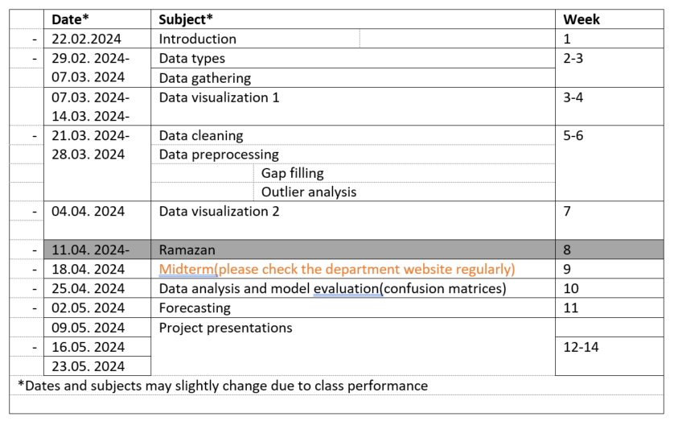
Syllabus

Slide 11
Tutor responsibilities
Conducting lectures according to the syllabus.
Starting and finishing the lectures on time.
If there is any emergencies it will be announced on avesis.
Giving the information of reference materials for each lecture.
Sharing the lecture slides on online system after each lecture.
Making and grading the exams on time upon the calendar of the department.
Grading the class project reports and presentations.
Providing supervision about class projects and any problems related to the lecture.
Preparing the presentation schedule.

Slide 12
Student responsibilities
Attending classes(%70)
Filling the form below for communication about the class project. Your e-mail addresses will be shared with the class members.
https://docs.google.com/spreadsheets/d/1t7aOhflnQgNYrMzot99KfEMQq5hzJvih7Fb66TbpOxU/edit?usp=sharing
Installing the required programs on their computers.
Taking the exams on time
In case of any excuse (medical report, legal assignment by the university etc.) students have to submit their official documents to the department.
The list of those who can take the make-up exam is determined by the faculty board based on these documents
*The Make-up exam will include all the subjects like the final exam.
Completing the class project.
Organizing the project work group(3-4 members) by 7.03.2024 23:59 (after that, any students who are not a member of a group, will be assigned randomly)
Choosing the project subject and collecting the data
Providing the interim report by 04.04.2024 23:59
Providing the final report by 07.05.2024 23:59
Presenting the project on time according to the presentation schedule
Weekly presentation schedule will be shared the day before the class. All groups must be ready for presentation starting from 09.05.2024. You may volunteer for the presentation before the schedule is shared.

Slide 13
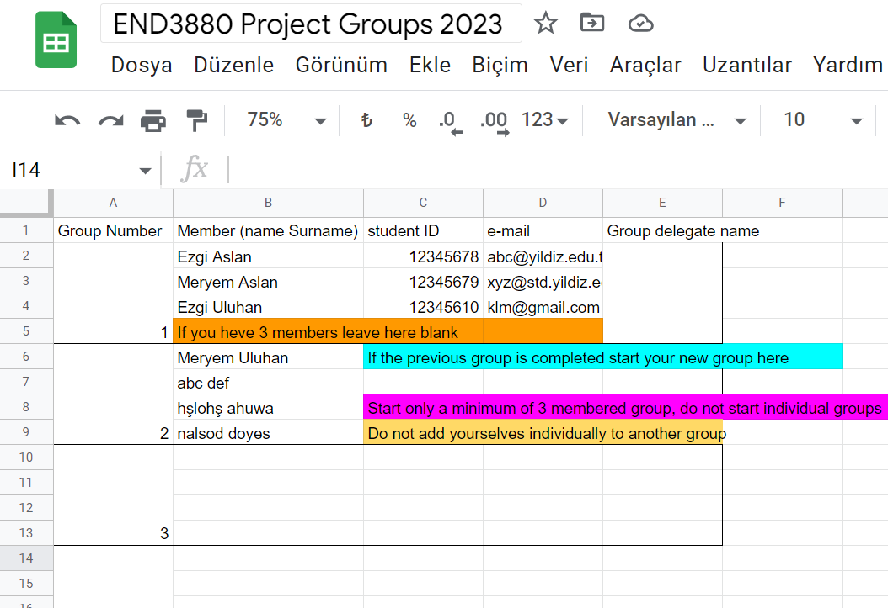
Class project
Organizing the project group
Organize a group that has 4-5 members
Chose your group delegate
Group delegates should fill the sheet below
https://docs.google.com/spreadsheets/d/1t7aOhflnQgNYrMzot99KfEMQq5hzJvih7Fb66TbpOxU/edit?usp=sharing
Anyone who doesn't have a group by 07.03.2024 23:59 will be assigned to a group randomly

Slide 14
Class project
Choosing the project subject and collecting the data
Group members will decide the subject and be responsible to find their data.
Data should be spatio-temporal (data has samples with time and latitude longitude futures) and it must include minimum of 1000 samples(rows).
Some database examples are given at the end of the presentation but you can find your own data
The project will be conducted using Tableau, other programming languages may be used for support.

Slide 15
Class project
Providing the interim report by 04.04.2024 23:59
The interim report must include the following:
Project information chart
Explanation of the subject selection and the data gathering process.
First data visualization
Completed data cleaning
Completed data preprocessing
10 points will be cut from your grade each day after the deadline.

Slide 16
Class project
Providing the final report by 07.05.2024 23:59
The final report must include the following:
Project information chart
Explanation of the subject selection and the data gathering process.
First data visualization
Completed data cleaning
Completed data preprocessing
Second data visualization
Completed data analysis and modeling
Completed forecasting
Interpretations and solution suggestions
The format of the report.
10 points will be cut from your grade each day after the deadline.

Slide 17
Class project
Presenting the project on time according to the presentation schedule
Presentations will be in English
Each presentation will be 15-20 minutes(will determined according to the number of groups)
All group members must participate in the presentation.
The grading will be done individually according to the presentation performance. (Students who are in the same group may have different scores)
*Students who did not attend to the presentations will have 0(zero) grade from the Project
Weekly presentation schedule will be shared the day before the class. All groups must be ready for presentation starting from 09.05.2024. You may volunteer for the presentation before the schedule is shared.

Slide 18
Important Dates
Organizing the project group | by 07.03.2024 23:59
Providing the interim report | by 04.04.2024 23:59
Midterm exam | 15-20.04.2024
Providing the final report | by 07.05.2024 23:59
Project presentations | 09.05.2024
 | 16.05.2024
 | 23.05.2024
Final exam | 27.05.2024-06.06.2024

Slide 19
What is data?
Information pieces or signals that is produced by different sources.
Sources of data
Business: Web, e-commerce, transactions, stocks, …
Science: Remote sensing, bioinformatics, scientific simulation, satellite images…
Society and everyone: news, digital cameras, social media…

Slide 20
What is data analytics?
" Data analytics is defined as the application of computer systems to the analysis of large data sets for the support of decisions. "
Interdisciplinary field
statistics
pattern recognition
computational intelligence
machine learning
operations research
signal theory

Slide 21
Why we need data analytics?
"The information in the world doubles every 20 months ".
Available data is growing explosively.
With all those available data, still we need to extract the information and knowledge.
To know the past
To know the current state
To predict the feature
To know what we should do in the future

Slide 22
Why we need data analytics?
Risk management
cash flow analysis and prediction
Resource planning
set pricing strategy in a highly competitive market
Fraud detection
Money laundering: suspicious monetary transactions
Medical insurance
Professional patients, ring of doctors, and ring of references
Unnecessary or correlated screening tests
Telecommunications: phone-call fraud
Phone call model: destination of the call, duration, time of day or week. Analyze patterns that deviate from an expected norm
Anti-terrorism
Bio informatics
DNA studies
Quality control
6 sigma

Slide 23
Why we need data analytics?
Text mining
Emails
Social media entries
Market analysis
Customer profiling—What types of customers buy what products (clustering or classification)
Customer requirement analysis
Identify the best products for different customers
Predict what factors will attract new customers
Natural disasters
Earthquakes, floods, volcanic eruption, dust storms
Educational decisions
Business needs
Trends
Medical procedures and decisions

Slide 24
Road Map to Data Analytics
Aim
Research question?
Data
Suitable methods to gather correct data
Visualization
Or previsualization of the data to decide the cleaning and preprocessing process
Problem?
If no preprocessing needed

Slide 25
Road Map to Data Analytics
Data cleaning
Check format
Data preprocessing
Gap filling
Visualization
Delete non-valid values
Join duplicates
Outlier analysis
Feature scaling
Seeing patterns
Deciding methods for analyze
Normalization
Standardization

Slide 26
Road Map to Data Analytics
Data analysis
Discover patterns
Interpretation
What does your analysis show?
Future
Make decision
Make forecasting to see future projections
Discover trends
Discover changes
Understanding of outcomes.
Model evaluation

Slide 27
DIKW Pyramid
Wisdom
Information
Data
Knowledge
How to act : Cleaner fuels, alternative roads, variable work hours
Motor vehicles and traffic jam increases the pollution
Pollution is more in the morning and evening
Polluter levels
Air pollution
Future Decision Making
Past Data Analytics
Reality (research question or aim)

Slide 28
Example data websites
Note that these web sites have large amount of data and you should choose the right one according to your subject and the data you choose must be spatio-temporal and it must include minimum of 1000 samples(rows).
https://github.com/
https://www.kaggle.com/
https://www.microsoft.com/en-us/research/project/urban-computing/
https://data.ibb.gov.tr/
http://odds.cs.stonybrook.edu/
https://www.tuik.gov.tr/

Slide 29
Example data websites
Note that These web sites have large amount of data and you should choose the right one according to your subject and the data you choose must be spatio-temporal and it must include minimum of 1000 samples(rows).
https://archive.ics.uci.edu/ml/index.php
https://w3.unece.org/PXWeb/en#
https://ec.europa.eu/eurostat/data/database
https://en.wikipedia.org/wiki/List_of_datasets_for_machine-learning_research#Anomaly_data

Slide 30
Materials and references of the lecture
T.A.Runker, Data Analytics Models and Algorithms for Intelligent Data Analysis, 2012, Springer
Songül VARLI, Yıldız Technical University Department of Computer Engineering, Dana Mining and Knowledge Discovery Lecture Notes,2015
Mohiuddin Ahmed and Al-Sakib Khan Pathan, Data Analytics Concepts, Techniques, and Applications 2019, CRC press
Moreira et.al, A General Introduction to Data Analytics,2019, JohnWiley & Sons, Inc
A.B.Badiru, Data AnalyticsHandbook of Formulas and Techniques,2020, CRC press

