Slide 1
END3880 Applied Data Analytics
Meryem Ezgi ASLAN, Ph.D.
Lecture 3

Slide 2
Overview
Introduction to Tableau
Connecting our dataset
Visualization with single dataset

Slide 3
Data set and data sources
A data set (data source, or database) in the context of Tableau, contains the data used to build visualizations. Every chart has a connected database or spreadsheet that supplies the data.
Data source types:
Spreadsheet: such as Microsoft Excel or Google Sheets, the records are stored as single rows of data.
Relational databases: Store data in multiple tables, There is a logical connection(relation) between different tables.
Cloud data: Organizations may prefer to store their data in the cloud such as Amazon Web Services or Microsoft Azure. Outsourcing their servers.
Other: Tableau connects to spatial files for mapping, such as .kml or .shp, and statistical files created in R

Slide 4
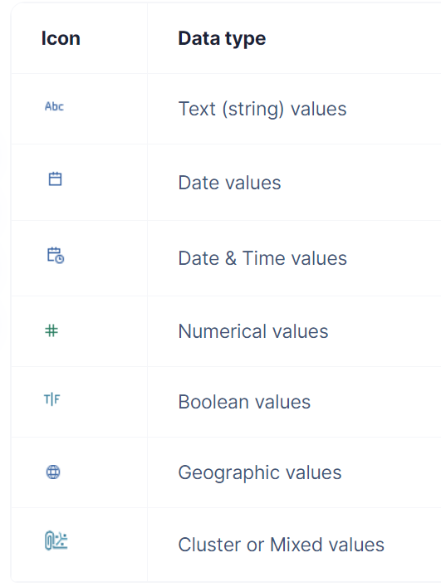
Data types and roles
The data fields in the data set are automatically assigned a role and a type.
Role: A field can be assigned to a Dimension role or a Measure role.
Type: The field's data type defines if the field is one of the following data types, they can be changed by the user.
Any changes made in Tableau are not written to the data source. Changes are instead stored as metadata. Your original data source will not change.

Slide 5
Data types and roles
The data fields in the data set are automatically assigned a role and a type.
Role: A field can be assigned to a Dimension role or a Measure role.
Type: The field's data type defines if the field is one of the following data types, they can be changed by the user.
Any changes made in Tableau are not written to the data source. Changes are instead stored as metadata. Your original data source will not change.

Slide 6
Chart types in Tableau
Line — View trends in data over time
Bar — Compare data across categories.
Heat Map — Show the relationship between two factors.

Slide 7
Chart types in Tableau
Highlight Table — Shows detailed information on heat maps.
Treemap — Show hierarchical data as a proportion of a whole.
Gantt — Show duration over time.

Slide 8
Chart types in Tableau
Bullet — Evaluate performance of a metric against a goal.
Scatterplot — Investigate relationships between quantitative values.
Histogram — Understand the distribution of your data.

Slide 9
Chart types in Tableau
Symbol maps — Use for totals rather than rates. Be careful, as small differences will be hard to see.
Area maps — Use for rates rather than totals. Use sensible base geography.
Box-and-Whisker — Show the distribution of a set of data.

Slide 10
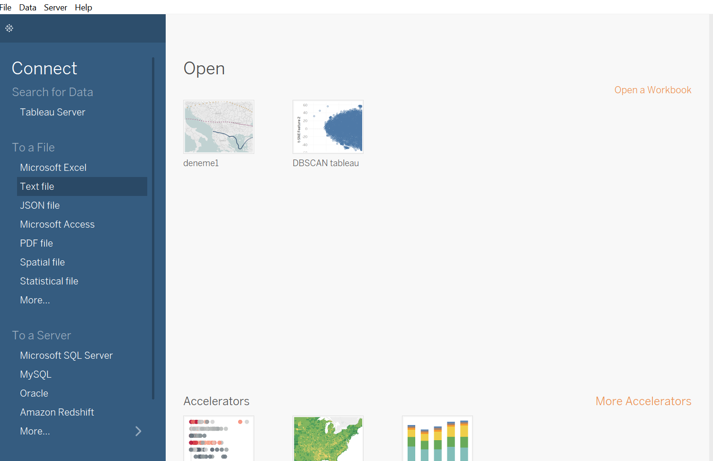
Connecting our data

Slide 11
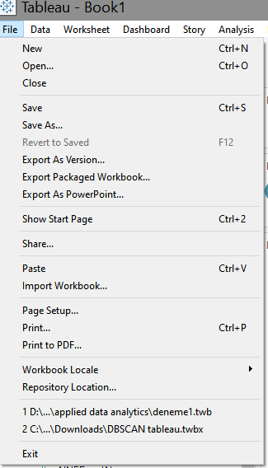
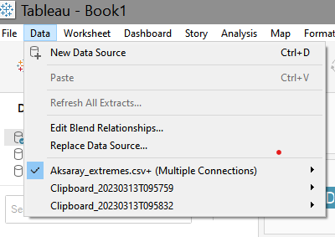
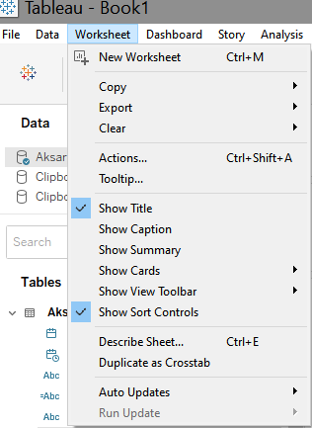
Getting know the tabs

Slide 12
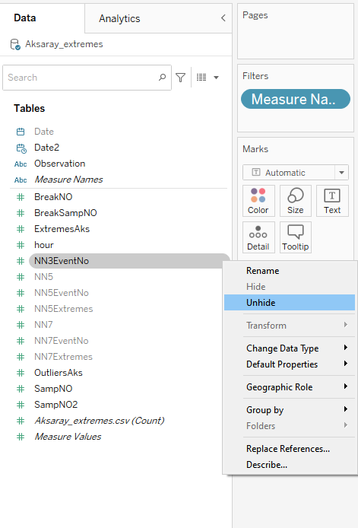
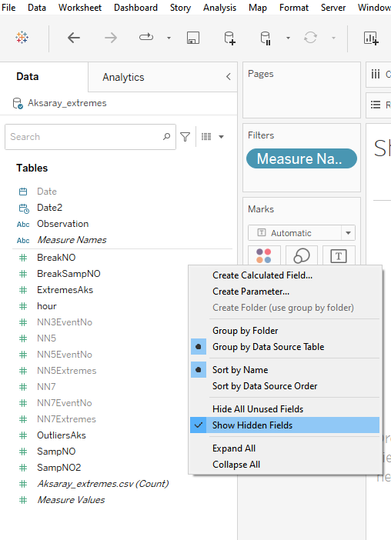
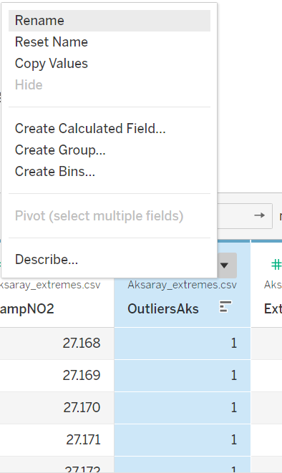
Getting know the visualization tools(single dataset)
Prepare data
Rename columns
Hide unnecessary data

Slide 13
Getting know the visualization tools(single dataset)
Prepare data
Adjust data types
Numerical, Boolean, String
Observations → micrograms per cubic meter (µg/m³) → Numerical
Outlier Labels, Extreme event labels → 0,1 → Boolean
Hour → time dimension → Dimension

Slide 14
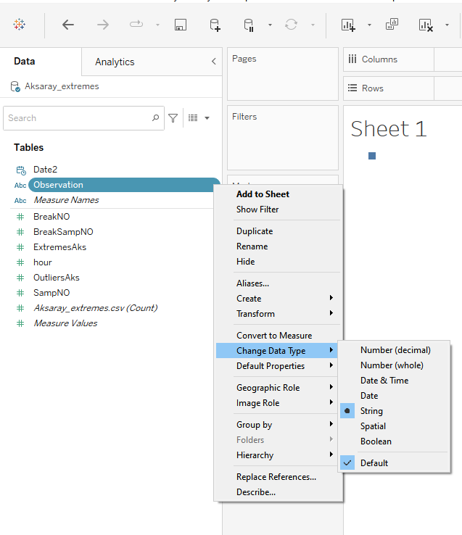
Getting know the visualization tools(single dataset)
Observations → micrograms per cubic meter (µg/m³) → Numerical

Slide 15
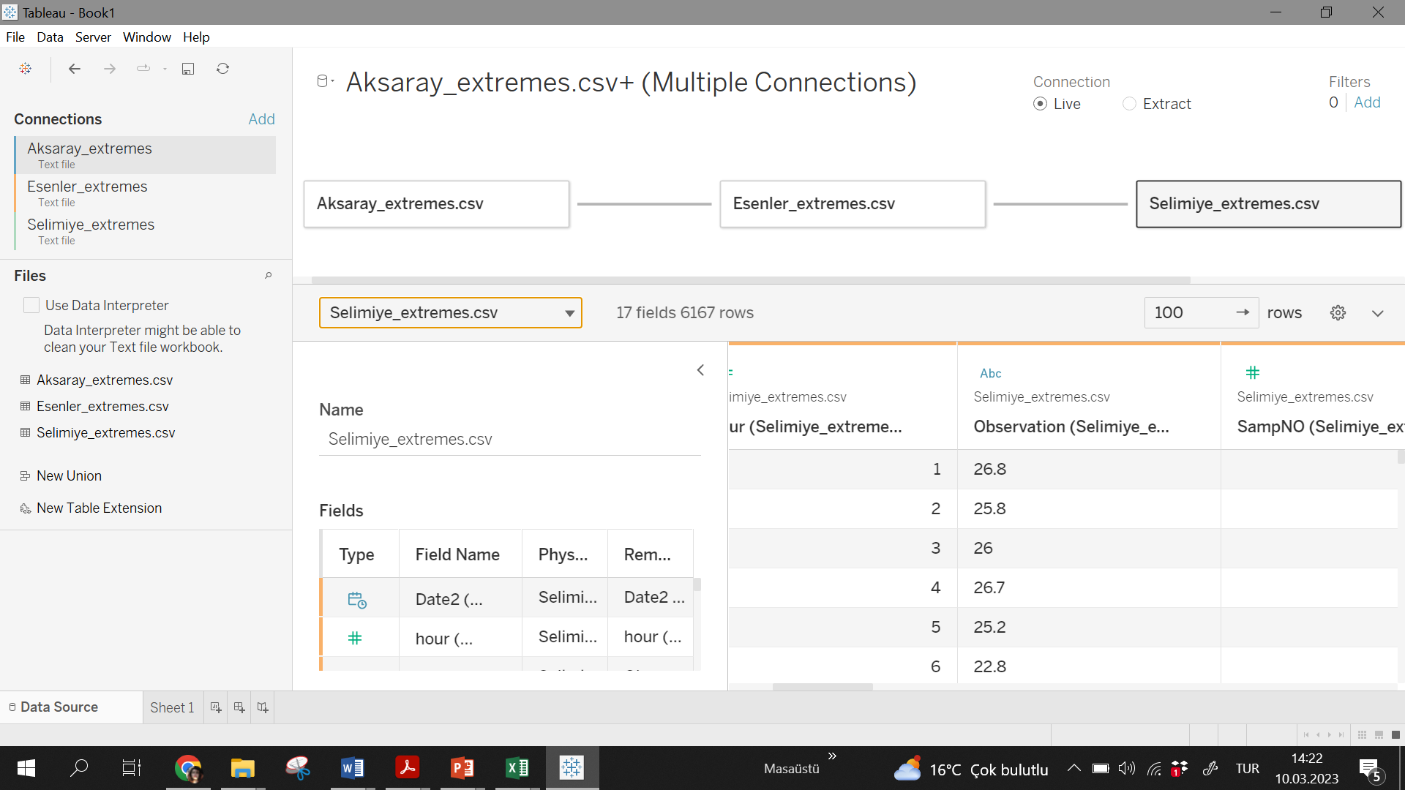
Changing data type
String
numerical

Slide 16
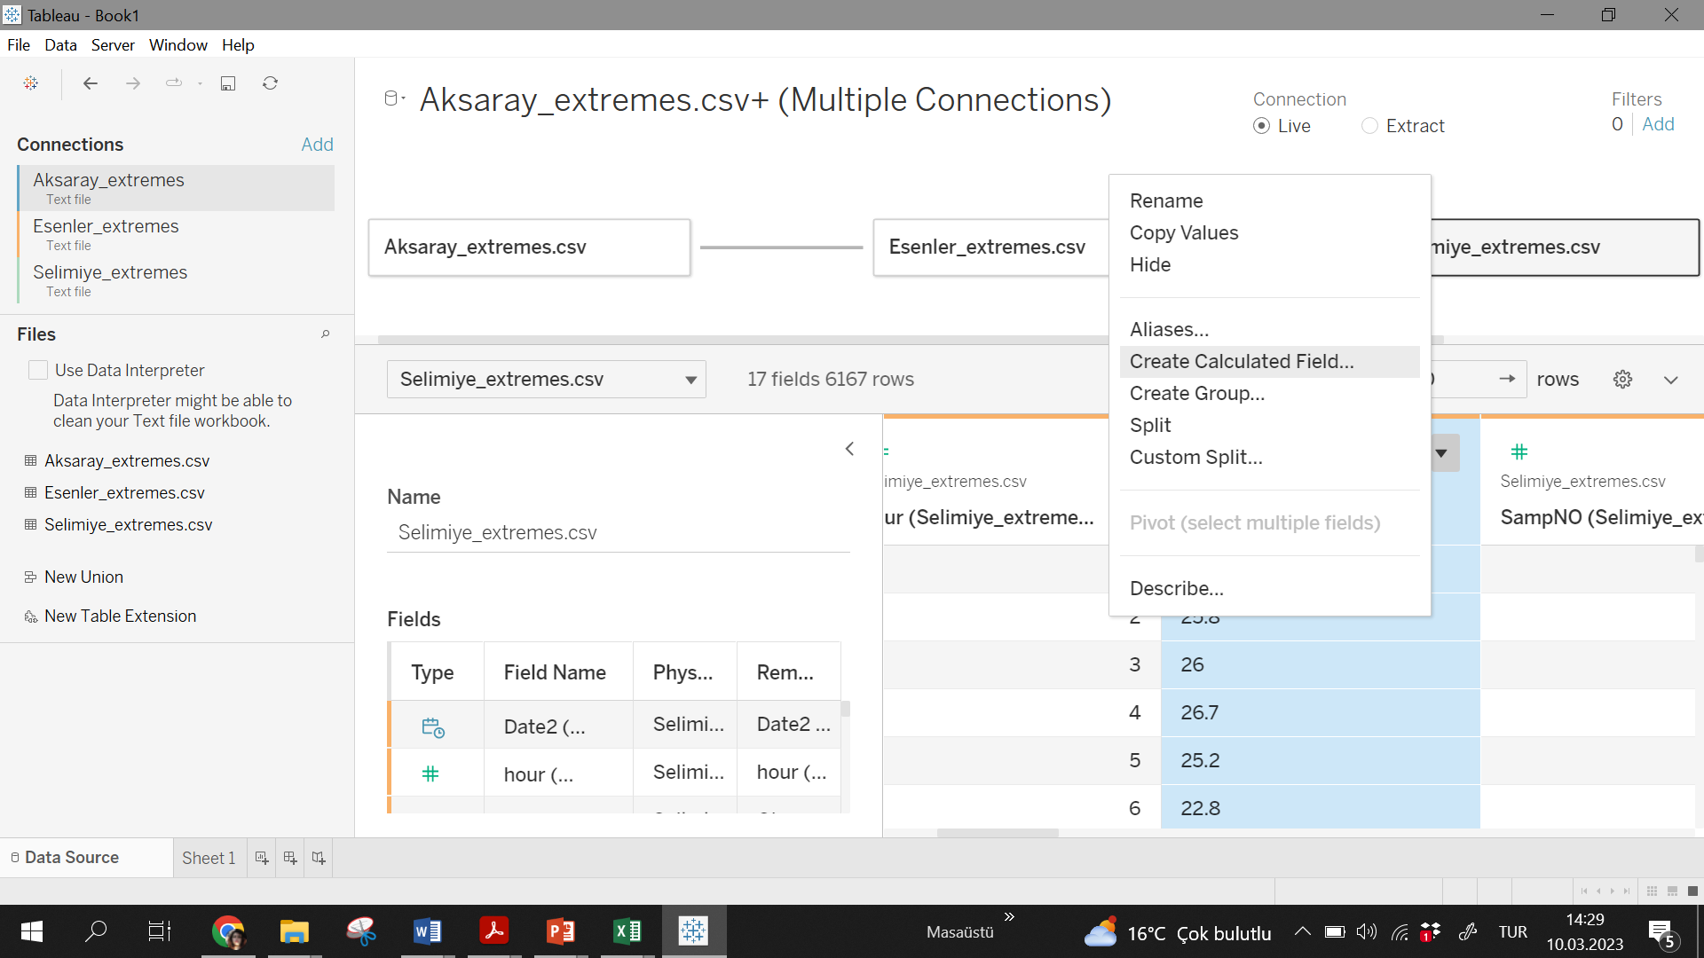
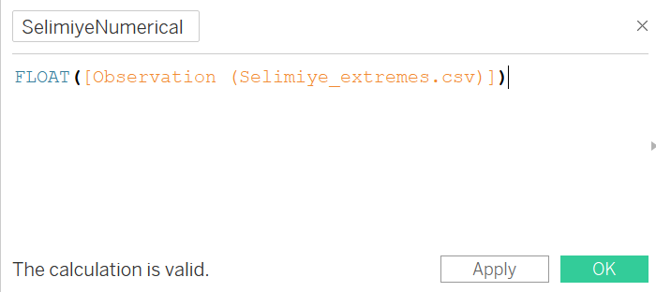
Changing data type

Slide 17
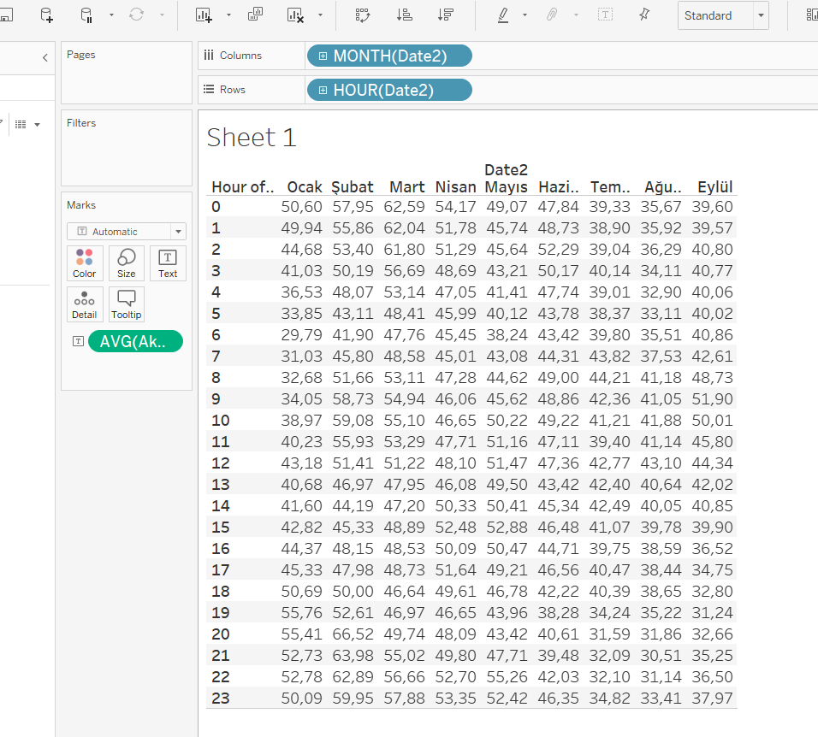
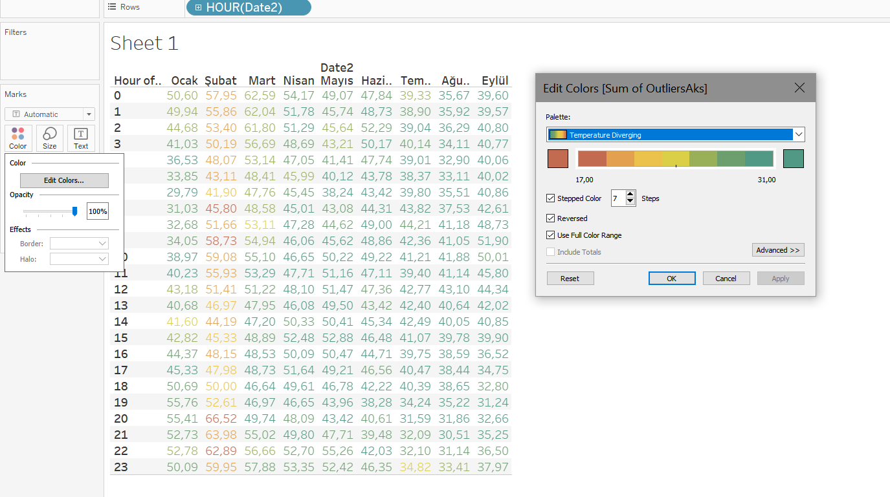
Table

Slide 18
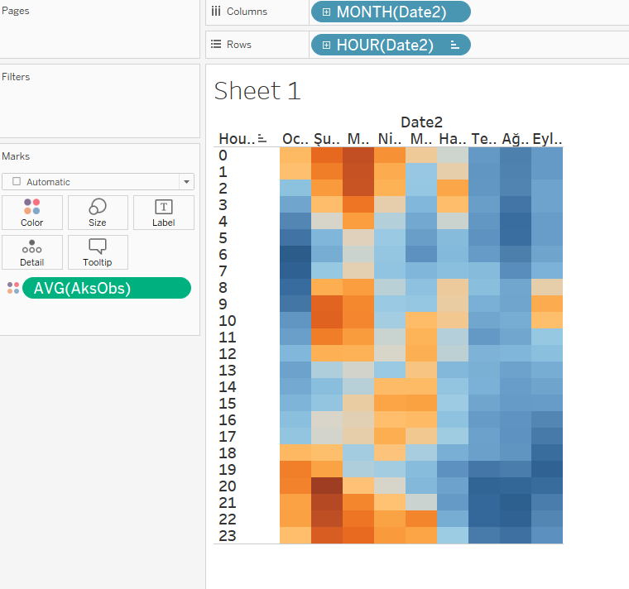
Heat Map

Slide 19
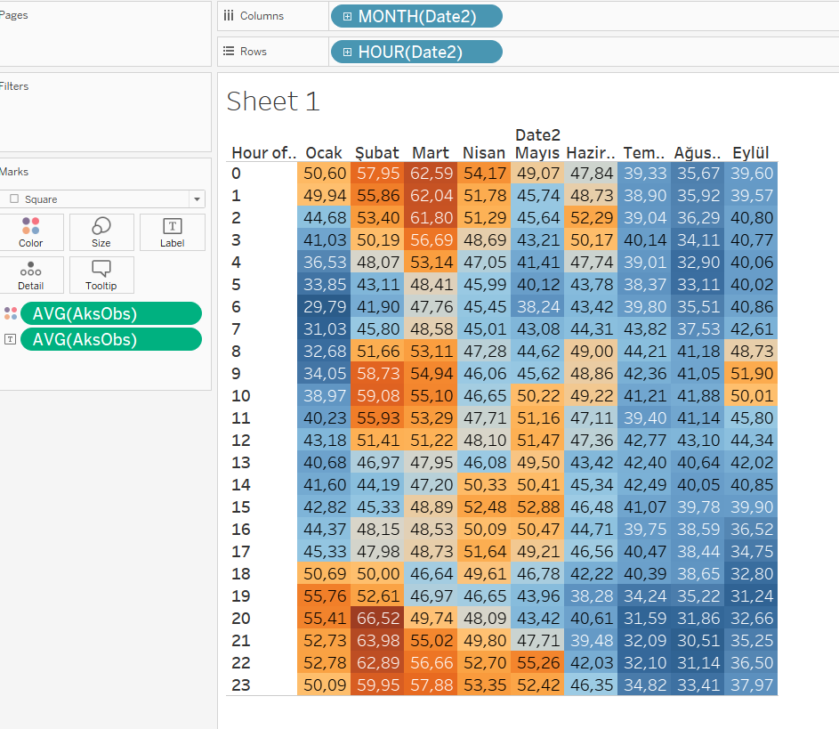
Highlight Tables

Slide 20
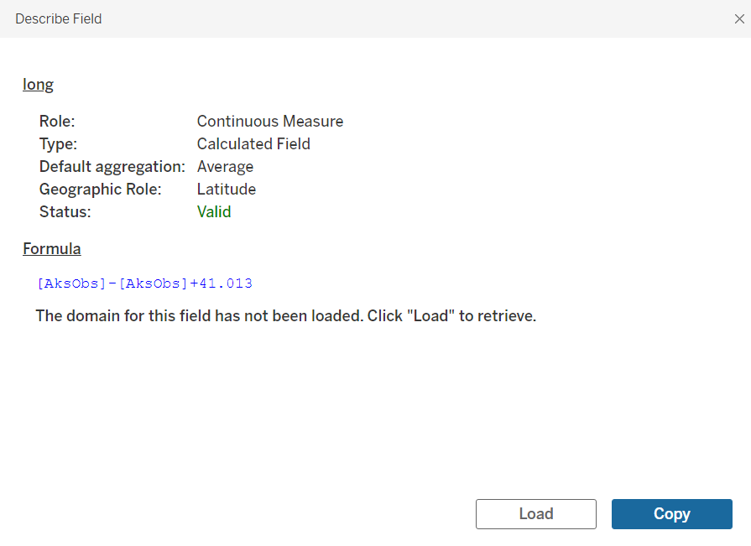
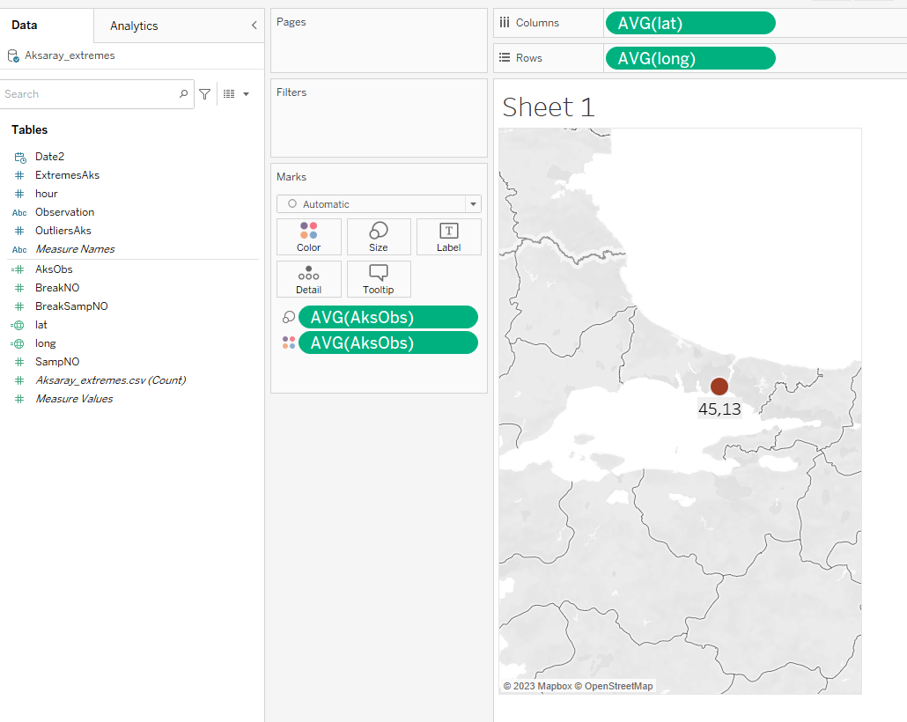
Maps
Adding latitude(28.954) and longitude(41.013)

Slide 21
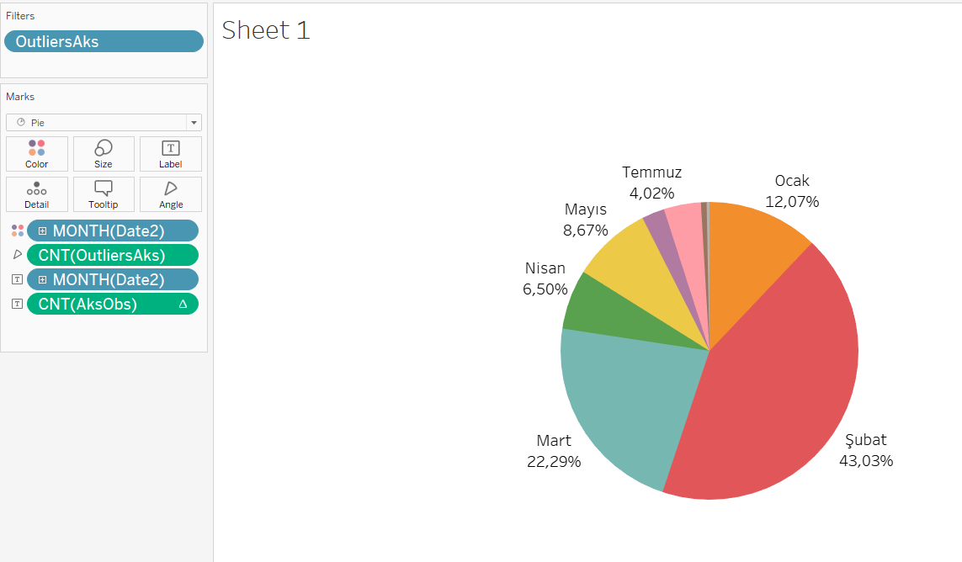
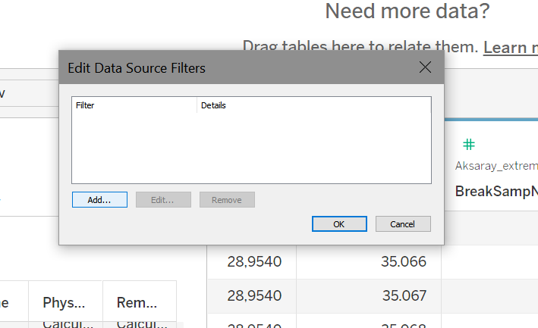
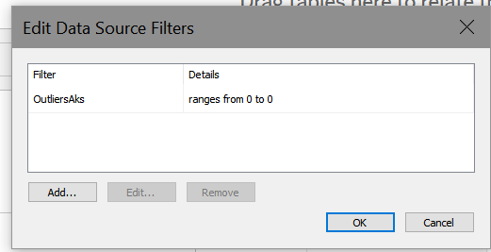
Pie chart
Filter outliers
Monthly outlier percentages

Slide 22
Horizontal Bars
How many outliers discovered monthly
How many outliers discovered hourly

Slide 23
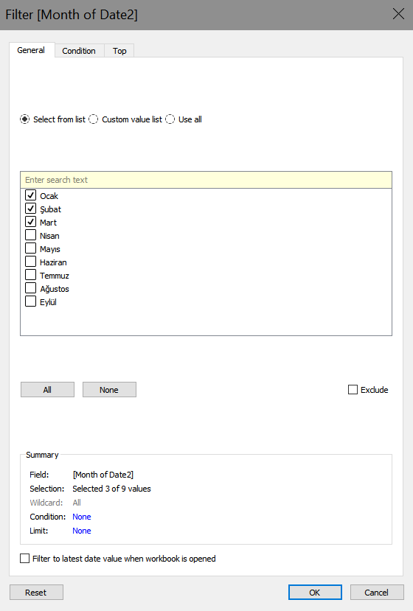
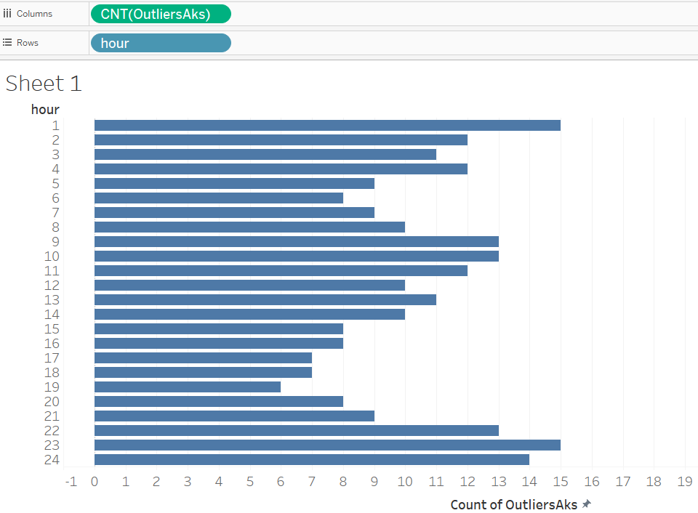
Horizontal Bars
Adding month filters(winter)
Winter hourly outliers

Slide 24
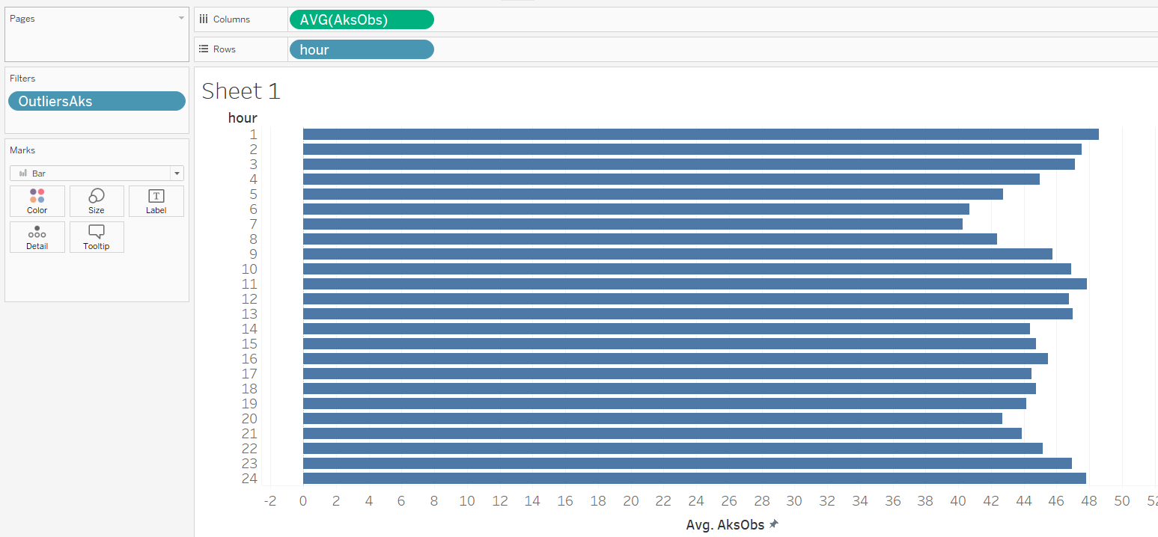
Horizontal Bars
Adding month filters(winter)
Winter hourly measures

Slide 25
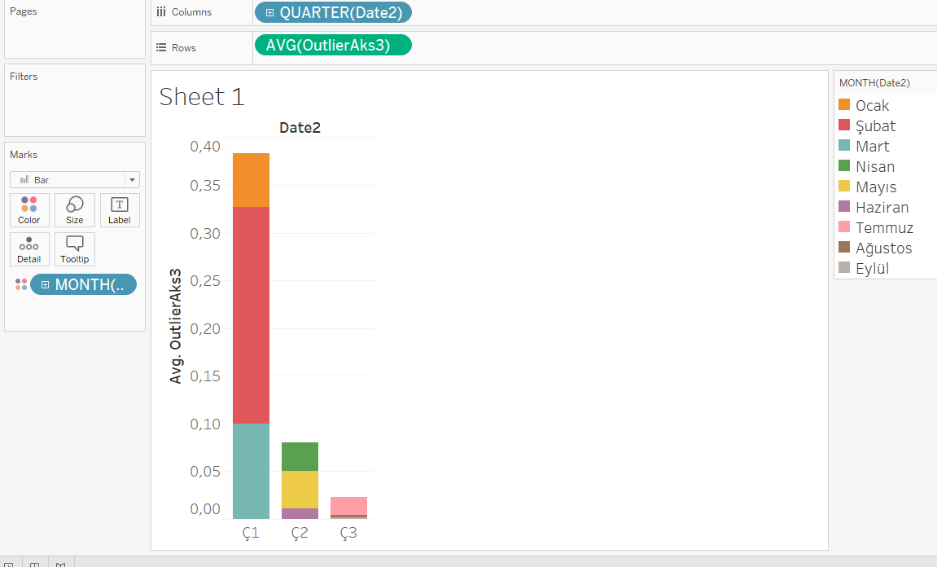
Stacked Bars
Changing boolean values of outliers
Month by quarter

Slide 26
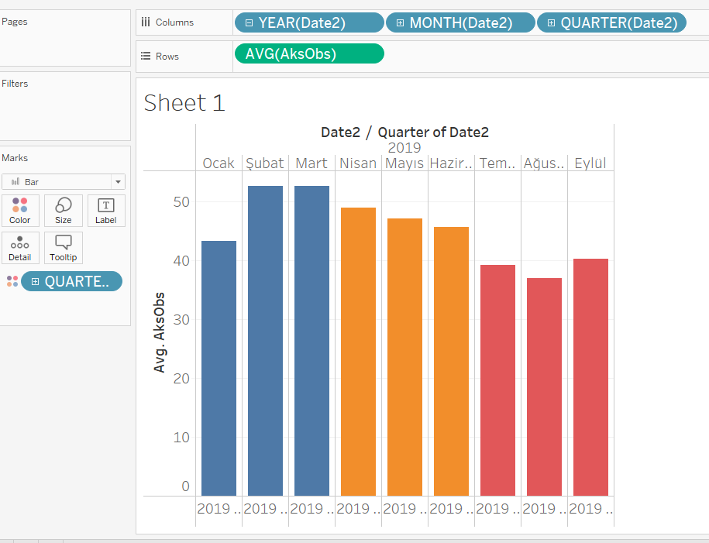
Side-by-side-bars
Month, quarter, year

Slide 27
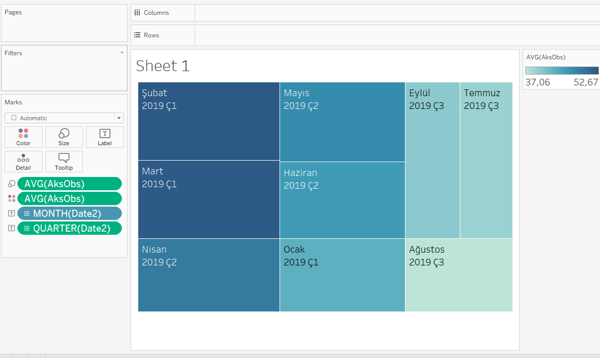
Tree map
Month, quarter, year

Slide 28
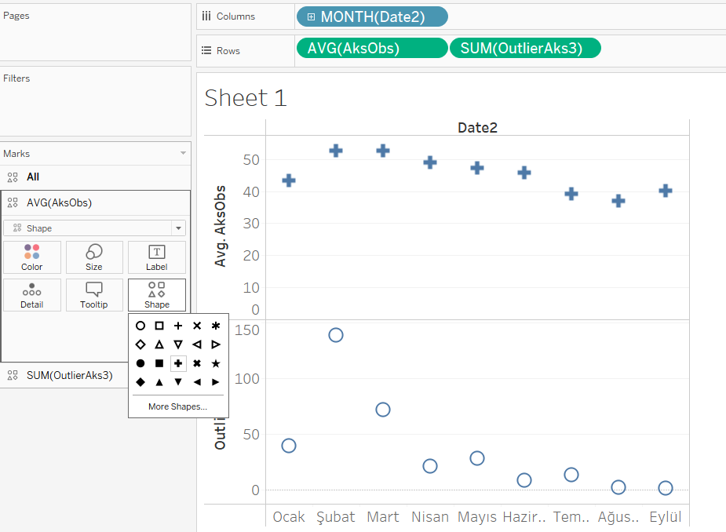
Circle
Month, average, outliers

Slide 29
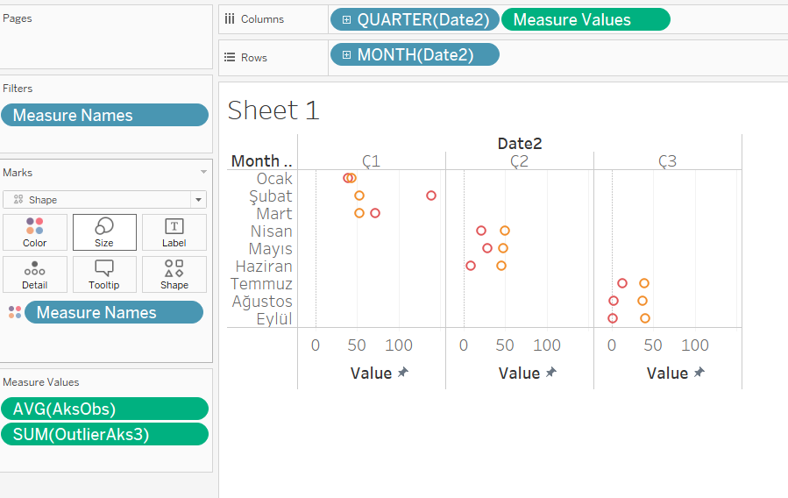
Side-by-side-circle
Month, quarter,average, outliers

Slide 30
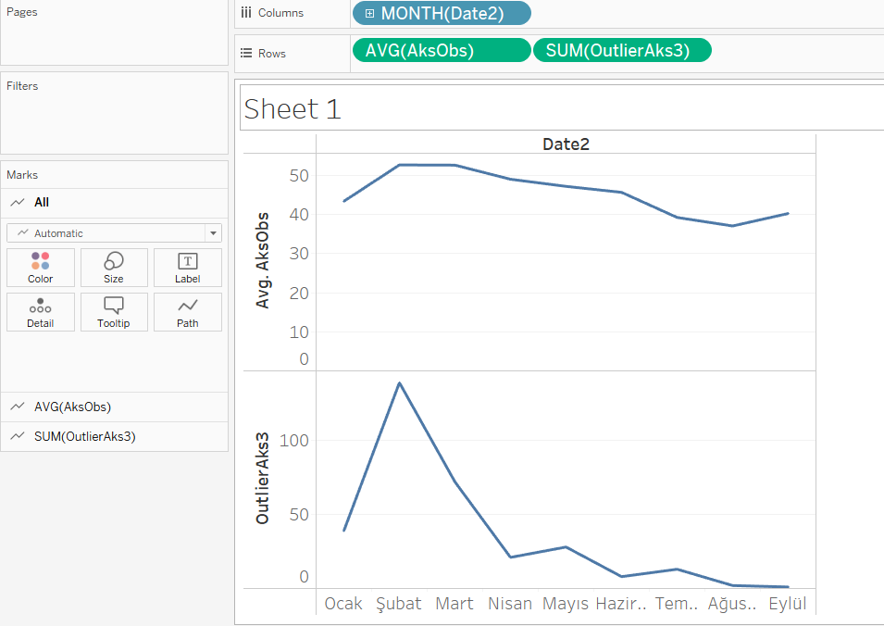
Line chart

Slide 31
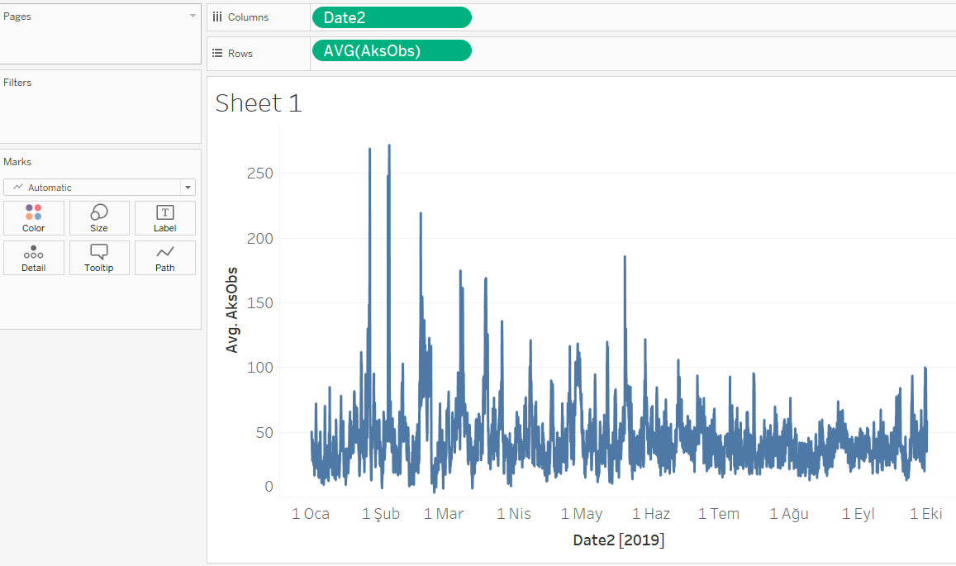
Line chart
Time series

Slide 32
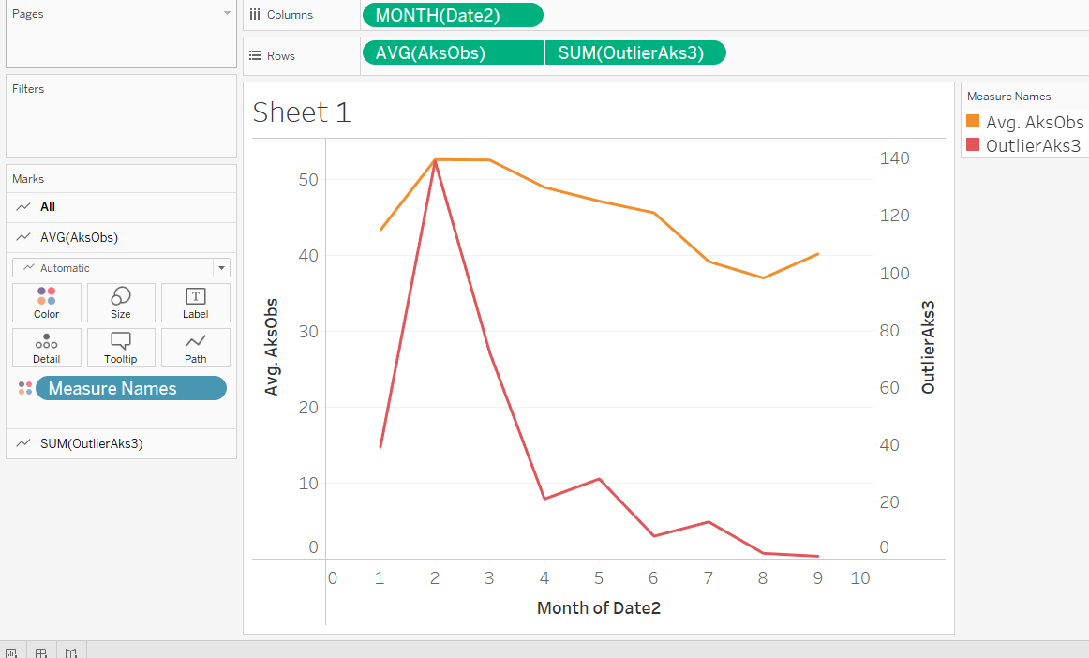
Line chart
Dual lines

Slide 33
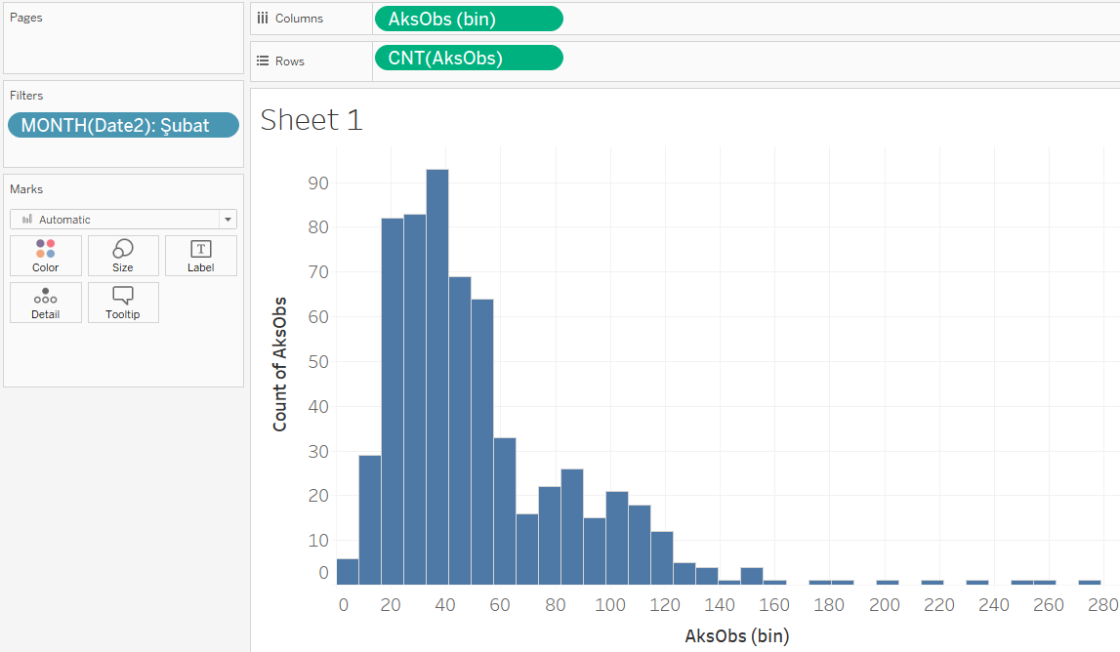
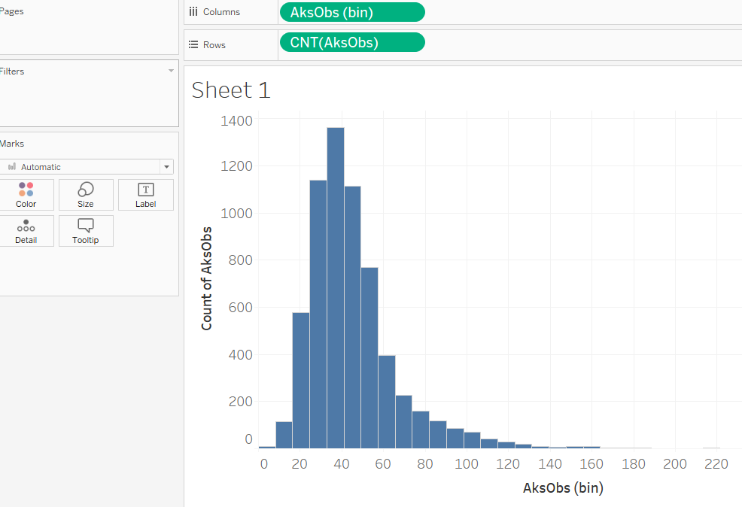
Histogram
Distribution
Filtered, not filtered

Slide 34
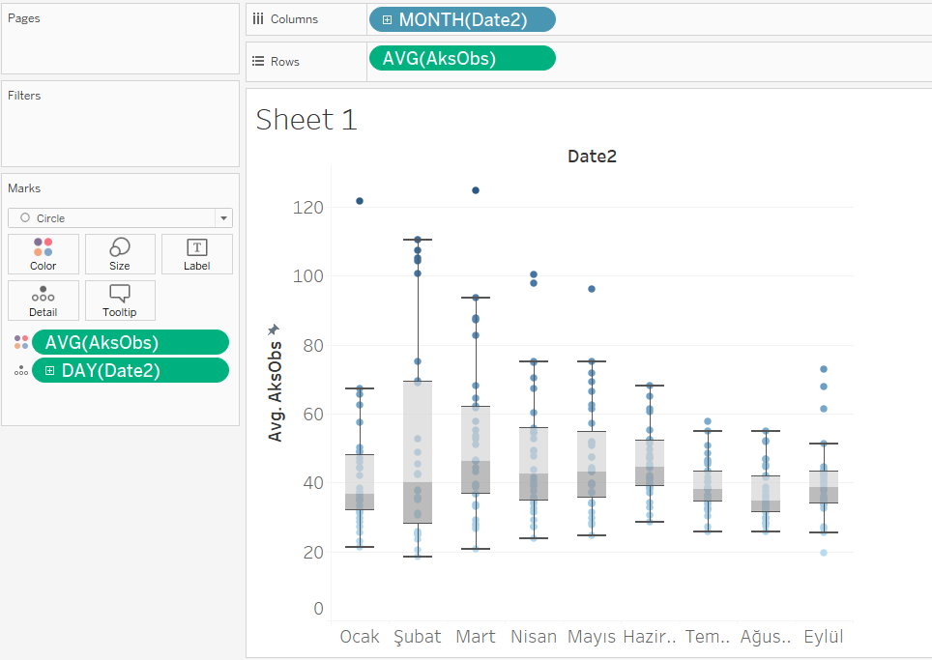
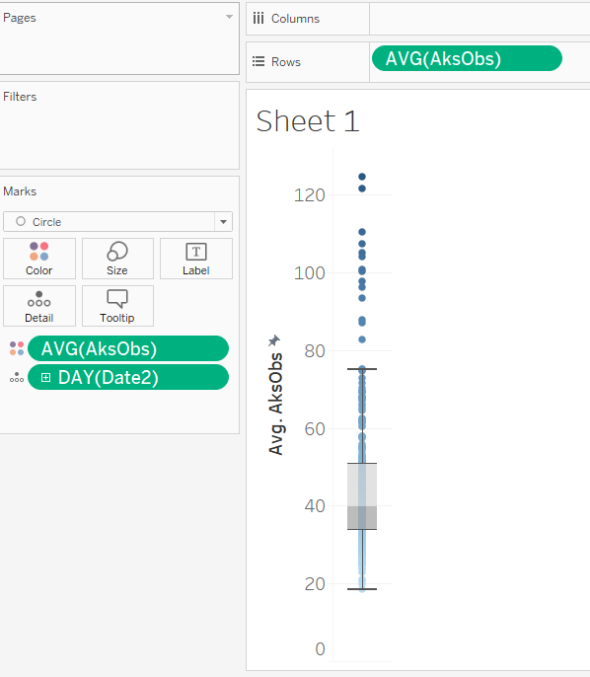
Box and whisker
Percentiles
Outliers

Slide 35
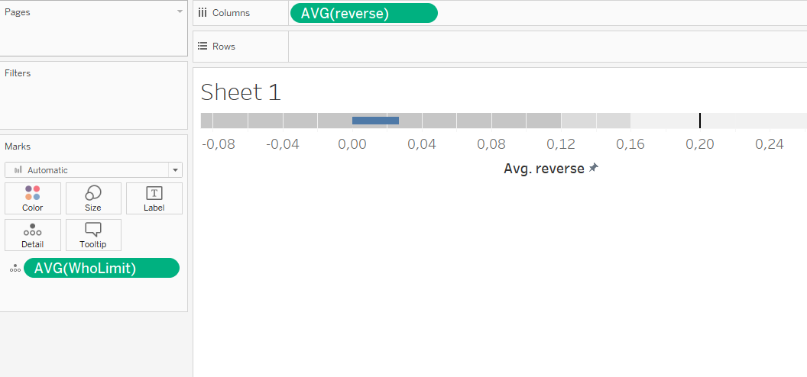
Bullet graph

Slide 36
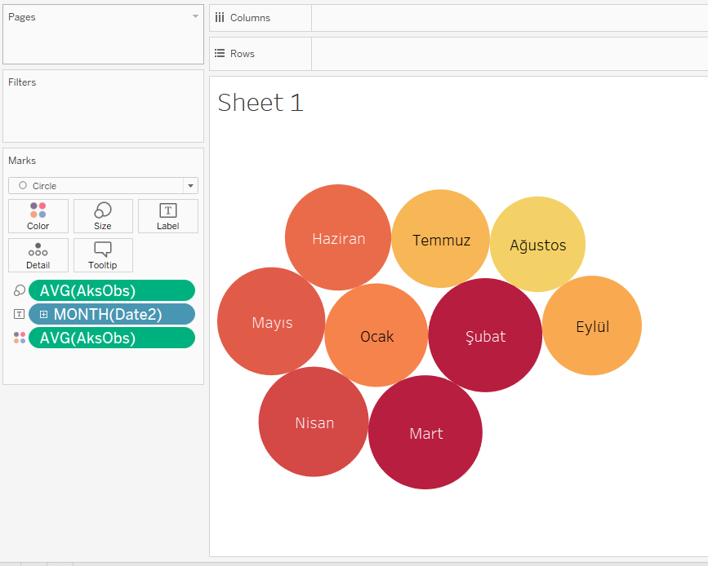
Packet bubles

Slide 37
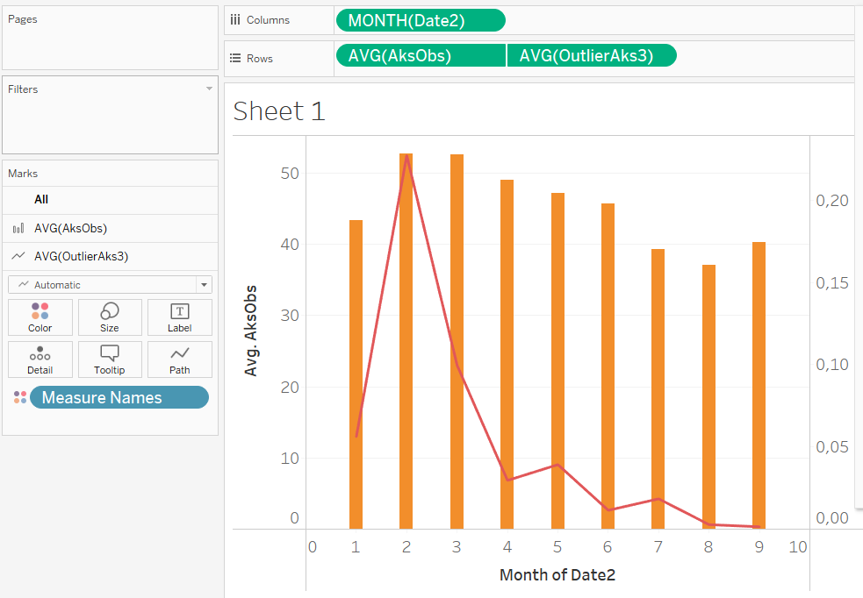
Dual combination

