Slide 1
ENGINEERING CALCULATIONS
Prof. Dr. Nursu TUNALIOĞLU ÖCALAN
Yildiz Technical University
Faculty of Civil Engineering
Department of Geomatic Engineering
Lecture Notes

Slide 2
SPHERICAL TRIANGLE

Slide 3
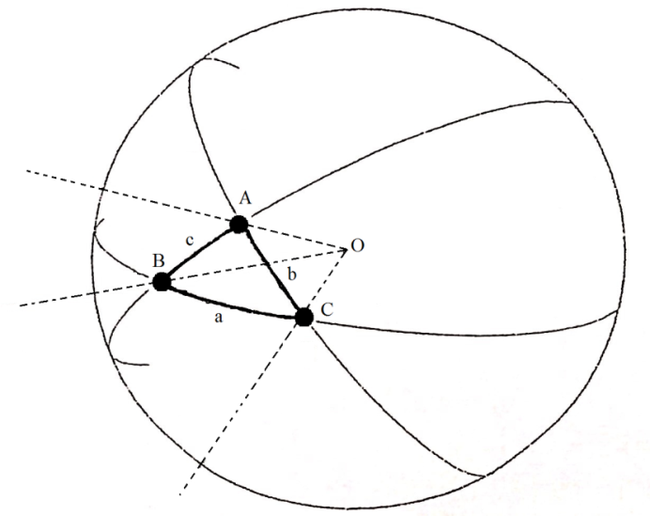
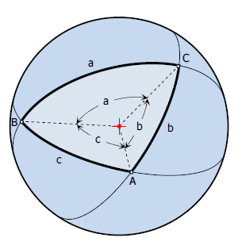
DEFINITIONS:
Suppose that the angular point of a solid angle is made the centre of a sphere; then the planes which form the solid angle will cut the sphere in arcs of great circles. Thus a figure will be formed on the surface of the sphere which is called a spherical triangle if it is bounded by three arcs of great circles; this will be the case when the solid angle is formed by the meeting of three plane angles.
Spherical triangle has 6 elements:
3 angles (A, B, C)
3 sides (a, b, c)
A spherical triangle is formed from arcs along three great circles

Slide 4
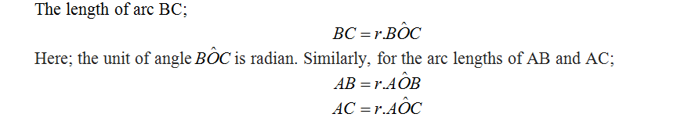
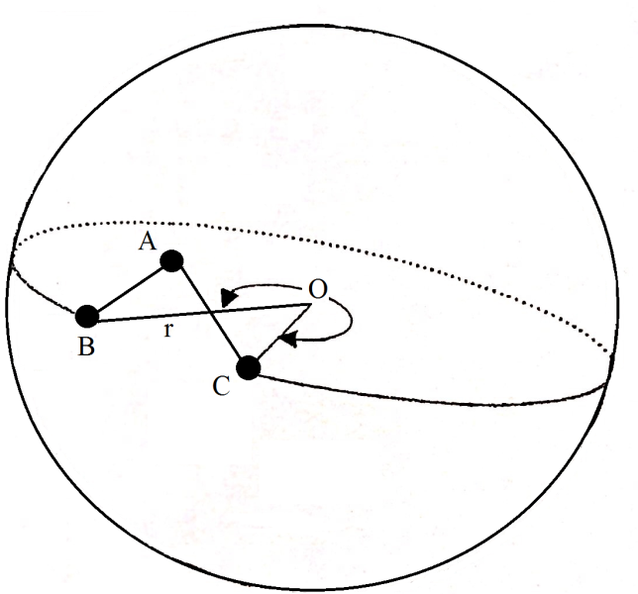
DEFINITIONS:
As seen from the formulas, since the same r (radius of sphere) is used to compute the arcs of great circles, r should be taken as unit. Thus, the length of arc of great circle is equal to the central angle that subtends the arc from the center. Therefore, sides of the great circles can be defined as angles.
General Spherical Triangle

Slide 5
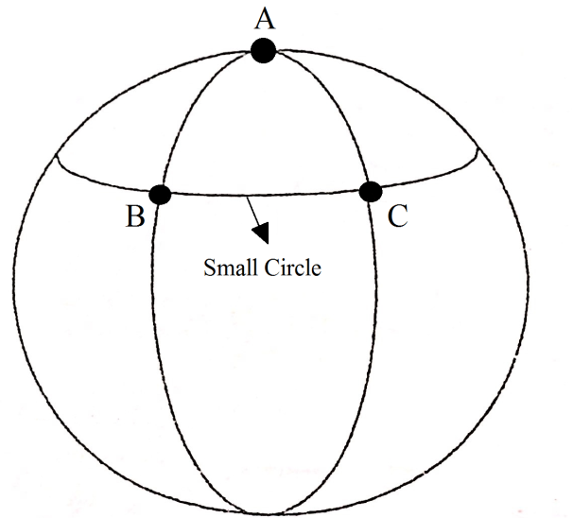
DEFINITIONS:
The computations and formulas given for the great circle cannot be implemented to solve a small circle.

Slide 6

If any sides of the triangle are no bigger than 180 degree, this triangle is so called Euler spherical triangle.
Euler Spherical Triangle
General Spherical Triangle

Slide 7
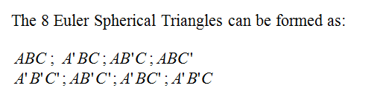
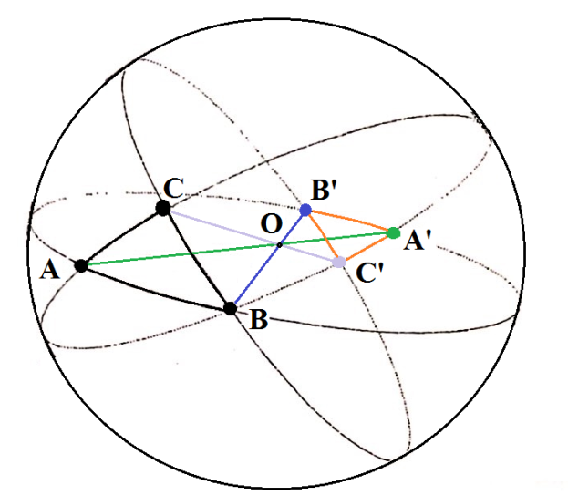
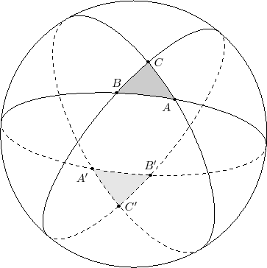
If three great circles are drawn from points A, B, C among AB, BC, and CA; let O be the center of a sphere, and suppose a solid angle formed at O by the meeting of three plane angles. Let AB, BC, CA be the arcs of great circles in which the planes cut the sphere; then ABC is a spherical triangle, and the arcs AB, BC, CA are its sides. Three intersection points are found symmetric to center of sphere O. In this case, Euler Spherical Triangles are formed. Let denote the intersection points of the great circles from the sphere center.

Slide 8
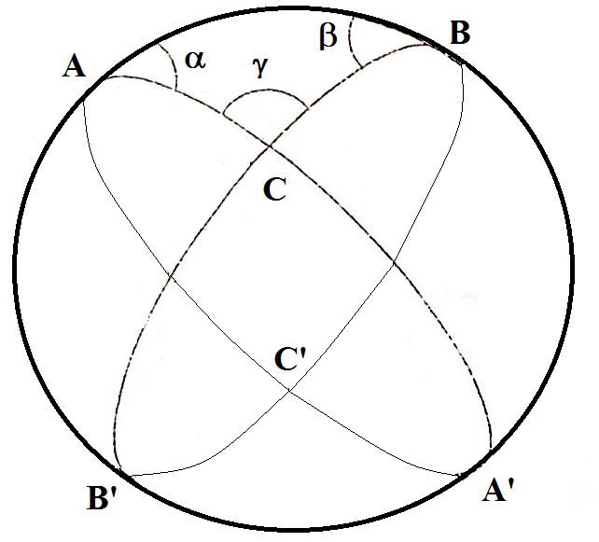
Area of a Spherical Triangle & Spherical Excess
To compute the area of ABC triangle, equations of spherical lune are used.
Let ABC be a spherical triangle; produce the arcs which form its sides until they meet again two and two, which will happen when each has become equal to the semicircumference.

Slide 9
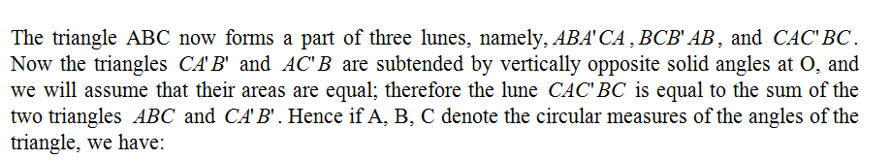
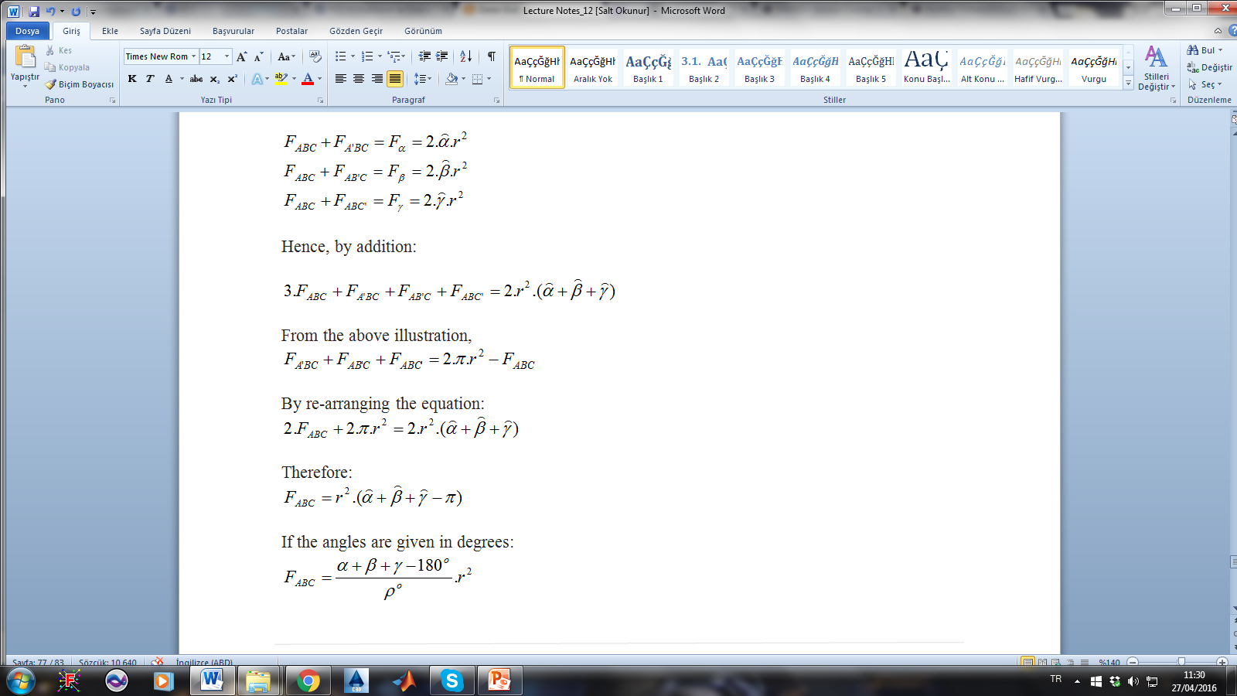
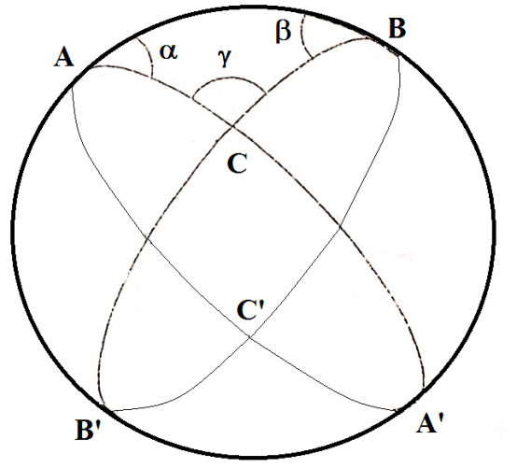

Slide 10
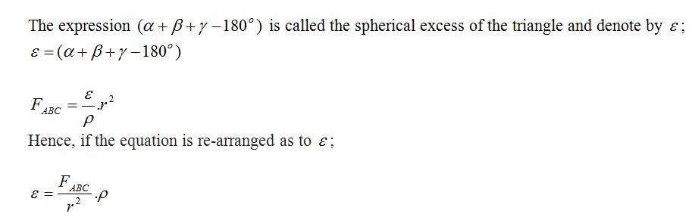
The sum of three angles of the spherical triangle is not constant, and is proportional to the area of spherical triangle. Since area is getting bigger, the excess is getting bigger as well. Just the contrary is also valid similarly. If the radius of a sphere is infinite, then it will be a plane. Thus, the excess will be 0 and the sum of the angles will be 180º. The area of small spherical triangles can be supposed to the plane triangles which have the same side lengths. These triangles are assumed as small spherical triangles when considering their sides are so small comparing with the radius of sphere. For instance, for the triangles having the sides up to 100 km are assumed as this.

Slide 11
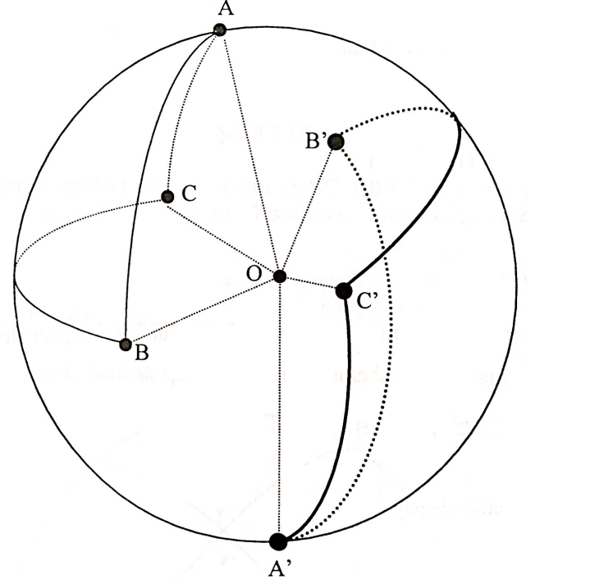
POLAR TRIANGLE and TRIHEDRON
The triangles, which are symmetric to the center of O and equal to each other, are so called polar triangle.
To obtain the orthogonals of the planes, one pole side (right or left) is taken. In the illustration, the left side pole is taken to draw the polar triangle (A ➔ B; B➔ C; C➔A)

Slide 12
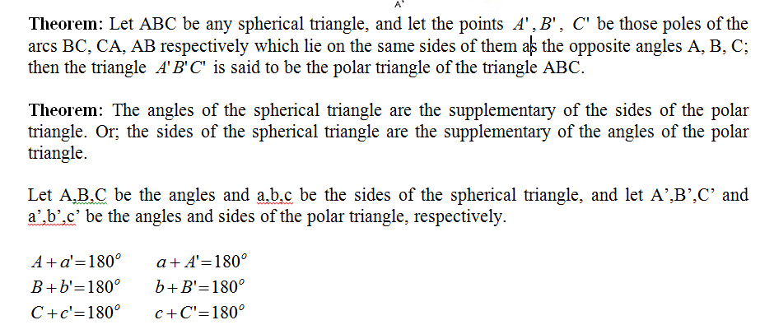

Slide 13
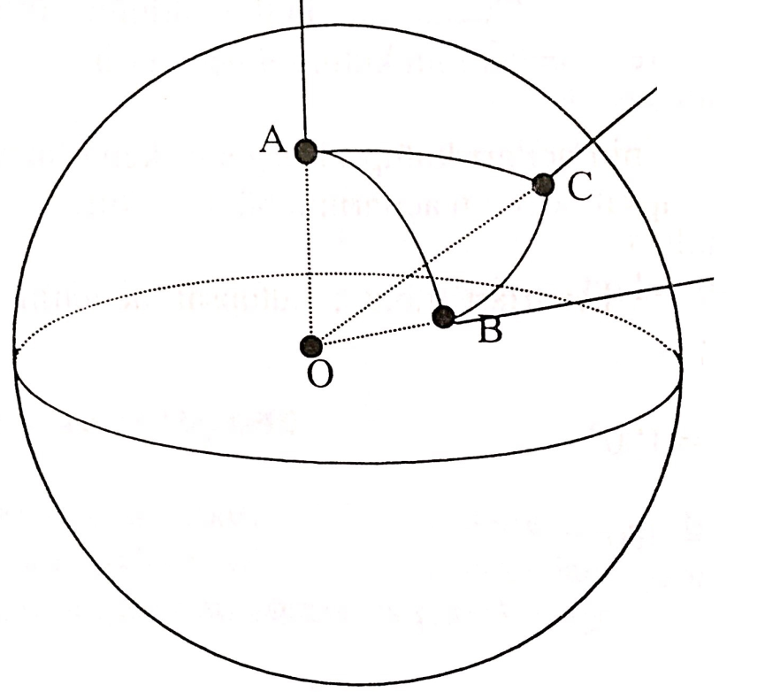
TRIHEDRON
If three corners of a spherical triangle are connected to the center of this sphere, a trihedron is formed. O –center of the sphere- is the apex; OA, OB and OC are the sides; AOB, BOC and COA are the faces of the trihedron. Since any spherical triangle has a trihedron, reverse is valid as well. Angles between the sides of the trihedron are sides of the spherical triangle.

Slide 14
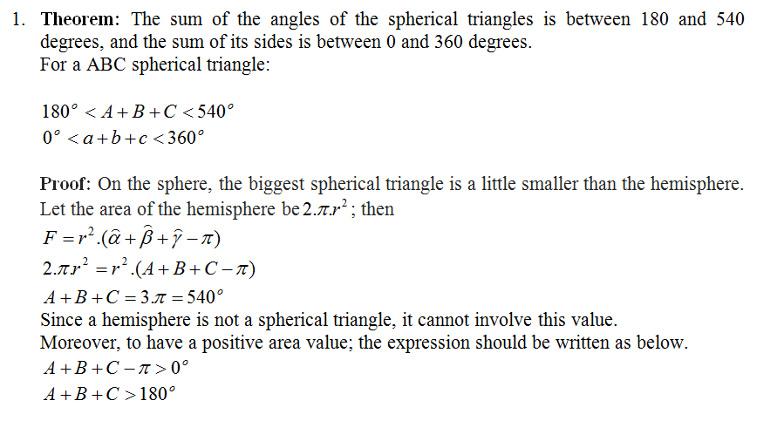
Specifications of Spherical Triangles
The letters A, B, C are used to denote the angles of a spherical triangle, and the letters a, b, c are used to denote the sides.

Slide 15
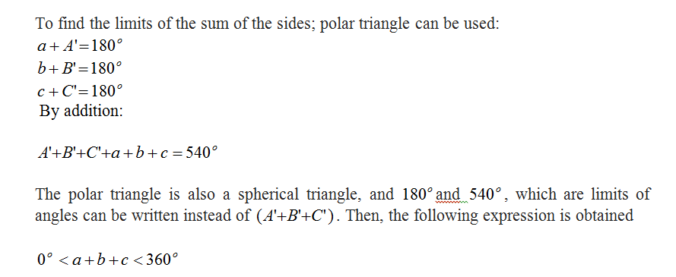

Slide 16
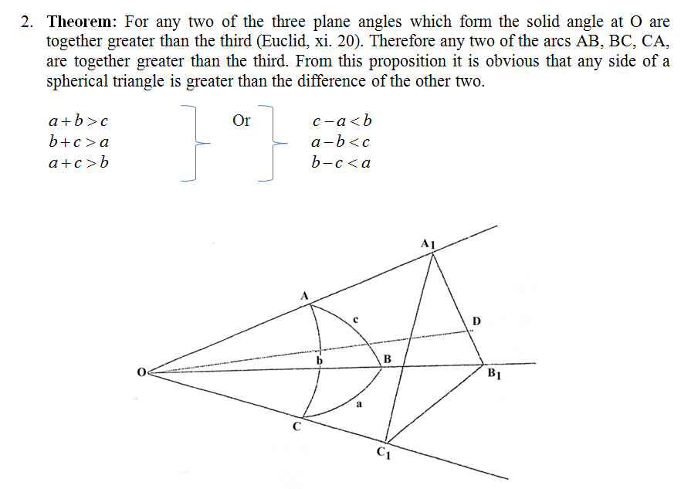

Slide 17
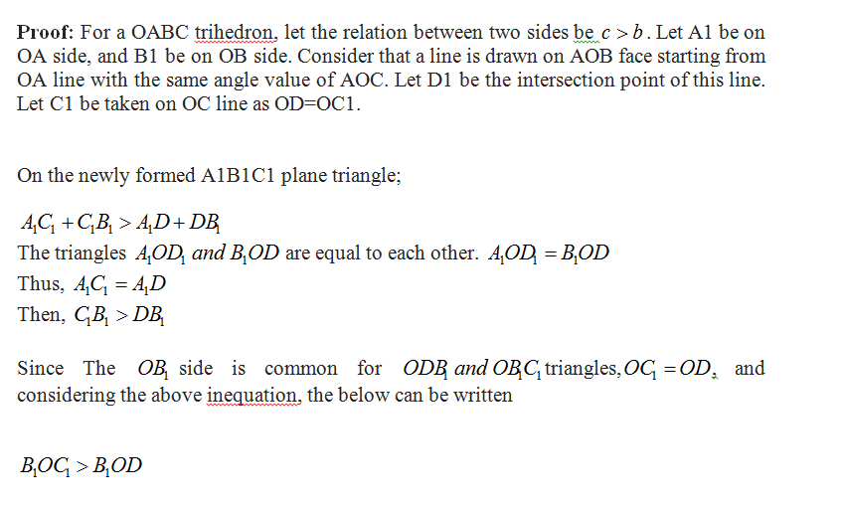

Slide 18
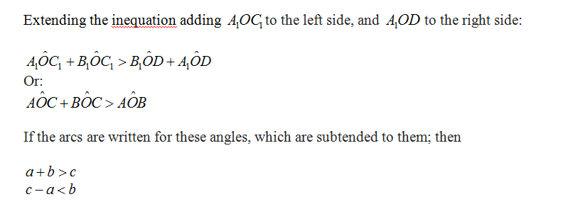

Slide 19
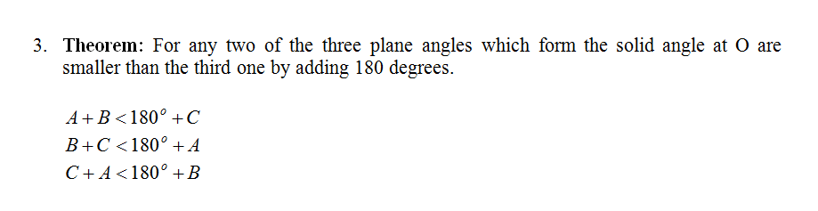
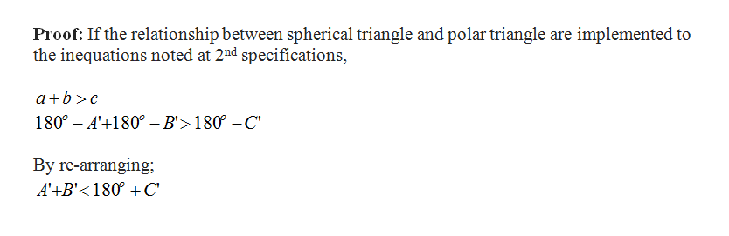

Slide 20
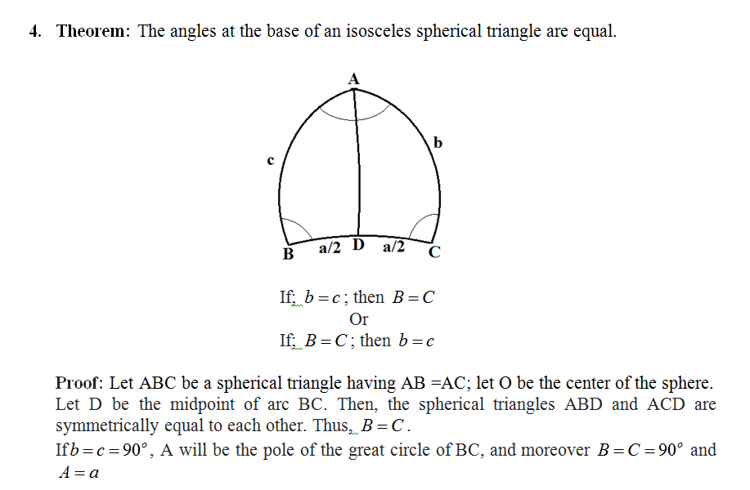

Slide 21
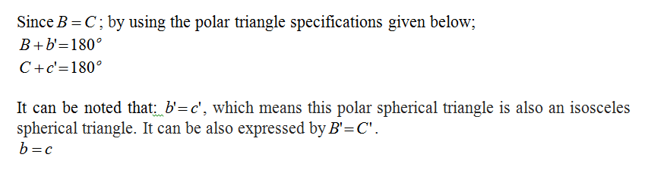

Slide 22
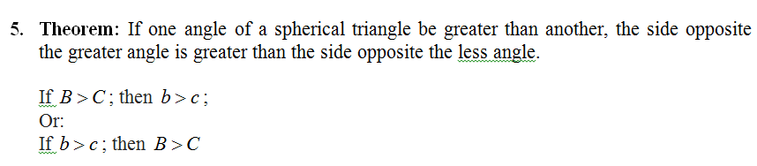

Slide 23
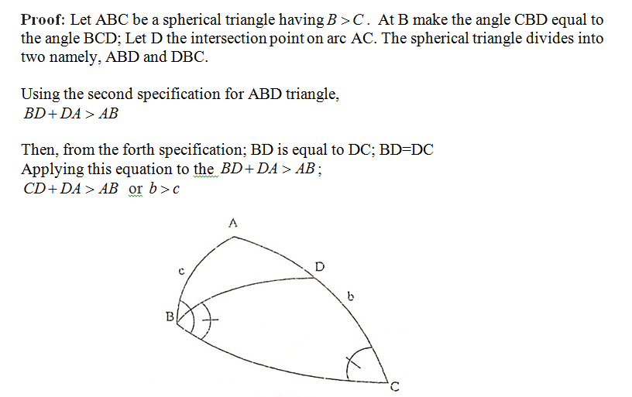

Slide 24
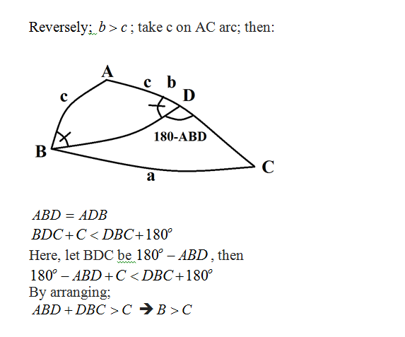

Slide 25
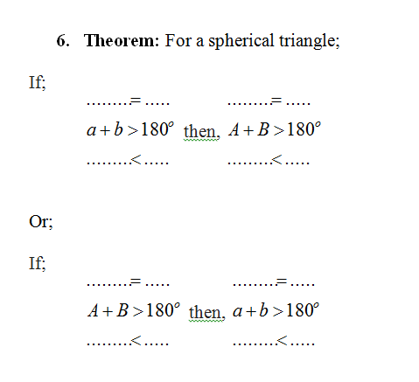

Slide 26
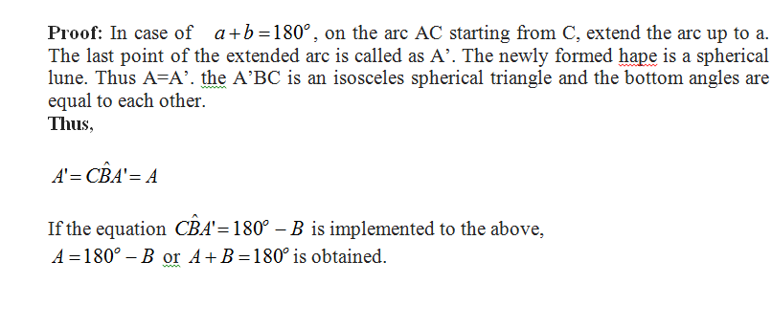


Slide 27
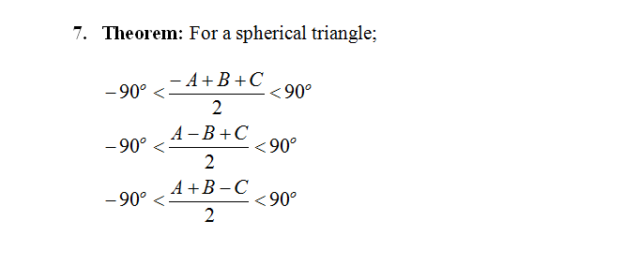
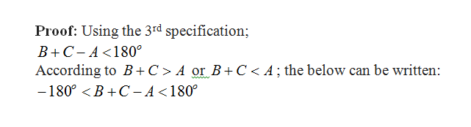

Slide 28
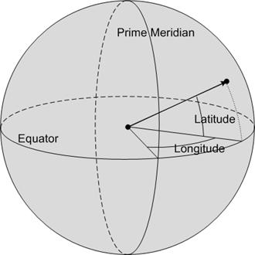

Slide 29
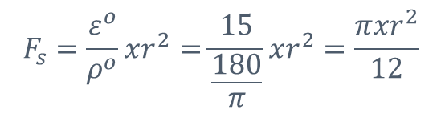

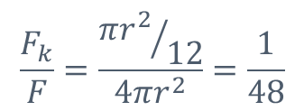
EXERCISE-1:
The angles of a spherical triangle are A= 55º, B=45º and C=95º. Compute the ratio between the area of spherical triangle and area of whole sphere.
ε=A+B+C-180º
ε=55º+45º+95º-180º
ε=15º

Slide 30
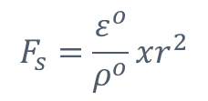
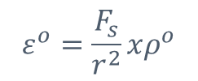
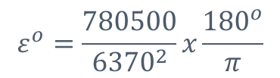


EXERCISE-2:
Compute the excess of a spherical triangle whose area is 780 500 km² on the globe.

Slide 31



EXERCISE-3:
For a spherical triangle, A= 125º, B=55º and a=130º , then compute the side b.

Slide 33
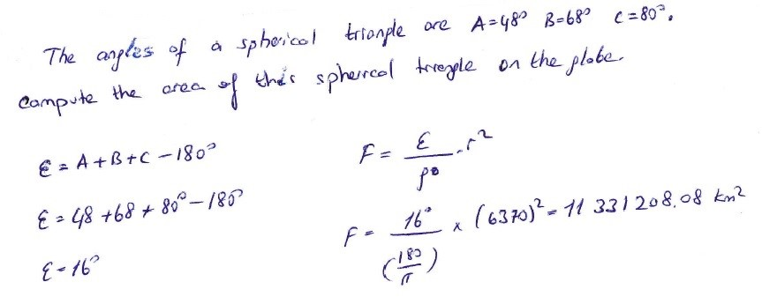

Slide 34
