Slide 1



PHYSICAL ANALYSIS IN WHEAT GRAIN

Slide 2

Wheat quality can be defined in terms of physical characteristics of the kernel including size, weight, and hardness (physical) and intrinsic properties such as protein contents and quality.
Wheat Kernel Quality:
Hectoliter Weight or Test Weight
Vitreous Kernel Content
Weight per 1000 Kernels
Kernel Size
Kernel Damage
Shrunken and Broken Kernels
Foreign Material
Protein Content
Falling Number
Moisture

Slide 3

Wheat grains include water, carbohydrates, protein, fat, cellulose, minerals, enzymes and vitamins. The amount of these substances in the grain of wheat varies according to the variety and the region in which it grows.

Slide 4
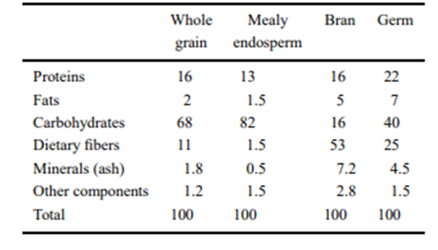
Composition of wheat kernel
Table 1: Chemical Compositions of wheat grain (Belderok et al., 2000)
The moisture content of lots of commercial wheat may vary between 12 and 18%, depending on the weather during harvest.
Wheat grain lipid content is low; they contain healthy polyunsaturated fatty acids. They are sources of vitamins; vitamins B and E and mineral; selenium, zinc, copper. Phytic acid– found in bran chelates the minerals

Slide 5
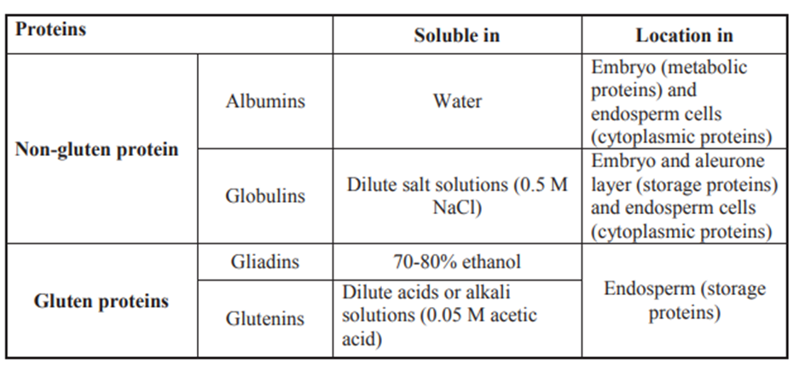
Wheat proteins are classified into groups on the basis of their solubility.
It is one of the important factors in determining the economic value of wheat grain. Wheat with high protein content has higher economic value because high protein flour is preferred in bread making.

Slide 6
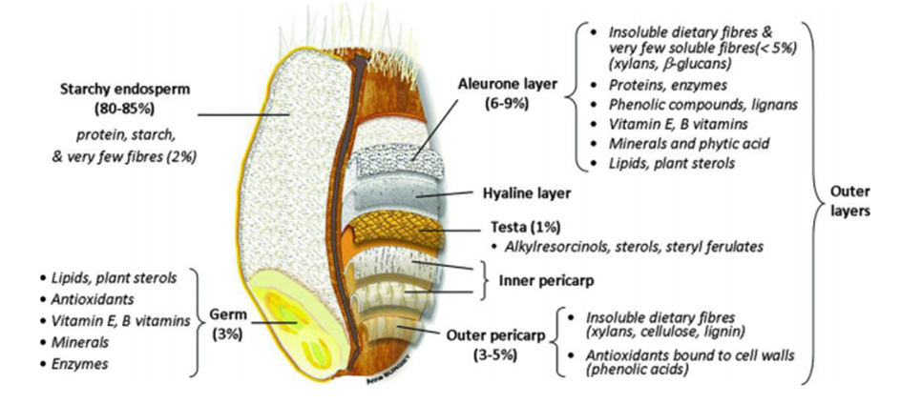
Structure of wheat grain
Wheat grain is constituted by three distinct parts: the germ (embryo), the bran and the mealy endosperm. Wheat grains contain 2–3% germ, 13–17% bran and 80–85% mealy endosperm.
The outer layer of kernel is removed as “bran” during milling. Bran is rich in “cellulose”, “hemi cellulose” and “lignin”.
“Endosperm” of the kernel is like an energy depot . Endosperm is generally composed of starch particles and cytoplasm.
Germination of the grain is managed by embryo (germ) and also supplies energy.
About 80% of the daily energy and protein demand of population is provided by cereal grains in Turkey.

Slide 7
Wheat Grain Quality Analysis

Slide 8
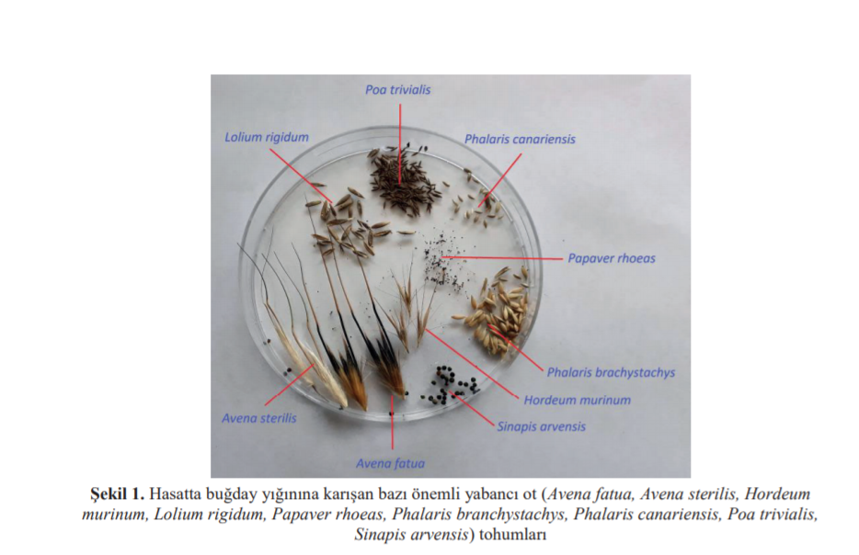
Foreign Matter Analysis
Foreign matter in wheat contains all the elements in the wheat sample except the main variety.

Slide 9


Place a clean dry basin (Bottom Pan) in place to receive any materials that may go through the sieve. Weigh 200 grams of the representative sample. Put the Wheat in the sieve provided (1.6 mm slotted-hole sieve).Shake the sieve horizontally for 30 times for about 15 seconds. Collect all the foreign organic matter that has passed through the sieve. Weigh all the foreign matter collected from the bottom.
https://www.youtube.com/watch?v=5WxRmNLVWOI

Slide 10
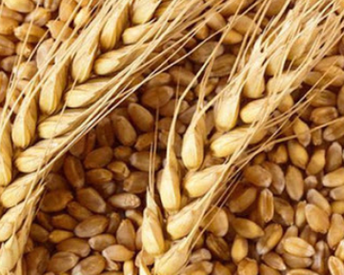
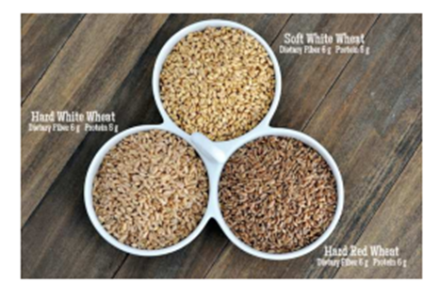
Colour Analysis
Wheat comes in different colours: red, white, and amber. As the hardness of the grain increases, the colour darkens. Colour also varies according to nature conditions and harvest season. Improper storage conditions and diseases have a detrimental effect on color.

Slide 11
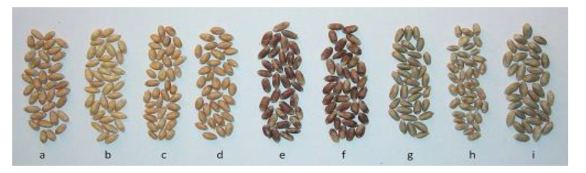
The colour determination is done by using the standard colour charts (scales). As the determination is subjective, the results differ slightly from the determinants.
https://www.youtube.com/watch?v=hL3j6LhzhcU

Slide 12
Determination of Test Weight-Hectoliter Weight

Slide 13
Hectolitre mass, also referred to in some countries as bushel-, specific- test-, or hectolitre weight is the weight of a standard volume of grain and is generally believed to be a measure of the bulk density and soundness of grain.
Hectoliter weight is an important indicator of the physical quality of wheat and has long been recognized as an indicator of the flour yield of wheat.
A high linear correlation coefficient was reported between test weight and flour yield in the range from 53 to 84 kg/hl.
Hectoliter weight is changing according to biological structure, moisture content and chemical composition. Hectoliter weight of Turkish wheat is between 72-83 kg/hl. The average is 78 kg/hl.

Slide 14
PROCEDURE:
https://www.youtube.com/watch?v=3zuaRlcaZ4Q

Slide 15
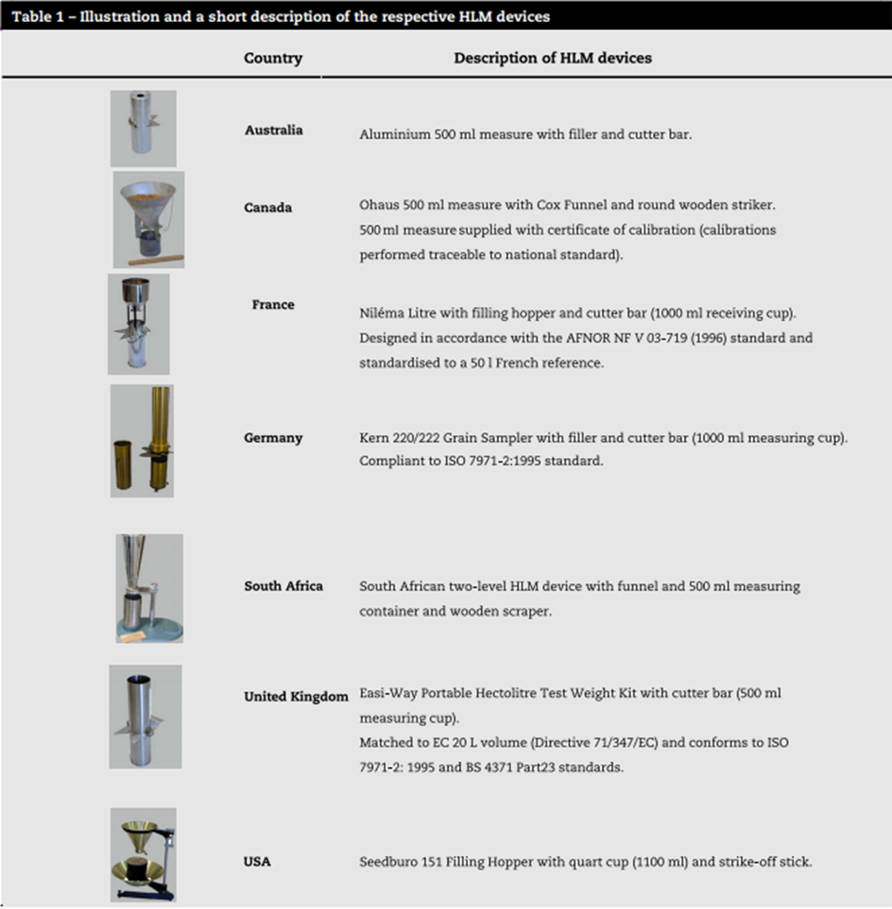

Slide 16
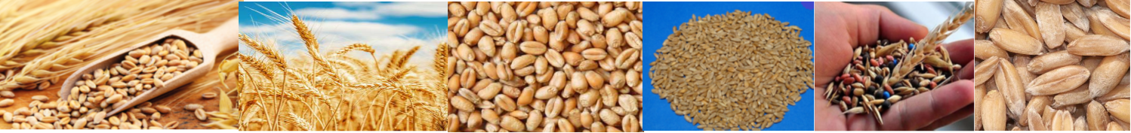
Thousand kernel weight
1,000 kernel weights is the weight in grams of 1,000 seeds. It varies according to seed size. Related to variety and environmental conditions.
Indicator of flour extraction yield.
The measurement of the thousand kernel weight includes weighing and counting the kernels.
Weight data is obtained from scales and traditional methods based on manual counting are used to count the kernels.

Slide 17
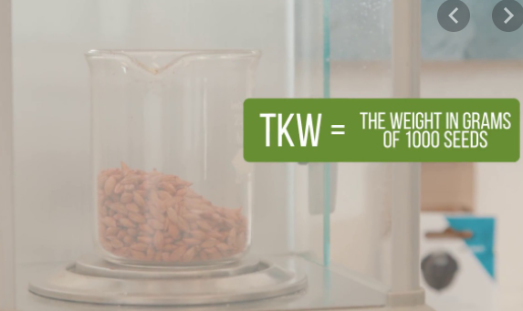

As manual counting is time-consuming and labour-intensive with subjective results, electronic counting devices are also commonly used.
For same variety, a thousand grain weight is directly proportional to the amount of starch and inversely proportional to the amount of protein.
It gives an idea about the grain size, fullness, ricidity and flour yield.
It is generally higher in hard wheat.
The weight of a thousand grains varies according to variety, climate and soil conditions.
It is an important measure for estimating the flour yield of wheat grain.

Slide 18

First, the impurities in the sample are removed.
The weight of a thousand grains is then determined by counting 500 or 1000 grains and weighing weight of these 500 or 1000 grains or weighing 15 grams of grains and then counting them.
During analysis studied with at least three parallel and then the average of the parallel is taken. Calculation is done according to the following formula:
It is stated that thousand kernel weight varies between 24-51 g for soft wheat and 26-58 g for hard wheat.

Slide 19
https://www.youtube.com/watch?v=QXErTO6fCE8

Slide 21
Grain hardness analysis
Grain hardness is important for the flour industry because it has significant impacts on milling, baking and qualities of wheat. The farmer generally makes more profit with harder textured wheat, due to the higher protein content. It is one of key determinant for classification of wheat and end product quality.
In general, glassiness is related to hardness and high protein content; opacity is considered to be associated with softness and low protein content. The light transmission property of the endosperm causes glassy or floury appearance of the grain.
While wheat grain loses water during drying, air gaps may form as a result of compression and rupture in protein structure and the endosperm appears opaque. In the vitreous grains, the protein is compressed, there are no breaks in the structure so that reason, no air gaps occur.
Vitreous kernels are associated with higher protein content and water-absorption capacity and with greater loaf volume potential in breadmaking. Therefore, in the production of bread, it is desirable for hard wheat to contain a high percentage of vitreous kernels.

Slide 22

It has been concluded in some studies that starchy durum wheat is softer than vitreous durum wheat, and gives a lower yield of coarse semolina and a higher yield of flour, thereby reducing milling potential.

Slide 23
Kernels that are glasslike and translucent in appearance are referred to as vitreous, whereas kernels that lack translucency or are light colored opaque are called nonvitreous (Starchy or piebald).

Slide 25

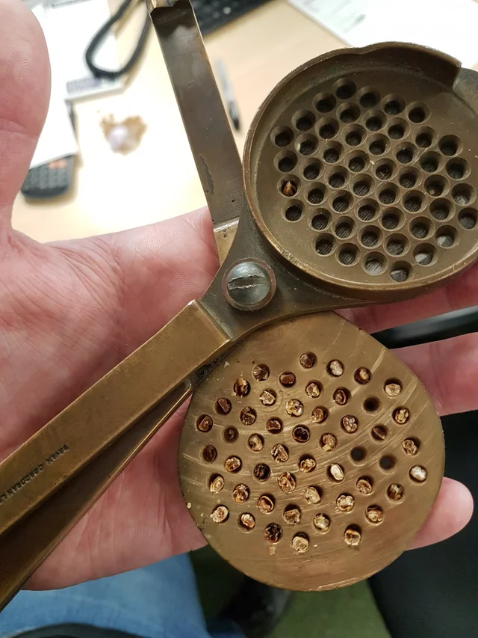

Slide 26

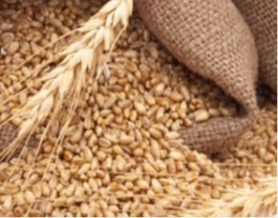

The Grobecker cutting tool has a bottom plate with 50 holes on which the wheats are placed, a blade over it and a perforated plate on the blade.
For the determination of the hardness, the blade between the two plates is taken out in the position to cut the grains.
The wheat is placed on the top plate of the hole and gently shaken to fill all the holes and the tool's special wood is pressed from the top.
Then the grain is cut from the center of the wheat by a single action transversely with the blade and the cross-sectional surfaces of crosscut half-grains in the holes in the bottom plate are examined one by one by pouring the remaining portion on the blade.
Since the Grobecker cross-section tool can take 50 cross-sections, the result is multiplied by two and the hard and soft grain rates are expressed as a percentage.

