Slide 1
Economic Systems
Spring 2024

Slide 2
Regional Averages of GDP per capita, 1820-2010
 | Western | Eastern | Western | Latin America | East | South & |  | Sub-Saharan
 | Europe | Europe | Offshoots | &Caribbean | Asia | South East Asia | MENA | Africa
1820 | 1226 |  | 1294 | 595 | 579 |  | 580
1830 | 1344 |  | 1489
1840 | 1522 |  | 1641
1850 | 1589 |  | 1809 | 663 | 599
1860 | 1823 |  | 2200 | 676
1870 | 1976 | 719 | 2421 | 754 | 543 | 516 | 720
1880 | 2190 |  | 3135 | 846
1890 | 2506 | 1002 | 3375 | 998 | 582 | 572
1900 | 2912 | 1273 | 4013 | 1129 | 607 | 597
1910 | 3172 | 1433 | 4915 | 1433 |  | 674
1920 | 3070 | 927 | 5396 | 1540 |  | 662
1930 | 4006 | 1597 | 6025 | 1795 | 723 | 756
1940 | 4472 | 2097 | 6837 | 1981 |  | 749
1950 | 4518 | 2583 | 9258 | 2502 | 655 | 675 | 1459 | 843
1960 | 6825 | 3627 | 10957 | 3119 | 1082 | 814 | 1977 | 987
1970 | 10108 | 5138 | 14554 | 3977 | 1796 | 977 | 3020 | 1239
1980 | 13127 | 6216 | 18054 | 5436 | 2479 | 1196 | 4102 | 1282
1990 | 15919 | 6389 | 22347 | 5047 | 3782 | 1609 | 3807 | 1135
2000 | 19315 | 4950 | 27572 | 5848 | 5451 | 2198 | 4497 | 1099
2010 | 20841 | 8027 | 29581 | 7109 | 9804 | 3537 | 5743 | 1481

Slide 3
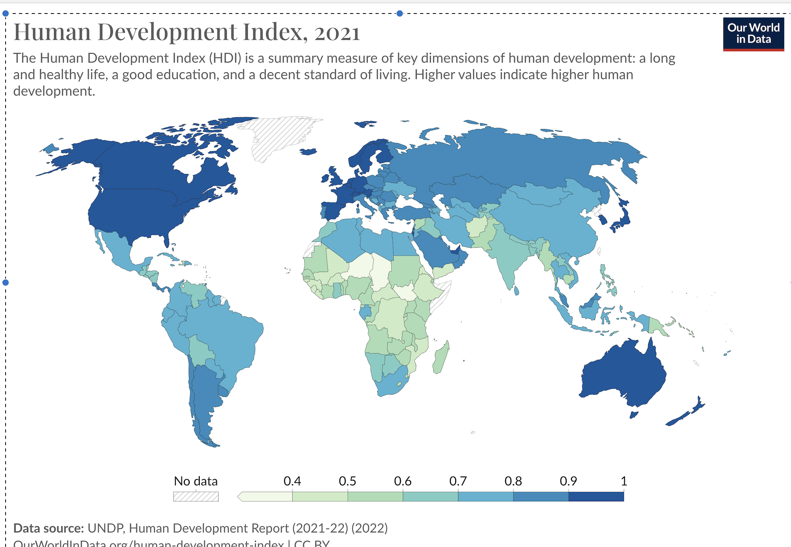

Slide 4
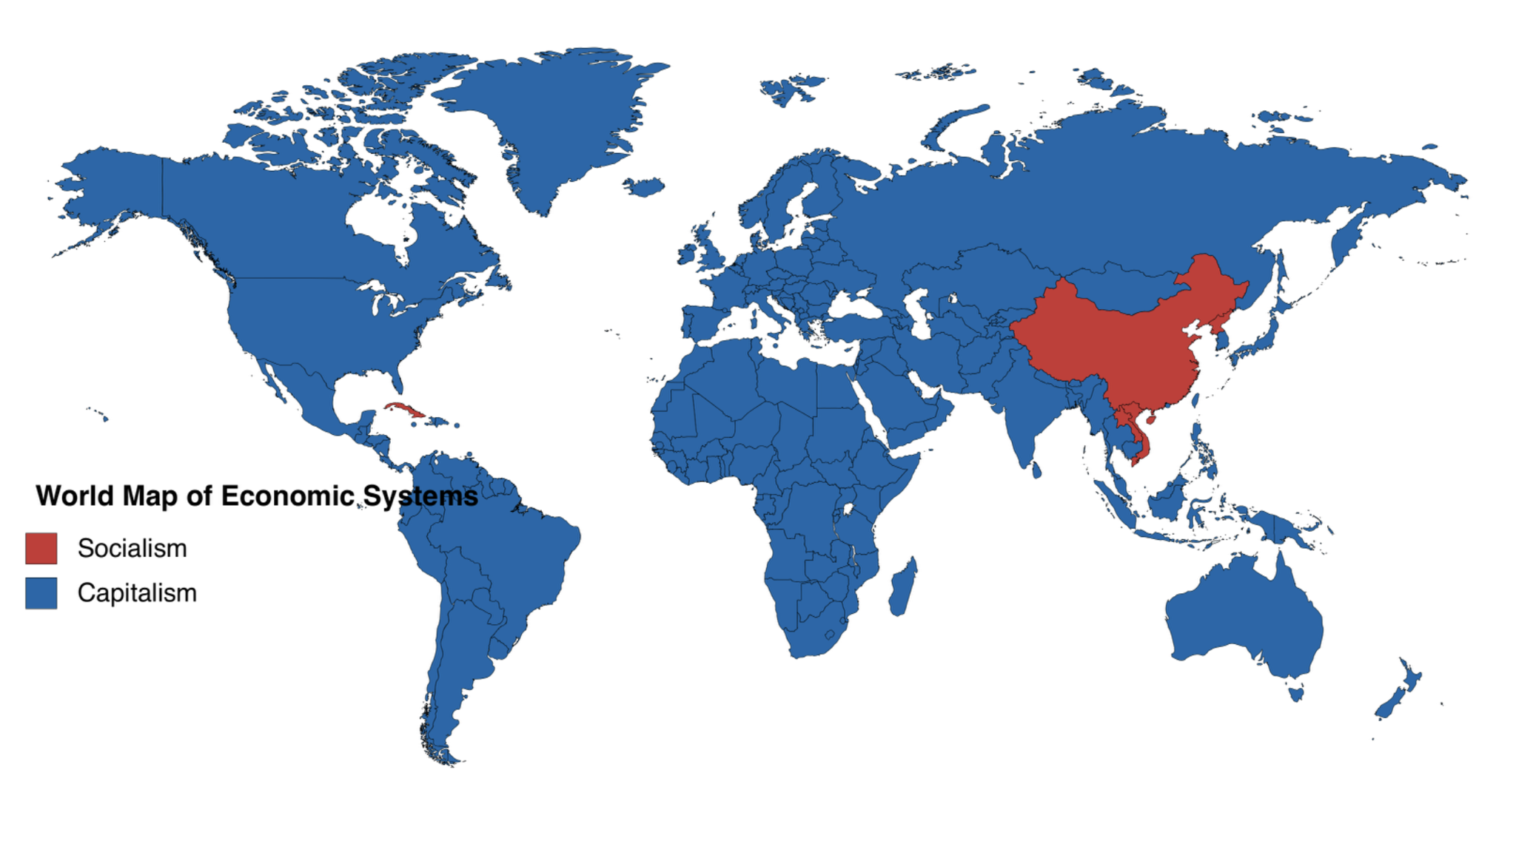

Slide 5
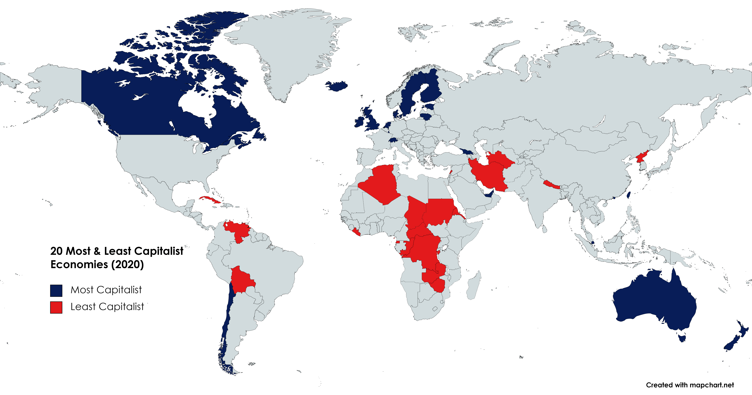

Slide 6
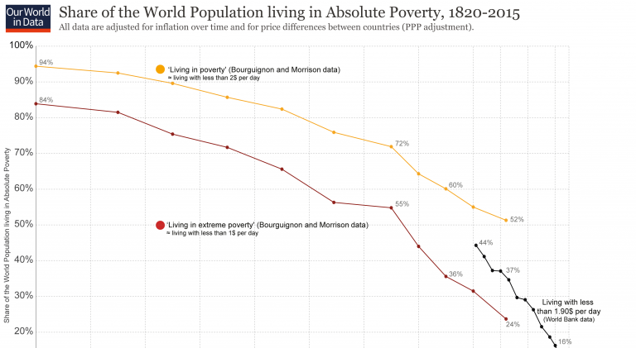

Slide 7
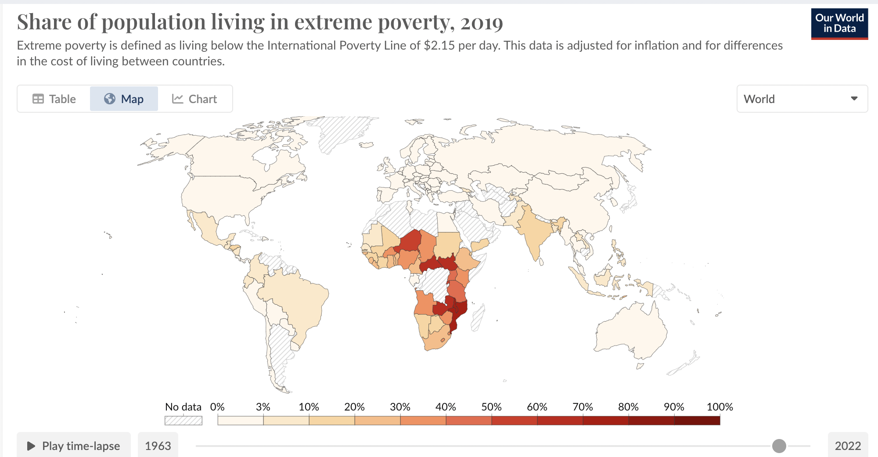

Slide 9
 | Africa | America | Asia | Europe | Former Soviet Union | Global Average
Period when earliest health transition in region began | 1920s | 1820s or 1830s | 1870s-1890s | 1770s | 1890s or 1900s
Life exp. Before heath transition | 26.4 | 34.8 | 27.5 | 34.3 | 29
1800 |  |  |  | 33.3
1870 |  | 35.1 |  | 36.2 |  | 29.7
1900 |  | 41 | 28 | 42.7 | 34.2-38.6 (1913) | 34
1950 | 35.6 | 58.4 | 41.6 | 64.7 | 56.1 | 48
1973 | 46.9 | 66 | 57.5 | 70.9 | 68.9 | 60
1990 | 52.9 | 70.8 | 64.5 | 74.2 | 69.1
2001 | 50.5 | 73.2 | 67.1 | 76.8 | 66.6 | 66.6

Slide 10
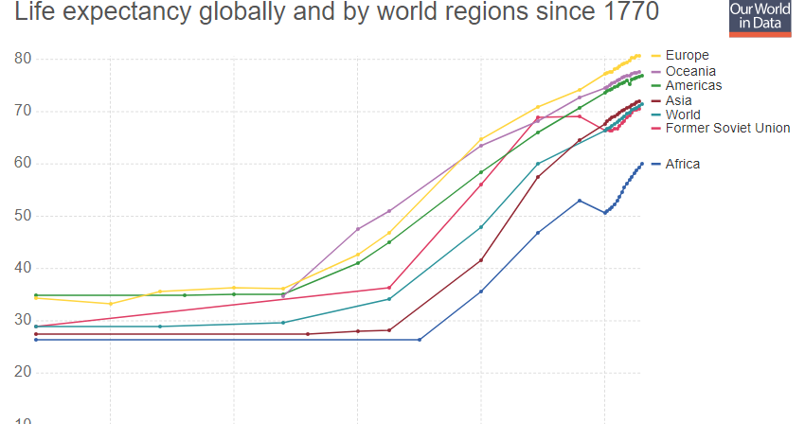

Slide 11
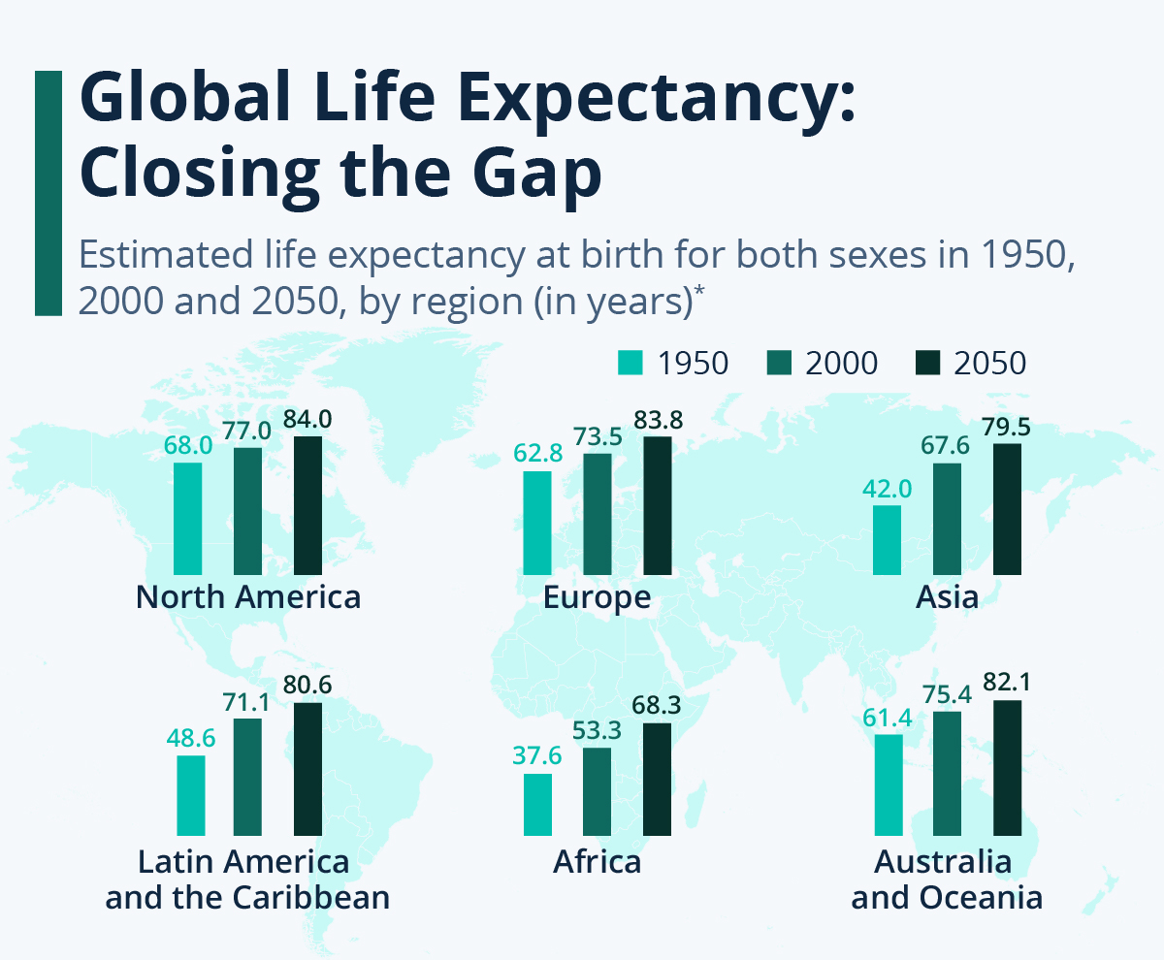

Slide 12
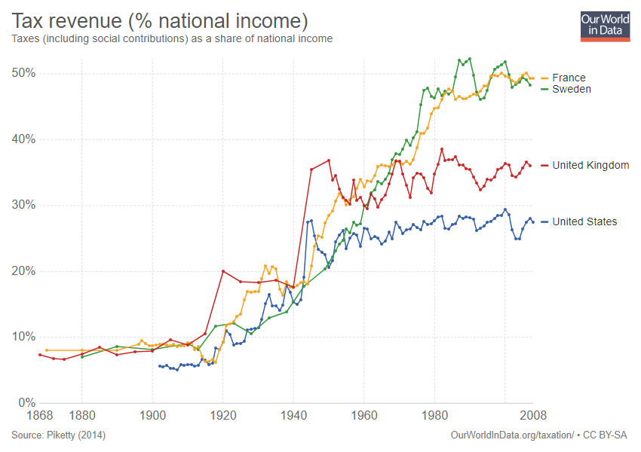

Slide 13
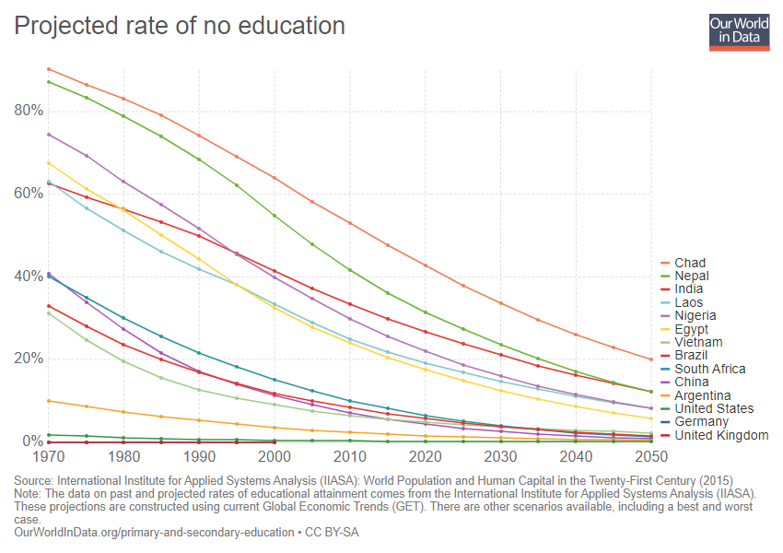

Slide 14
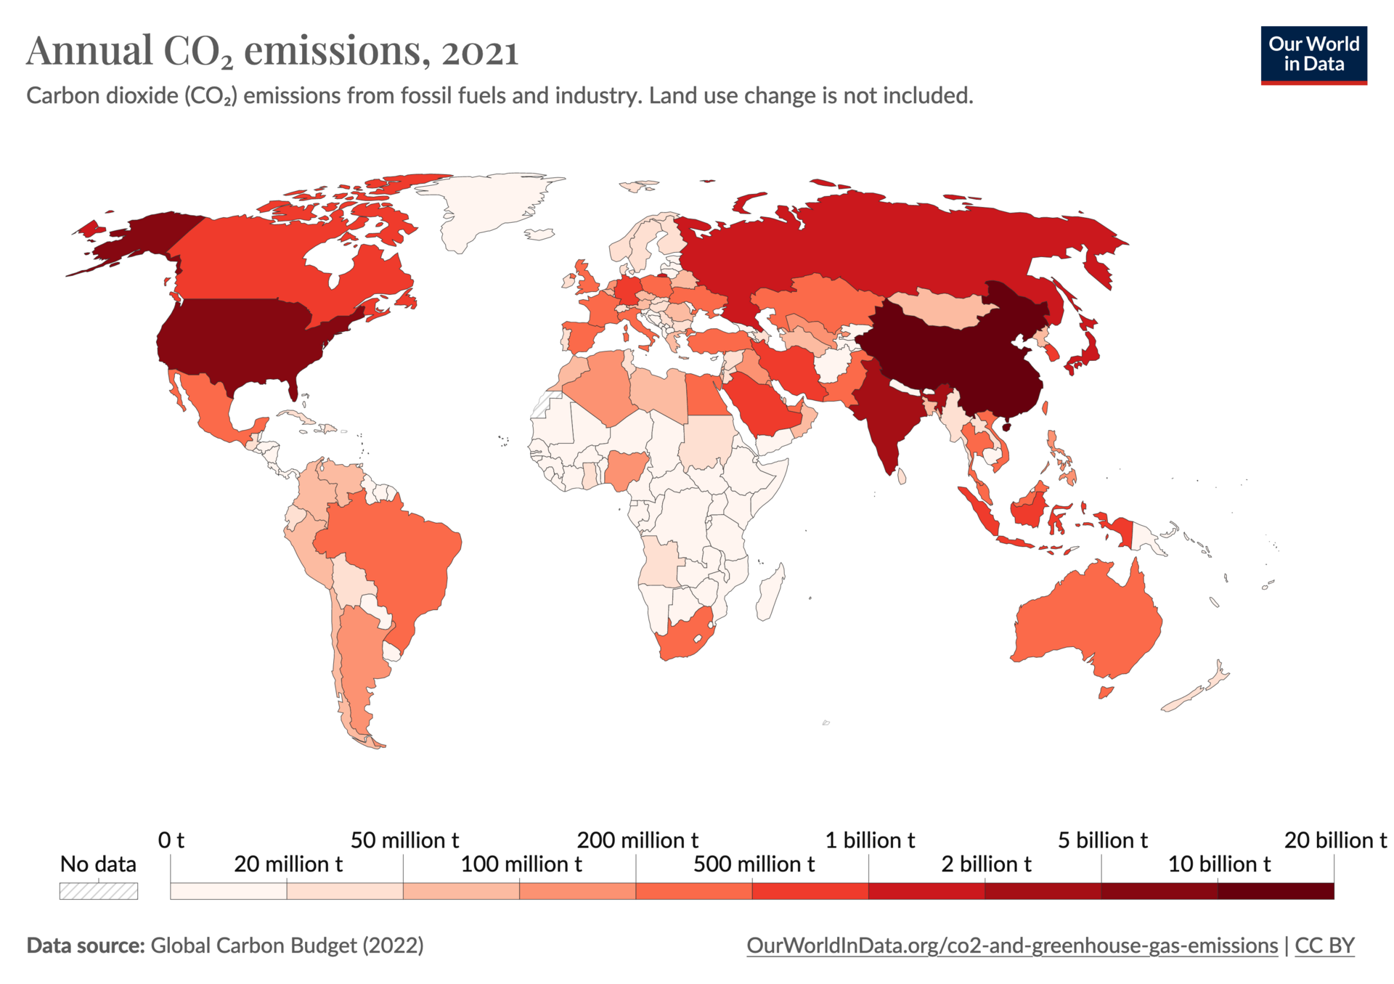

Slide 15
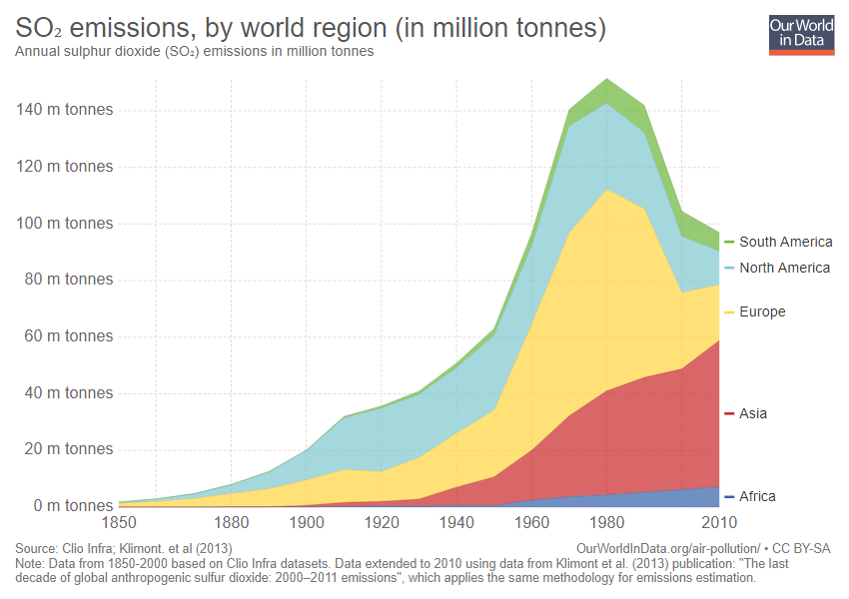

Slide 16
