Slide 1
Construction Management
Recitation-2

Slide 2
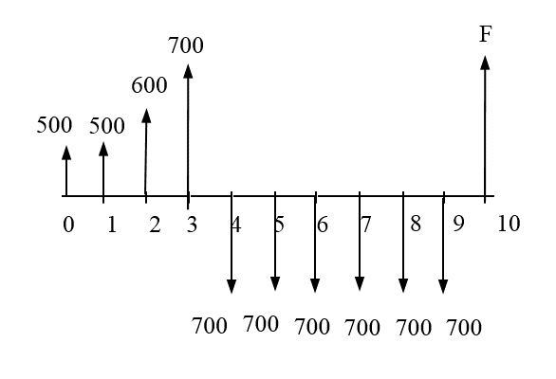
Composite Cash Flows
Example 1:
Calculate the value of this cash flow at the end of 10th year. Annual interest rate is 10%.

Slide 3
Example 1:
Calculate the value of this cash flow at the end of 10th year. Annual interest rate is 10%.
Solution

Slide 4
Solution
500 ( F/P, 10%, 10 )

Slide 5
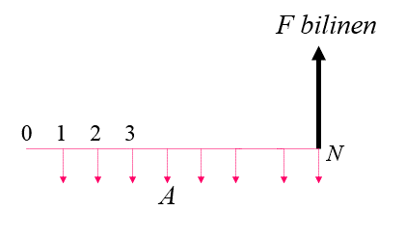
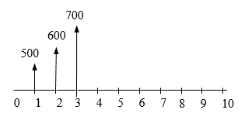
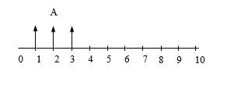
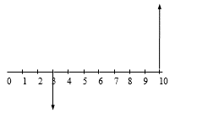
1) Calculation of A value for the arithmetic gradient series.
A= 500 + 100 ( A/G, 10%, 3)
2) Formula for calculation of F value when A, i and N are given.
F3 = A ( F/A, 10%, 3)
= [500 + 100 ( A/G, 10%, 3 )] ( F/A, 10%, 3 )
3) Calculation of F value for the single payment
F10 = F3 (F/P, 10%, 7) F10 is the future value for F3
F10 = [500 + 100 ( A/G, 10%, 3 )] ( F/A, 10%, 3 ) ( F/P, 10%, 7 )

Slide 6
2) Formula for calculation of F value when A, i and N are given.
F9= 700 ( F/A, 10%, 6 )
2) Calculation of F value for the single payment
F10= F9 ( F/P, 10%, 1 ) F10 is the future value of F9.
= ( F/A, 10%, 6 ) ( F/P, 10%, 1 )

Slide 7
F + 500 ( F/P, 10%, 10 ) + [500 + 100 ( A/G, 10%, 3 )] ( F/A, 10%, 3 ) ( F/P, 10%, 7 ) - 700 ( F/A, 10%, 6 ) ( F/P, 10%, 1 ) = 0
F + 500 x 2,594 + ( 500 + 100 x 0,9366 ) x (3,310) x (1,949) - 700 x 7,716 x 1,1 = 0
F + 1.297 + 3.829,81 - 5.941,32 = 0
F = 814,51 $

Slide 8
Example 2:
Calculate the net present value of cash flow given below. Annual interest rate is 10%.
300
A=650
200
250
0
1
2
3
4
5
6
7
8
9
10
P=?
100
A=650
50
0
200
200
200
1
2
3
4
5
6
7
8
9
10
P=?

Slide 9
100
A=650
50
0
200
200
200
1
2
3
4
5
6
7
8
9
10
P=?
First Solution
P= A1(P/A, %10, 3)+ G(P/G, %10, 3)+ A2(P/A,%10,6)*(P/F, %10, 4)
= 200*(2.4869) + 50*(2.3291) + 650*(4.3553)*(0.6830)
= 497.38 + 116.455+ 1933.54 >>>> P=2547
$$P=200∗\left[\frac{{\left(1+0,1\right)}^{3}−1}{0,1∗{\left(1+0,1\right)}^{3}}\right]+\frac{50}{0,1∗{\left(1+0,1\right)}^{3}}∗\left[\frac{{\left(1+0,1\right)}^{3}−1}{0,1}−3\right]+650∗\left[\frac{{\left(1+0,1\right)}^{6}−1}{0,1∗{\left(1+0,1\right)}^{6}}\right]∗\frac{1}{{\left(1+0,1\right)}^{4}}$$
P=2547

Slide 10
300
A=650
250
0
200
1
2
3
4
5
6
7
8
9
10
P=?
Second Solution
P= [A1+ G*(A/G, %10,3)]*(P/A, %10, 3) + A2(P/A,%10,6)*(P/F, %10, 4)
P= [200+50(0.9366)]* 2.4869 + 650*(4.3553)*(0.6830)
= (246.83*2.4869) + 1933.54 =613.84+1933.54
P=2547

Slide 11
Example 3:
The two cash flow given below are equal to each other for an interest rate of 10%. . Please calculate the X value.
100 $
100 $
X
X
X
X
100 $
100 $
100 $
100 $
≡
0 1 2 3 4 5 6 7
0 1 2 3 4 5 6
0 1 2 3 4 5 6 7
Solution
P = 100 ( P/A, 10%, 7 ) – 100 ( P/F, 10%, 2 ) = (100 x 4,8684) – (100 x 0,826) = 404,19 $
(4,8684) (0,8265) read from interest table
404,19 = X + X ( P/F, 10%, 2 ) + X ( P/F, 10%, 4 ) + X ( P/F, 10%, 6 )
404,19 = 3,074X
X = 131,49 $

Slide 12
Solution 4:
Please calculate the net present value of cash flow given below.
500
400
200
200
300
100
0
2
1
100
3
4
5
6
7
8
i=%8
i=%10
Solution
P= F1(P/F, %8, 1)- F2(P/F, %8, 2)+(A1+G(A/G, %10, 5)*(P/A, %10, 5)*(P/F, %8, 3)
$$P=\frac{200}{(1+0,08)}−\frac{100}{{\left(1+0,08\right)}^{2}}+\left[100+100∗\left[\frac{1}{0,1}−\frac{5}{{\left(1+0,1\right)}^{5}−1}\right]\right]∗\left[\frac{{\left(1+0,1\right)}^{5}−1}{0,1∗{\left(1+0,1\right)}^{5}}\right]∗\frac{1}{{\left(1+0,08\right)}^{3}}$$
P=945,306

Slide 13
Problem-3: With an interest rate of 8% per annum, 10000 liras was withdrawn from the bank. In the first year, a certain amount was paid, in the following years respectively 500 TL, 1500 TL, 3000 TL and 5000 TL were added to the amount paid in the first year. Find the amount of the first payment accordingly?
Solution
P = 10.000 TL
1
2
3
4
5
X
X + 500
i = 8 %
X + 1500
X + 3000
X + 5000
1- First Solution
10.000(A/P, 8%, 5) = X + [500(P/F, 8%, 2) (A/P, 8%, 5)] + [1.500(P/F, 8%, 3) (A/P, 8%, 5)] + [3.000(P/F, 8%, 4) (A/P, 8%, 5)] + 5000(A/F, 8%, 5)
10.000 x 0,25046 = X + (500 x 0,8573 x 0,25046) + (1.500 x 0,7938 x 0,25046) + (3.000 x 0,7350 x 0,25046) + 5.000 x 0,17046
2.504,60 = X + 107,36 + 298,22 + 552,26 + 852,30
X = 2.504,60 - 1.810,14
= 694,46 TL

Slide 14
Problem-3: With an interest rate of 8% per annum, 10000 liras was withdrawn from the bank. In the first year, a certain amount was paid, in the following years respectively 500 TL, 1500 TL, 3000 TL and 5000 TL were added to the amount paid in the first year. Find the amount of the first payment accordingly?
Solution
P = 10.000 TL
P = 10.000 TL
1
2
3
4
5
1
2
3
4
5
X
X + 500
i = 8 %
X
X
X
X
X
X + 1500
500
i = 8 %
X + 3000
1500
X + 5000
3000
5000
Second Solution
10.000 - [500 *(P/F, 8%, 2) + 1500* (P/F, 8%, 3) + 3000* (P/F, 8%, 4) + 5000 *(P/F, 8%, 5) - X *(P/A, 8%, 5) ] = 0
10.000 - [(500* 0.8573) + (1500*0.7938) + (3000*0.7350) + (5000* 0.6806) – (3.9927 X ) ] = 0
10.000 - 428.65 + 1190.7 + 2205 + 3403 - 3.9927 X = 0
3.9927 X = 2772,65
X = 694,46 TL

Slide 15
Example 6:
A construction company compares two alternatives. The first alternative is an automatic feeding machine, the other is a manual feeding machine.
The initial cost of the first alternative, which is thought to have a 10-year economic life, is 23000 TL and the estimated salvage value is 4000 TL. Operation cost is 12 TL per hour. The expected production amount per hour is 8 tons. Annual maintenance and operation costs are considered to be 3500 TL.
The second machine, which is considered as an alternative, has an initial cost of 8000 TL and no salvage value. Its economic life is estimated to be 5 years. In order to make this machine 6 tons per hour, three workers must be employed for 8 TL per hour. Annual maintenance and operation costs are estimated to be 1500 TL.
Since the whole project is estimated to yield 10%, how many tons of production should be produced per year so that an automatic machine can be selected?
-----------------------------------------------------------------------------------------------------------------------------------------------------
X represents the annual production
Annual variable cost for alternative 1= $12/hour* 1hour/8ton* x ton/year
D₁= 1.5x
ENH₁= - 23,000(A/P,10%,10) + 4000(A/F, 10%,10) - 3500 - 1.5x
ENH₁= -6992-1.5x
Annual variable cost for alternative 2= $8/hour*3*1hour/6ton* x ton/year
D₂= 4x
ENH₂= - 8000(A/P,10%,5) - 1500 - 4x
ENH₂ = -3610-4x
ENH₁= ENH₂
-6992-1.5x = -3610-4x
x= 1353 ton/yıl
If annual production exceed the 1353 tons, automatic feeding machine should be acquired.

Slide 16
Solution 7:
Activity | Predecessor | Normal Duration | Activity Cost
A, B, C | - | 4 | 2500
D, E | C, B | 5 | 3500
F | A | 2 | 750
G | F, E | 7 | 450
H | D, G | 8 | 1000
It is assumed that each activity will be completed without any delay and Cost of each activity will be paid right after its completion.
A client thinks to deposit all money required to complete this project into a bank with an interest rate of 2%, in order pay less amount of money. How much money this client should deposit to be able to cover all the expenses of the project.

Slide 17
Solution
4
7
9
9
16
16
24
24
F
2
G
7
H
8
A
4
E
5
0
0
4
4
B
4
D
5
C
4
4
4

Slide 18
P=?
0
1
2
3
4
5
6
7
8
9
10
11
12
13
14
15
16
17
18
19
20
21
22
23
24
750
450
1000
7500
7000
$$P=\frac{7500}{{(1+0,02)}^{4}}+\frac{750}{{(1+0,02)}^{6}}+\frac{7000}{{(1+0,02)}^{9}}+\frac{450}{{(1+0,02)}^{16}}+\frac{1000}{{(1+0,02)}^{24}}=14401,63$$

