Slide 1
Construction Management
Recitation-3

Slide 2
Problem-1
A company wants to acquire new equipment for its new production plant. After determining the incomes and outcomes of the equipments, the procurement team is going to chose the best one among two alternatives. If MARR is 10%, please determine which the best alternative is.
 | Machine X | Machine Y
Initial Cost | 38000 $ | 38000$
Net Income at first year (After subtracting all expenses) | 14000$ | 1500$
Income at upcoming years | Decreases by 2000$ each year | Increases by 3500$ each year
Service Life | 6 | 6

Slide 3
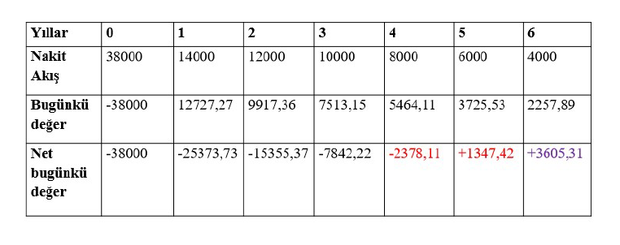
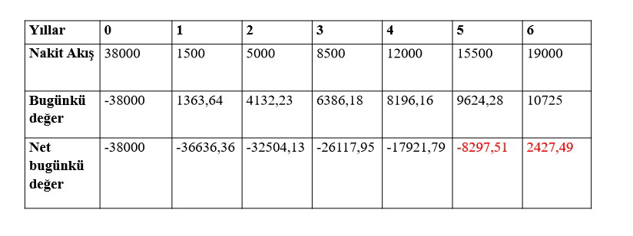
Machine X
Years
Cash Flow
Present Value
Net Present Value
Machine Y
Years
Cash Flow
Present Value
Net Present Value

Slide 4
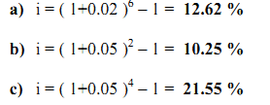
Problem-4
a) If monthly interest rate is 2%, what is the effective interest rate semi-annually?
b) If the quarterly interest rate is 5%, what is the effective interest rate semiannually?
c) If the quarterly interest rate is 5% , what is the effective interest rate annually ?
Solution
$i_{e}$ = ${(1+\text{i} )}^{m}$ - 1
Problem-5
What is the monthly effective interest rate so that a deposit can be tripled within 5 years?
Solution
3P = P(1 + i)⁶⁰
3 = (1 + i)⁶⁰
i = 1.85% aylık
$F$ = ${ P x (1+\text{i} )}^{n}$

Slide 5
PROBLEM-6
Problem-6 How much money should be paid every year to ensure that the annual deposit is equal to 600 TL paid every six months. Interest rate is 24%, compounding quarterly.
Solution

Slide 6
PROBLEM-7
A=400
0
1
2
3
4
5
6
7
8
9
10
11
12
A=500
If present value of the given cash flow is zero, what is the value of monthly interest ratio?

Slide 7
PROBLEM-7
$$400∗\frac{{\left(1+i_{2ay}\right)}^{6}−1}{i_{2ay}∗{\left(1+i_{2ay}\right)}^{6}}=500∗\frac{{\left(1+i_{3ay}\right)}^{4}−1}{i_{3ay}∗{\left(1+i_{3ay}\right)}^{4}}$$
$$i_{2ay}={\left(1+i_{ay}\right)}^{2}−1$$
$$i_{3ay}={\left(1+i_{ay}\right)}^{3}−1$$

Slide 8
PROBLEM-8
A construction company conducts feasibility study between two options.
In the first option, the company can buy an excavation machine. This machine has an economic life of 8 years. The initial cost of this machine is 1.000.000 TL and the annual maintenance cost is 150.000 TL. In addition, for this machine, an operator must be employed for 3,000 TL per month and a helper for 100 TL per day. It is known that the salvage value of the machine is 250.000 TL.
Alternatively, the machine can be rented for 2,000 TL per day. This rental is included in the cost of personnel and all other costs.
Use the Break-even method to determine which option should be selected when the MARR value is 8%.

Slide 9
PROBLEM-8
0,08=(1+i_{aylık})¹² - 1 >>> i_{aylık}=0,00643
A_{investment} = 1.000.000*[(0,08*(1+0,08)⁸)/((1+0,08)⁸-1)]=173.927,3071
A_{annual operator} = 3000*[((1+0,00643) ¹²-1)/0,00643]=37.300,82651
A_{maintenance} = 150.000
A_{annual salvage} = 250.000*[0,08/((1+0,08)⁸-1)]=23.503,69015
A_{helper}= 100 x
A_{(second option) =} 2000 x
(-173.927,3071)-(37.300,82651)-(150.000)+(23.503,69015)-100x=-2000x
(-337.724,4435) = -1900 x
X=177,749
If machine to be operated more than 178 days in a year, first machine should be selected.

Slide 10
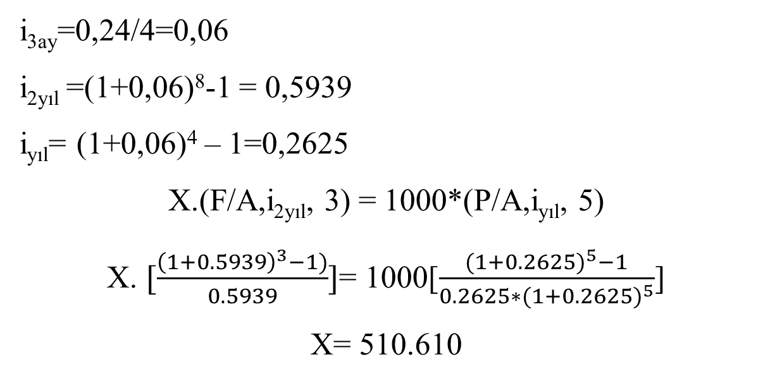
PROBLEM-9
The interest rate is nominal rate of 24%, compounding quarterly. Accordingly, what should be the X value in order for the cash flow diagram below to be zero? (Use the Equal Serial Payments method, including X payments)
1000 1000 1000 1000 1000
(yıl)
0
1
2
3
4
5
6
7
8
9
10
X X X
i_{3ay}=0,24/4=0,06
i_{2yıl} =(1+0,06)⁸-1 = 0,5939
i_{yıl}= (1+0,06)⁴ – 1=0,2625
X.(F/A,i_{2yıl}, 3) = 1000*(P/A,i_{yıl}, 5)
X. $[\frac{{\left(1+0.5939\right)}^{3}−1)}{0.5939}]$= 1000[$\frac{{(1+0.2625)}^{5}−1}{0.2625∗{(1+0.2625)}^{5}}$]
X= 510.610

Slide 11
Problem-2
A municipality plans to construct new Metrobus Line for its new residential area. Benefit and cost analysis of system is given as follow;
Initial investment of the Metrobus system is 15.000.000 TL.
In addition, Annual maintenance costs are 250.000 TL. Operating and energy costs are expected to be 500.000 TL/year and these expenses are expected to rise by 50.000 once a three year.
Municipality expects that revenue of the system will be 1.000.000 TL and it is expected that this revenue is going to increase 200.000 once in two years.
Users of this system also are going to save 3.000.000 TL in a year.
Unfortunately, Costs of environmental effects of this systems are estimated as 1.000.000 in a year.
Economic life of the system is 30 years.
As a decision maker of this municipality, by using benefits and costs analysis, please decide whether invest in this system or not. MARR should be taken as 10%.

Slide 12
Problem-2
•Costs?
– Initial investment
– Maintenance
– Energy
– Direct Revenue obtained from the system
• Benefits?
– Benefits of users from the system
– Environmental Effects

Slide 13
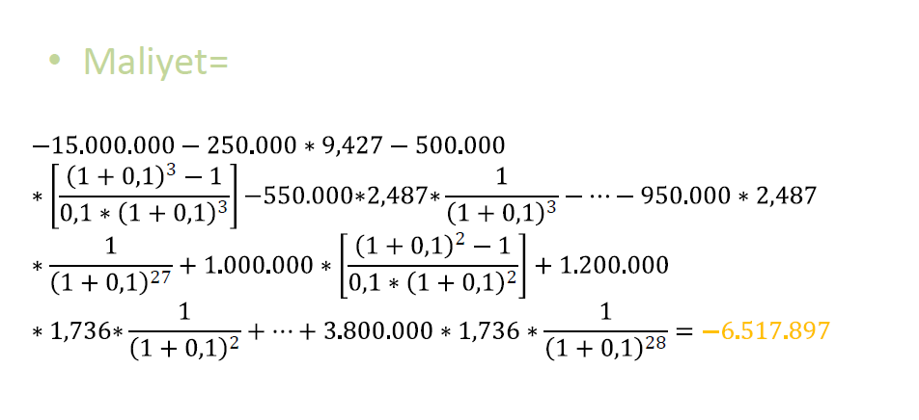
Problem-2
Costs=

Slide 14
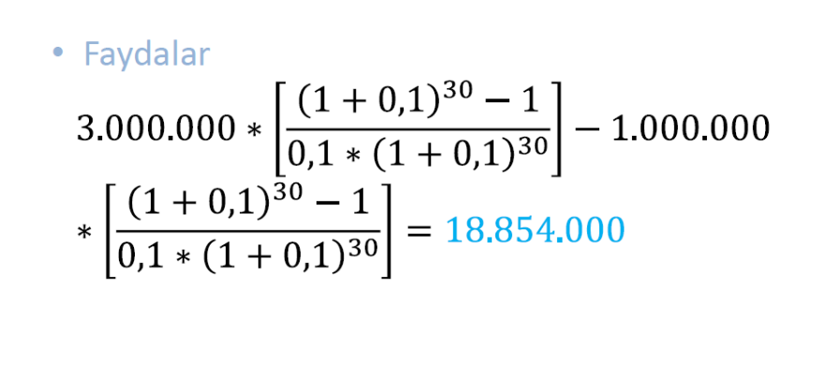
Problem-2
Benefits=

Slide 15
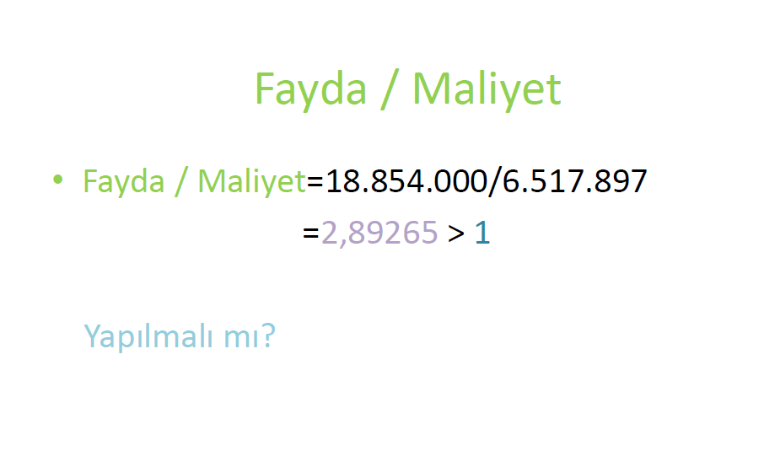
Problem-2
Benefits/ Costs=
Benefits/ Costs=
Benefits/ Costs
Is the system feasible ?

Slide 16
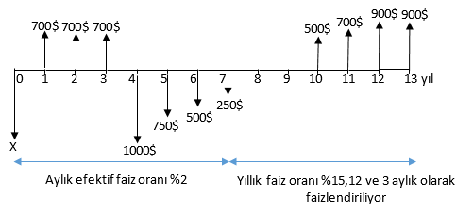
PROBLEM-10
$X=700∗\left(P/A,0,2682,3\right)−(1000−250(A/G,0.02682,4)$) * (P/A,0.2682,4) * (P/F,0.2682,3)+(500+200*(A/G,0.16,3)) * (P/A,0.16,3) * (P/F,0.16,2) * (P/F,0.2682,7)+900 * (P/F,0.16,6) * (P/F,0.2682,7) = 832,243

Slide 17
PROBLEM-1
a) Draw the network.
b) Find critical paths
c) Calculate normal duration and cost
d) Please perform necessary crashings to complete project in 15 months and calculate the cost of crashing at every step.
Relationships between the activities
Activity can start after activity A, B, C are completed.
In order to start activity E, activity B and C have to be completed.
Activity F can start after activity C is completed.
Activity G can start after activity D is completed.
Activity H is related to completion of activity D and E.
Act. | Dr. (Month)
A | 6
B | 5
C | 8
D | 4
E | 5
F | 10
G | 4
H | 4

Slide 18
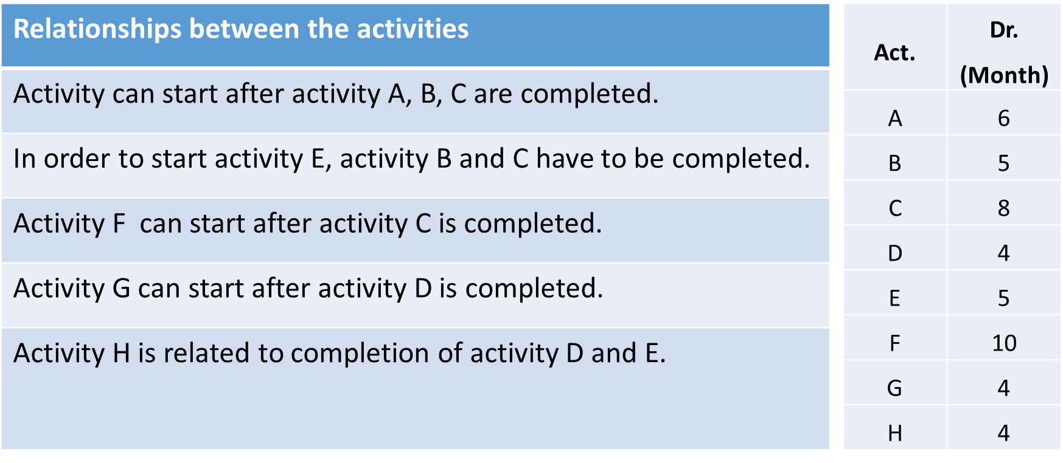
PROBLEM-1
a)- Draw the network
A
6
4
D
4
5
G
4
1
B
5
3
E
5
6
H
4
7
C
8
2
F
10

Slide 19
PROBLEM-1
b) Find critical path
Act. | Dr. (Month)
A | 6
B | 5
C | 8
D | 4
E | 5
F | 10
G | 4
H | 4
8
10
12
14
TB= 4 SB= 2
A
6
D
4
G
4
4
5
TB= 2 SB= 0
TB= 2 SB= 2
0
0
8
9
18
18
TB= 0 SB= 0
TB= 1 SB= 1
1
B
5
3
E
5
6
H
4
7
TB= 1 SB= 0
13
14
TB= 0 SB= 0
8
8
C
8
2
F
10
TB= 0 SB= 0
Critical Path: 1-2, 2-7 or C-F
Normal Duration: 18 month

Slide 20
PROBLEM-1
c) Calculate normal cost
Akt. | ND (Month) | CD(Month) | NC (TL) | First CC (TL) | Second CC (TL) | Third CC (TL) | Fourth CC (TL)
A | 6 | 5 | 200 | 225 | - | - | -
B | 5 | 3 | 400 | 440 | 480 | - | -
C | 8 | 4 | 900 | 920 | 965 | 1010 | 1060
D | 4 | 1 | 600 | 610 | 640 | 685 | -
E | 5 | 3 | 400 | 415 | 440 | - | -
F | 10 | 6 | 700 | 730 | 745 | 775 | 835
G | 4 | 2 | 500 | 520 | 550 | - | -
H | 4 | 2 | 100 | 120 | 150 | - | -
Normal Duration: 18 ay
Normal Cost: 3800 TL

Slide 21
First Crashing: ACT. 1 – 2 (C) / 8 month 7 month / Const = 20 TL
7
9
11
13
First Crashing
C- 1 Day, T₁ = 17
C₁ = 3800 + 20 =3820 TL
A
6
4
D
4
5
G
4
0
0
7
8
17
17
B
5
E
5
H
4
920-900= 20 TL
1
3
6
7
12
13
7
7
CP : C²⁰ – F³⁰
C
7*
2
F
10
Akt. | ND (Month) | CD(Month) | NC (TL) | First CC (TL) | Second CC (TL) | Third CC (TL) | Fourth CC (TL)
A | 6 | 5 | 200 | 225 | - | - | -
B | 5 | 3 | 400 | 440 | 480 | - | -
C | 8 | 4 | 900 | 920 | 965 | 1010 | 1060
D | 4 | 1 | 600 | 610 | 640 | 685 | -
E | 5 | 3 | 400 | 415 | 440 | - | -
F | 10 | 6 | 700 | 730 | 745 | 775 | 835
G | 4 | 2 | 500 | 520 | 550 | - | -
H | 4 | 2 | 100 | 120 | 150 | - | -

Slide 22
Second Crashing: Act. 2 – 7 (F) / 10 month 9 month / Cost = 20 TL
7
8
11
12
A
6
4
D
4
5
G
4
Second Crashing
F - 1 GÜN, T₂ = 16
C₂ = 3820 + 30 = 3850 TL
0
0
7
7
16
16
1
B
5
3
E
5
6
H
4
7
12
12
730-700= 30 TL
7
7
C
7
2
F
9*
CP : C⁴⁵ – F³⁰
Akt. | ND (Month) | CD(Month) | NC (TL) | First CC (TL) | Second CC (TL) | Third CC (TL) | Fourth CC (TL)
A | 6 | 5 | 200 | 225 | - | - | -
B | 5 | 3 | 400 | 440 | 480 | - | -
C | 8 | 4 | 900 | 920 | 965 | 1010 | 1060
D | 4 | 1 | 600 | 610 | 640 | 685 | -
E | 5 | 3 | 400 | 415 | 440 | - | -
F | 10 | 6 | 700 | 730 | 745 | 775 | 835
G | 4 | 2 | 500 | 520 | 550 | - | -
H | 4 | 2 | 100 | 120 | 150 | - | -

Slide 23
Third Crashing: Act. 2 – 7 (F) / 9 month 8 month/ cost = 25 TL
Act 3 – 6 (E) / 5 month 4 month/ cost = 15 TL
7
7
11
11
Third Crashing
E&F 1 DAY, T₃ = 15
C₃ = 3840 + 15 + 15 =3880
A
6
4
D
4
5
G
4
0
0
7
7
15
15
1
B
5
3
E
4*
6
H
4
7
745-730= 15 TL
415-400= 15 TL
11
11
7
7
CP : C⁴⁵ – F¹⁵
C⁴⁵ – E¹⁵ - H²⁰
C
7
2
F
8*
Akt. | ND (Month) | CD(Month) | NC (TL) | First CC (TL) | Second CC (TL) | Third CC (TL) | Fourth CC (TL)
A | 6 | 5 | 200 | 225 | - | - | -
B | 5 | 3 | 400 | 440 | 480 | - | -
C | 8 | 4 | 900 | 920 | 965 | 1010 | 1060
D | 4 | 1 | 600 | 610 | 640 | 685 | -
E | 5 | 3 | 400 | 415 | 440 | - | -
F | 10 | 6 | 700 | 730 | 745 | 775 | 835
G | 4 | 2 | 500 | 520 | 550 | - | -
H | 4 | 2 | 100 | 120 | 150 | - | -

Slide 24
Assessments related to cost
Crashing Costs
Cost of first crashing: 920 – 900 =20 TL
Cost of second crashing: 730 – 700 =30 TL
Cost of third crashing: (745 – 730) + (415 – 400)= 30 TL
------------------------------------------------------
Total crashing cost: 80 TL
Total Cost of the Project
1. Total cost of the project after first crashing: 3800 +20= 3820 TL
2. Total cost of the project after second crashing : 3800 + 20 + 30 = 3850 TL
3. Total cost of the project after third crashing : 3800 + 20 + 30 + 15 + 15= 3880 TL

