Slide 1
Construction Management
Recitation-1

Slide 2
PROBLEM-1
Draw the CPM diagram (A-O-A).
Find critical path, normal duration, normal cost, total and free floats.
Activity |  | Normal Duration (Month) | Normal Cost (Million $)
1 | 2 | 3 | 14
1 | 3 | 2 | 10
1 | 5 | 5 | 10
2 | 4 | 4 | 25
2 | 5 | 5 | 29
3 | 5 | 2 | 25
3 | 6 | 4 | 35
4 | 5 | 6 | 29
4 | 8 | 3 | 14
4 | 7 | 2 | 10
5 | 6 | 5 | 10
5 | 7 | 4 | 25
6 | 7 | 5 | 29
6 | 9 | 2 | 25
6 | 10 | - | -
8 | 9 | 6 | 29
8 | 10 | 10 | 14
7 | 8 | 4 | 35
7 | 9 | 2 | 10
9 | 10 | 5 | 10

Slide 3
PROBLEM-1
Activity |  | Normal Duration (Month) | Normal Cost (Million$)
1 | 2 | 3 | 14
1 | 3 | 2 | 10
1 | 5 | 5 | 10
2 | 4 | 4 | 25
2 | 5 | 5 | 29
3 | 5 | 2 | 25
3 | 6 | 4 | 35
4 | 5 | 6 | 29
4 | 8 | 3 | 14
4 | 7 | 2 | 10
5 | 6 | 5 | 10
5 | 7 | 4 | 25
6 | 7 | 5 | 29
6 | 9 | 2 | 25
6 | 10 | - | -
8 | 9 | 6 | 29
8 | 10 | 10 | 14
7 | 8 | 4 | 35
7 | 9 | 2 | 10
9 | 10 | 5 | 10
27
27
3
3
7
7
4
3
8
2
4
6
10
3
5
6
2
4
5
4
2
5
1
5
7
9
10
0
0
13
13
23
23
33
33
38
38
2
2
5
5
2
3
4
6
2
11
18
18
Normal Duration: 38 ay

Slide 4
PROBLEM-1
Activity |  | Normal Duration (Month) | Normal Cost (Million$)
1 | 2 | 3 | 14
1 | 3 | 2 | 10
1 | 5 | 5 | 10
2 | 4 | 4 | 25
2 | 5 | 5 | 29
3 | 5 | 2 | 25
3 | 6 | 4 | 35
4 | 5 | 6 | 29
4 | 8 | 3 | 14
4 | 7 | 2 | 10
5 | 6 | 5 | 10
5 | 7 | 4 | 25
6 | 7 | 5 | 29
6 | 9 | 2 | 25
6 | 10 | - | -
8 | 9 | 6 | 29
8 | 10 | 10 | 14
7 | 8 | 4 | 35
7 | 9 | 2 | 10
9 | 10 | 5 | 10
3
27
27
3
3
4
7
7
TB= 0 SB= 0
8
2
4
TB= SB= 17
10
5
2
TB= 0 SB= 0
6
4
6
TB= 0 SB= 0
3
TB= 0 SB= 0
TB= SB= 14
TB= 0 SB= 0
TB= SB= 1
TB= SB= 5
5
5
4
2
1
5
7
9
10
TB= 8 SB= 8
TB= SB= 6
TB= SB= 8
TB= 0 SB= 0
0
0
2
2
13
13
5
23
23
33
33
38
38
5
2
TB=9 SB= 0
TB= SB= 9
TB= 0 SB= 0
TB= SB= 13
3
4
TB= SB= 12
6
2
11
18
18
Critical Path: 1-2, 2-4, 4-5, 5-6, 6-7, 7-8, 8-9, 9-10
Normal Duration: 38 Months

Slide 5
PROBLEM-1
Activity |  | Normal Duration (Month) | Normal Cost (Million $)
1 | 2 | 3 | 14
1 | 3 | 2 | 10
1 | 5 | 5 | 10
2 | 4 | 4 | 25
2 | 5 | 5 | 29
3 | 5 | 2 | 25
3 | 6 | 4 | 35
4 | 5 | 6 | 29
4 | 8 | 3 | 14
4 | 7 | 2 | 10
5 | 6 | 5 | 10
5 | 7 | 4 | 25
6 | 7 | 5 | 29
6 | 9 | 2 | 25
6 | 10 | - | -
8 | 9 | 6 | 29
8 | 10 | 10 | 14
7 | 8 | 4 | 35
7 | 9 | 2 | 10
9 | 10 | 5 | 10
3
27
27
3
3
4
7
7
TB= 0 SB= 0
8
2
4
TB= SB= 17
10
5
2
TB= 0 SB= 0
6
4
6
TB= 0 SB= 0
3
TB= 0 SB= 0
TB= SB= 14
TB= 0 SB= 0
TB= SB= 1
TB= SB= 5
5
5
4
2
1
5
7
9
10
TB= 8 SB= 8
TB= SB= 6
TB= SB= 8
TB= 0 SB= 0
0
0
2
2
13
13
5
23
23
33
33
38
38
5
2
TB=9 SB= 0
TB= SB= 9
TB= 0 SB= 0
TB= SB= 13
3
4
TB= SB= 12
6
2
11
18
18
Critical Path: 1-2, 2-4, 4-5, 5-6, 6-7, 7-8, 8-9, 9-10
Normal Duration: 38 Months

Slide 6
PROBLEM-1
Activity |  | Normal Duration (Month) | Normal Cost (Million $)
1 | 2 | 3 | 14
1 | 3 | 2 | 10
1 | 5 | 5 | 10
2 | 4 | 4 | 25
2 | 5 | 5 | 29
3 | 5 | 2 | 25
3 | 6 | 4 | 35
4 | 5 | 6 | 29
4 | 8 | 3 | 14
4 | 7 | 2 | 10
5 | 6 | 5 | 10
5 | 7 | 4 | 25
6 | 7 | 5 | 29
6 | 9 | 2 | 25
6 | 10 | - | -
8 | 9 | 6 | 29
8 | 10 | 10 | 14
7 | 8 | 4 | 35
7 | 9 | 2 | 10
9 | 10 | 5 | 10
3
27
27
3
3
4
7
7
TB= 0 SB= 0
8
2
4
TB= SB= 17
10
5
2
TB= 0 SB= 0
6
4
6
TB= 0 SB= 0
3
TB= 0 SB= 0
TB= SB= 14
TB= 0 SB= 0
TB= SB= 1
TB= SB= 5
5
5
4
2
1
5
7
9
10
TB= 8 SB= 8
TB= SB= 6
TB= SB= 8
TB= 0 SB= 0
0
0
2
2
13
13
5
23
23
33
33
38
38
5
2
TB=9 SB= 0
TB= SB= 9
TB= 0 SB= 0
TB= SB= 13
3
4
TB= SB= 12
6
2
11
18
18
Critical Path: 1-2, 2-4, 4-5, 5-6, 6-7, 7-8, 8-9, 9-10
Normal Duration: 38 Months
Normal Cost: 388 million $

Slide 7
PROBLEM-2
Tunnel tender was held in the Black Sea region in winter because the roads were closed for 3 months due to snow. The tunnel will connect the two cities and shorten the road by an hour. Since the length of the tunnel is 8,5 km and the duration of the project is 2 years. 9 construction companies will take part the construction of the tunnel. Yıldız Construction company will be responsible for the 1.2 km section of the tunnel. The activities and their relationship with each other are given below.
The indirect cost for the project is 80.000 TL / month.
Draw the network for this job and make the necessary calculations, find the critical path and show on the network.
How much does it cost to complete this project as soon as possible?
Calculate the total project cost as a result of each acceleration step ?
Find the optimum duration of the project ?
Activity | Normal Duration (Months)
Geotechnical Investigation | 2
Construction of Shoring | 8
Tunnel Boring | 8
Shotcrete | 4
Isolation works | 5
Material Supply | 2
Formwork and Steel Works | 7
Concrete Works | 5
Asphalt pavement, installation of traffic signs | 4

Slide 8
Relationship between the activities;
“Tunnel boring” and “Shoring” are going to start after “Geotechnical Investigation” is completed
2. “Shotcrete” starts after “Shoring” is completed.
3. “Isolation” and “Material Supply“ are going to start after “Tunnel Boring” is completed.
4. “Formworks and Steel works” is completed upon the completion of “Isolation” and “Shotcrete”.
5. “Concrete works” is completed after the “Formwork and Steel work”
6. “Asphalt pavement, installation of traffic signs” will start after “Concrete works” and “Material Supply” are competed.

Slide 9
Relat. | Activity | Normal Duration (Month) | Crashing Duration (Month) | Cost (TL) | Unit Crashing Cost ($/Month)
1 – 2 | Geotechnical Investigation | 2 ay | 1 ay | 150.000 | 50.000
2 – 3 | Construction of Shoring | 8 ay |  | 800.000
2 – 4 | Tunnel Boring | 8 ay |  | 1.300.000
3 – 5 | Shotcrete | 4 ay |  | 350.000
4 – 5 | Isolation works | 5 ay | 4 ay | 400.000 | 75.000
4 – 7 | Material Supply | 2 ay |  | 1.350.000
5 – 6 | Formwork and Steel Works | 7 ay | 5 ay | 1.850.000 | 325.000
6 – 7 | Concrete Works | 5 ay | 3 ay | 650.000 | 225.000
7 – 8 | Asphalt pavement, installation of traffic signs | 4 ay | 3 ay | 300.000 | 150.000
 |  |  |  | 7.150.000

Slide 10
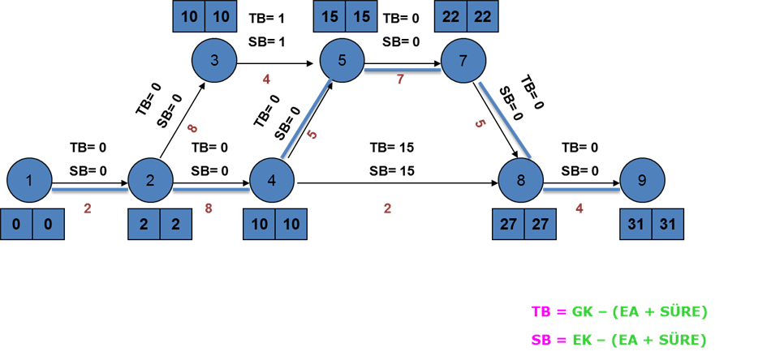
11
6
1
7
8
Critical Path: 1-2, 2-4, 4-5, 5-6, 6-7, 7-8
Total Cost= Direct Cost+Indirect Cost
Total Project Cost: 7.150.000 + (31 x 80.000) = 9.630.000

Slide 11
1. HIZLANDIRMA : 1 – 2 / 2 months 1 month / Cost = 50.000 TL
10
6
1
7
8
Critical Path : 1-2, 2-4, 4-5, 5-6, 6-7, 7-8
Total cost of the project after first crashing
7.150.000 + (30 x 80.000) +50.000= 9.600.000 TL

Slide 12
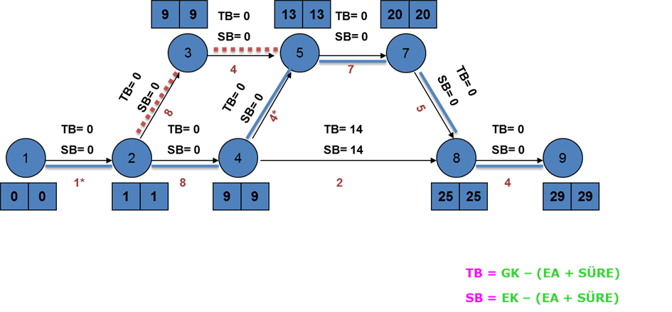
2. HIZLANDIRMA : İş 4 – 5 / 5 months 4 months / Cost = 75.000 TL
6
7
8
Critical Path-1: 1-2, 2-4, 4-5, 5-6, 6-7, 7-8
Critical Path-2: 1-2, 2-3, 3-5, 5-6, 6-7, 7-8
Total cost of the project after second crashing
7.150.000 + (29 x 80.000) +50.000 + 75.000 = 9.595.000 TL

Slide 13
3. HIZLANDIRMA : İş 7 – 8 / 4 months 3 months / Cost = 150.000 TL
6
7
8
3*
28
28
Critical Path-1: 1-2, 2-4, 4-5, 5-6, 6-7, 7-8
Critical Path-2: 1-2, 2-3, 3-5, 5-6, 6-7, 7-8
Total cost of the project after third crashing
7.150.000 + (28 x 80.000) +50.000 + 75.000 + 150.000 = 9.665.000 TL

Slide 14
Assessments Related to Cost
Crashing Costs:
Cost of first crashing: 50.000 TL
Cost of second crashing : 75.000 TL
Cost of third crashing 150.000 TL
------------------------------------------------------
Total cost of crashing: 275 .000 TL
Total direct cost of the project:
7.150.000 TL (indirect costs are excluded).
If indirect costs are 80.000 TL/months :
1. Cost of first crashing : 7.150.000 + (30 x 80.000) +50.000= 9.600.000 TL
2. Cost of second crashing : 7.150.000 + (29 x 80.000) +50.000 + 75.000 = 9.595.000 TL
3. Cost of third crashing : 7.150.000+(28 x 80.000)+50.000+75.000+150.000 = 9.665.000 TL

Slide 15
As figure given below shows, the optimum duration of the project is 29 months. Beyond this, each crashing will increase the cost of the project
Utility Curve

Slide 16
PROBLEM-3 Draw the A-O-N network using the activities given below. Calculate the normal duration, total floats.
Activity | Duration (Day) | Dependency
A | 4 | -
B | 7 | A
C | 5 | A
D | 4 | B
E | 8 | -
F | 8 | B,C,E
G | 16 | -

Slide 17
Activity | Duration (Day) | Dependency
A | 4 | -
B | 7 | A
C | 5 | A
D | 4 | B
E | 8 | -
F | 8 | B,C,E
G | 16 | -
A
B
D
C
Start
E
End
F
G

Slide 18
4 11
B
 | 7
11 15
D
 | 4
0 4
A
 | 4
4 9
C
 | 5
11 19
F
 | 8
19 19
0 |  | 0
Start
 | 0
End
 | 0
0 8
E
 | 8
0 16
G
 | 16

Slide 19
4 11
B
 | 7
11 15
4 7 11
D
 | 4
0 4
A
 | 4
4 9
15 4 19
C
 | 5
0 4 4
11 19
6 5 11
F
 | 8
19 19
0 |  | 0
Start
 | 0
End
 | 0
0 8
11 8 19
E
 | 8
0 0 0
19 0 19
3 8 11
0 16
G
 | 16
3 16 19

Slide 20
0
4 11
B
 | 7
4
11 15
4 7 11
D
 | 4
0
0 4
A
 | 4
2
15 4 19
4 9
C
 | 5
0 4 4
0
11 19
6 5 11
F
 | 8
0
19 19
0 |  | 0
Start
 | 0
End
 | 0
0
3
11 8 19
0 8
E
 | 8
0 0 0
19 0 19
0 8 11
0 16
3
G
 | 16
3 16 19

Slide 21
PROBLEM-4 Please re-draw the A-o-A network given below as A-o-N network. Find the critical path, normal duration, total floats.
2
A
4
D
11
1
B
E
3
5
4
6
7
G
6
4
C
F
4
H
6
I
7
8
4
J
10
Notes:
Now, consider another example, in this example the network is given, and it is asked to determine the free floats and total floats of the activities. We start with the forward pass, so firstly we consider the start event. And we assign 0 to the early start of this activity. Now consider this event, since there exist only one activity between these events, we can calculate the early start by summing up the early start of the first and the duration of A. We get 11. Let’s consider this event. There exist three paths which affect this event. First one is this. The second one is B activity. Last one is this path. However, in order to determine the early start of this event, we have to calculate the early start of this event. Therefore, we firstly consider this event. Between these two events, there exist only one activity. We calculate the early start of this event by summing up zero with 6. We get 6 as the early start of this event. Now, we can calculate the early start of this event. From first path we get 11, from b activity, we get 7, from the last path, we get 10. We should assign the highest value as the early start for this event, in other words the early start of this event is 11. Now, lets check this event, there exist two paths which affect this event. From first path, we get 15 and from second path, we get 17. We determine the early start of this event as 17. Now let’s consider this event. We have two paths, first one is the dummy activity, the other one is H. We get 17 and 14 from these paths. So, the early start of this event is 17. Now we can determine the early start of the last event, in other words the duration of the project. There exist two paths which affect the last event. First one is activity G, the other one is activity I. From these paths, we calculate early start dates as 24 and 20 respectively. So, the early start of this event is 24. Now we can perform the backward pass in order to determine the late start and late finish dates of events. We should start with the last event of the project. We assign 24 as the late finish for this event. When we consider this event, we calculate 20 as the late finish by subtracting the late finish of the last event from the duration of activity I. Now consider this event, there exist two paths which affect the late start of this event. First one is activity G and dummy activity. We calculate 17 as the late finish by subtracting the late finish of the last event from the duration of activity G from first path. We get 20 from the dummy activity. We assign 17 as the late finish of this event. Lets consider this event now. You can see that there exist only one event which affects the late finish of this event, this is E. The late finish of this activity is calculated as 11. We have three events left for calculating the late finish. For this event, we must consider D activity in calculation of late finish. The late finish of this event is calculated as 11. For this event, there are three activities which affect the late finish of this event. From f, we get 7, from h, we get 9 and from j, we get 14. We should use the lowest value for the late finish. Consequently, the late finish of this event is calculated as 7. Finally, the late finish of the start event of the project should be taken as 0. Now we can calculate the free floats and total floats.

Slide 22
Notes:
Now, consider another example, in this example the network is given, and it is asked to determine the free floats and total floats of the activities. We start with the forward pass, so firstly we consider the start event. And we assign 0 to the early start of this activity. Now consider this event, since there exist only one activity between these events, we can calculate the early start by summing up the early start of the first and the duration of A. We get 11. Let’s consider this event. There exist three paths which affect this event. First one is this. The second one is B activity. Last one is this path. However, in order to determine the early start of this event, we have to calculate the early start of this event. Therefore, we firstly consider this event. Between these two events, there exist only one activity. We calculate the early start of this event by summing up zero with 6. We get 6 as the early start of this event. Now, we can calculate the early start of this event. From first path we get 11, from b activity, we get 7, from the last path, we get 10. We should assign the highest value as the early start for this event, in other words the early start of this event is 11. Now, lets check this event, there exist two paths which affect this event. From first path, we get 15 and from second path, we get 17. We determine the early start of this event as 17. Now let’s consider this event. We have two paths, first one is the dummy activity, the other one is H. We get 17 and 14 from these paths. So, the early start of this event is 17. Now we can determine the early start of the last event, in other words the duration of the project. There exist two paths which affect the last event. First one is activity G, the other one is activity I. From these paths, we calculate early start dates as 24 and 20 respectively. So, the early start of this event is 24. Now we can perform the backward pass in order to determine the late start and late finish dates of events. We should start with the last event of the project. We assign 24 as the late finish for this event. When we consider this event, we calculate 20 as the late finish by subtracting the late finish of the last event from the duration of activity I. Now consider this event, there exist two paths which affect the late start of this event. First one is activity G and dummy activity. We calculate 17 as the late finish by subtracting the late finish of the last event from the duration of activity G from first path. We get 20 from the dummy activity. We assign 17 as the late finish of this event. Lets consider this event now. You can see that there exist only one event which affects the late finish of this event, this is E. The late finish of this activity is calculated as 11. We have three events left for calculating the late finish. For this event, we must consider D activity in calculation of late finish. The late finish of this event is calculated as 11. For this event, there are three activities which affect the late finish of this event. From f, we get 7, from h, we get 9 and from j, we get 14. We should use the lowest value for the late finish. Consequently, the late finish of this event is calculated as 7. Finally, the late finish of the start event of the project should be taken as 0. Now we can calculate the free floats and total floats.

Slide 23
D
G
A
E
B
I
Start
End
F
C
H
J

Slide 24
11 15
D
 | 4
17 24
G
 | 7
0 11
A
 | 11
11 17
E
 | 6
I
 | 4
0 4
17 21
0 |  | 0
Start
 | 0
B
 | 4
24 24
End
 | 0
6 10
F
 | 4
0 6
C
 | 6
6 14
H
 | 8
6 16
J
 | 10

Slide 25
11 15
D
 | 4
17 24
G
 | 7
0 11
A
 | 11
13 4 17
17 7 24
0 11 11
11 17
E
 | 6
11 6 17
I
 | 4
0 4
17 21
0 |  | 0
Start
 | 0
B
 | 4
24 24
End
 | 0
6 10
F
 | 4
7 4 11
20 4 24
0 0 0
24 0 24
7 4 11
0 6
C
 | 6
6 14
H
 | 8
1 6 7
12 8 20
6 16
J
 | 10
14 10 24

Slide 26
11 2 15
D
 | 4
17 0 24
G
 | 7
0 0 11
A
 | 11
13 4 17
17 7 24
0 11 11
11 0 17
E
 | 6
11 6 17
I
 | 4
0 7 4
17 3 21
0 | 0 | 0
Start
 | 0
B
 | 4
24 0 24
End
 | 0
6 1 10
F
 | 4
7 4 11
20 4 24
0 0 0
24 0 24
7 4 11
0 1 6
C
 | 6
6 6 14
H
 | 8
1 6 7
12 8 20
6 8 16
J
 | 10
14 10 24

