Slide 1
COLLOIDAL SYSTEMS

Slide 2
Definition of Colloidal Systems
Materials that are dispersed in the solvent, the size of the particles, which are larger than the molecular of the solvent in which it is dissolved, are generally called colloidal systems.
If the particles in the dispersion vary in size from 1-1000 nm (or 1 nm-1 μm), the dispersion is determined as colloidal.
Colloid is the name given to the heterogeneous mixture formed by the distribution of one substance within another substance to an extent that cannot be seen with the naked eye.
Colloidal solutions are formed by granular distribution of an insoluble material in a homogeneous medium such as scavenging of clay, soap and water in a homogeneous medium, as well as colloidal solutions in milk, blood serum, solution of a gum water and solutions of polymers in their respective solvents.

Slide 3
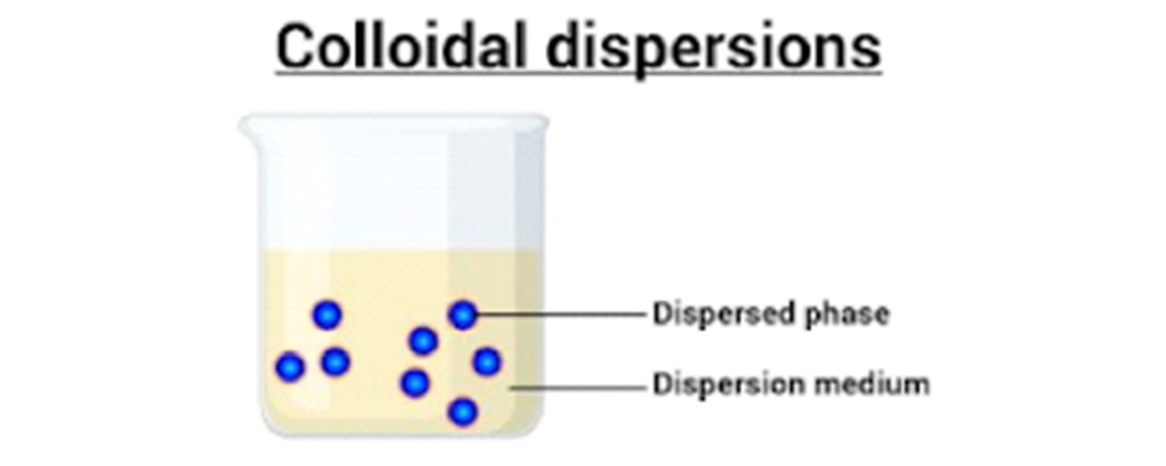
Colloidal solutions consist of two phases including;
Dispersion phase
Dispersed phase
The solvent, which is the continuous phase, the dispersion medium, consists of finer particles and is completely separated.
The dispersed phase, the discontinuous phase, has a larger granularity and a homogeneous distribution within the dispersion medium.

Slide 4
Classification of Colloidal Systems
Colloidal systems can be classified according to their molecular size or phase.
In general, the classification of colloidal dispersions according to physical state of dispersion phase and dispersion medium is given in Table. The dispersing phase and dispersion medium may be solid, liquid and gas.
Dispersion phase | Dispersed Phase | Name of the system | Example
Liquid | Solid | Sol | Ink, gold solutions
Liquid | Liquid | Emulsion | Milk, cream, butter
Liquid | Gas | Foam | Soap bubbles
Solid | Solid | Solid sol | Mineral stones (quartz, opal, etc.)
Solid | Liquid | Gel | Cheese, jelly
Solid | Gas | Solid foam | Cake, bread
Gas | Solid | Solid aerosol | Smoke
Gas | Liquid | Aerosol | steam, fog, cloud

Slide 5
Example | Class | Dispers Phase | Dispertion Medium
Dispersed Systems
Fog, smoke, aerosol sprays | Liquid aerosols | L | G
Industrial smokes | Solid aerosols | S | G
Milk, oil, mayonnaise, asphalt, creams | Emülsions | L | L
Inorganic colloids (gold, silver iodide, sulfur, metallic hydroxides, etc.), dyes | Soller or colloidal suspensions | S | L
Clay muds, toothpaste, muds, polymer lattices | Paste | S | L
Opal, pearl, colored glass, pigmented plastic | Solid suspension or dispertion | S | S
Foams | Foam | G | L
Meerschaum, expanded plastics | Solid foam | G | S
Macromoleculer Colloids
Gels, adhesives | Gels | Macromolecules | Solvent
Associations Colloids
Soap / water, detergent / water, paint solutions | ---- | Micelles solvent | Micelles
Biocolloids
Blood |  | Corpuscles Hydroxyapatite | Serum
Bone |  |  | Collagen
Muscle, cell membrane |  | Protein structures

Slide 6
Another classification refers to the particle sizes of the dispersed phase:
Molecular Dispersions (True Solutions):
Particle sizes less than 1 nm and are not visible even in the electron microscope.
Particles can pass through semi-permeable membranes.
In general, oxygen molecules, water-soluble potassium and chloride ions are rapidly diffused.
Colloidal Dispersions (Colloidal Solutions):
Particle sizes are between 1 nm-1 µm and are visible in electron microscope.
They cannot pass through the semipermeable membranes, but can pass through filter paper.
They are usually slowly diffused. For example colloidal silver bars, surfactant micelles and aqueous latexes in an aqueous phase.
Coarse Dispersions (Suspentions):
Colloidal systems with particle sizes greater than 1 µm.
They can be seen very clearly in the optic microscope.
They cannot pass through normal filter paper and semi-permeable membranes.

Slide 7
Properties | True solution | Colloidal solution | Suspension
Particle size | < 1 nm | 1-1000 nm | >1000 nm
Mixture | Homogenous | Heterogenous | Heterogenous
Permeability (Diffusion through filter paper) | Particles pass quickly through the filter paper | It can pass through filter paper. However, it cannot pass through the semi-permeable membrane. | It cannot pass through filter paper or semi-permeable membrane.
Visibility | Particles cannot be observed with the naked eye. | It cannot be observed with the naked eye but can be seen with an ultra microscope. | Particles can be observed with the naked eye.
Physical appereance | Transparent | Semi-Transparent | Matte

Slide 8
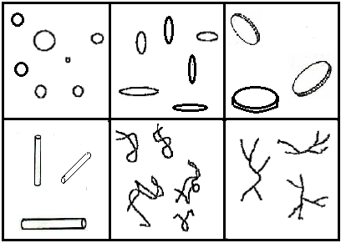
Features and Shapes of Colloidal Particles
The size and shape of the particles of a dispersion system are the most important features.
Both properties affect the appearance, collapse rate, redistribution and the physical stability of the product.
The colors of colloidal dispersions are related to particle sizes. The color of the gold dispersion is red when the particles are small and blue when the size of the particles increases.
The shape of the colloidal particles can be spherical or small ellipses, needles, rods, or loosely bound yarns.
Structures of Colloidal Particles

Slide 9
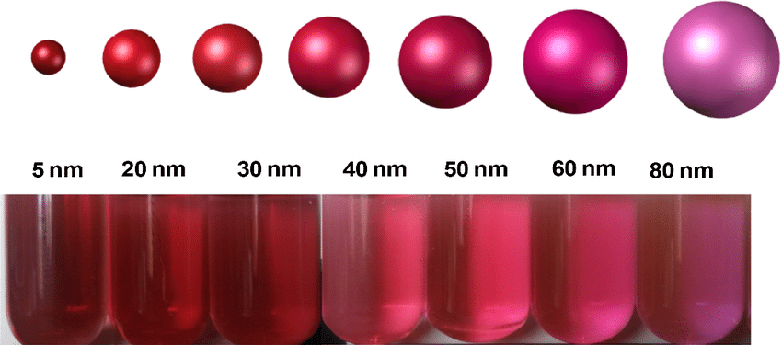
The shape differences of the particles cause problems in the physical stability of the colloidal systems. Shape differences cause aggregation (agglomeration). Apart from the particle size and shape of the colloidal systems, the surface properties of the particles, particle-particle and particle-solvent interactions are also important in the evaluation of their stability.
Colloidal gold solutions

Slide 10
Types of Colloidal Systems
Colloidal systems can be examined in three groups as lyophilic, lyophobic and association colloids according to interactions between dispersion phase and dispersion medium.

Slide 11
Lyophilic Colloids:
This type of colloids love the dispersion medium and easily form colloidal dispersions or soles.
If the dispersion medium is water, these systems are called hydrophilic colloid-hydrosol.
Various properties of lyophilic colloidal dispersions are based on the tensile forces between the dispersed phase and the dispersion medium that result in solvatation.
Solvatation is the binding of solvent molecules to dispersed phase molecules. In hydrophilic colloids, when water is the dispersion medium, this term is called hydration.
Most of the lyophilic colloids are organic molecules. For example gelatin, gum arabic, insulin, albumin, rubber and polystyrene.
Of these, insulin, albumin, gelatin and gum arabic form lyophilic colloids in aqueous dispersion medium.

Slide 12
Rubber and polystyrene form lyophilic colloids in organic solvents. These are called lipophilic colloids. Lipophilic substances have affinity to oil. They like oil. The oils contain mainly hydrocarbons and have low dielectric constants. For example mineral oil, benzene, carbon, vegetable oils (cotton oil, hazelnut oil).
In the case of lyophilic dispersions, the interaction between the dispersed phase and the dispersion medium is high and therefore occurs spontaneously.
They are thermodynamically durable and recyclable.
When the dispersion medium is separated from the dispersed phase, it can easily be restored.
Dispersions are resistant even in the presence of electrolyte.
The viscosity of the dispersion medium increases depending on the dispersed phase. In high concentrations, the sol turns into gel.

Slide 13
Lyophobic Colloids
There is little or no interaction between the dispersion medium and the dispersed phase.
They don't like dispersion media. Lyophilic materials are generally hydrophobic. So they don't like water.
The dispersing phase consists of inorganic compounds. For example, sulfur, silver chloride and gold.
They are not thermodynamically durable and are irreversible.
Disperse phases are difficult to come back to when they are separated from the dispersion medium.
They are not stable when the electrolyte is present, even at very low concentrations.
The viscosity of the dispersion medium does not increase as the concentration of the dispersing phase increases.
Unlike lyophilic colloids, they are not easy to prepare. Special preparation techniques are available. Generally, they may be prepared by bringing the small particles into colloidal size or by reducing the size of the coarse particles.

Slide 14
Association Colloids
In this type of colloids, the dispersed phase is in the form of aggregates of organic molecules.
Molecules have both hydrophilic and hydrophobic groups. They are also called amphiphilic molecules.
Particles are very small and combine in aqueous and oily solutions to form dissociation micelles. As the micelles formed are very large as colloidal particles, these are also called colloids of association.
The hydrophilic and lipophilic moieties of the molecule may be solvated with respect to the fact that the dispersion medium is aqueous or organic.
Critical micelle concentration decreases with the addition of electrolyte to aqueous solutions.
When a high concentration of electrolyte is added, the outflow is called salting out.
Above the critical micelle concentration, the colloidal aggregates are formed spontaneously.
As the concentration increases, the viscosity of colloidal dispersion increases.

Slide 15
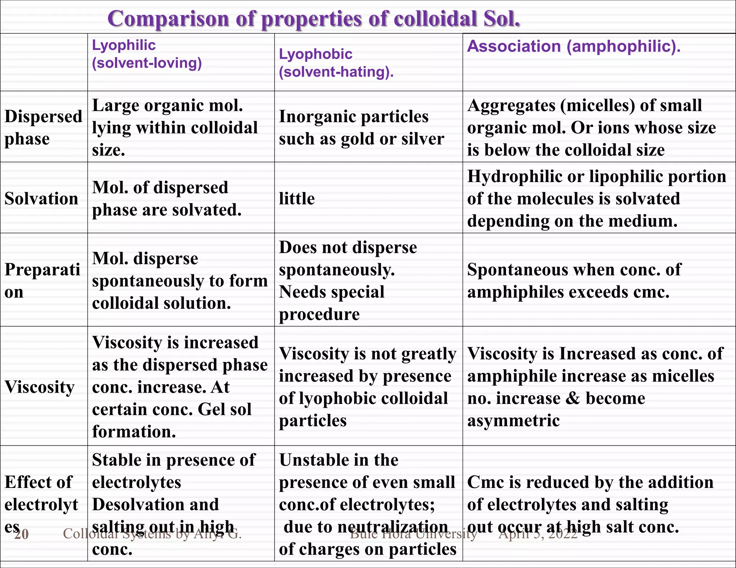

Slide 16
Properties of colloidal systems
Optical properties
Kinetic properties
Electrical properties

Slide 17
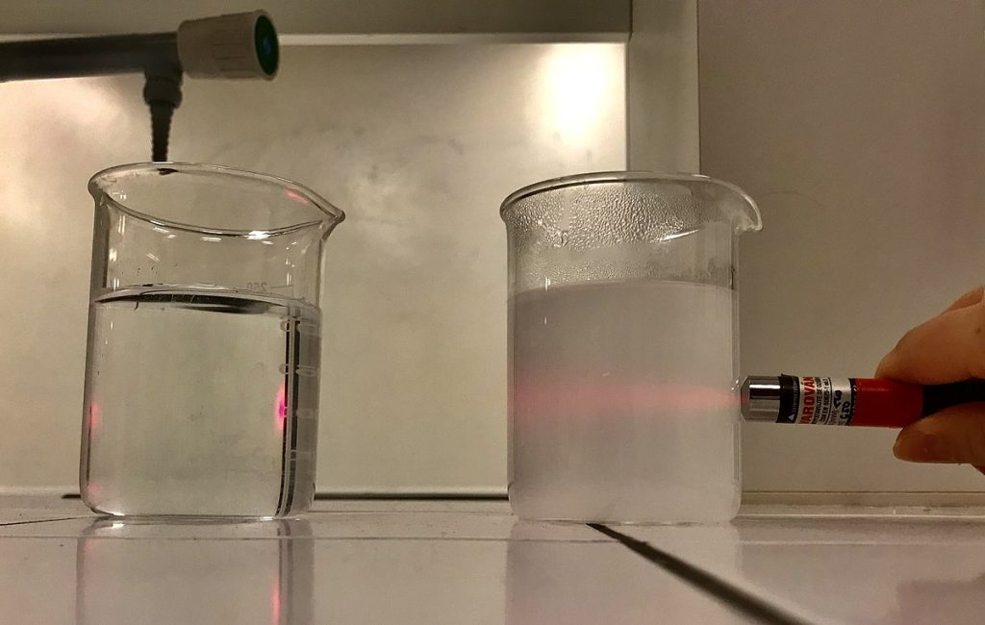
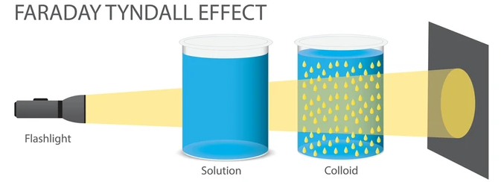
Optical Properties
Faraday Tyndall Effect:
If a strong light beam is passed through a colloidal sol, a visible cone is formed as a result of the scattering of light by the colloidal particles.
This phenomenon is known as the Faraday Tyndall effect.
It is the phenomenon of colloidal systems scattering light.
This phenomenon is not observed in real solutions.

Slide 18
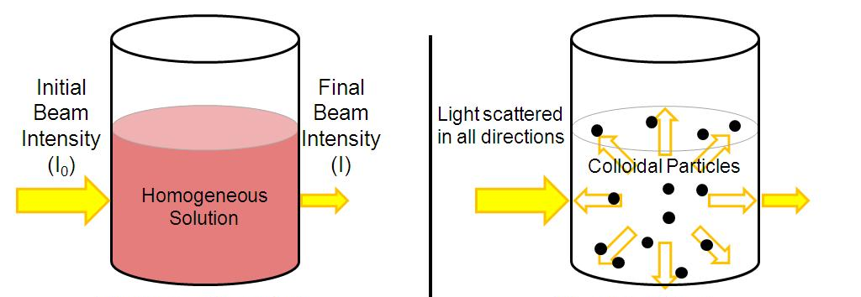
Light Scattering:
It is based on the Faraday Tyndall effect and is a method used to determine the molecular weight of colloids.
At the same time, very small (nanometer-sized) particles such as microemulsions and micellar solutions can be measured.
When laser light is shined on dilute colloidal particles, light is scattered from each particle.
Light scattering is defined by turbidity (T).Turbidity is the fractional decrease in intensity due to scattering of light passing through 1 cm of solution.

Slide 19
Kinetic Properties
These properties of colloidal systems are related to the movement of particles in the dispersion medium. These are:
Thermal properties (Brown movement, diffusion, osmotic pressure),
Those due to the effect of gravity (sedimentation),
Those due to external influence (viscosity).

Slide 20
Electrical Properties
The electrical properties of colloidal systems depend on their surface charge.
Particles dispersed in the liquid medium can gain charge in various ways:
  The first is the ionization of functional groups on the surface of the particles.
  The second is the adsorption of ions.
  In the third, particles can gain charge due to the difference in dielectric constant between the particle and the dispersion medium.
Additionally, the pH of the dispersion medium is also very important.
At low pHs, proteins are positively charged, while at high pHs they are negatively charged.
The pH at which the net charge is zero is known as the isoelectric point of proteins.

Slide 21
Intermolecular Forces in Colloidal Dispersions
The forces that interact the particles with each other are the forces that arise when the colloidal particles or electrical double layer systems approach each other.
These forces are divided into DLVO and non-DLVO forces.
DLVO forces (described by scientists in Derjaguin, Landau, Verwey and Overbeek in the 1940s and are a theory that explains the stability of colloids) are described as van der Waals attraction, electrostatic forces, brownish motion, diffusion, double layer repulsion or attraction.
Examples of non-DLVO forces include steric effects, bridging interaction and hydrophobic effects. The forces in the colloidal dispersions may vary with intermittent access distances, the forces may be repulsive or attractive to their structures.

Slide 22
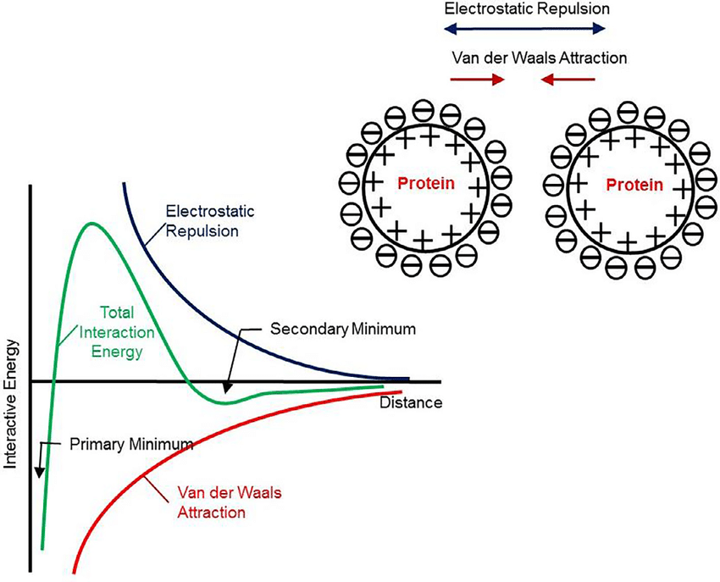
DLVO theory describes the energy of the interaction between suspended and emulsified particles.
The interaction between the two charged particles is shown as potential energy curves as a function of the distance between the particles (Figure).
The force on the particles in a colloidal distribution is due to the electrostatic repulsion and van der Waals tensile forces.
In the figure V_{A}, the attractive energy curve; V_{R}, repulsive energy curve and V_{T}, total energy curve are seen. V_{T} is the sum of the tensile and repulsion energies between two particles.
V_{T}=V_{A}+V_{R}

Slide 23
Stabilization of Colloidal Systems
The presence and size of the charge on the colloidal particle is very important in their stability. Stabilization is achieved in two main ways:
Ensure that the disperse particles are electrically charged,
Covering of each dispersed particle with a protective agent (protective colloid effect).

Slide 24
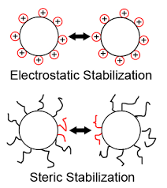
Stabilization can take place in two cases; steric stabilization and electrostatic stabilization.
When the particles are surrounded by layers carrying the same electrical charge, an electrostatic repulsion between them is called electrostatic stabilization.
As a result of adsorption of some additives by particles, the particle surfaces are coated with these materials and the particles cannot approach each other. This effect is called steric stabilization.

