Slide 1
Microwave Engineering
Meaning, Definition, Application…
Peyman Mahouti
Alper Çalışkan
DEPARTMENT OF ELECTRONICS AND COMMUNICATION ENGINEERING PROGRAM OF COMMUNICATION ENGINEERING

Slide 2
Microwaves
Frequency
Wavelength λ
Long waves
30-300 kHz
10-1 km
Medium waves (MW)
300-3000 kHz
1000-100 m
Short waves (SW)
3-30 MHz
100-10 m
Very high frequency (VHF) waves
Microwaves
30-300 MHz
0.3-30 GHz*
10-1 m
100-1 cm
Millimeter waves
30-300 GHz
10-1 mm
Submillimeter waves
300-3000 GHz
1-0.1 mm
Infrared (including far-infrared)
300-416,000 GHz
10⁴-0.72 μm
* 1 GHz = 1 gigahertz = 10 Hertz or cycles per second,
⁺ 1 μm = 10⁻⁶ m.

Slide 3
A Century of Antennas-- from Hertz to Hand-Held

Slide 4
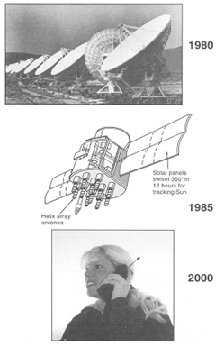
Very large array of 27 steerable parabolic dish
Antennas
25 meter diameter, operating at ~ cm wavelength
To listen to signals transmitted billions of year away
24 GPS Antennas, medium earth orbits-MEO
Operating at 20 cm wavelength
Uses helix antennas, at 20,000 km
Hand-held cell-phones
Operating at 30 cm wavelength

Slide 5
Electro Magnetic Spectrum

Slide 6
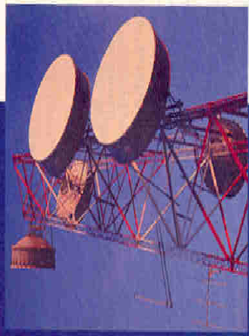
Radio Communications
Applications:
Radio Communication is in use since
early 30’s.
First was used for broadcasting then
commercial communication.
Radio used for long distance
telephone service.
Many phone lines are connected to an
Exchange, and many exchanges to a tower

Slide 7
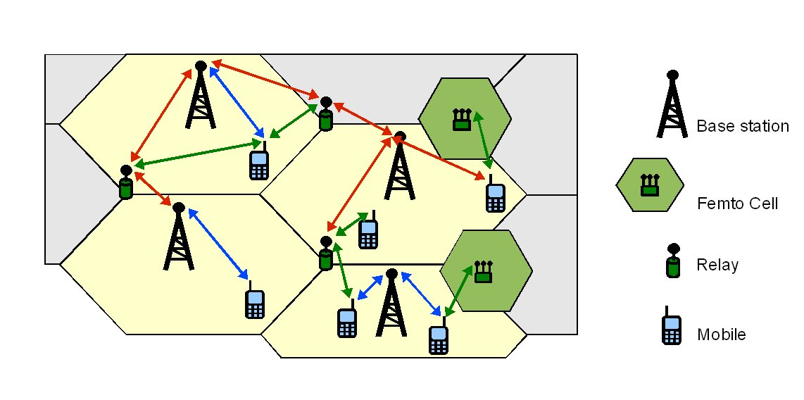
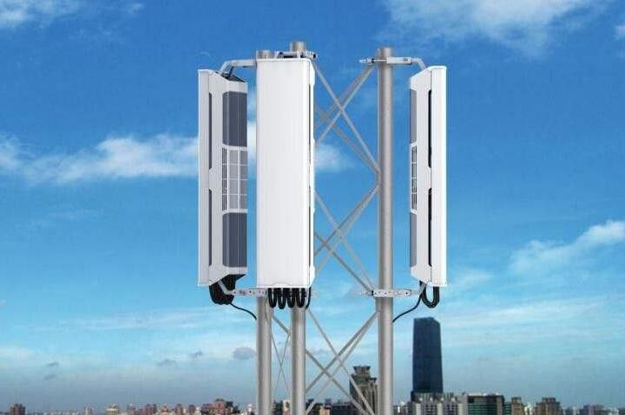
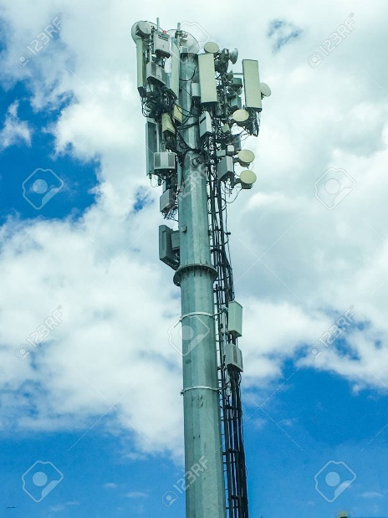

Slide 9
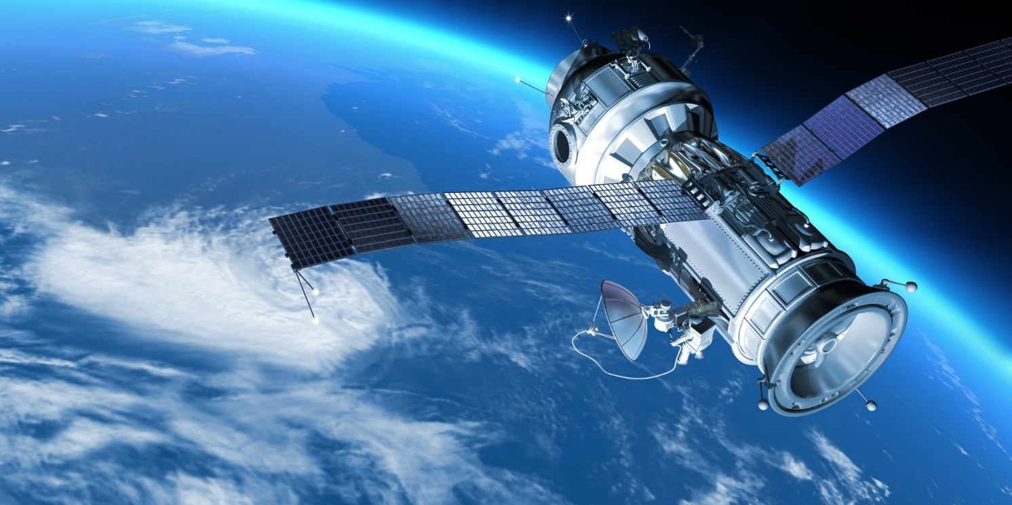
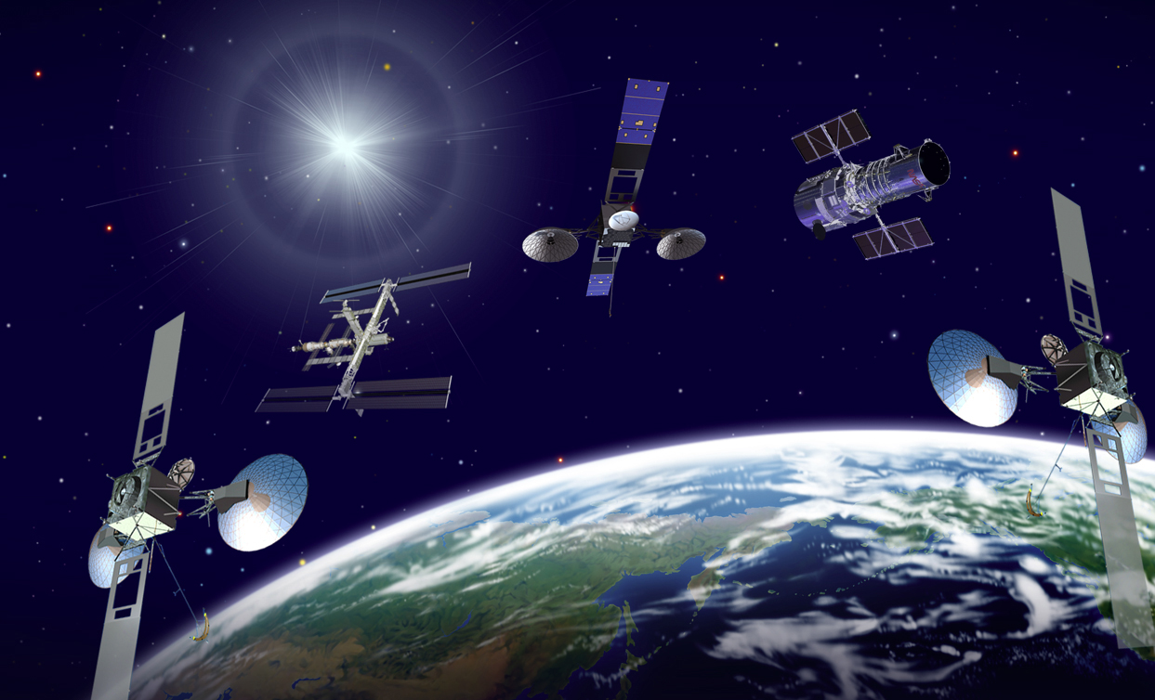
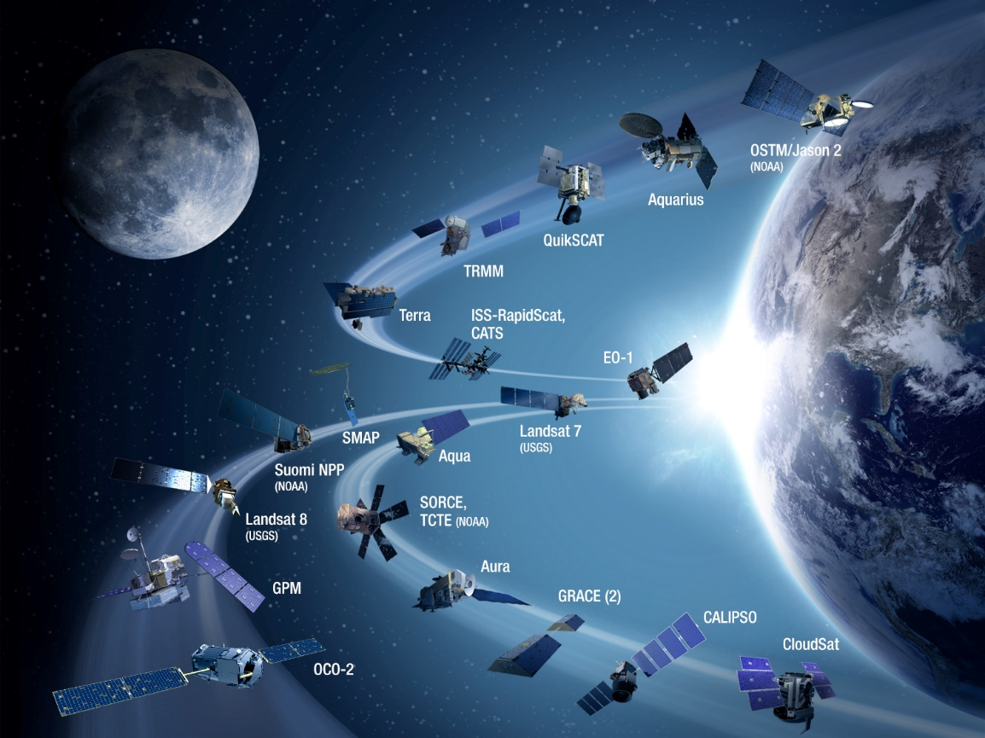

Slide 10
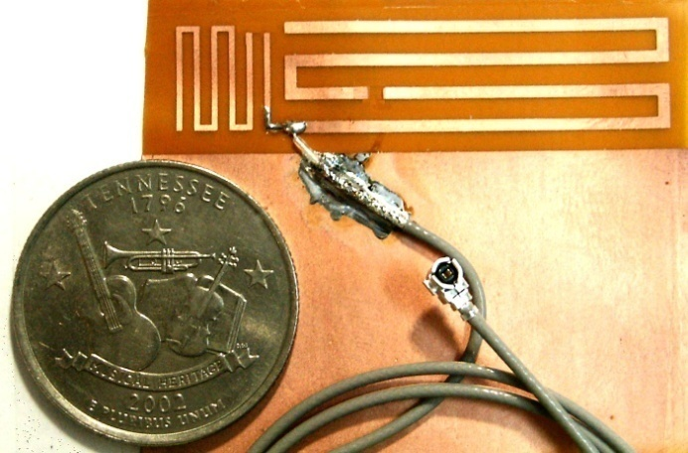
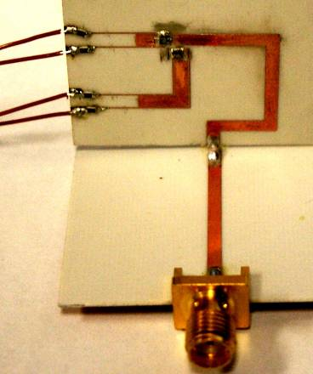
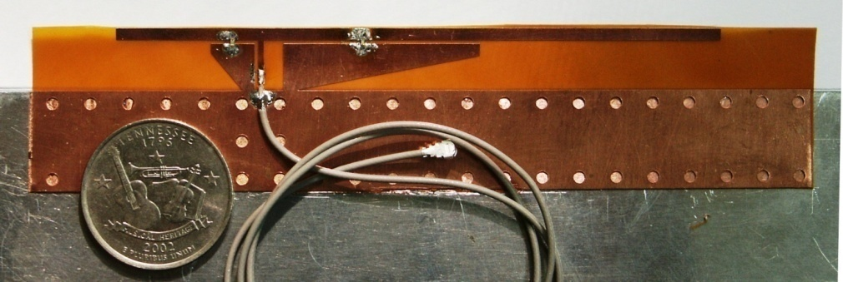
Research Progress
42mm
Switch Locations
11mm
50cm coaxial cable
RF blocking resistor
Reconfigurable Multi-band branched Monopole Antenna
DC
Feeds
MEMS
Switches
Reconfigurable Multi-band Twin PIFA Antenna with PIN diode switch
“Maze” Reconfigurable Fractal Loop Antenna
“mini-Maze” Reconfigurable Bent Monopole Antenna with MEMS switch
90mm
10mm
p-i-n diodes
50cm coaxial cable
Ground

Slide 11
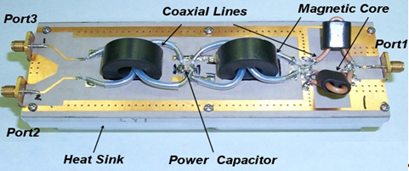
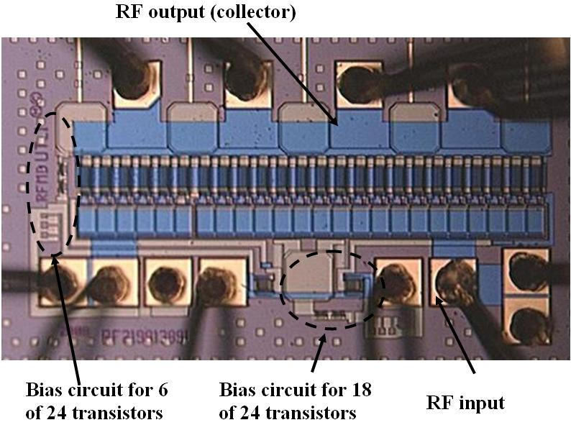
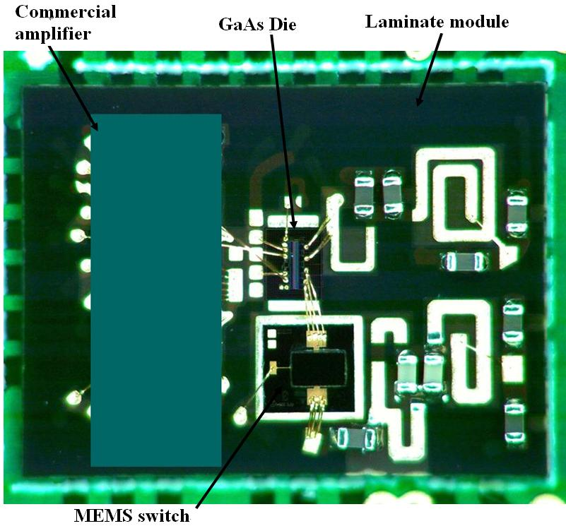
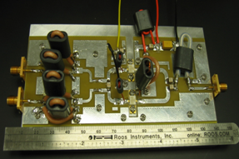
Power Amplifiers and Combiners

Slide 12
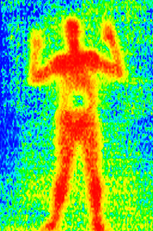
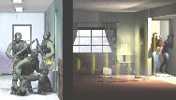
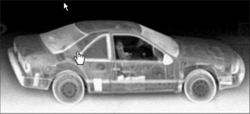
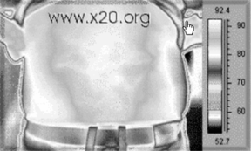
THz- BACKGROUND
The detection of concealed weapons and explosives
represents one of the most daunting problems facing
the military and civilian law enforcement personnel.
The exposure and identification of biological and chemical weapons is also a major homeland security concern.
Terahertz (THz) imaging, by virtue of its ability to penetrate materials and its short wavelength (leading to high resolution), and THz spectroscopy, due to its capability to recognize unique signatures of dangerous biological and chemical agents, provide the most promising approach to address these problems.

Slide 13
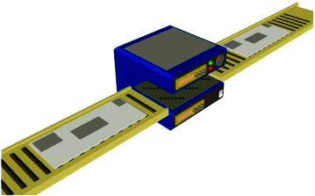
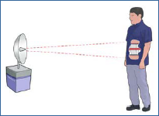
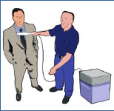
Homeland Security Applications
Potential Security Applications
Detection of hidden weapons and explosives
Detecting non-metallic weapons
Postal screening of envelopes for bacteria
Chem/bio detection
Envelope
Postal screening
Explosives
Stand-off detection
Security screening wand

Slide 14
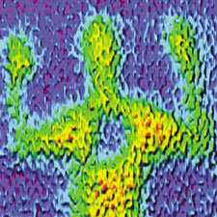
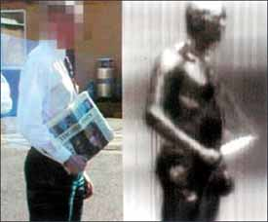
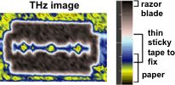
Terahertz Images Can Reveal Objects Concealed Under Cloth, Paper, Tape, Even Behind Walls
Objects Concealed Under clothes
Knife Wrapped in Newspaper

Slide 16
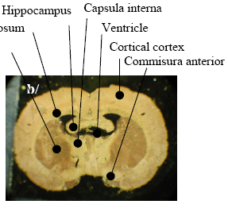
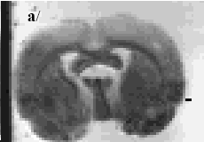
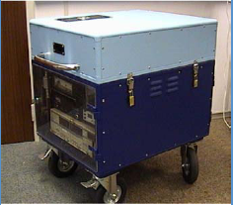
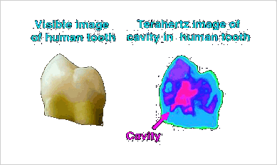
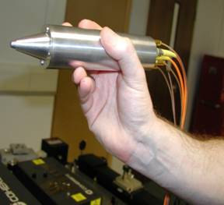
Powerful Medical Imaging Capabilities of THz
Diseased
skin
Normal skin
Skin Cancer
White light image
THz image
Brain
Dental
THz device and probe (TeraView)

Slide 18
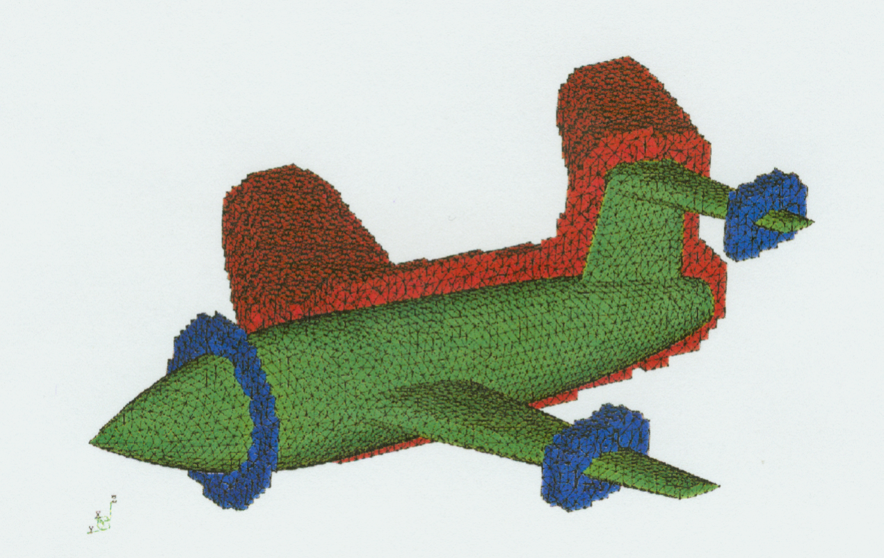
CONFORMAL ANTENNAS …Fast Computations, New Materials…
New Exotic Materials have been recently
developed.
Stealth Technology and Many others
can benefit

Slide 19
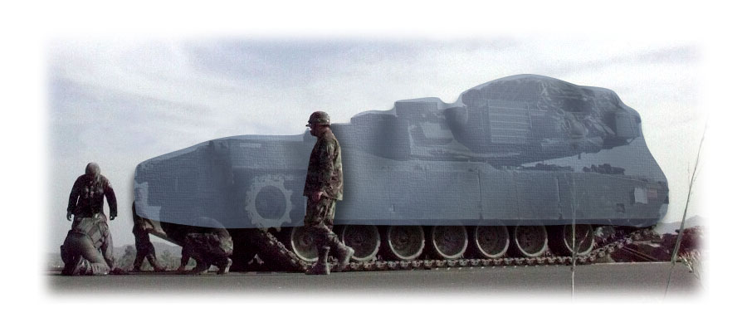
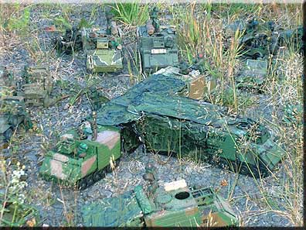
E-Textiles

Slide 20
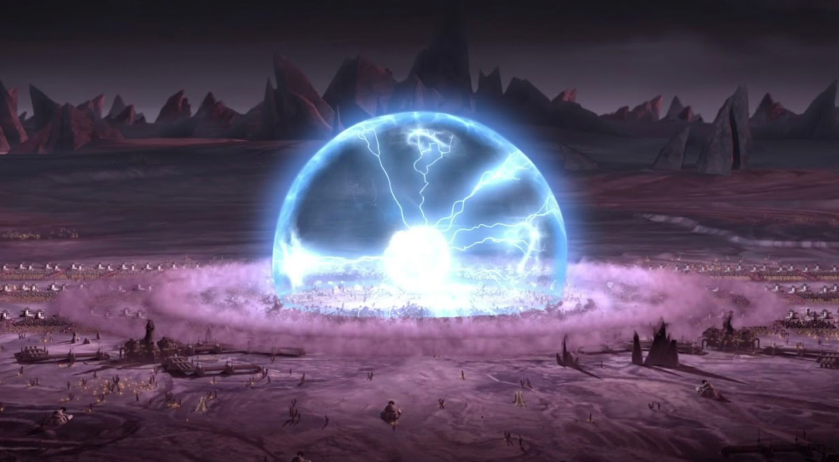
Electromagnetic Pulse Weapon
*a screenshot from a game its not real

Slide 21
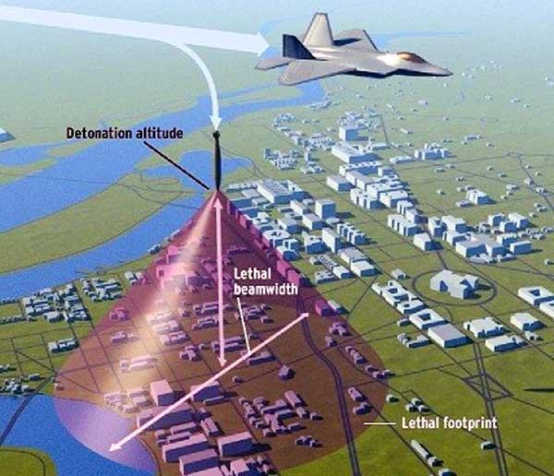

Slide 22
Thank you

