Slide 1
WEEK 5-6 :
EFFICIENT MARKET HYPOTHESIS
And
behavıoral fınance

Slide 2
«I would be a bum on the street with a tin cup if the markets were efficient»
- Warren buffett

Slide 3
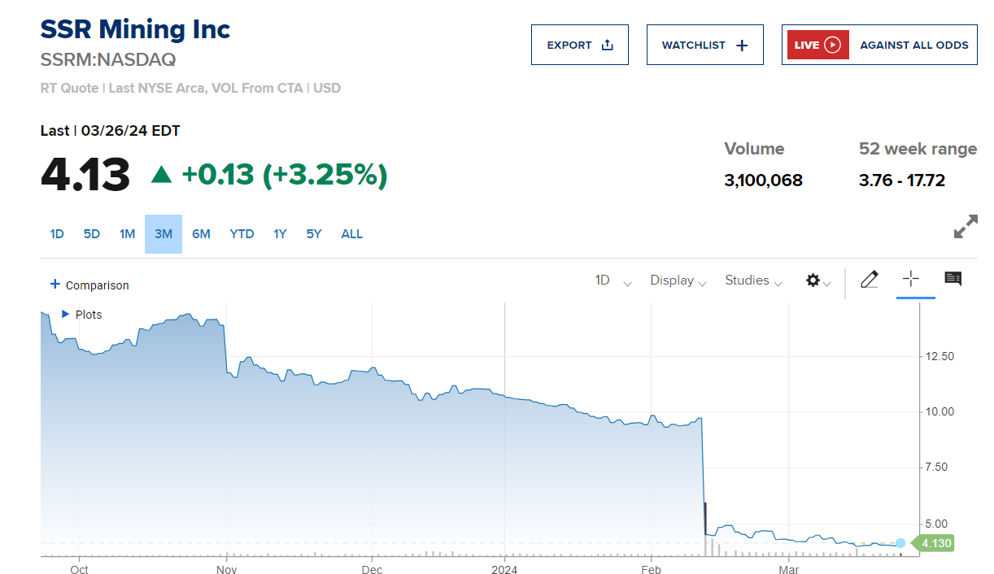

Slide 5
Market Efficiency Criteria
Three criteria are required when market efficiency is considered:
Operational Efficiency
Allocation Efficiency
Informational (Pricing) Efficiency

Slide 6
Efficient Capital Market
An efficient capital market is one in which security prices adjust rapidly to the arrival of new information, and, therefore, the current prices of securities reflect all information about the security.
Most of the early work related to efficient capital markets was based on the random walk hypothesis, which contended that changes in stock prices occurred randomly. In other words, the prices of stocks and commodities seemed to follow a random walk.

Slide 7
Set of Assumptions
An efficient market requires that a large number of profit-maximizing participants analyze and value securities, each independently of the others.
New information regarding securities comes to the market in a random fashion, and the timing of one announcement is generally independent of others.
The buy and sell decisions of all those profit-maximizing investors cause security prices to adjust rapidly to reflect the effect of new information.

Slide 8
Efficient Capital Market
In his original article, Fama divided the overall efficient market hypothesis (EMH) and the empirical tests of the hypothesis into three subhypotheses depending on the information set involved:
weak-form EMH,
semistrong-form EMH, and
strong-form EMH.

Slide 9
Weak-Form Efficient Market Hypothesis
The weak-form EMH assumes that current stock prices fully reflect all security market information, including the historical sequence of prices, rates of return, trading volume data, and other market-generated information. Because it assumes that current market prices already reflect all past returns and any other security market information.
This hypothesis implies that past rates of return and other historical market data should have no relationship with future rates of return.
Therefore, this hypothesis contends that you should gain little from using any trading rule which indicates that you should buy or sell a security based on past rates of return or any other past security market data.

Slide 10
Semistrong-Form Efficient Market Hypothesis
The semistrong-form EMH asserts that security prices adjust rapidly to the release of all public information; that is, current security prices fully reflect all public information.
Notably, public information also includes all nonmarket information, such as dividend announcements, stock splits, news about the economy, and political news.
This hypothesis implies that investors who base their decisions on any important new information after it is public, should not derive above-average risk-adjusted profits from their transactions, considering the cost of trading because the security price should immediately reflect all such new public information.

Slide 11
Strong-Form Efficient Market Hypothesis
The strong-form EMH contends that stock prices fully reflect all information from public and private sources. This means that no group of investors has monopolistic access to information relevant to the formation of prices
Therefore, this hypothesis contends that no group of investors should be able to consistently derive above-average risk-adjusted rates of return

Slide 12
Prospect Theory
Prospect theory modifies the analytic description of rational risk-averse investors found in standard financial theory.
Higher wealth provides higher satisfaction, or “utility,” but at a diminishing rate (the curve
flattens as the individual becomes wealthier).

Slide 17
Behavioral Finance
The premise of behavioral finance is that conventional financial theory ignores how real people make decisions and that people make a difference.
Individuals are irrational and have irrationalities.
1. Investors do not always process information correctly and therefore infer incorrect probability distributions about future rates of return
2. Even given a probability distribution of returns, they often make inconsistent or systematically suboptimal decisions.

Slide 18
Behavioral Biases
Errors in information processing can lead investors to misestimate the true probabilities of possible events or associated rates of return.
Forecasting Errors: people give too much weight to recent experience compared to prior beliefs when making forecasts
Overconfidence: People tend to overestimate the precision of their beliefs or forecasts, and they tend to overestimate their abilities.
Conservatism: A conservatism bias means that investors are too slow (too conservative) in updating their beliefs in response to new evidence.
Representativeness: The notion of representativeness bias holds that people commonly do not take into account the size of a sample, acting as if a small sample is just as representative of a population as a large one.

Slide 19
Behavioral Biases
Even if information processing were perfect, many studies conclude that individuals would tend to make less-than-fully-rational decisions using that information.
Framing: Decisions seem to be affected by how choices are framed. Individuals may act risk averse in terms of gains but risk seeking in terms of losses.
Mental Accounting: Mental accounting is a specific form of framing in which people segregate certain decisions
Regret Avoidance: Psychologists have found that individuals who make decisions that turn out badly have more regret (blame themselves more) when that decision was more unconventional.
Affect: is a feeling of “good” or “bad” that consumers may attach to a potential purchase or investors to a stock.
Anchoring: After forming an opinion, people are often unwilling to change it, even though they receive new information that is relevant.

