Slide 1
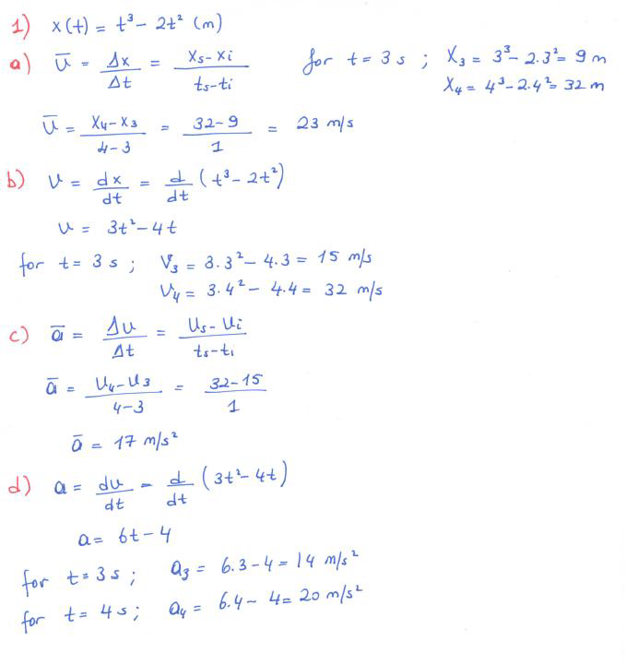
Problem Session 1

Slide 2
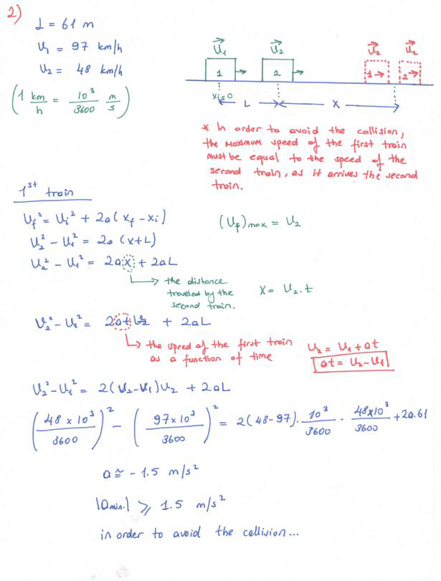
2- After returning from the bend, a train driver with a speed of 97 km/h recognizes a car 61 m away from the train and moving with a constant speed of 48 km/h. The train driver immediately applies the brake. If the train slows with a constant acceleration, what should be the acceleration in order to avoid from the collision of the train and car?

Slide 3
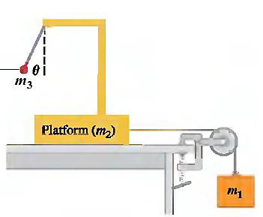
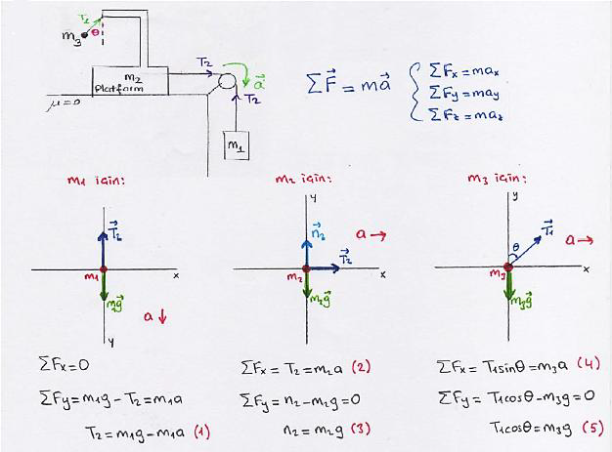
3) The assembly in the Right Figure is used to calculate the acceleration of a given system. An observer on the platform can calculate the acceleration of the system by measuring the the angle (θ) of the ball. In here, m1 = 250 kg and m2 = 1250 kg. Calculate;
a) The acceleration of the system,
b) Derive an equation between the θ and the acceleration of the system and find θ.
(Suppose that there is no friction between the platform and the table). (g=9.8 m/s2)

Slide 4
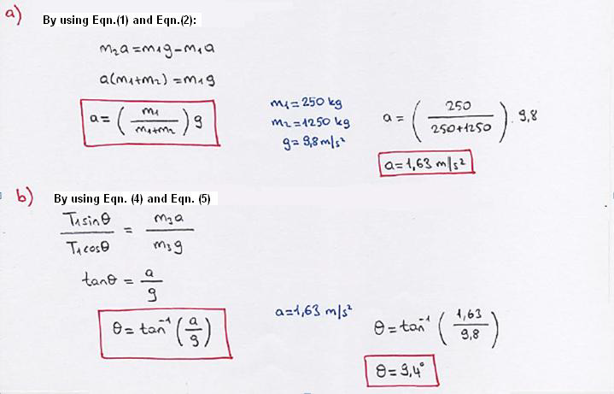

Slide 5
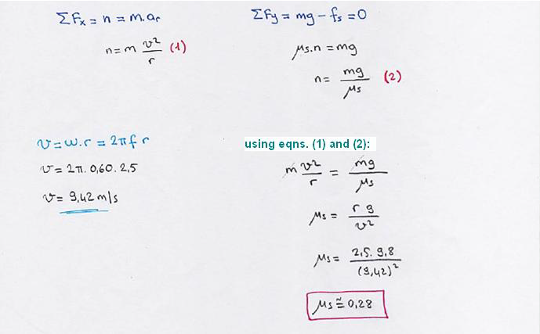
4) In an old-fashioned amusement park ride, passengers stand
inside a 5.0 m diameter hollow steel cylinder with their backs
against the wall. The cylinder begins to rotate about a vertical
axis and reaches 0.60 rev/sec constant speed. Then the floor on
which the passengers are standing suddenly drops away! If all
goes well, the passengers will “stick” to the wall and not slide.
Draw the free body diagram for the person inside the cylinder
after the floor drops away and,
b) Find the minumum static coefficient of friction in order to keep the person inside the cylinder.

Slide 6
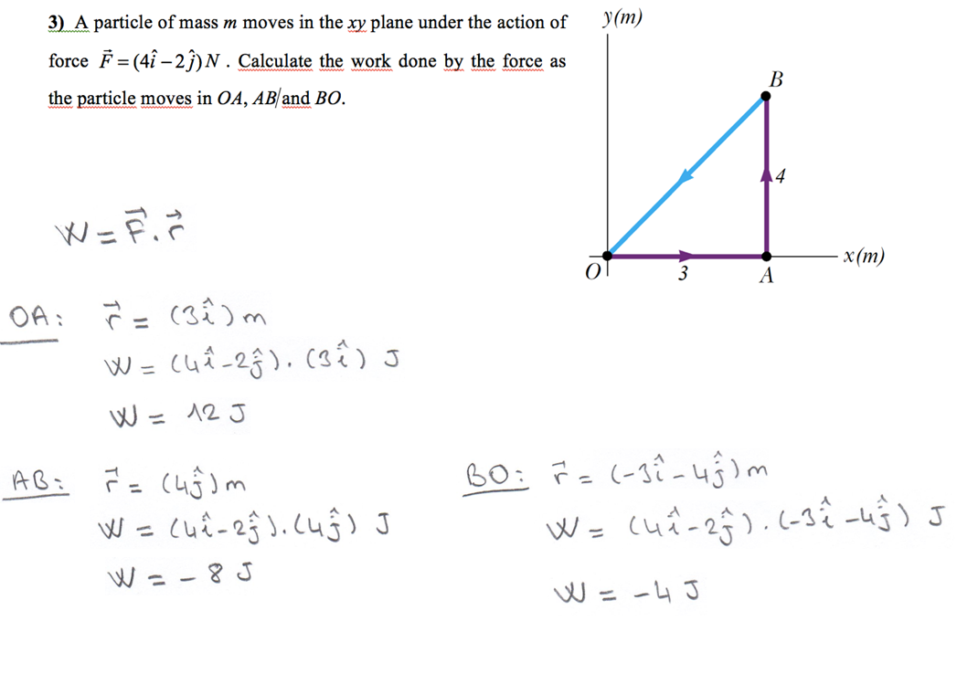

Slide 8
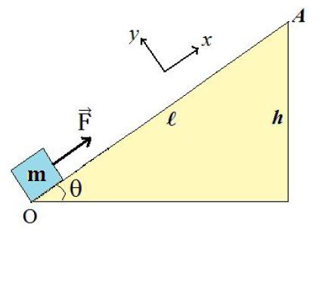
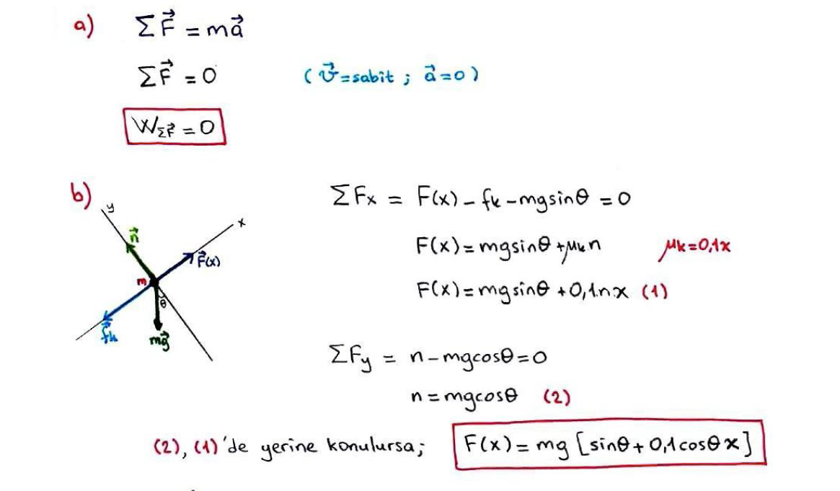
7) A block of mass m is pushed at constant speed up an θ incline by a constant horizontal force (F), from point O to point A through I= IOAI, as shown in Figure. The coefficient of kinetic friction between the block and the incline is changed with
a) Determine the work done by net force through IOAI
b) Draw a free-body diagram for the block and determine F(x) force in terms of m, g, θ and x.
c) What is the work done by F(x) through IOAI in terms of m, g, θ and .

Slide 9
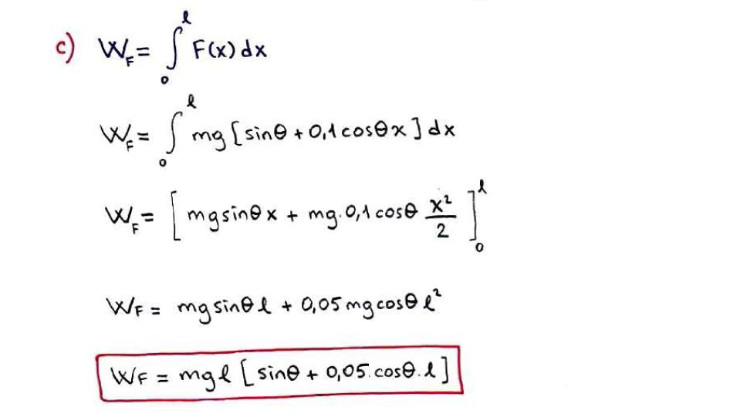

Slide 10
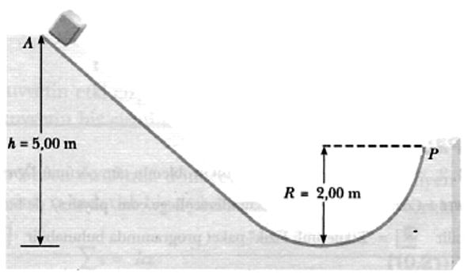
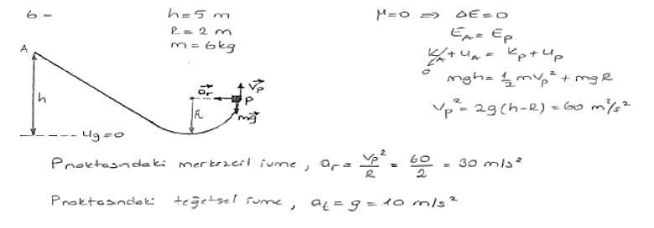
8) A 6.0 kg block is released from A on
the frictionless track shown in Figure. Determine the radial and tangential components of acceleration for the
block at P.

Slide 11
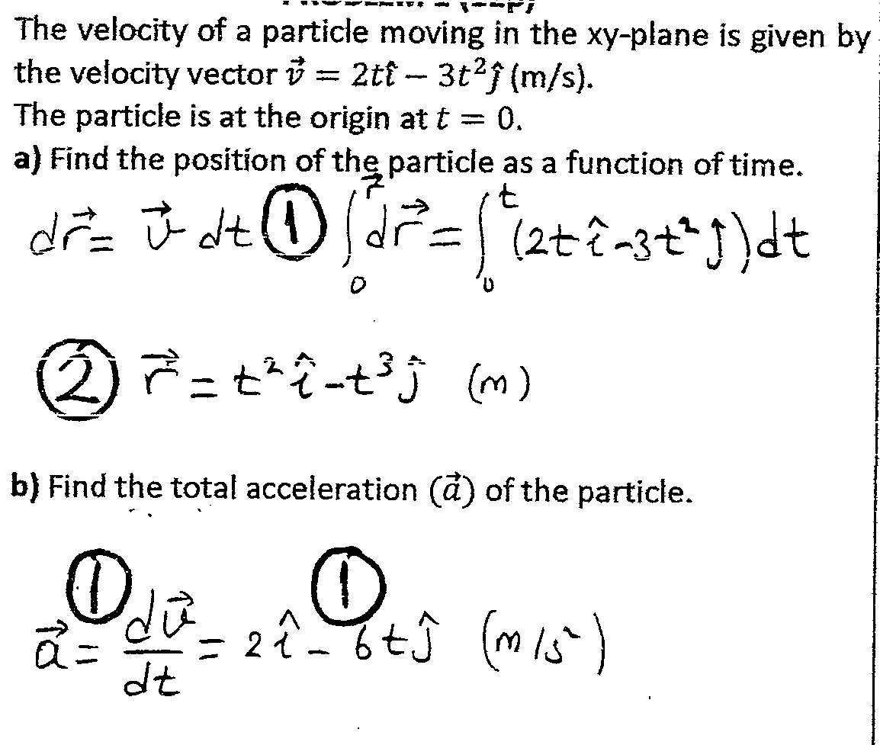
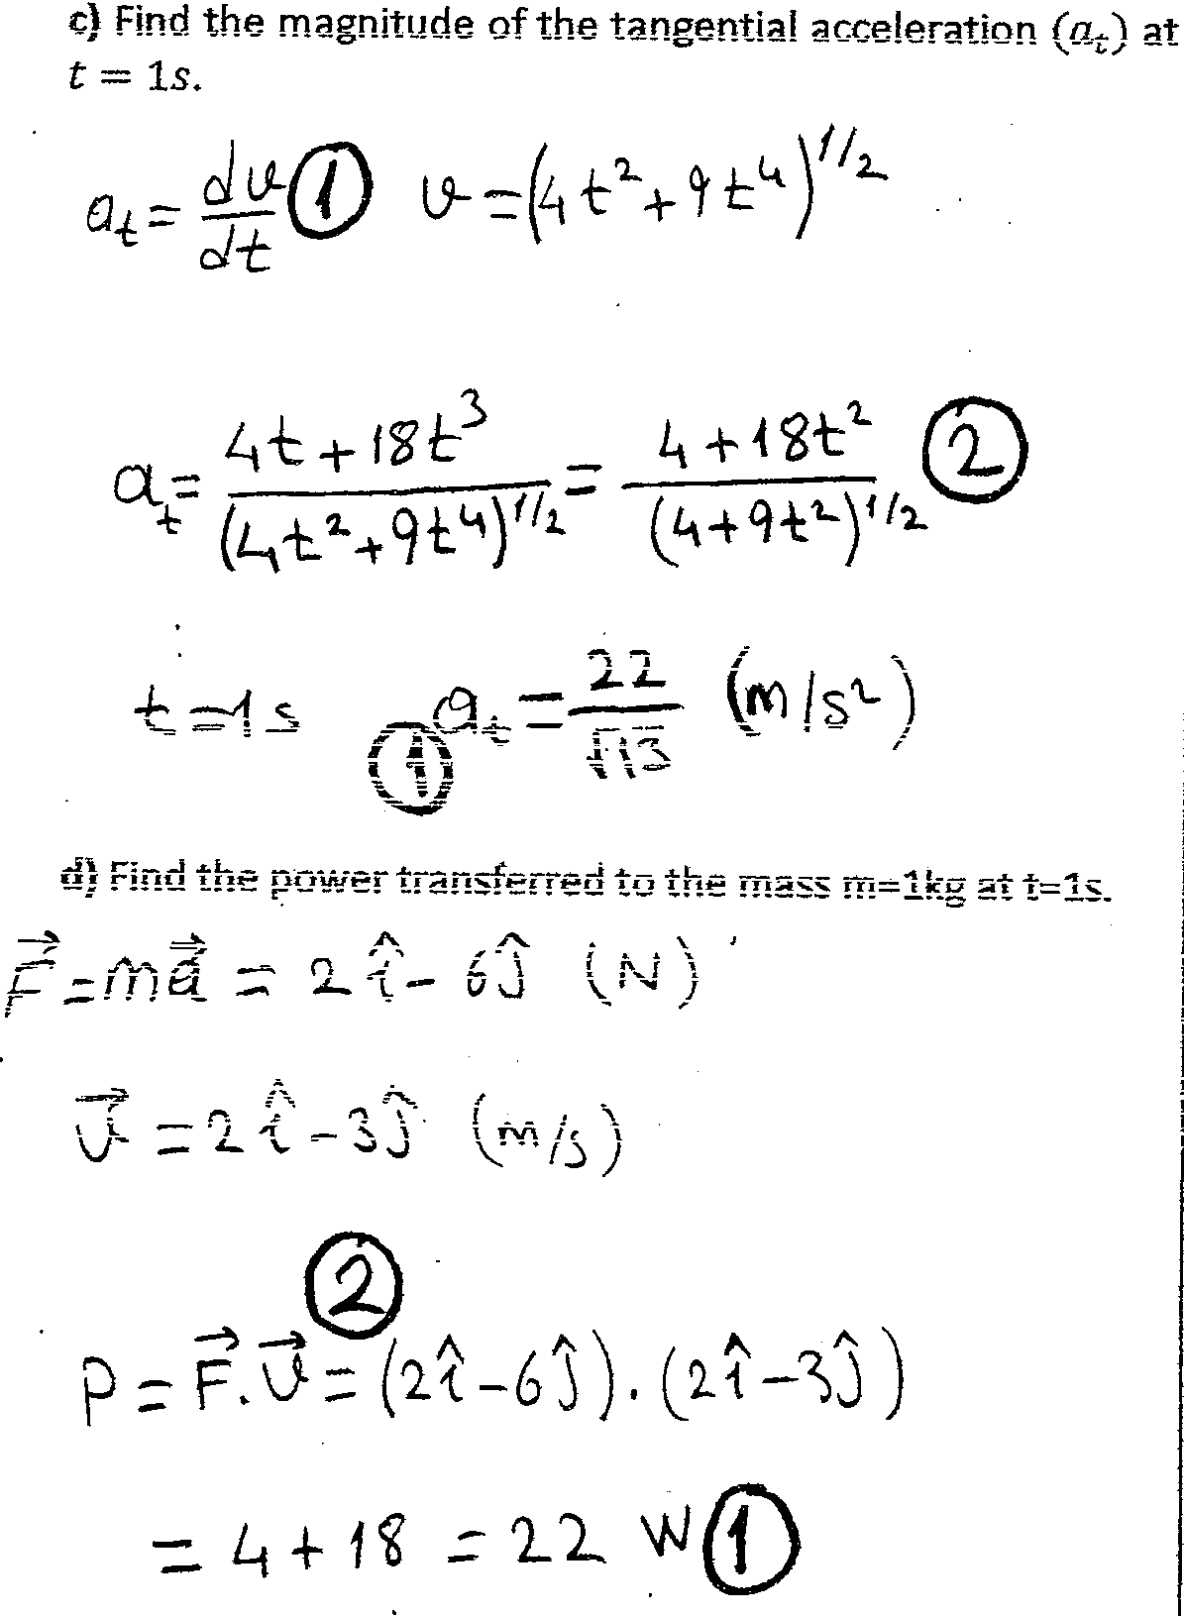
9)

Slide 12
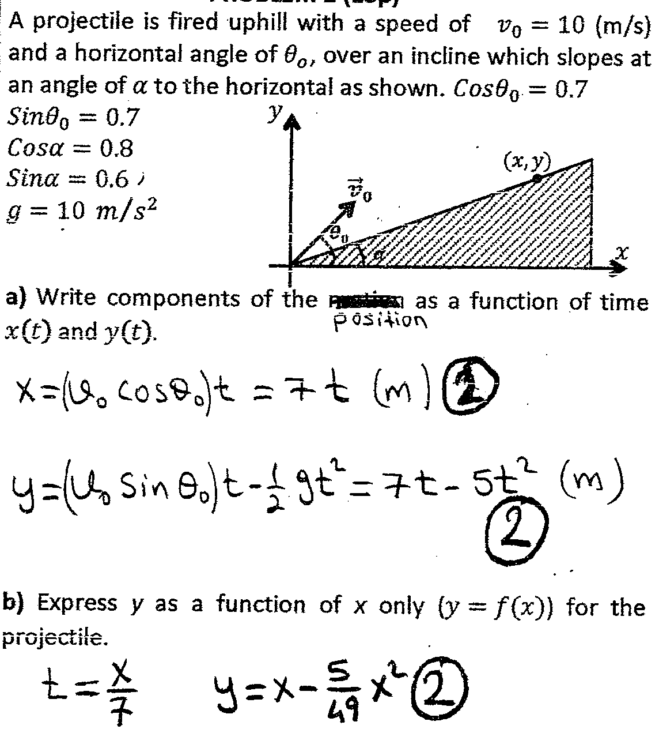
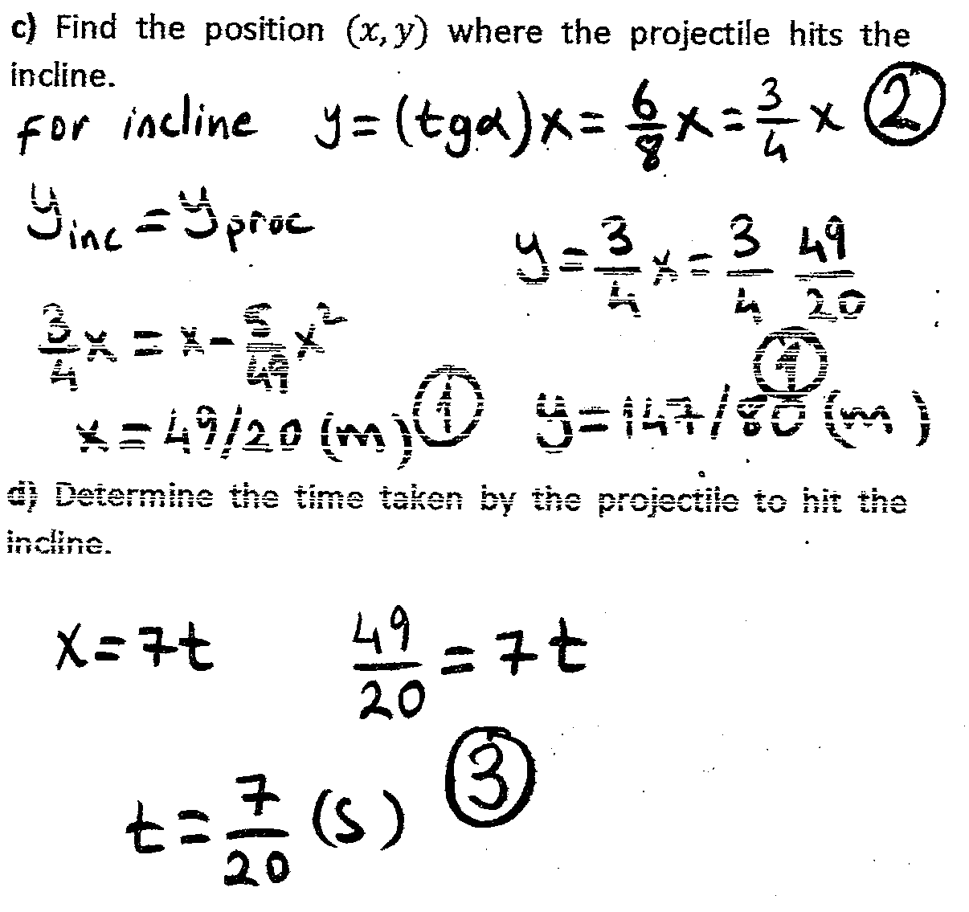
10)

Slide 13
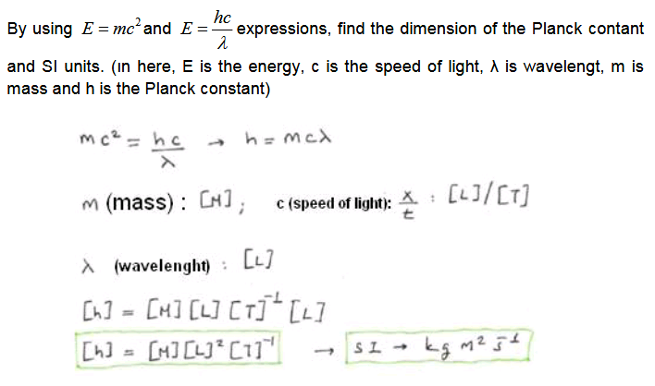
12)

Slide 14
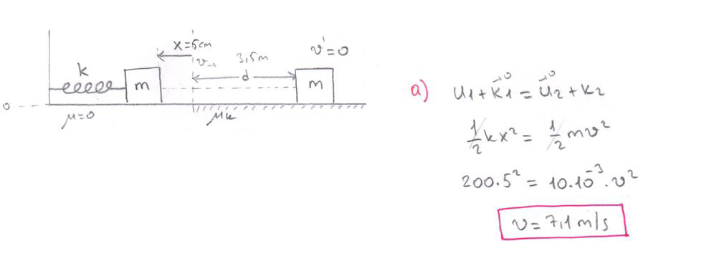
13)

Slide 16
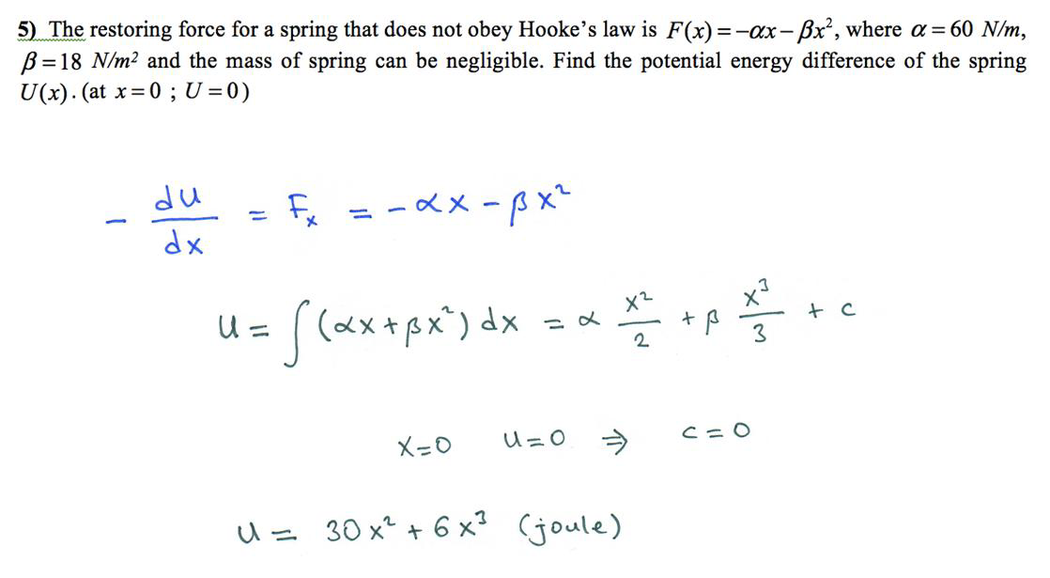

Slide 17
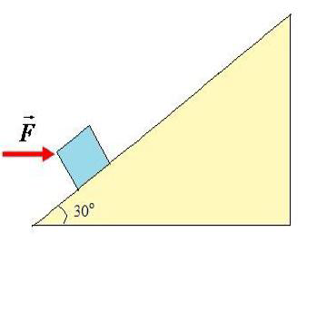
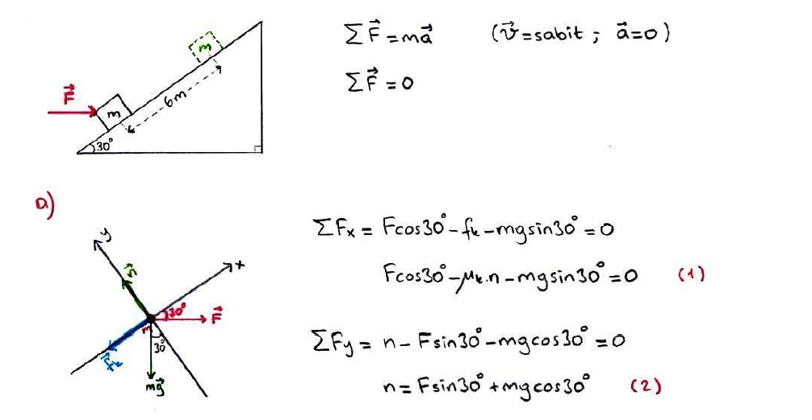
7) A 50 kg trunk is pushed 6 m at constant speed up a 30o incline by a constant horizontal force (F). The coefficient of kinetic friction between the trunk and the incline is 0.2. What is the work done by;
a) The applied horizontal force
b) The force of friction
c) The force of gravity
d The normal force exerted by the incline
e) Determine the total work done on the trunk.

Slide 18
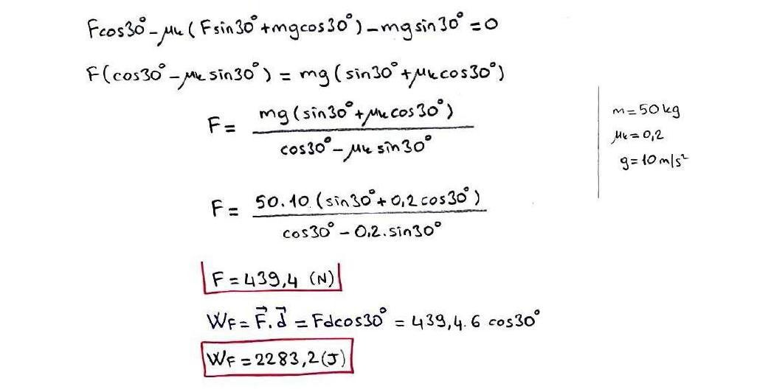

Slide 19
