Slide 1
Dr Salih Karasu
Homogenization and Mashing

Slide 2
Size reduction in Semi-solid food
Different size reduction process were applied,
Homogenization
Crushing
Mashing

Slide 3
Homogenization
Homogenization is the process of converting two immiscible liquids into an emulsion or of reducing the size of the droplets in an existing emulsion.
A mechanical device known as a homogenizer is used to achieve homogenization by applying intense energy in order to disrupt and mix the oil and water phases

Slide 4
Homogenization is mostly applied in ;
milk and dairy ındustry,
sauce,
mayonnaise and, dressing type emulsion

Slide 5
Physical stability
The main of the homogenization is to increase phsical stability of emulsion and dispersion.
Phsical stability can be explained as ability to resist changes in spatial distribution of ingredients over time
(- e.g., creaming, flocculation, coalescence)

Slide 10
Homogenizers
Ultra-Turrax homogenizer,
the Polytron PT homogenizer,
the Warring blender,
colloidal mills, and
highpressure valve homogenizers

Slide 11
Ultra Turrax
Princible is Rotor-stator principle (mixing, shear, and elongational stresses, turbulence, and cavitation).
Produce emulsions of medium and high viscosity;
particle size can be reduced to a threshold of ca 4–10 μm;
often used in food research lab and food industry;
shear rate ranges from 20,000 to 100,000 s⁻¹; residence time of 10−5–10−4;

Slide 12
Ultra Turrax
Avantages and dis advnatages
Difficult to maintain adequate flow and result in unevenly distributed particle size when both viscosity of materials and vessel size increases;
Uneven distribution may create zones of localized heat leading to thermal degradation

Slide 13
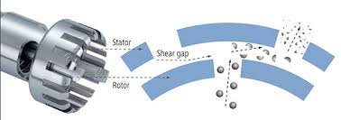
Ultra Turraks

Slide 14
Colloid mill
Produce emulsions of medium and high viscosity;
produce emulsions with a minimum droplet size of 1 μm;
often used in pilot plant and industrial production;
the gap distance between the rotor and state can be adjusted from 50 to 1,000 μm to change the intensity of shear stress;
the flow rate can be varied between 4 and 20,000 Lh⁻¹;

Slide 15
Do not have issue above such as uneven distribution of particle size and degradation (materials can be continuously fed into colloid mill);
The liquids to be homogenized usually are fed in the form of a coarse emulsion

Slide 16
Warring blender, turbines and propeller-type stirrers
Produce emulsions of low or intermediate viscosity;
produce emulsion with a minimum droplet size of 2 μm; residence time (undefined);
blades, propellers, and turbines are common stirrers used.
May generate localized heat which could result in thermal degradation of emulsion samples

Slide 17
High pressure valve homogenizer
Intense shear, cavitation, turbulent, and laminar flow
Produce emulsions of low or intermediate viscosity;
produce emulsions with a minimum droplet size of 0.1 μm; residence
time in the range of milliseconds
one-stage valve and two-stage valve homogenizers are two types of high pressure homogenizers used

Slide 18
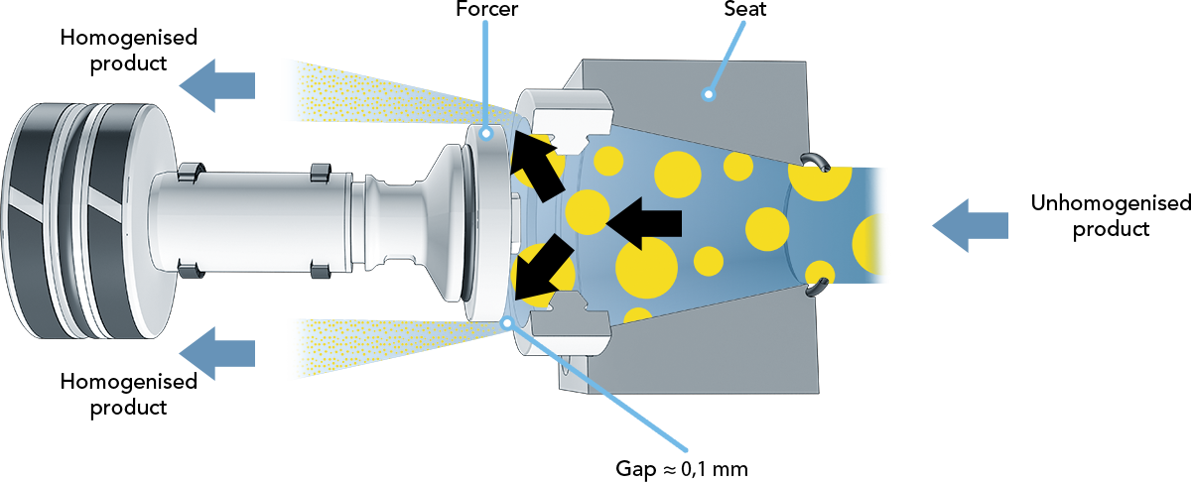

Slide 19
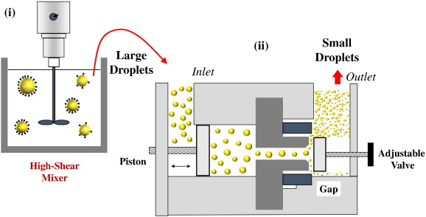

Slide 21
Milk and Dairy industry
Partial homogenization (cream homogenization)
Whole milk homogenization
Advantages
sensory properties
Low fat in whey
Increase viscosity
Disadvantages
Low stability (microbial and oxidation).
Soft curd
Low heat stability of protein

Slide 22
Mashing and crushing
Mashing applied is a process in which size of the semi solids and semi solid food were reduced to increase surface area, preparation of process condition and facilitate process.
Mashing is aplied in processing of beer, fruit juice, paste,

