Slide 1
HOLDING MEETINGS

Slide 2
List of sub-headings:
Reasons for meetings
Rules for effective meetings
Getting the meeting started
Setting the Agenda
Problem-solving techniques
Agreeing and disagreeing
Interruptions
Ending the meeting

Slide 3
Key words/phrases used in meetings: reach a decision (v)
to arrive at a decision
to decide, agree, conclude
After a two-hour-long meeting, the committee has finally reached a decision.

Slide 4
consensus (n)
an opinion reached by a group as a whole
general agreement
The declaration reflects a growing consensus
on the types of reform necessary in developingcountries.

Slide 5
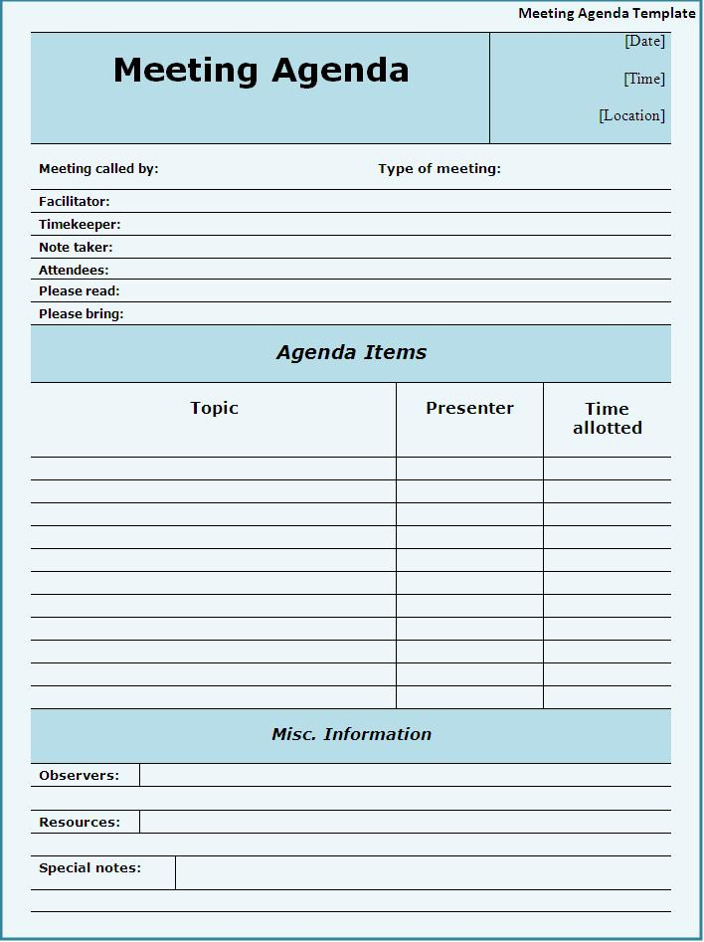
agenda (n)
list of things to do
program,
schedule
Unless your proposal is on the meeting's agenda, it won't be addressed.

Slide 6
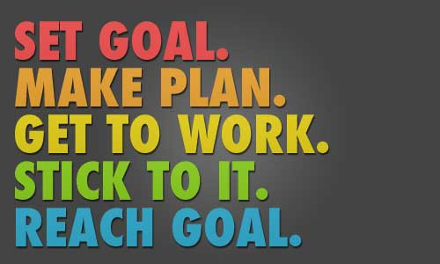
stick to (v)
to continue doing or using stg esp
when it is difficult to do so
Please let’s stick to the agenda.
Miguel was determined to stick to his decision.

Slide 7
ground rules
a statement spelling out the proper procedure for an activity
guideline,
instruction,
protocole
Before the debate begins, let's lay out some ground rules.

Slide 8
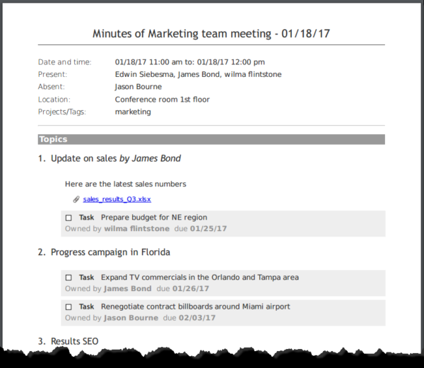
minutes (n)
an official record of what was said
and done in a meeting
The secretary read the
minutes of the last meeting.
The secretary took the minutes
during the meeting.

Slide 9
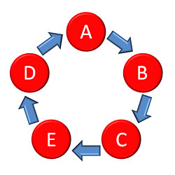
circulate (v)
distribute,
spread
A summary of the report was circulated to all board members.

Slide 10
go through (v)
to read or discuss stg in order to make sure it is correct
to experience a particular process
to practice stg
Candidates must go through a process of selection.
We’ll go through the details later on.

Slide 11
look into (v)
to try to find out the truth about a problem, crime etc in order to solve it
investigate,
check, research
The owner is looking into new options for promoting business.

Slide 12
eliminate (v)
remove,
throw out
get rid of
The company plans to eliminate more than 2,000 jobs in the coming year.

Slide 13
impractical (adj)
unrealistic,
improbable,
illogical
All the goals were wildly impractical and none were achieved.

Slide 14
draw up (v)
to prepare a written document, such as a list or contract
He was asked to draw up proposals for reforming the law.

Slide 15
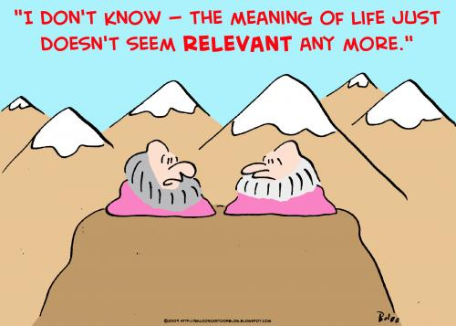
relevant (adj)
appropriate,
to the purpose
llustrations have been moved closer to their relevant paragraphs.

Slide 16
relatively (adv)
comparatively,
almost,
nearly
We've had a relatively warm winter.
E-commerce is a relatively recent phenomenon.

Slide 17
confirm (v)
to show that stg is
definitely true
approve
Could you confirm the dates we discussed?
I am writing to confirm a booking for a single room for the night of 6 June.
confirmation (n)

Slide 18
approve (v)
to officially accept
a plan, proposal etc
The conference approved a proposal for a referendum.
approval (n)

Slide 19
reject (v)
to refuse to believe, accept, or consider stg
My teacher rejected my excuse for being late.
The committee rejected my suggestion.

Slide 20
conflict (v/n)
(v): to disagree, to be at odds
(n): disagreement, difference
Their research conflicts with [=contradicts] what other scientists have found.
They're having serious conflicts over the budget.

