Slide 1
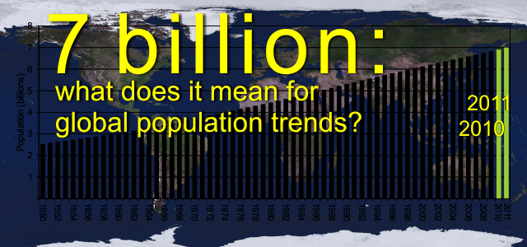
POPULATION TRENDS

Slide 2
Discuss:
How has the world’s population been changing in the last 50 years …
In the developing countries?
In the developed countries?
What might be the reasons for this?

Slide 3
Paragraph 1
What does ‘demography’ mean?
What is the recent demographic trend in the world?
In which countries is the population growing faster? Why?

Slide 4
Paragraph 2&3
What are the most important reasons why the world’s population is growing so fast?
…..
…..

Slide 5
Life expectancy
Do you have an idea about the average life expectancy for men and for women in Turkey?
…
…
Can you compare these to other countries from the west and the east?
Think about the possible reasons why in some places people live longer/shorter.

Slide 6
LIFE EXPECTANCY
According to the WHO, global average life expectancy for children born in 2015 was 71.4 years while newborns in 22 others -- all of them in sub-Saharan Africa -- have life expectancy of less than 60 years.
The life-expectancy for children in Turkey born in 2015 was 75.8 years (78.9 years for females and 72.6 years for males).
Women in Japan, with an average of 86.8 years, can expect to live the longest.
Switzerland has the longest average survival for men, at 81.3 years, while people in Sierra Leone have the world’s lowest life expectancy for both sexes: 50.8 years for women and 49.3 years for men.

Slide 7
JAPAN : LIFE EXPECTANCY
Male Female
80.5 86.8
According to the latest WHO data published in 2015 life expectancy in Japan is: Male 80.5, female 86.8 and total life expectancy is 83.7, which gives Japan a World Life Expectancy ranking of 1.

Slide 8
Fertility Rate
What factors are mentioned in paragraph 3 that affect the fertility rate in a country?
….
….

Slide 9
Fertility Rate in Ethiophia
In 2015, fertility rate for Ethiopia was 4.3 births per woman. Fertility rate of Ethiopia fell gradually from 6.9 births per woman in 1966 to 4.3 births per woman in 2015.

Slide 10
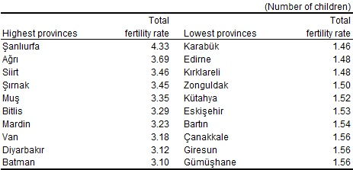
Fertility Rate in Turkey
In 2016 the province having the highest total fertility rate was Şanlıurfa with 4.33 children.

Slide 11
Paragraph 4
How did countries such as China and India control their population growth in the past?
China: ….
India: ….

Slide 12
China – 1980s

Slide 13
Population Control

Slide 14
Paragraph 5
In which part of the world is population growing the fastest?
What is the concern of many experts about this?

Slide 15
Paragraph 6
In which countries there is a decline in population?
Why is the falling fertility rate a problem for some countries?

Slide 16
Falling Fertility Rate in Europe

Slide 17
Paragraph 7
How does the government encourage people to have more children?

Slide 18
TARGET VOCABULARY according to (phr)
as stated/reported by,
in a way that is based on stg
in agreement with
According to the weather report, it's going to rain.
World population is expected to reach 8 billion people in 2023 according to the United Nations (in 2026 according to the U.S. Census Bureau).
.

Slide 19
agriculture (n)
the science or practice of cultivating the soil, producing crops
The forest was cut down, and the land given over to agriculture.

Slide 20
child care (n)
the care of children especially as a service while parents are working
It is generally the women who overwhelmingly make and maintain child care arrangements.

Slide 21
demography (n)
the study of changes (such as the number of births, deaths, marriages, and illnesses) that occur over a period of time in human populations.
As a result of more immigrants coming into the city, the demography of the area is changing.

Slide 22
effort (n)
work done by the mind or body,
energy used to do something
He put a lot of effort into finishing the project on time.

Slide 23
existing (adj)
current, present
exist (v) to have real being
existence (n)
existent (adj)

Slide 24
explosion (n)
A large and sudden increase
His comments prompted an explosion of laughter from the crowd.

Slide 25
fertility rate (n)
The average number of children per woman
In the developed world, most nations are deeply concerned about low fertility rates.
fertile (adj) productive, rich
mortality rate: death rate

Slide 26
figure (n)
a number
a numbered drawing in a book
The company had yearly sales figures of half a million units.

Slide 27
financial (adj)
having to do with money
He makes an annual report, showing the financial condition of the company.
finance (n)

Slide 28
hygiene (n)
cleanliness, sanitaiton
Good hygiene is an essential part of the defense against flu.

Slide 29
life expectancy (n)
the statistically probable length of time that a typical individual can be expected to live
The life expectancy of the average male has already increased by 10 years in the last half century.

Slide 30
maternity leave (n)
time off from a job given a mother to take care of a newborn child
In Finland, women are allowed to start maternity leave 50 working days at the earliest and 30 working days at the latest before the estimated date of delivery.

Slide 31
penalty (n)
a punishment that s/o is given for doing something which is against a law or rule.
Tom believes that the death penalty should be abolished.

Slide 32
population (n)
the whole number of people or inhabitants in a country or region
The world's population has increased greatly.

Slide 33
replace (v)
Take the place of,
Put in place of
Will computers ever completely replace books?
Paper bags have been largely replaced by plastic bags.
She was hired to replace the previous manager.

Slide 34
retired (adj)
Having withdrawn from active life,
Done working
They don’t work anymore. They are retired.
retire (v)
retirement (n)

Slide 35
trend (n)
flow,
movement,
style,
fashion
A trend towards part-time employment

