Slide 2
Answer (Q1):
$V_{H}=200 cm^{3}{ W}_{H}=240 g V_{SSD}=143 cm^{3}{ W}_{SSD}=230.8 g$
$H\%=$ ${ (W}_{H}−W_{SSD})/W_{SSD}=(240−230.8)/(230.8)=4\%$
b) $β_{H}=\frac{W_{H}}{V_{H}}=\frac{240}{200}=1.2\frac{g}{cm^{3}}=1200\frac{kg}{m^{3}} β_{SSD}=\frac{W_{SSD}}{V_{SSD}}=\frac{230.8}{143}=1.6\frac{g}{cm^{3}}=1600\frac{kg}{m^{3}}$
c) 1 m³ SSD aggregate➔ 1600 kg. In order to obtain 1600 kg SSD aggregate, we should consider the moist content of the aggregates ➔ From 1m³ moist aggregates (1200 kg) we can obtain $\frac{1200}{1,04}=1154 kg$ SSD aggregate. How much more aggregate is needed?
1600 (required)- 1154 (exist)= 446 kg (need) SSD aggregates that we need to obtain 1600 kg SSD agg.
$446∗\left(1+0.04\right)=464 kg$ more moist aggregates !!!
Thus, 1200+464=1664 kg moist aggregates needed to obtain 1600 kg SSD aggregates (As mass)
As volume➔ 1664/1200= 1.39 m³ moist aggregate required!!!
d) 1664-1600= 64 kg excess water

Slide 3
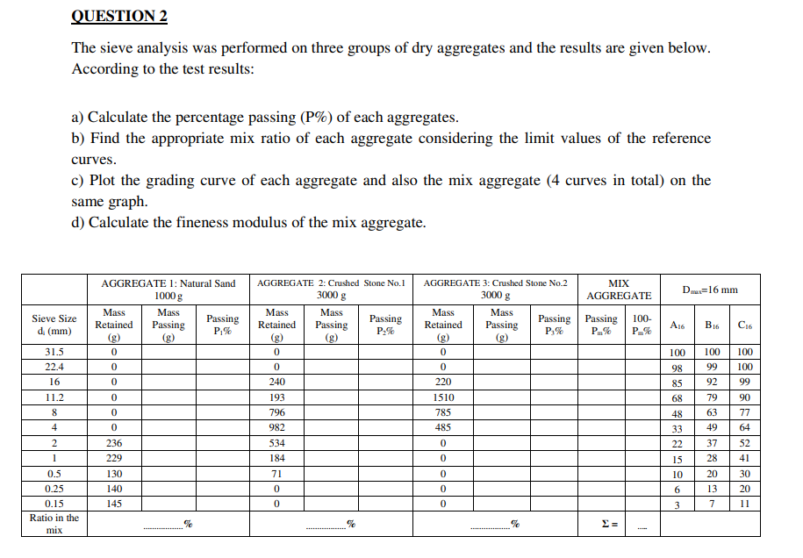

Slide 4
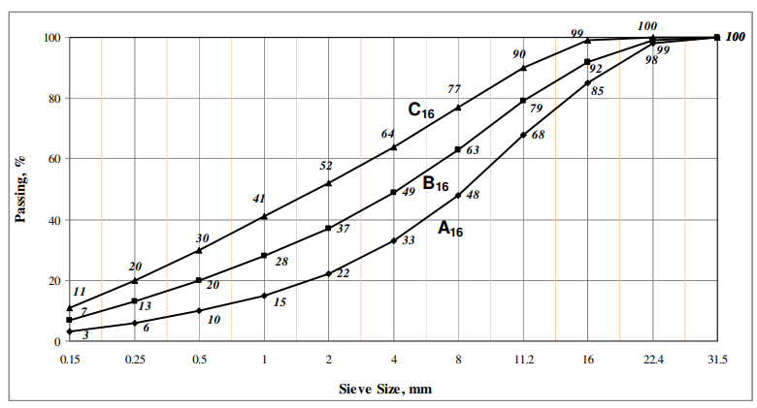
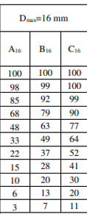

Slide 5
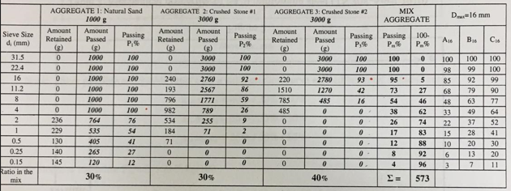

Slide 6
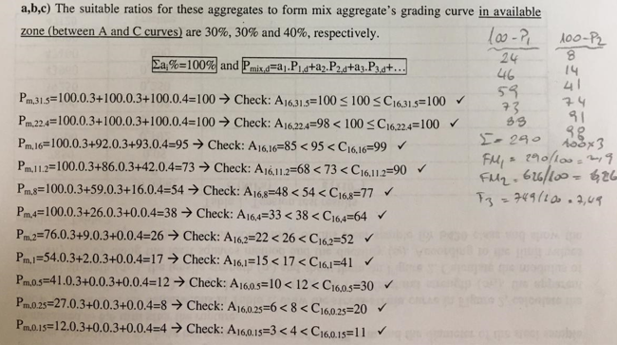

Slide 7
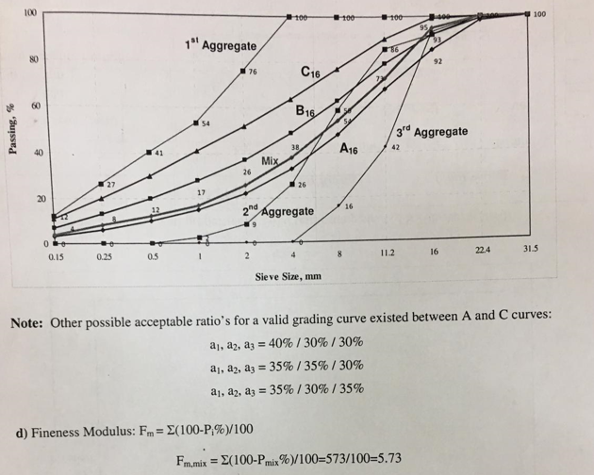

Slide 8
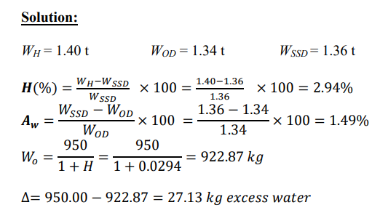

Slide 9
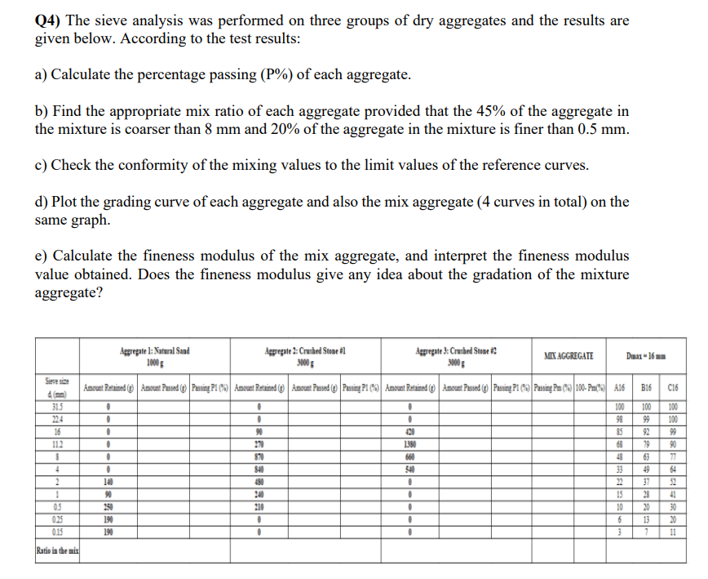

Slide 10
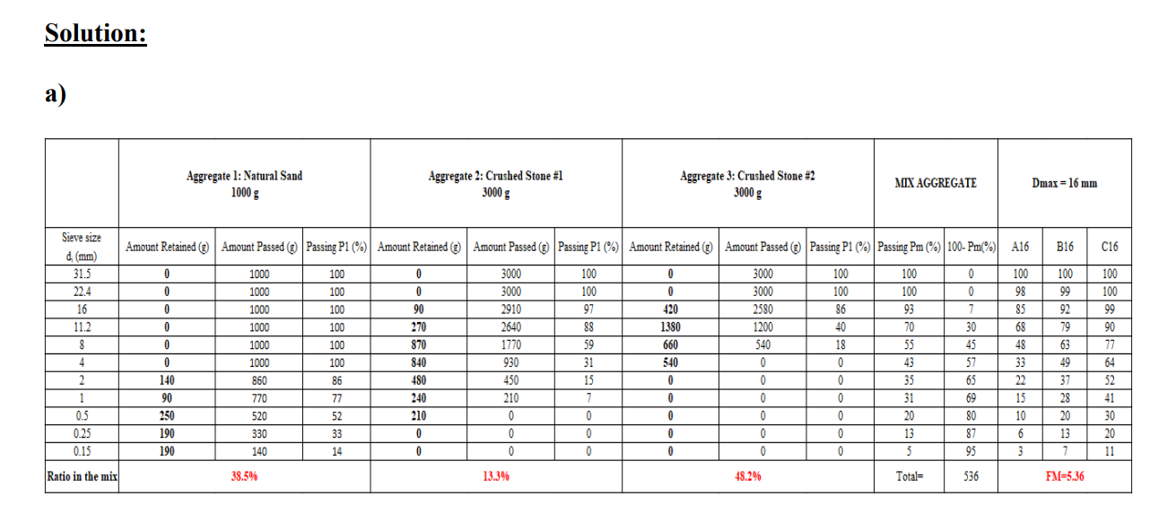

Slide 11
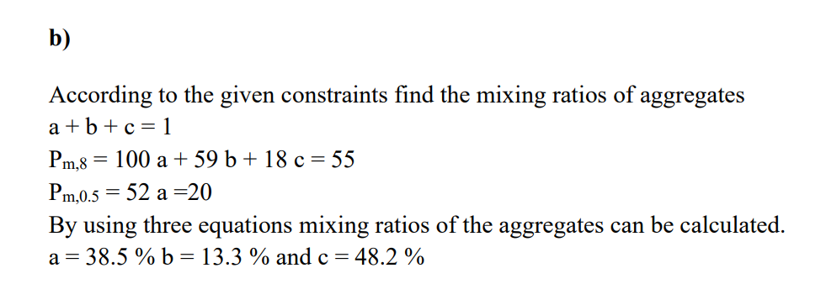

Slide 12
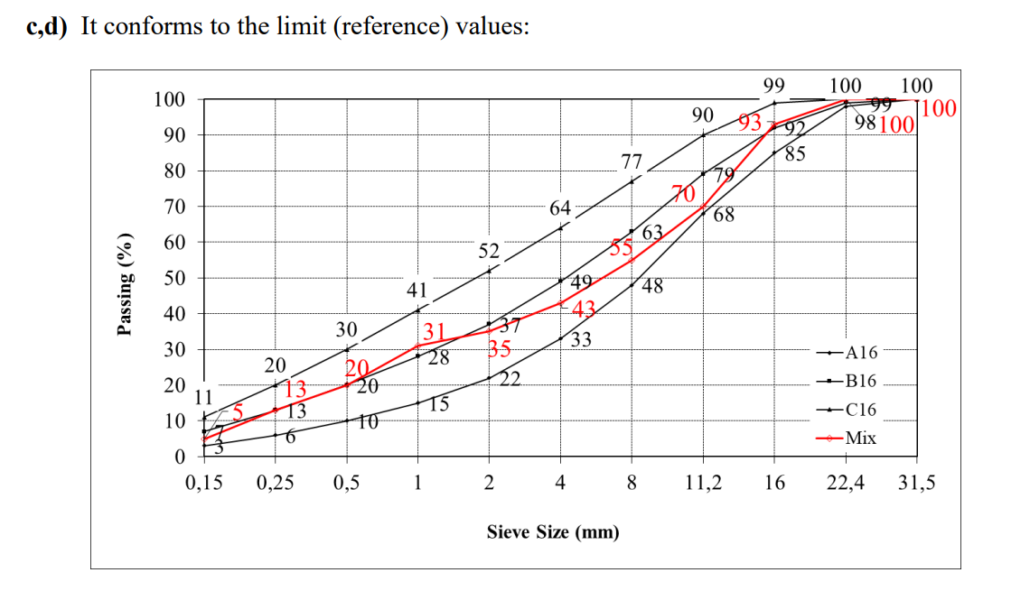

Slide 13
